Slide 1
參考用

Slide 2

Ambiguous Source Rules
Lex is partitioning the input stream, not searching for all possible matches
i.e. each character is accounted for once and only once
When more than one expression can match the current input,
The longest match is preferred
The rule given first is preferred
E.g.
she s++;
he h++;
. |
\n ;
she {s++; REJECT;}
he {h++;}
. |
\n ;
s=1 h=1
s=1 h=2
s=1 h=0
Input stream:
… Is God a she, he or an it?
Notes:
Preferred :優先 越長越優先，越在前面寫越優先
REJECT:一個元素其中的組成分子如果可以對應到其中兩個表示法..則都要算到

Slide 3
Other Lex Library Routines
yylex()
the default main() contains a call of yylex()
yymore()
keep current token in yytext.
yyless(n)
retain all token except the first n characters in yytext
yywarp()
is called whenever lex reaches an end-of-file
The default yywarp() always returns 1
… mega-health …
mega- {ECHO; yymore();}
health {ECHO;}
… mega-mega-health …
… foobar …
foobar {ECHO; yyless(3);}
[a-z]+ {ECHO;}
… foobarbar …
Notes:
yylex() 所有的動作程式碼會COPY到此FUNCTION中
yymore()將下一個TOKEN家在目前的TOKEN中
yyless(n)保留配對到的TOKEN前N個字元
yywarp()

Slide 4
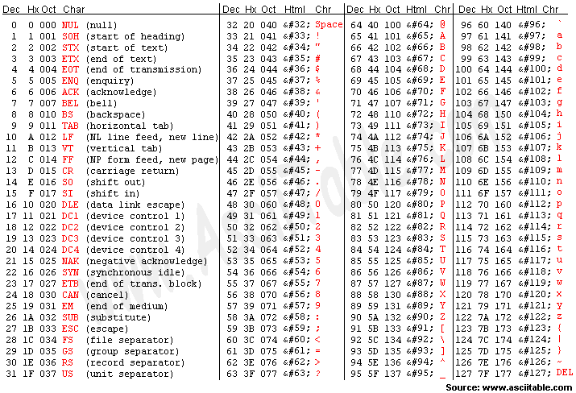
About Regular expression
The \ character provides the usual escapes within character class brackets.
[\40-\176] matches all printable characters in the ASCII character set, from octal 40 (blank) to octal 176 (tilde~)

Slide 5
Pattern Matching Primitives
Metacharacter | Matches
. | any character except newline
\n | newline
* | zero or more copies of the preceding expression
+ | one or more copies of the preceding expression
? | zero or one copy of the preceding expression
^ | beginning of line
$ | end of line
a|b | a or b
(ab)+ | one or more copies of ab (grouping)
[ab] | a or b
[^a] | complement
a{3} | 3 instances of a
“a+b” | literal “a+b” (C escapes still work)
Notes:
^:代表一行的開頭 放在括弧裡哲變成不包含

Slide 6
Lex Example 1
digit [0-9]
letter [_a-zA-Z]
%{
int count;
%}
%%
{letter}({letter}|{digit})* {printf(“ID:%s\n”, yytext); count++;}
…
%%
int main(void) {
yylex();
printf(“\n\nnumber of identifiers = %d\n”, count);
return 0;
}

Slide 7
Lex Example 2
%{
int nchar, nword, nline;
%}
word [^ \t\n]+
%%
{word} { nword++; nchar += yyleng; }
\n { nline++; nchar++; }
. { nchar++; }
%%
int main(void) {
yylex();
printf(“%d\t%d\t%d\n”, nchar, nword, nline);
return 0;
}

