Slide 1
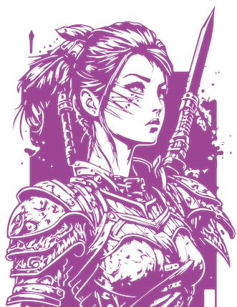
Boulder Creek Video Games presents
Word Warrior 2.0
Rules/Gameplay:
Spell valid words starting from center pentagon on board.
Words must build West to East or North to South and use at least one tile from the previous hand (except the first turn).
Points are awarded when the Go button is pressed.
Users my press and hold the dictionary button on the lower right side to check words on the board before hitting Go. If the characters turn red then the words created are not recognized.
If a blank tile is played the player can right click on the tile to set the letter they intend the blank tile to be.
Once the player hits the Go button they cannot move their tiles anymore.
If all seven tiles in the players hand are played in one turn there is a scoring bonus of 50 points. Letters that fall on tile and word multipliers will be applied to the score automatically when the player presses Go.
It is the players turn when the “Your Turn” banner is displayed at the center bottom of the screen.
The player may use their turn to exchange tiles by:
  Not playing a tile on the board.
  Right clicking the tile in their hand which turns the tile red.
  Then hitting the Go button which will exchange the indicated red tiles for new randomly selected tiles thus ending their turn.
Up to four players can join the game thru the Boulder Creek Video Games Gameserver Rev 2.0 or newer.
Are you skilled in the art of word making warrior ?
About Game:
This is a free game made for fun and learning with my son Connor. We both worked on this for the better part of October and November 2024. It is distributed under the GPL (https://en.wikipedia.org/wiki/GNU_General_Public_License)
PRESS F1 TO RETURN TO GAME

