Slide 1
Preliminary Results from Recent Work in Higher Ed Finance
Keaton Miller
Tom Ben-Shahar

Slide 2
The Higher Ed sector is under considerable scrutiny and pressure from multiple dimensions
Federal government skeptical of academic freedom and admissions policies
State governments face revenue challenges and see higher ed as source, not sink
Broader public skeptical of value proposition for higher ed degrees
These trends have increased intra-sector and institutional frictions – time for some introspection!
Today: Preliminary results on two pressing questions + roadmap for future work

Slide 3
Faculty Unions, Faculty Salaries, and Tuition
Keaton Miller
Tom Ben-Shahar

Slide 4
Higher education since 1970: A summary
Measures of research and instructional productivity have increased (Sridhar et al., 2010; Brint & Clotfelter, 2016; Haghani et al., 2022)
Institutional financial health has improved (Zumeta et al., 2012)
Student debt has increased (Mitchell, 2021; Dinerstein et al., 2024)
Yet average real faculty salaries have remained constant

Slide 5
In response, faculty at many universities have chosen to unionize
Faculty tradeoff: Pay union dues (e.g. 1% of salary) to get greater power in labor market
But: Do unions focus on pay? Or other issues?
Social tradeoff: If unions are effective and universities have pricing power, markup logic dictates some passthrough from faculty salaries to tuition
But: Potentially other effects of unionization to consider

Slide 6
We use federal financial disclosures and modern diff-in-diff methods to study these issues
Question: Does unionization increase faculty salaries? Does it increase tuition?
Could go different directions for different faculty depending on bargaining priorities of union
Data: IPEDS (Federal, DOE) from 2004-2023, Higher-Ed Collective Bargaining Database from Hunter College, CUNY
Methods: Diff-in-diff with variation in treatment timing (Callaway & Sant’Anna, 2021)
Results: Suggestive evidence that unions increase salaries slightly, no impact on tuition

Slide 7
We are connected to a broader literature on unionization in higher education and beyond
Union wage premium in higher ed: Barbezat, 1989; Monks, 2000; Hedrick et al., 2011
Most studies find neutral to slightly positive results using survey data
We use administrative data on salaries with independent data on bargaining units
Closest to us: Baker et al. (2024), Canadian context
Drivers of tuition increases: Archibald & Feldman, 2012; Gillen 2015; Turner, 2018, Bundick & Pollard, 2019
Price discrimination: Higher tuition, but higher aid to match
Non-classroom amenities: Better gyms, more resources
Administrative surplus capture: We can’t pay Deans millions, but we can give them many subordinates

Slide 8
Our data on colleges and universities comes from the Integrated Postsecondary Education Data System (IPEDS)
Participation is mandatory for federal student aid eligibility
Collect average salaries and institutional characteristics from 2004-2023
10,269 unique institutions
Average Salary ($000s) | Mean | Std dev | 10% | Median | 90%
Assistant Professors | 60.0 | 17.4 | 41.7 | 57.4 | 81.7
Associate Professor | 70.0 | 20.8 | 47.0 | 65.8 | 95.6
Professor | 83.1 | 33.3 | 50.6 | 77.6 | 123.2
Instructor | 50.0 | 17.2 | 32.1 | 47.3 | 71.5
Lecturer | 53.0 | 17.8 | 34.8 | 51.0 | 73.3
No Rank | 54.2 | 22.5 | 31.1 | 51.8 | 78.9
All Instructional Staff | 60.6 | 22.9 | 34.9 | 57.9 | 88.9

Slide 9
Our data on unions comes from the National Center for the Study of Collective Bargaining in Higher Education
Data comes as list of union “locals” and specifies institution, job categories covered, affiliation, recognition date, and first CBA date
Some institutions have multiple locals to cover different job categories
We manually code the data and match to IPEDS institution IDs
Overall: 775 bargaining units covering 600+ institutions

Slide 10
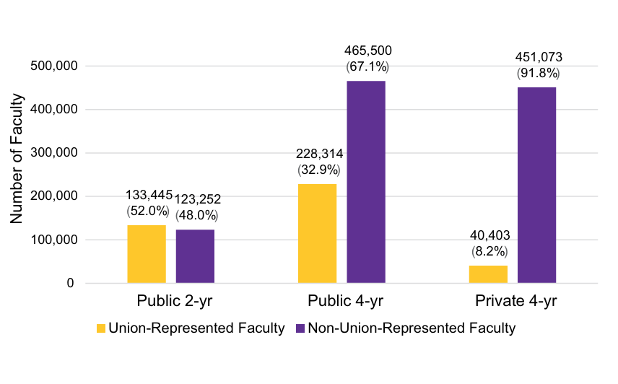
Faculty unions have the largest presence in public institutions
Faculty Union Representation by Institution Type
Source: Herbert et al. (2024), Figure 4

Slide 11
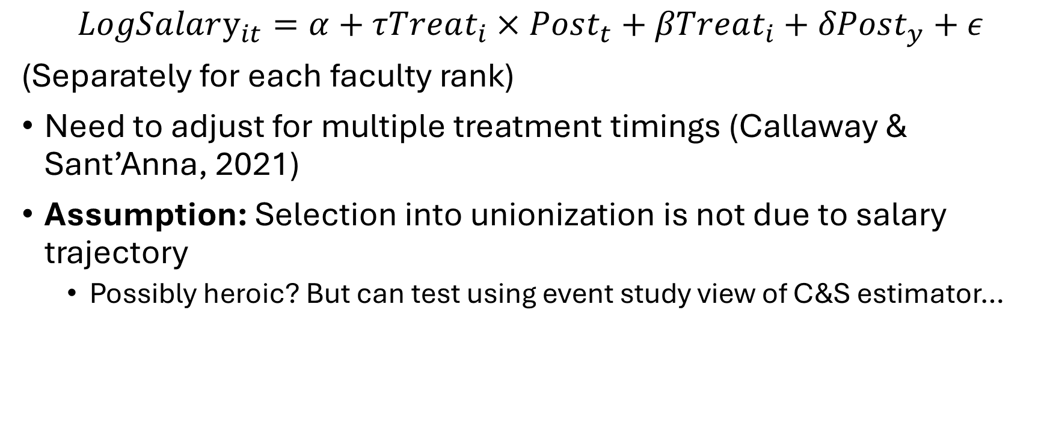
We use a differences-in-differences framework
$$LogSalary_{it}=α+τTreat_{i}×Post_{t}+βTreat_{i}+δPost_{y}+ε$$
(Separately for each faculty rank)
Need to adjust for multiple treatment timings (Callaway & Sant’Anna, 2021)
Assumption: Selection into unionization is not due to salary trajectory
Possibly heroic? But can test using event study view of C&S estimator…

Slide 12
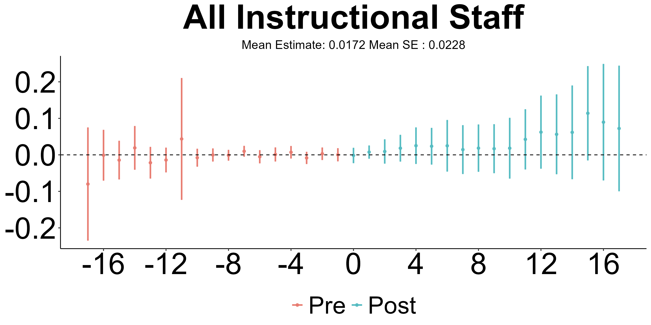
Overall, we find weak evidence that unionization increases faculty salaries

Slide 13
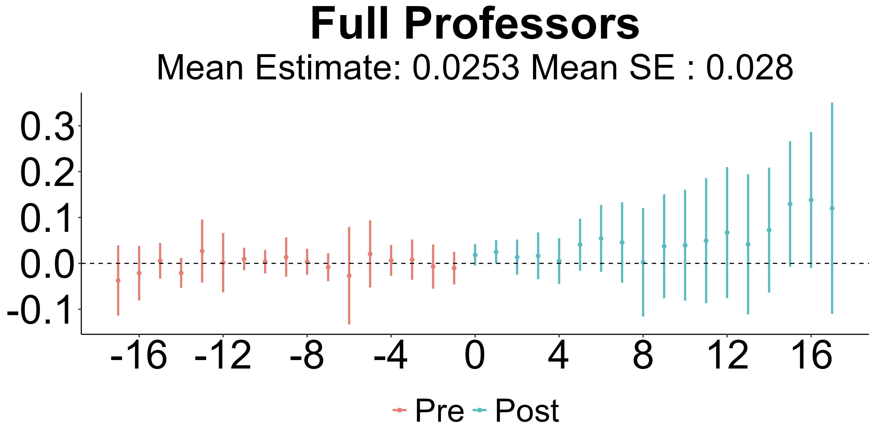
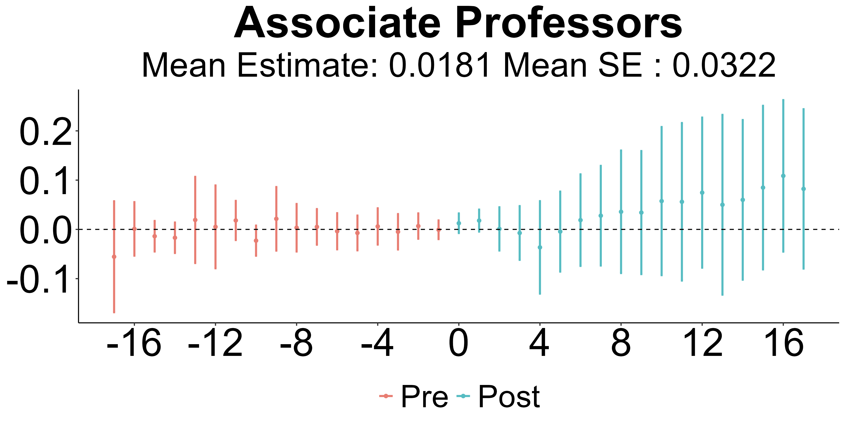
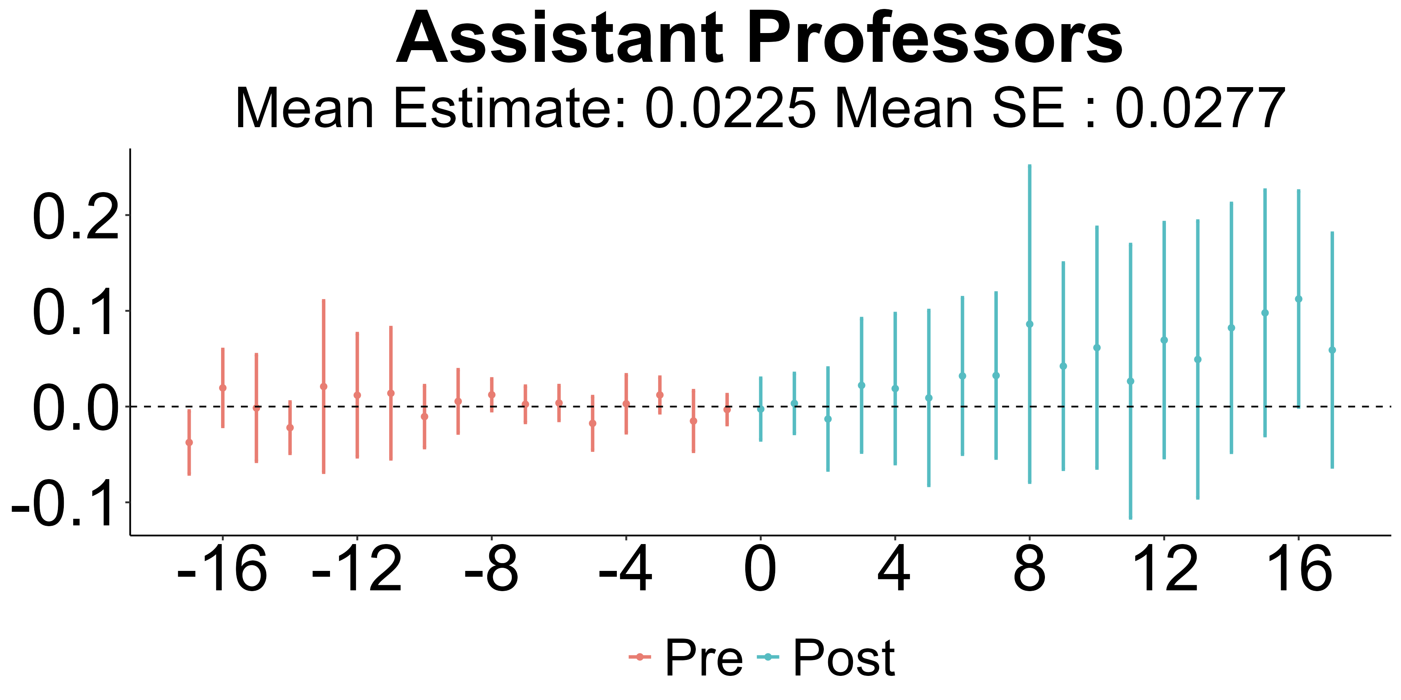
The signal is strongest for associate professors (most incentive compatible?)

Slide 14
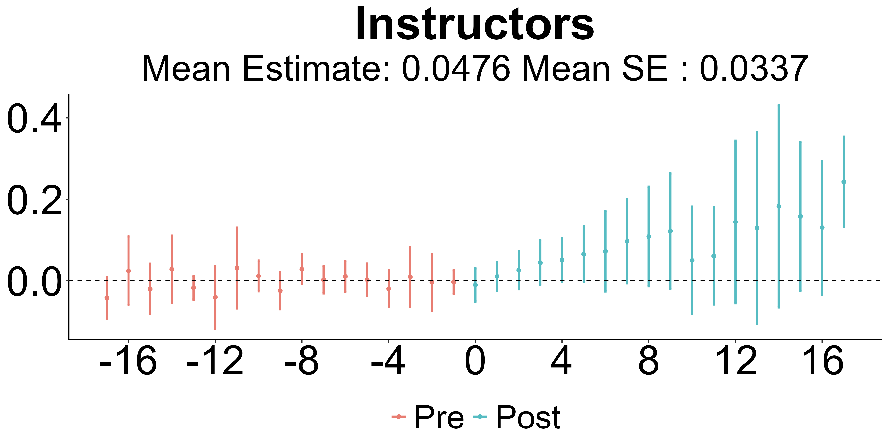
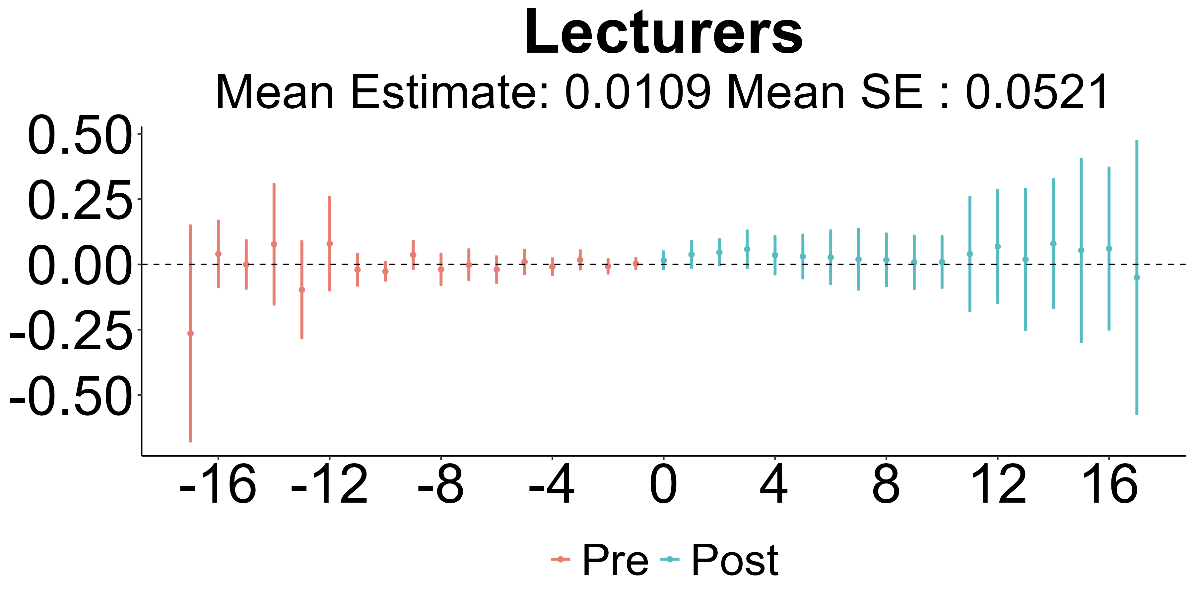
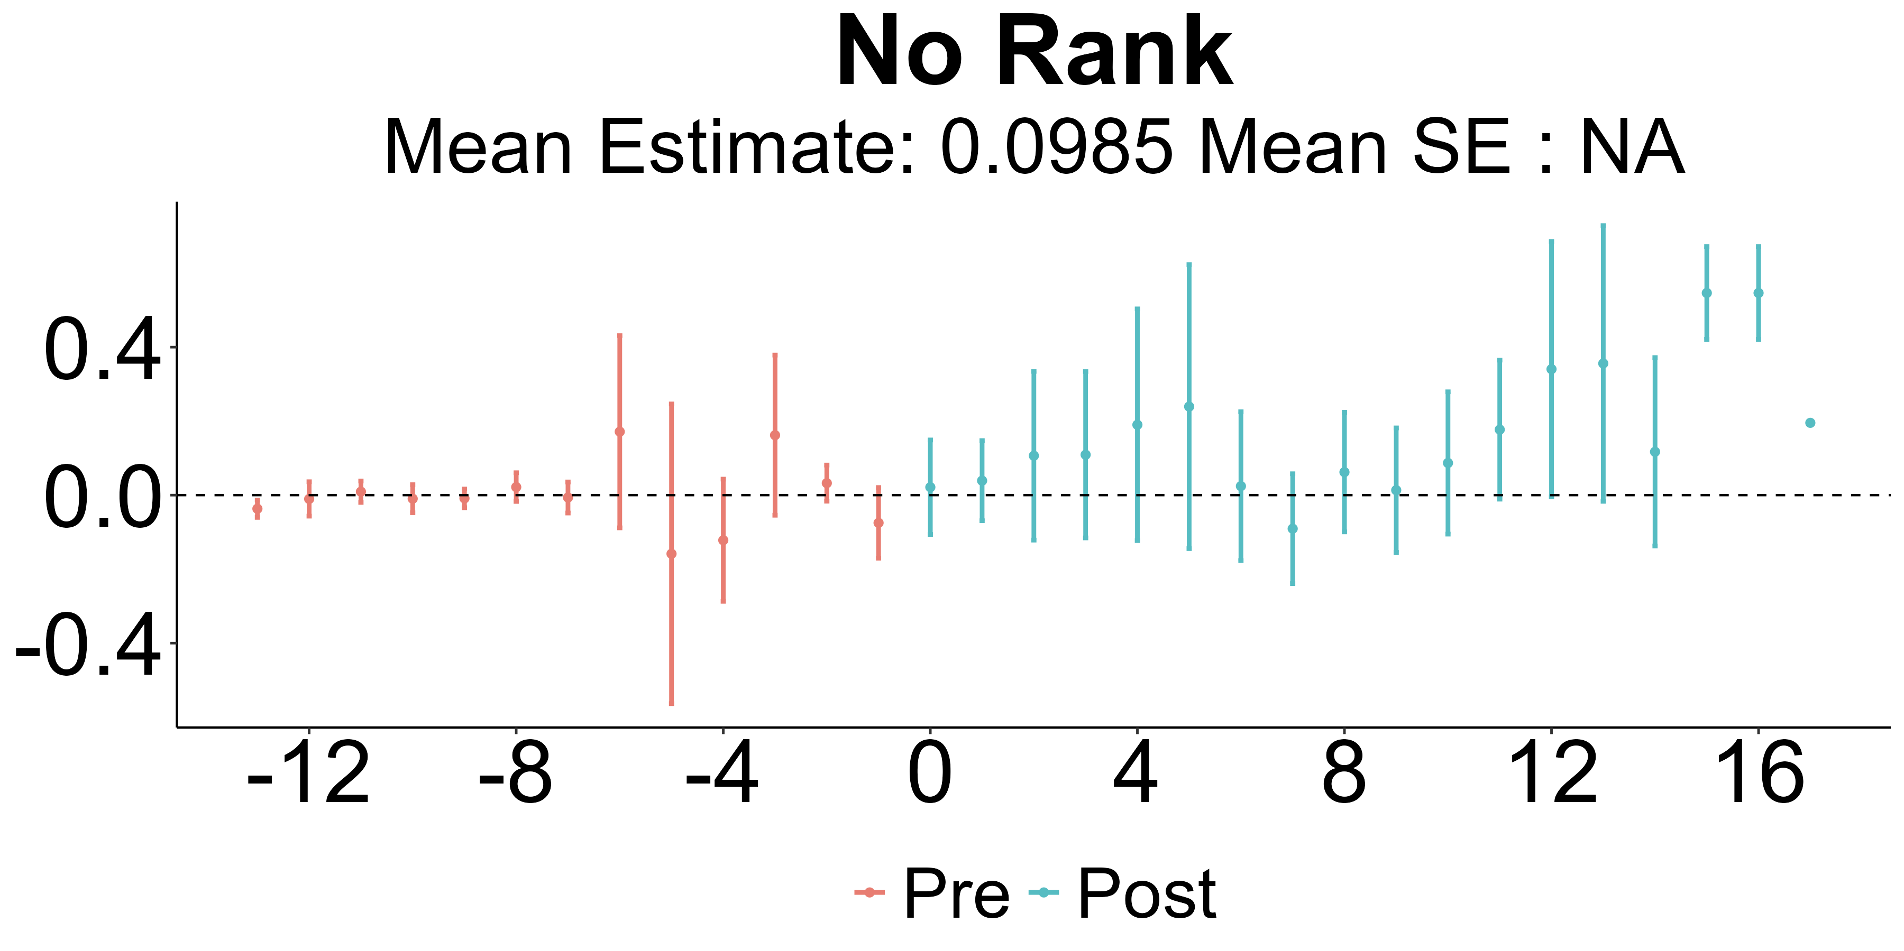
Instructors fare better than lecturers (possible union priority to change classifications)

Slide 15
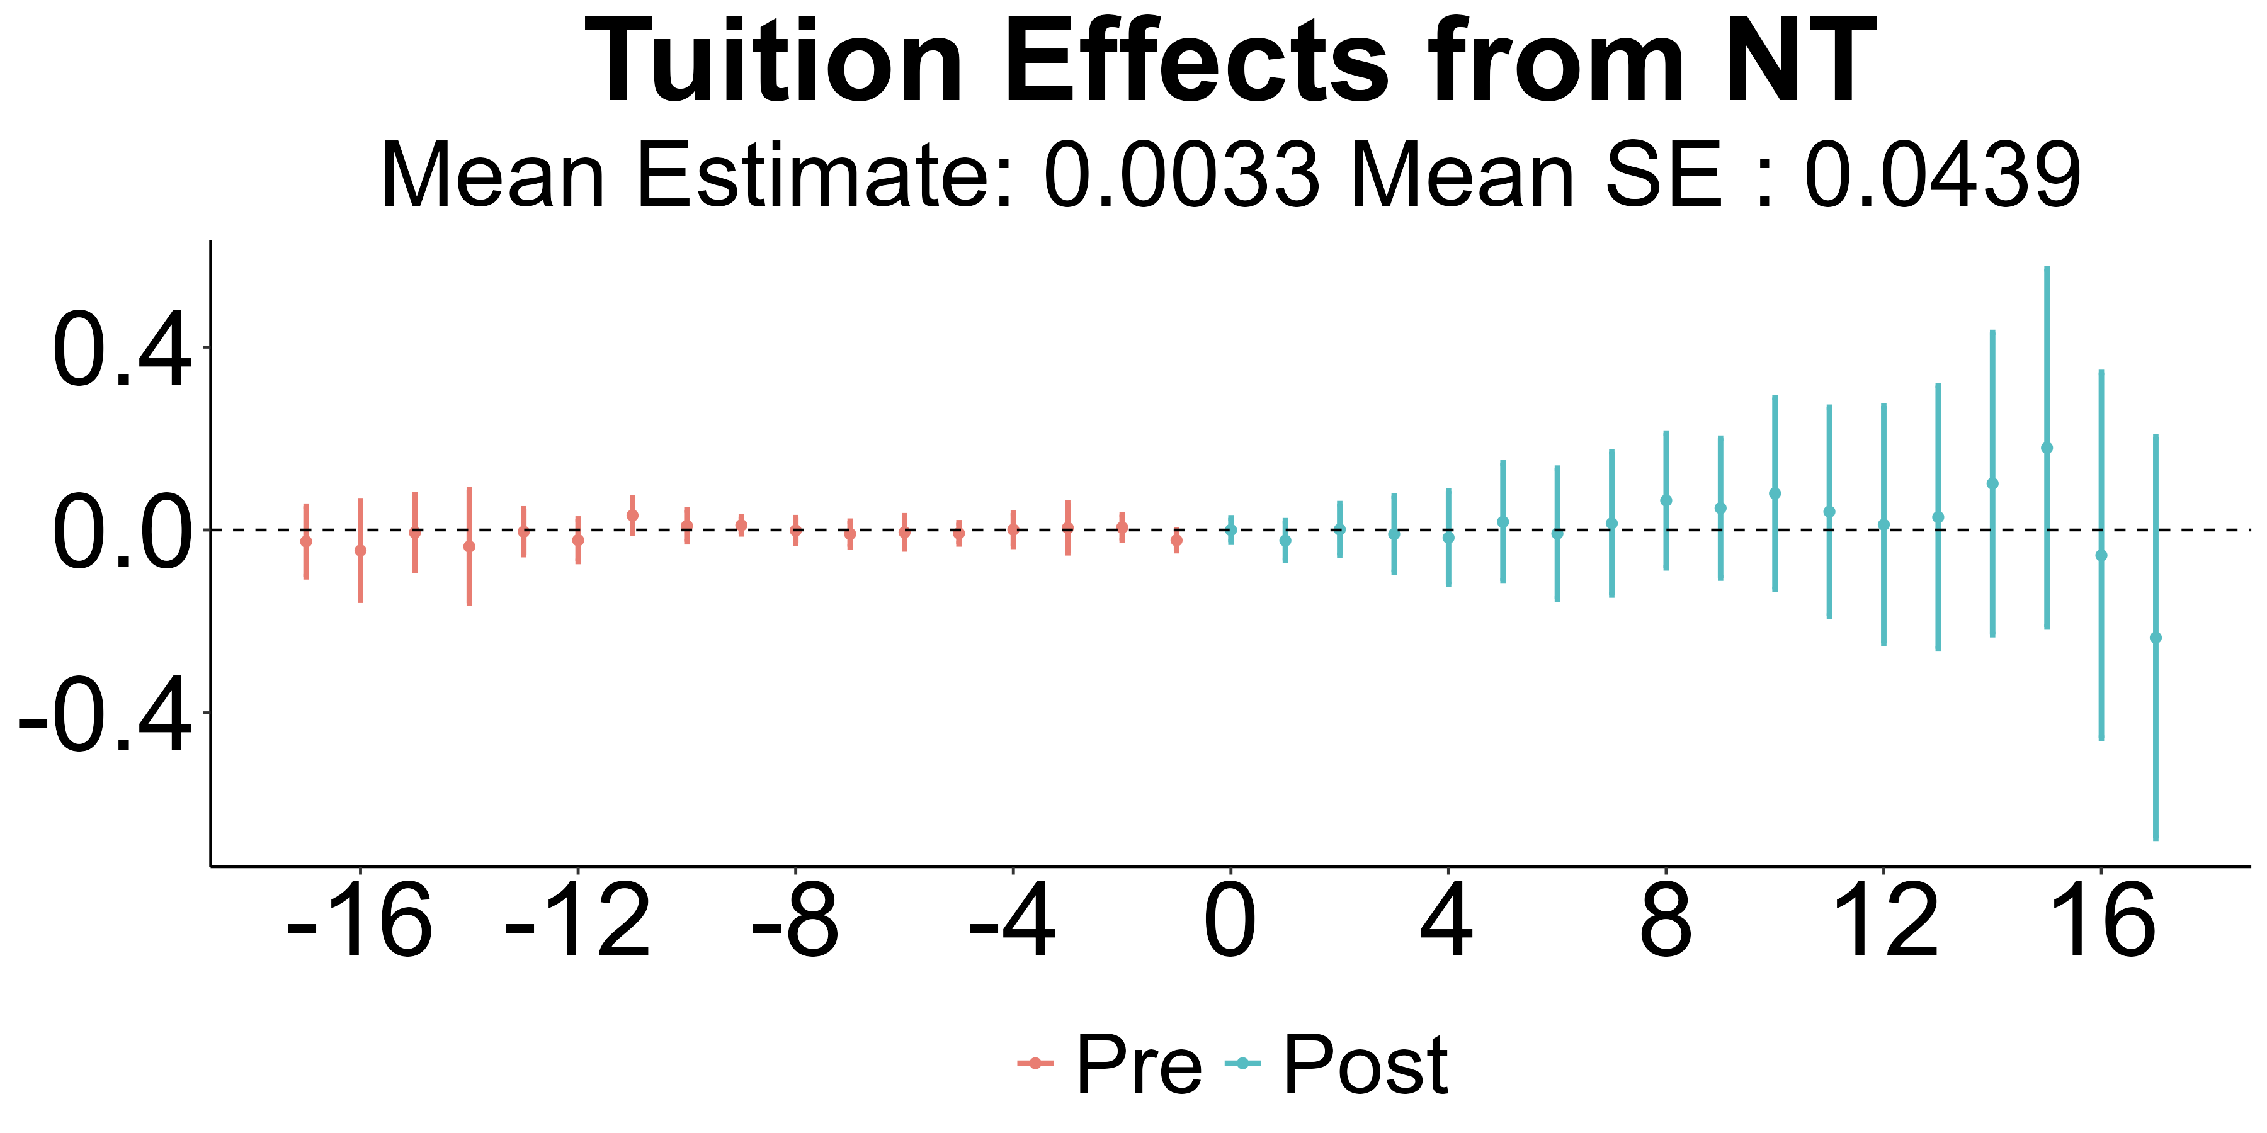
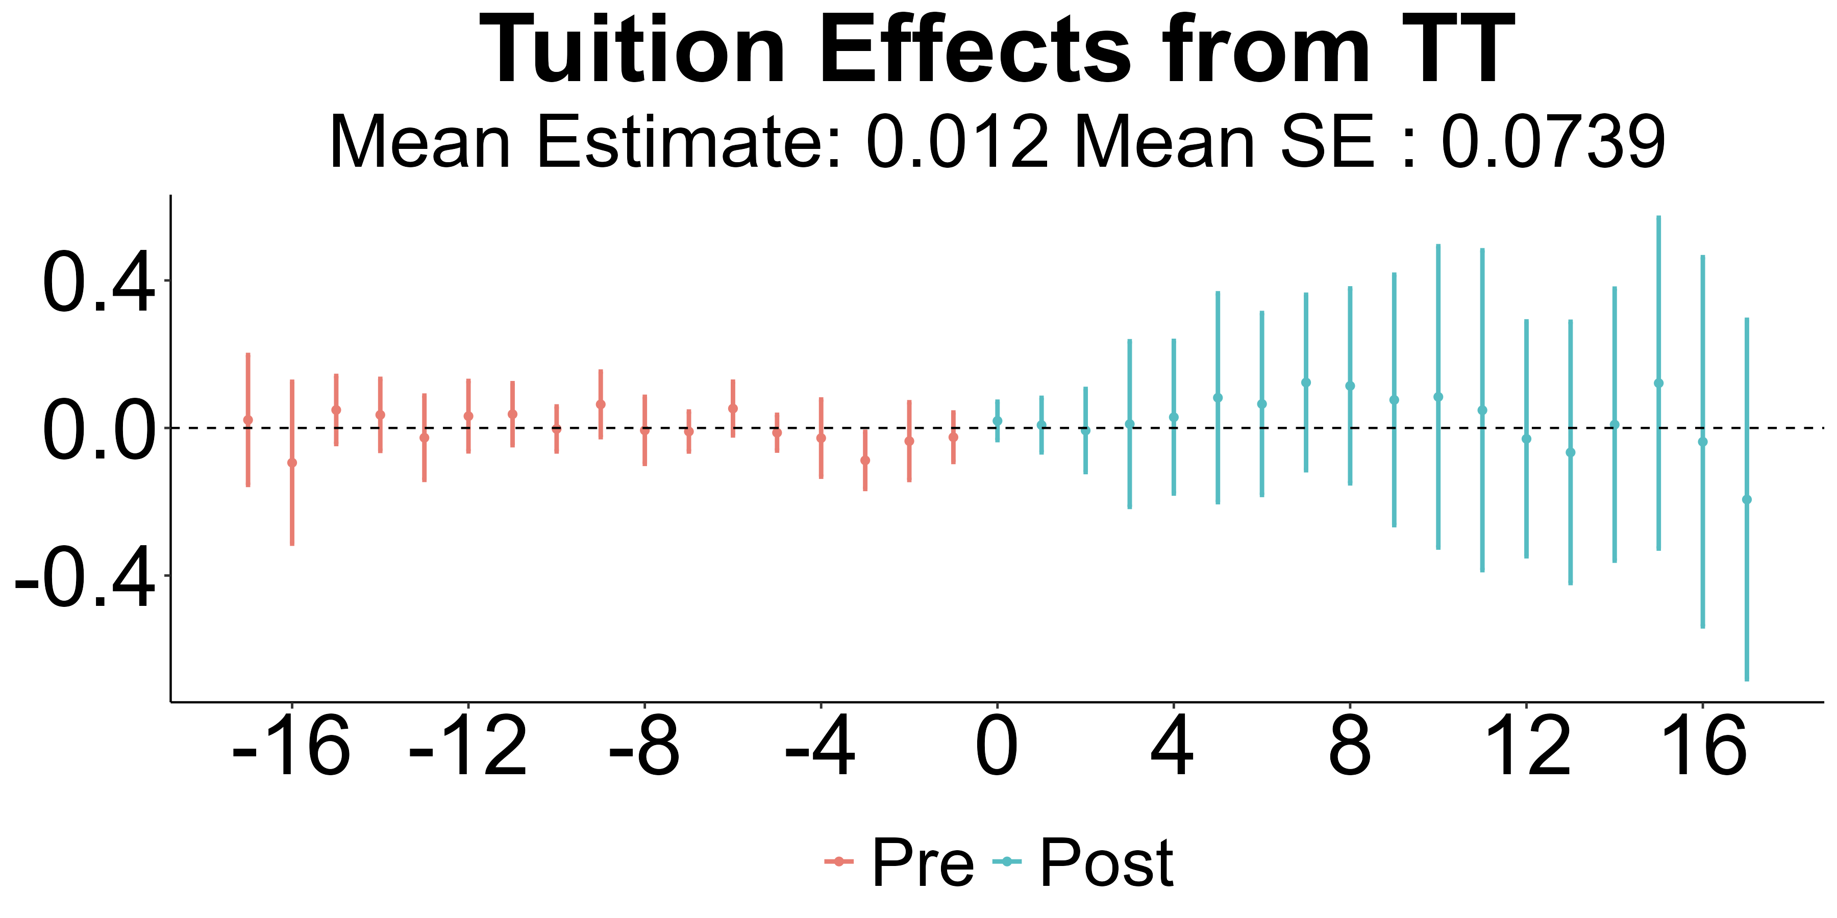
We don’t find evidence that unionization increases tuition

Slide 16
We have substantially more work to do
Initial results suggest unionization weakly positive impact on salaries, no impact on tuition
Biggest signal for Associate Professors
Next steps: tighten identification, more robustness checks, other outcomes
Do unions successfully reduce “precarity” for academic labor?
Are different national affiliates “better” at negotiating wages?
Future work: Model of admin/faculty bargaining? Production function estimation?

Slide 17
The effect of Foundation Transparency Laws on Foundation Size
Tom Ben-Shahar
Keaton Miller

Slide 18
Another important feature of the modern higher-ed landscape is the University Foundation
Non-profit associated with an institution which manages donations and builds wealth to support research/education/operations at major universities
Legal distinction from main institution (especially public institutions) means foundation not subject to public records laws
Advocates want to broaden laws to include foundations, opponents fear reduced contributions
This paper: check for effects from existing laws

Slide 19
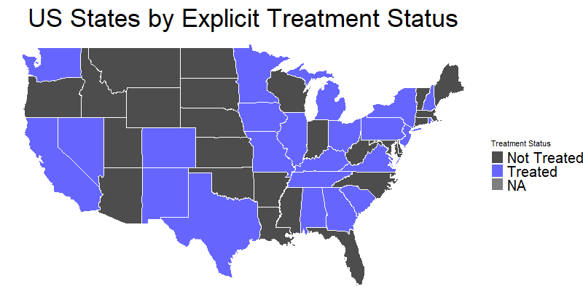
Our data on transparency laws was compiled by Andrew Ducharme, a UO physics PhD student

Slide 20
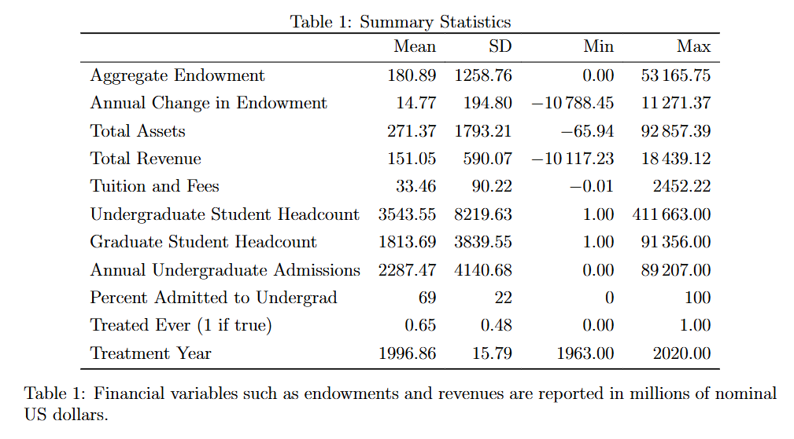
IPEDS contains data covering university foundations

Slide 21
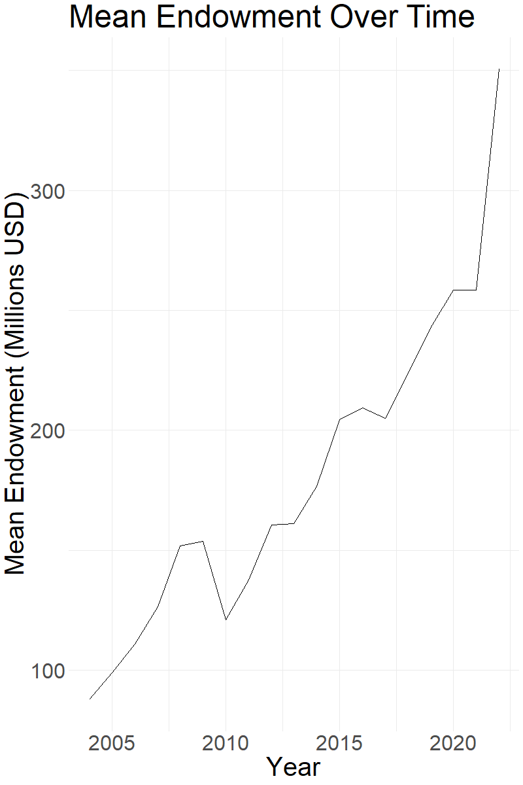
Endowment Trend

Slide 22
We follow the diff-in-diff approach of the previous section
Again, multiple treatment times means we’re in Callaway & Sant’Anna (2021) territory
Here, identification story is likely stronger: most of these laws are not specifically about foundations

Slide 23
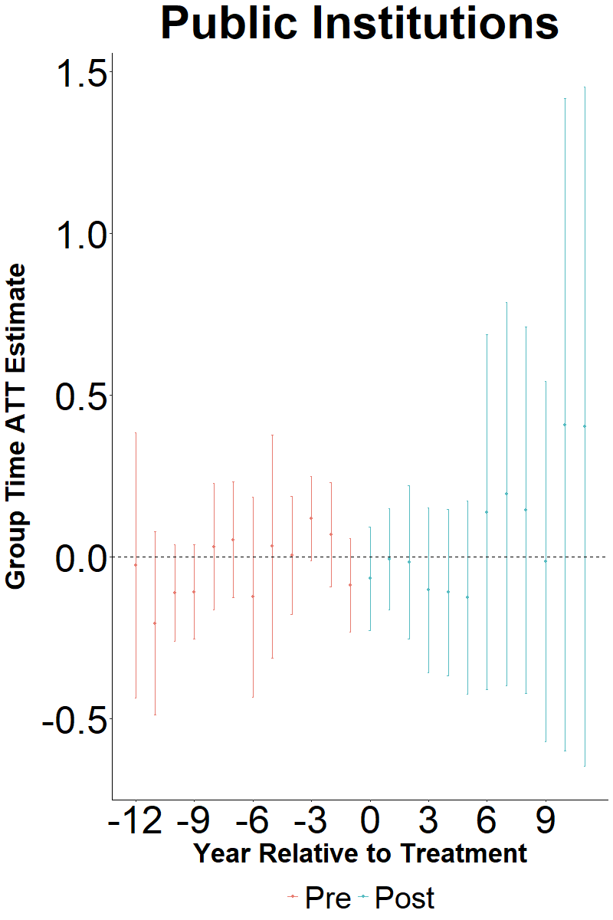
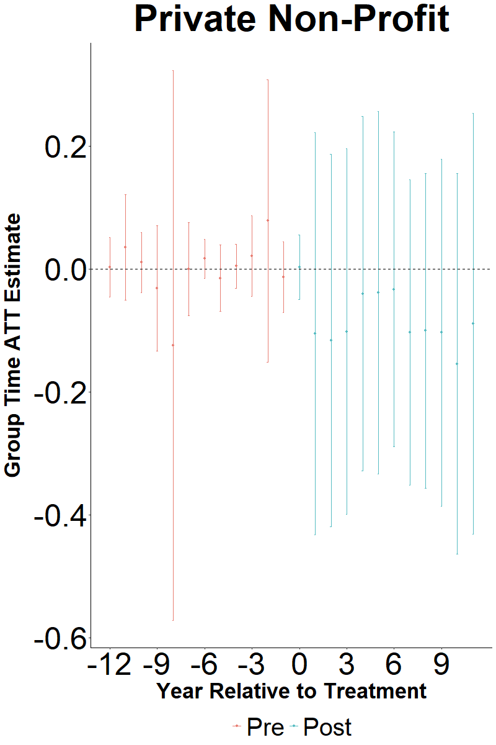
Our preliminary results suggest that, if anything, transparency improves the financial health of foundations

Slide 24
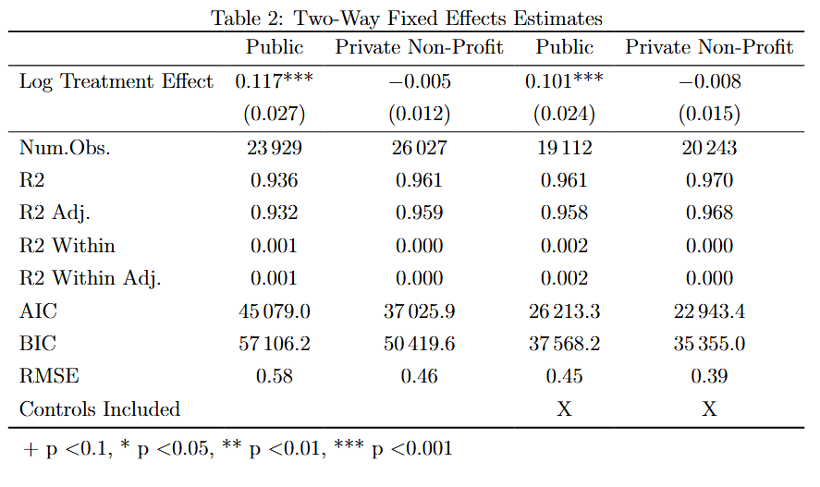
Our preliminary results suggest that, if anything, transparency improves the financial health of foundations

Slide 25
These preliminary results suggest future research directions
Unions: Does unionization change the bargaining relationship between faculty and admin?
Drive to unionize may not be about salaries per se but about power structure and resource allocation questions
Higher Ed Production: Seems production function for higher ed has changed, is this estimable?

