Slide 1
Smart Watch Smoking Detection
Team Members:
Han Geng
Yuting Xie
Ye Tian

Slide 2

Bad For Health!
Our APP “Smoker”
helps people to detect their smoking behaviors.
Based on the detection, it can give users useful feedback.

Slide 3
Design Progress

Slide 4
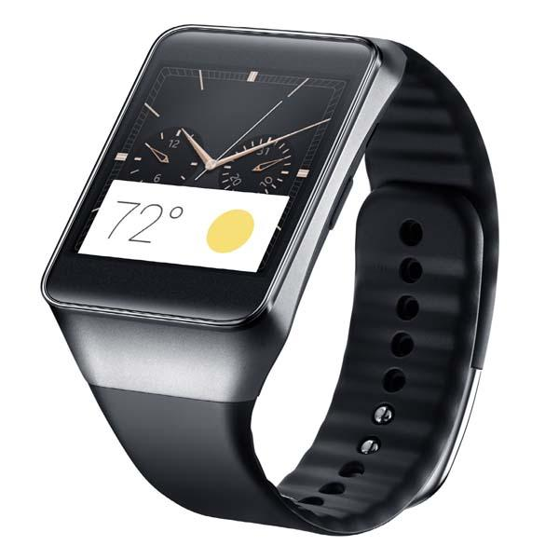
1. Dvelopment Environment
Android Wearable Device
Android Studio
JAVA

Slide 5
2. Structure
Found Click
Audio Analysis
Gesture Detection
Detected
g ++
No Click
N
g>5
Y
T>TimeLimit
Y
Audio Record
Record Result Cigarret +1

Slide 6


3. Approach
Audio Analyze
SVM
Audio features extraction
Gesture Detection
Accelerometer
Experimental Analyze

Slide 7
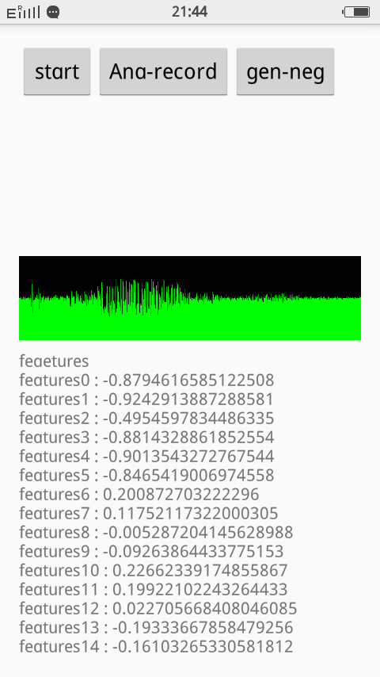
Sampling Method
Record the audio file which
includes positive samples
Move forward through the file
frame by fame
Extract features of frames
containing positive samples
and record the features in file.

Slide 8
SVM Training Test Result
Testing Sample size | Training Sample Size | Success rate of Prediction
(Han Geng) 50 positive | (Han Geng)50 positive 2870 negative | 97%
(Ye Tian) 50 positive | (Ye Tian)50 positive 2870 negative | 94%
Mixed 100 positive | (Mixed)100 positive 2870 negative | 89%
(Han Geng) 50 positive | (Ye Tian)50 positive 2870 negative | 72%
(Ye Tian) 50 positive | (Han Geng) 50 positive 2870 negative | 71%

Slide 9
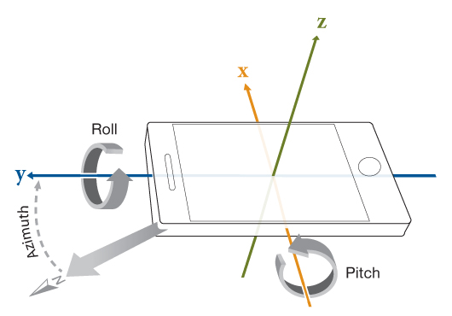
Accelerometer
In this app, these two
peremeters are mainly
used:
Pitch
Roll

Slide 10
Thank You!

