Slide 1
Operating System Concepts
Tenth Edition
Silberschatz, Galvin and Gagne
Chapter 6
Synchronization Tools

Slide 2
Chapter 6: Synchronization Tools
Background
The Critical-Section Problem
Peterson’s Solution
Synchronization Hardware
Mutex Locks
Semaphores
Monitors

Slide 3
Objectives
To present the concept of process synchronization.
To introduce the critical-section problem, whose solutions can be used to ensure the consistency of shared data
To present both software and hardware solutions of the critical-section problem
To examine several classical process-synchronization problems
To explore several tools that are used to solve process synchronization problems

Slide 4
Background
Processes can execute concurrently
May be interrupted at any time, partially completing execution
Concurrent access to shared data may result in data inconsistency
Maintaining data consistency requires mechanisms to ensure the orderly execution of cooperating processes
Illustration of the problem: Suppose that we wanted to provide a solution to the consumer-producer problem that fills all the buffers. We can do so by having an integer counter that keeps track of the number of full buffers. Initially, counter is set to 0. It is incremented by the producer after it produces a new buffer and is decremented by the consumer after it consumes a buffer.

Slide 5
Producer
while (true) { /* produce an item in next produced */
while (counter == BUFFER_SIZE) ;
/* do nothing */
buffer[in] = next_produced;
in = (in + 1) % BUFFER_SIZE;
counter++;
}

Slide 6
Consumer
while (true) {
while (counter == 0)
; /* do nothing */
next_consumed = buffer[out];
out = (out + 1) % BUFFER_SIZE;
counter--;
/* consume the item in next consumed */
}

Slide 7
Race Condition
counter++ could be implemented as
register1 = counter register1 = register1 + 1 counter = register1
counter-- could be implemented as
register2 = counter register2 = register2 - 1 counter = register2
Consider this execution interleaving with “count = 5” initially:
S0: producer execute register1 = counter {register1 = 5} S1: producer execute register1 = register1 + 1 {register1 = 6} S2: consumer execute register2 = counter {register2 = 5} S3: consumer execute register2 = register2 – 1 {register2 = 4} S4: producer execute counter = register1 {counter = 6 } S5: consumer execute counter = register2 {counter = 4}

Slide 8
Critical Section Problem
Consider system of n processes
Each process has critical section segment of code
Process may be changing common variables, updating table, writing file, etc
When one process in critical section, no other may be in its critical section
Critical section problem is to design protocol to solve this
Each process must ask permission to enter critical section in entry section, may follow critical section with exit section, then remainder section

Slide 9
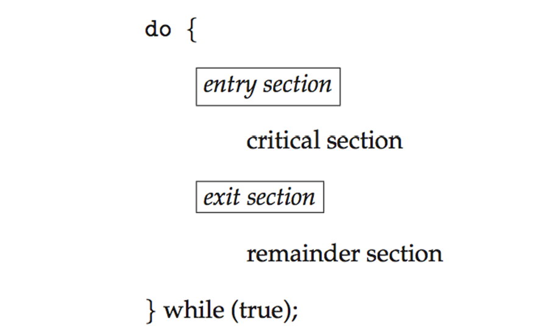
Critical Section
General structure of process P_{i}

Slide 10
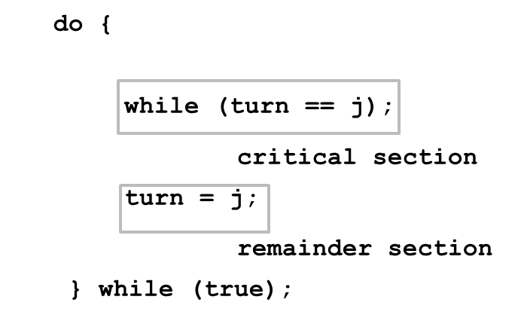
Algorithm for Process P_{i} 1

Slide 11
Solution to Critical-Section Problem
Mutual Exclusion - If process P_{i} is executing in its critical section, then no other processes can be executing in their critical sections
Progress - If no process is executing in its critical section and there exist some processes that wish to enter their critical section, then the selection of the processes that will enter the critical section next cannot be postponed indefinitely
Bounded Waiting - A bound must exist on the number of times that other processes are allowed to enter their critical sections after a process has made a request to enter its critical section and before that request is granted
Assume that each process executes at a nonzero speed
No assumption concerning relative speed of the n processes

Slide 12
Critical-Section Handling in O S
Two approaches depending on if kernel is preemptive or non- preemptive
Preemptive – allows preemption of process when running in kernel mode
Non-preemptive – runs until exits kernel mode, blocks, or voluntarily yields C P U
Essentially free of race conditions in kernel mode

Slide 13
Peterson’s Solution 1
Good algorithmic description of solving the problem
Two process solution
Assume that the load and store machine-language instructions are atomic; that is, cannot be interrupted
The two processes share two variables:
int turn;
Boolean flag[2]
The variable turn indicates whose turn it is to enter the critical section
The flag array is used to indicate if a process is ready to enter the critical section. flag[i] = true implies that process P_{i} is ready!

Slide 14
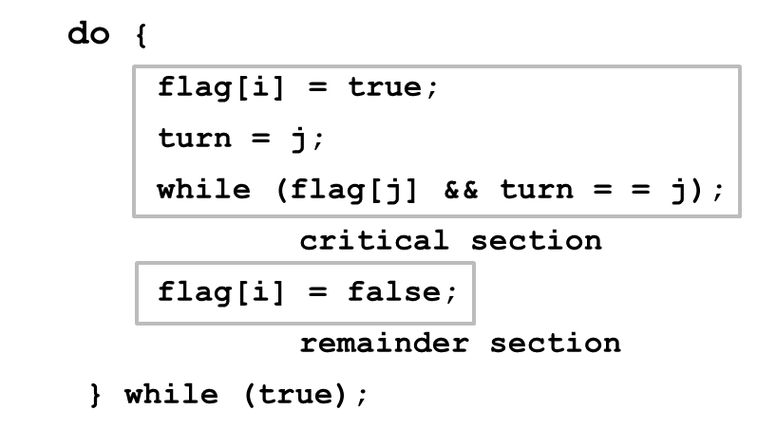
Algorithm for Process P_{i} 2

Slide 15
Peterson’s Solution 2
Provable that the three C S requirement are met:
Mutual exclusion is preserved
P_{i} enters C S only if:
either flag[j] = false or turn = i
Progress requirement is satisfied
Bounded-waiting requirement is met

Slide 16
Synchronization Hardware
Many systems provide hardware support for implementing the critical section code.
All solutions below based on idea of locking
Protecting critical regions via locks
Uniprocessors – could disable interrupts
Currently running code would execute without preemption
Generally too inefficient on multiprocessor systems
Operating systems using this not broadly scalable
Modern machines provide special atomic hardware instructions
Atomic = non-interruptible
Either test memory word and set value
Or swap contents of two memory words

Slide 17
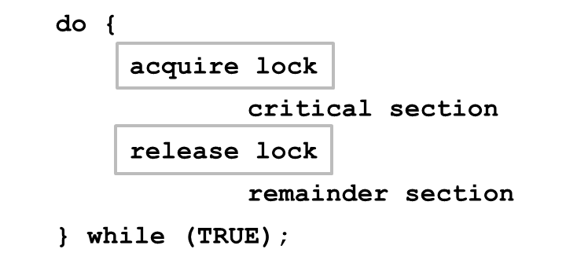
Solution to Critical-section Problem Using Locks

Slide 18
test_and_set Instruction
Definition:
boolean test_and_set (boolean *target)
{
boolean rv = *target;
*target = TRUE;
return rv:
}
Executed atomically
Returns the original value of passed parameter
Set the new value of passed parameter to “TRUE”.

Slide 19
Solution using test_and_set()
Shared Boolean variable lock, initialized to FALSE
Solution:
do { while (test_and_set(&lock))
; /* do nothing */
/* critical section */
lock = false;
/* remainder section */
} while (true);

Slide 20
compare_and_swap Instruction
Definition:
int compare _and_swap(int *value, int expected, int new_value) {
int temp = *value;
if (*value == expected)
*value = new_value;
return temp;
}
Executed atomically
Returns the original value of passed parameter “value”
Set the variable “value” the value of the passed parameter “new_value” but only if “value” ==“expected”. That is, the swap takes place only under this condition.

Slide 21
Solution using compare_and_swap
Shared integer “lock” initialized to 0;
Solution:
do { while (compare_and_swap(&lock, 0, 1) != 0)
; /* do nothing */
/* critical section */
lock = 0;
/* remainder section */
} while (true);

Slide 22
Bounded-waiting Mutual Exclusion with test_and_set
do { waiting[i] = true; key = true; while (waiting[i] && key)
key = test_and_set(&lock);
waiting[i] = false;
/* critical section */
j = (i + 1) % n;
while ((j != i) && !waiting[j])
j = (j + 1) % n;
if (j == i)
lock = false;
else
waiting[j] = false;
/* remainder section */
} while (true);

Slide 23
Mutex Locks
Previous solutions are complicated and generally inaccessible to application programmers
O S designers build software tools to solve critical section problem
Simplest is mutex lock
Protect a critical section by first acquire() a lock then release() the lock
Boolean variable indicating if lock is available or not
Calls to acquire() and release() must be atomic
Usually implemented via hardware atomic instructions
But this solution requires busy waiting
This lock therefore called a spinlock

Slide 24
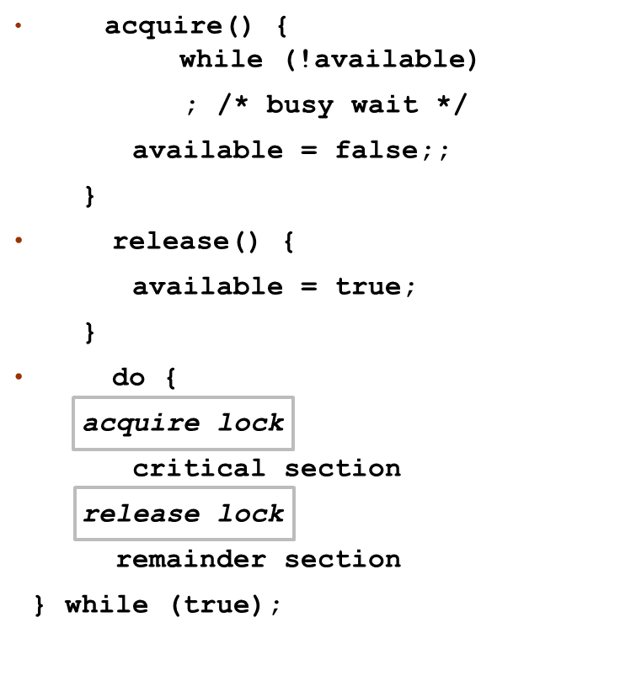
acquire() and release()

Slide 25
Semaphore
Synchronization tool that provides more sophisticated ways (than Mutex locks) for process to synchronize their activities.
Semaphore S – integer variable
Can only be accessed via two indivisible (atomic) operations
wait() and signal()
Originally called P() and V()
Definition of the wait() operation
wait(S) {
while (S <= 0)
; // busy wait
S--;
}
Definition of the signal() operation
signal(S) {
S++;
}

Slide 26
Semaphore Usage
Counting semaphore – integer value can range over an unrestricted domain
Binary semaphore – integer value can range only between 0 and 1
Same as a mutex lock
Can solve various synchronization problems
Consider P₁ and P₂ that require S₁ to happen before S₂
Create a semaphore “synch” initialized to 0
P1:
S₁;
signal(synch);
P2:
wait(synch);
S₂;
Can implement a counting semaphore S as a binary semaphore

Slide 27
Semaphore Implementation
Must guarantee that no two processes can execute the wait() and signal() on the same semaphore at the same time
Thus, the implementation becomes the critical section problem where the wait and signal code are placed in the critical section
Could now have busy waiting in critical section implementation
But implementation code is short
Little busy waiting if critical section rarely occupied
Note that applications may spend lots of time in critical sections and therefore this is not a good solution

Slide 28
Semaphore Implementation with no Busy waiting 1
With each semaphore there is an associated waiting queue
Each entry in a waiting queue has two data items:
value (of type integer)
pointer to next record in the list
Two operations:
block – place the process invoking the operation on the appropriate waiting queue
wakeup – remove one of processes in the waiting queue and place it in the ready queue
typedef struct{
int value;
struct process *list;
} semaphore;

Slide 29
Semaphore Implementation with no Busy waiting 2
wait(semaphore *S) {
S->value--;
if (S->value < 0) { add this process to S->list;
block();
}
}
signal(semaphore *S) {
S->value++;
if (S->value <= 0) { remove a process P from S->list;
wakeup(P);
}
}

Slide 30
Deadlock and Starvation
Deadlock – two or more processes are waiting indefinitely for an event that can be caused by only one of the waiting processes
Let S and Q be two semaphores initialized to 1
P₀ | P₁
wait(S); | wait(Q);
wait(Q); | wait(S);
... | ...
signal(S); | signal(Q);
signal(Q); | signal(S);
Starvation – indefinite blocking
A process may never be removed from the semaphore queue in which it is suspended
Priority Inversion – Scheduling problem when lower-priority process holds a lock needed by higher-priority process
Solved via priority-inheritance protocol

Slide 31
Problems with Semaphores
Incorrect use of semaphore operations:
signal (mutex) …. wait (mutex)
wait (mutex) … wait (mutex)
Omitting of wait (mutex) or signal (mutex) (or both)
Deadlock and starvation are possible.

Slide 32
Monitors
A high-level abstraction that provides a convenient and effective mechanism for process synchronization
Abstract data type, internal variables only accessible by code within the procedure
Only one process may be active within the monitor at a time
But not powerful enough to model some synchronization schemes
monitor monitor-name
{
// shared variable declarations
procedure P1 (…) { …. }
procedure Pn (…) {……}
Initialization code (…) { … }
}
}

Slide 33
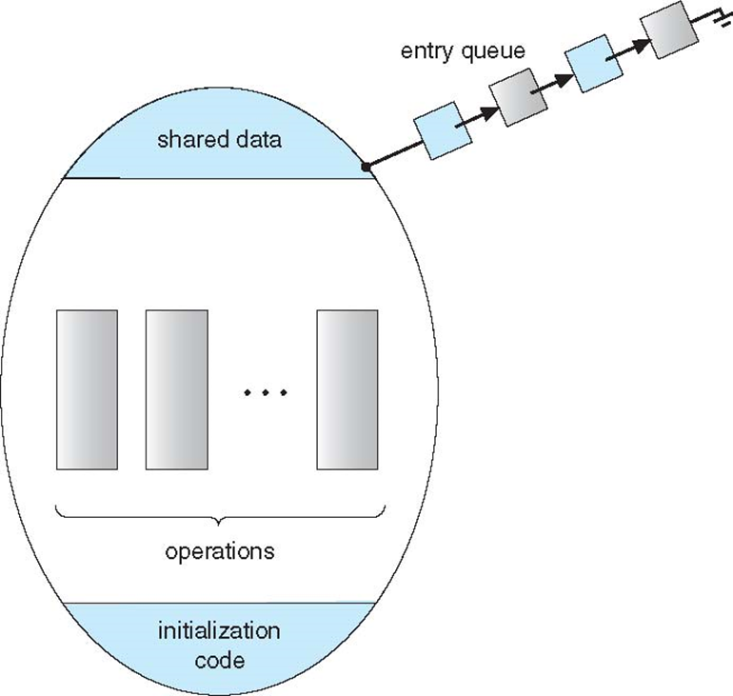
Schematic view of a Monitor

Slide 34
Condition Variables
condition x, y;
Two operations are allowed on a condition variable:
x.wait() – a process that invokes the operation is suspended until x.signal()
x.signal() – resumes one of processes (if any) that invoked x.wait()
If no x.wait() on the variable, then it has no effect on the variable

Slide 35
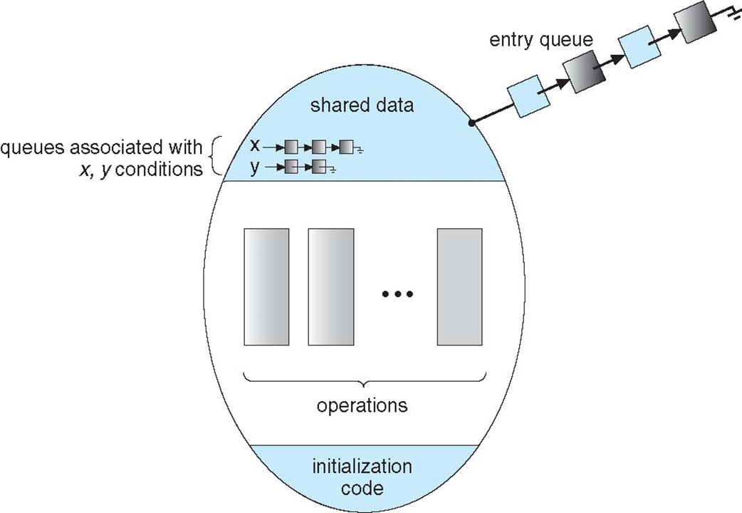
Monitor with Condition Variables

Slide 36
Condition Variables Choices
If process P invokes x.signal(), and process Q is suspended in x.wait(), what should happen next?
Both Q and P cannot execute in paralel. If Q is resumed, then P must wait
Options include
Signal and wait – P waits until Q either leaves the monitor or it waits for another condition
Signal and continue – Q waits until P either leaves the monitor or it waits for another condition
Both have pros and cons – language implementer can decide
Monitors implemented in Concurrent Pascal compromise
P executing signal immediately leaves the monitor, Q is resumed
Implemented in other languages including Mesa, C#, Java

Slide 37
Monitor Implementation Using Semaphores
Variables
semaphore mutex; // (initially = 1)
semaphore next; // (initially = 0)
int next_count = 0;
Each procedure F will be replaced by
wait(mutex);
…
body of F;
…
if (next_count > 0)
signal(next)
else
signal(mutex);
Mutual exclusion within a monitor is ensured

Slide 38
Monitor Implementation – Condition Variables
For each condition variable x, we have:
semaphore x_sem; // (initially = 0)
int x_count = 0;
The operation x.wait can be implemented as:
x_count++;
if (next_count > 0)
signal(next);
else
signal(mutex);
wait(x_sem);
x_count--;

Slide 39
Monitor Implementation
The operation x.signal can be implemented as:
if (x_count > 0) {
next_count++;
signal(x_sem);
wait(next);
next_count--;
}

Slide 40
Resuming Processes within a Monitor
If several processes queued on condition x, and x.signal() executed, which should be resumed?
FCFS frequently not adequate
conditional-wait construct of the form x.wait(c)
Where c is priority number
Process with lowest number (highest priority) is scheduled next

Slide 41
Single Resource allocation
Allocate a single resource among competing processes using priority numbers that specify the maximum time a process plans to use the resource
R.acquire(t);
...
access the resurce;
...
R.release;
Where R is an instance of type ResourceAllocator

Slide 42
A Monitor to Allocate Single Resource
monitor ResourceAllocator
{
boolean busy;
condition x;
void acquire(int time) {
if (busy)
x.wait(time);
busy = TRUE;
}
void release() {
busy = FALSE;
x.signal();
}
initialization code() {
busy = FALSE;
}
}

Slide 43
Copyright
Copyright © 2020 John Wiley & Sons, Inc.
All rights reserved. Reproduction or translation of this work beyond that permitted in Section 117 of the 19 76 United States Act without the express written permission of the copyright owner is unlawful. Request for further information should be addressed to the Permissions Department, John Wiley & Sons, Inc. The purchaser may make back-up copies for his/her own use only and not for distribution or resale. The Publisher assumes no responsibility for errors, omissions, or damages, caused by the use of these programs or from the use of the information contained herein.

