Slide 1
Operating System Concepts
Tenth Edition
Silberschatz, Galvin and Gagne
Chapter 15
File System Internals

Slide 2
Chapter 15: File System Internals
File Systems
File-System Mounting
Partitions and Mounting
File Sharing
Virtual File Systems
Remote File Systems
Consistency Semantics
N F S

Slide 3
Objectives
a

Slide 4
File System
a
b

Slide 5
Partitions and Mounting
Partition can be a volume containing a file system (“cooked”) or raw – just a sequence of blocks with no file system
Boot block can point to boot volume or boot loader set of blocks that contain enough code to know how to load the kernel from the file system
Or a boot management program for multi-O S booting
Root partition contains the O S, other partitions can hold other O S es, other file systems, or be raw
Mounted at boot time
Other partitions can mount automatically or manually
At mount time, file system consistency checked
Is all metadata correct?
If not, fix it, try again
If yes, add to mount table, allow access

Slide 6
File Sharing
a
b

Slide 7
Virtual File Systems 1
Virtual File Systems (V F S) on Unix provide an object-oriented way of implementing file systems
V F S allows the same system call interface (the A P I) to be used for different types of file systems
Separates file-system generic operations from implementation details
Implementation can be one of many file systems types, or network file system
Implements vnodes which hold inodes or network file details
Then dispatches operation to appropriate file system implementation routines

Slide 8
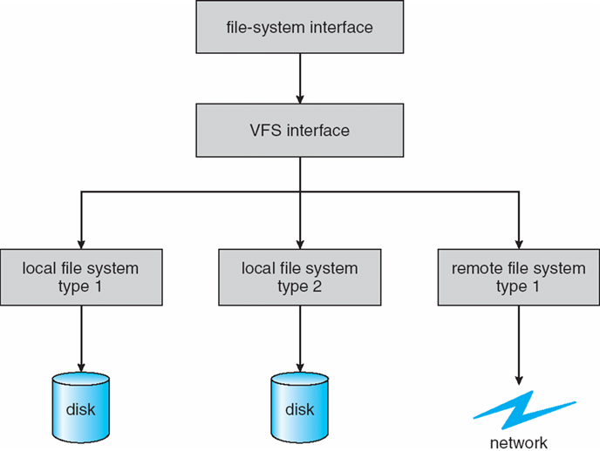
Virtual File Systems 2
The A P I is to the V F S interface, rather than any specific type of file system

Slide 9
Virtual File System Implementation
For example, Linux has four object types:
inode, file, superblock, dentry
V F S defines set of operations on the objects that must be implemented
Every object has a pointer to a function table
Function table has addresses of routines to implement that function on that object
For example:
• int open(. . .)—Open a file
• int close(. . .)—Close an already-open file
• ssize t read(. . .)—Read from a file
• ssize t write(. . .)—Write to a file
• int mmap(. . .)—Memory-map a file

Slide 10
The Sun Network File System (N F S) 1
An implementation and a specification of a software system for accessing remote files across LANs (or WANs)
The implementation is part of the Solaris and SunO S operating systems running on Sun workstations using an unreliable datagram protocol (U D P/I P protocol and Ethernet

Slide 11
The Sun Network File System (N F S) 2
Interconnected workstations viewed as a set of independent machines with independent file systems, which allows sharing among these file systems in a transparent manner
A remote directory is mounted over a local file system directory
The mounted directory looks like an integral subtree of the local file system, replacing the subtree descending from the local directory
Specification of the remote directory for the mount operation is nontransparent; the host name of the remote directory has to be provided
Files in the remote directory can then be accessed in a transparent manner
Subject to access-rights accreditation, potentially any file system (or directory within a file system), can be mounted remotely on top of any local directory

Slide 12
The Sun Network File System (N F S) 3
N F S is designed to operate in a heterogeneous environment of different machines, operating systems, and network architectures; the N F S specifications independent of these media
This independence is achieved through the use of R P C primitives built on top of an External Data Representation (X D R) protocol used between two implementation-independent interfaces
The N F S specification distinguishes between the services provided by a mount mechanism and the actual remote-file-access services

Slide 13
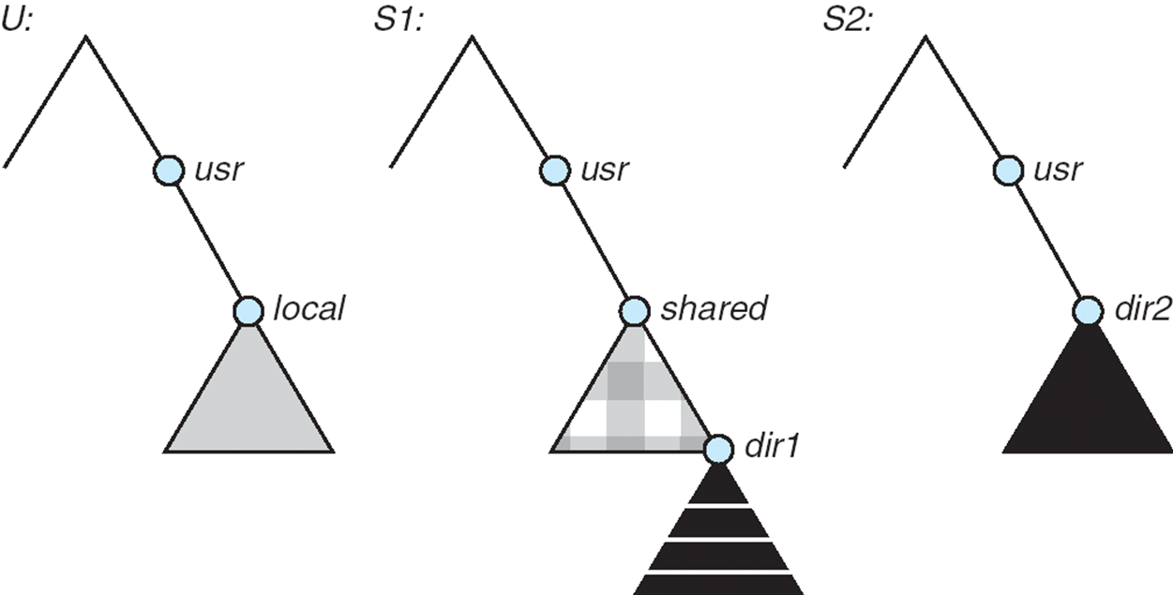
Three Independent File Systems

Slide 14
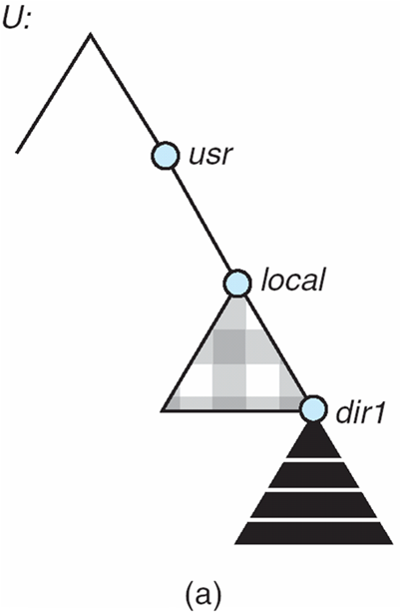
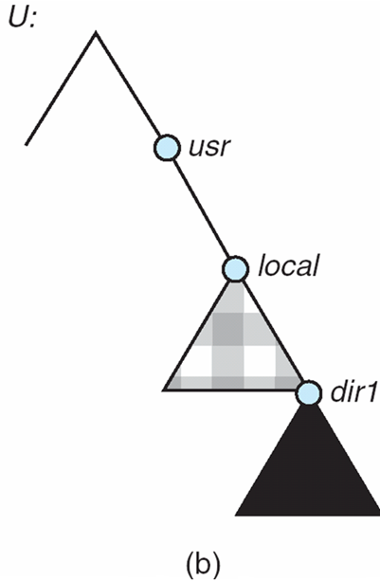
Mounting in N F S
Mounts
Cascading mounts

Slide 15
N F S Mount Protocol
Establishes initial logical connection between server and client
Mount operation includes name of remote directory to be mounted and name of server machine storing it
Mount request is mapped to corresponding R P C and forwarded to mount server running on server machine
Export list – specifies local file systems that server exports for mounting, along with names of machines that are permitted to mount them
Following a mount request that conforms to its export list, the server returns a file handle—a key for further accesses
File handle – a file-system identifier, and an inode number to identify the mounted directory within the exported file system
The mount operation changes only the user’s view and does not affect the server side

Slide 16
N F S Protocol
Provides a set of remote procedure calls for remote file operations. The procedures support the following operations:
searching for a file within a directory
reading a set of directory entries
manipulating links and directories
accessing file attributes
reading and writing files
N F S servers are stateless; each request has to provide a full set of arguments (N F S V4 is just coming available – very different, stateful)
Modified data must be committed to the server’s disk before results are returned to the client (lose advantages of caching)
The N F S protocol does not provide concurrency-control mechanisms

Slide 17
Three Major Layers of N F S Architecture
UNIX file-system interface (based on the open, read, write, and close calls, and file descriptors)
Virtual File System (V F S) layer – distinguishes local files from remote ones, and local files are further distinguished according to their file-system types
The V F S activates file-system-specific operations to handle local requests according to their file-system types
Calls the N F S protocol procedures for remote requests
N F S service layer – bottom layer of the architecture
Implements the N F S protocol

Slide 18
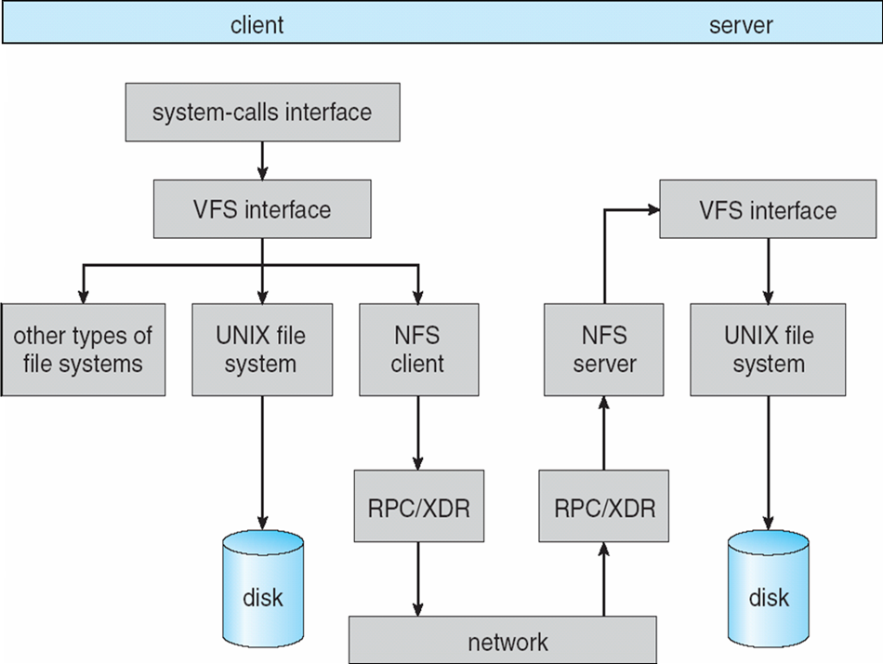
Schematic View of N F S Architecture

Slide 19
N F S Path-Name Translation
Performed by breaking the path into component names and performing a separate N F S lookup call for every pair of component name and directory vnode
To make lookup faster, a directory name lookup cache on the client’s side holds the vnodes for remote directory names

Slide 20
N F S Remote Operations
Nearly one-to-one correspondence between regular UNIX system calls and the N F S protocol R P Cs (except opening and closing files)
N F S adheres to the remote-service paradigm, but employs buffering and caching techniques for the sake of performance
File-blocks cache – when a file is opened, the kernel checks with the remote server whether to fetch or revalidate the cached attributes
Cached file blocks are used only if the corresponding cached attributes are up to date
File-attribute cache – the attribute cache is updated whenever new attributes arrive from the server
Clients do not free delayed-write blocks until the server confirms that the data have been written to disk

Slide 21
Copyright
Copyright © 2020 John Wiley & Sons, Inc.
All rights reserved. Reproduction or translation of this work beyond that permitted in Section 117 of the 19 76 United States Act without the express written permission of the copyright owner is unlawful. Request for further information should be addressed to the Permissions Department, John Wiley & Sons, Inc. The purchaser may make back-up copies for his/her own use only and not for distribution or resale. The Publisher assumes no responsibility for errors, omissions, or damages, caused by the use of these programs or from the use of the information contained herein.

