Slide 1
Operating System Concepts
Tenth Edition
Silberschatz, Galvin and Gagne
Chapter 4
Threads & Concurrency

Slide 2
Chapter 4: Threads
Overview
Multicore Programming
Multithreading Models
Thread Libraries
Implicit Threading
Threading Issues
Operating System Examples

Slide 3
Objectives
To introduce the notion of a thread—a fundamental unit of C P U utilization that forms the basis of multithreaded computer systems
To discuss the A P Is for the P threads, Windows, and Java thread libraries
To explore several strategies that provide implicit threading
To examine issues related to multithreaded programming
To cover operating system support for threads in Windows and Linux

Slide 4
Motivation
Most modern applications are multithreaded
Threads run within application
Multiple tasks with the application can be implemented by separate threads
Update display
Fetch data
Spell checking
Answer a network request
Process creation is heavy-weight while thread creation is light-weight
Can simplify code, increase efficiency
Kernels are generally multithreaded

Slide 5
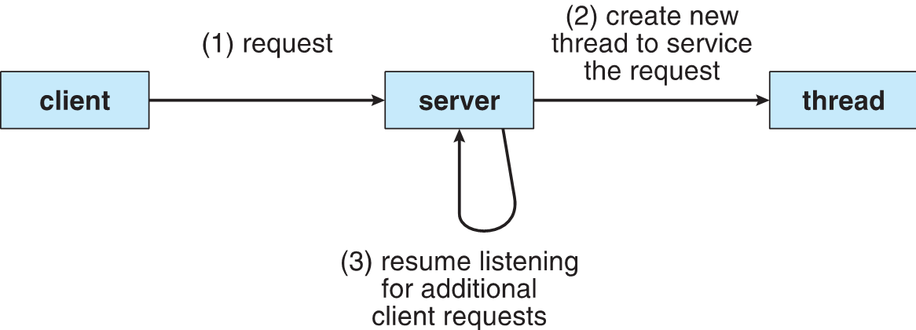
Multithreaded Server Architecture

Slide 6
Benefits
Responsiveness – may allow continued execution if part of process is blocked, especially important for user interfaces
Resource Sharing – threads share resources of process, easier than shared memory or message passing
Economy – cheaper than process creation, thread switching lower overhead than context switching
Scalability – process can take advantage of multiprocessor architectures

Slide 7
Multicore Programming 1
Multicore or multiprocessor systems putting pressure on programmers, challenges include:
Dividing activities
Balance
Data splitting
Data dependency
Testing and debugging
Parallelism implies a system can perform more than one task simultaneously
Concurrency supports more than one task making progress
Single processor / core, scheduler providing concurrency

Slide 8
Multicore Programming 2
Types of parallelism
Data parallelism – distributes subsets of the same data across multiple cores, same operation on each
Task parallelism – distributing threads across cores, each thread performing unique operation
As # of threads grows, so does architectural support for threading
C P Us have cores as well as hardware threads
Consider Oracle S P A R C T4 with 8 cores, and 8 hardware threads per core

Slide 9
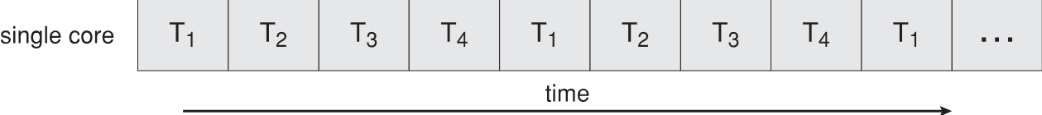
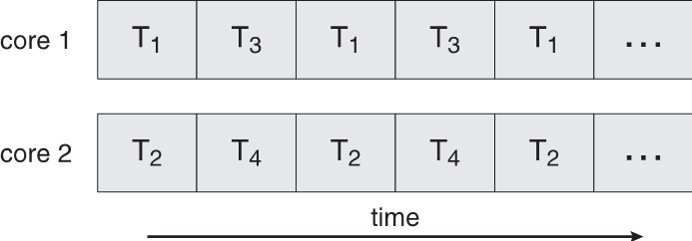
Concurrency versus Parallelism
Concurrent execution on single-core system:
Parallelism on a multi-core system:

Slide 10
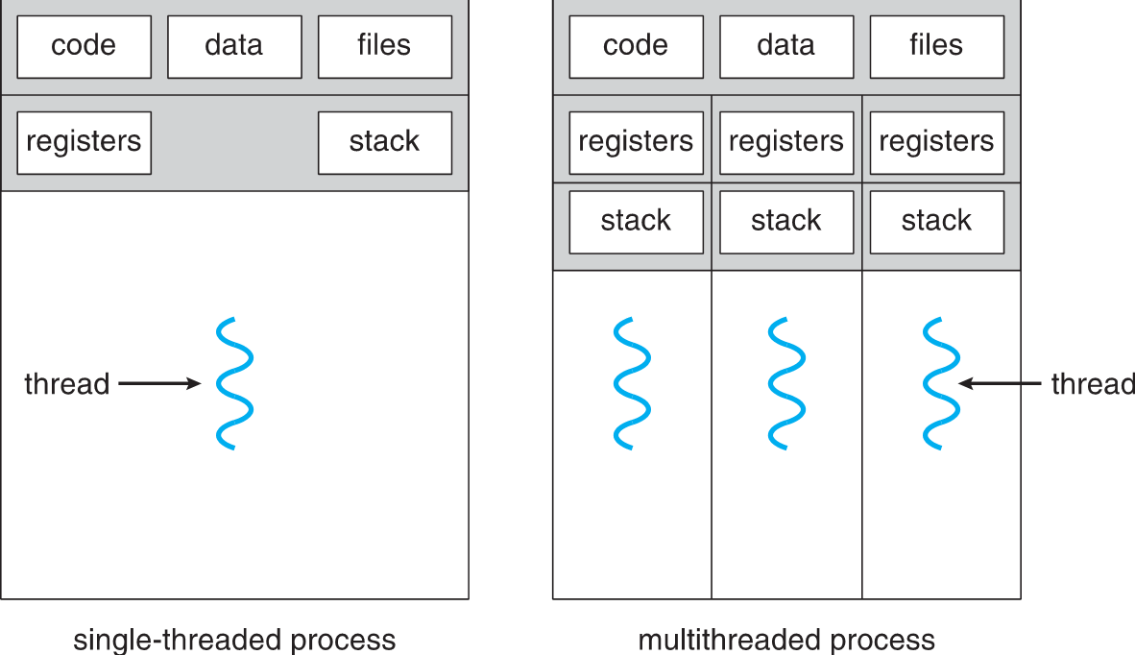
Single and Multithreaded Processes

Slide 11
Amdahl’s Law
Identifies performance gains from adding additional cores to an application that has both serial and parallel components
S is serial portion
N processing cores
That is, if application is 75% parallel / 25% serial, moving from 1 to 2 cores results in speedup of 1.6 times
As N approaches infinity, speedup approaches 1 / S
Serial portion of an application has disproportionate effect on performance gained by adding additional cores
But does the law take into account contemporary multicore systems?

Slide 12
User Threads and Kernel Threads
User threads - management done by user-level threads library
Three primary thread libraries:
P O S I X Pthreads
Windows threads
Java threads
Kernel threads - Supported by the Kernel
Examples – virtually all general purpose operating systems, including:
Windows
Solaris
Linux
Tru64 U N I X
Mac O S X

Slide 13
Multithreading Models
Many-to-One
One-to-One
Many-to-Many

Slide 14
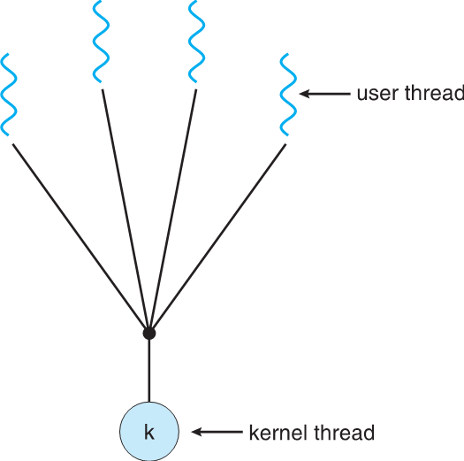
Many-to-One
Many user-level threads mapped to single kernel thread
One thread blocking causes all to block
Multiple threads may not run in parallel on muticore system because only one may be in kernel at a time
Few systems currently use this model
Examples:
Solaris Green Threads
G N U Portable Threads

Slide 15
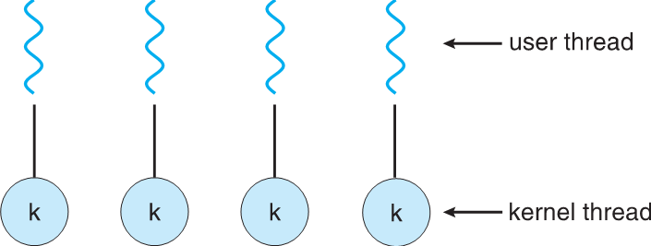
One-to-One
Each user-level thread maps to kernel thread
Creating a user-level thread creates a kernel thread
More concurrency than many-to-one
Number of threads per process sometimes restricted due to overhead
Examples
Windows
Linux
Solaris 9 and later

Slide 16
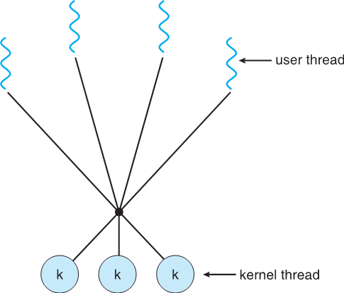
Many-to-Many Model
Allows many user level threads to be mapped to many kernel threads
Allows the operating system to create a sufficient number of kernel threads
Solaris prior to version 9
Windows with the ThreadFiber package

Slide 17
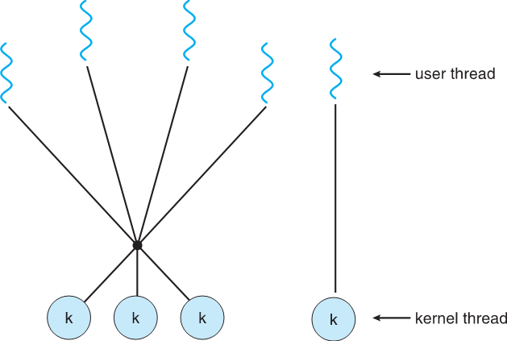
Two-level Model
Similar to M:M, except that it allows a user thread to be bound to kernel thread
Examples
I R I X
H P-U X
Tru64 U N I X
Solaris 8 and earlier

Slide 18
Thread Libraries
Thread library provides programmer with A P I for creating and managing threads
Two primary ways of implementing
Library entirely in user space
Kernel-level library supported by the O S

Slide 19
P threads
May be provided either as user-level or kernel-level
A P O S I X standard (I E E E 10 03.1c) A P I for thread creation and synchronization
Specification, not implementation
A P I specifies behavior of the thread library, implementation is up to development of the library
Common in U N I X operating systems (Solaris, Linux, Mac O S X)

Slide 20
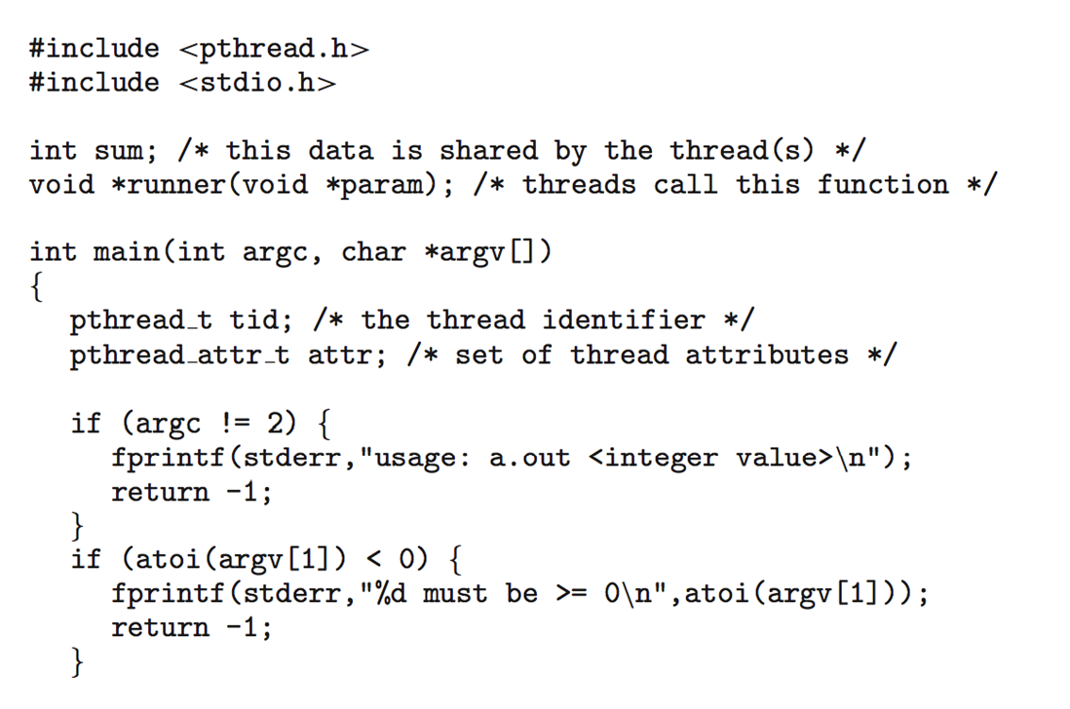
P threads Example 1

Slide 21
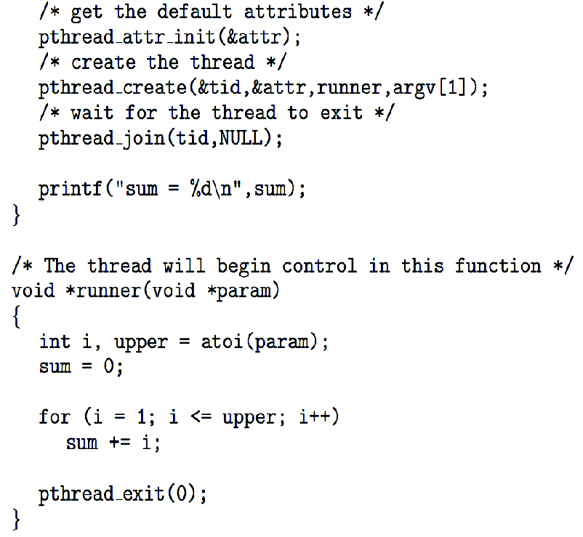
P threads Example 2

Slide 22
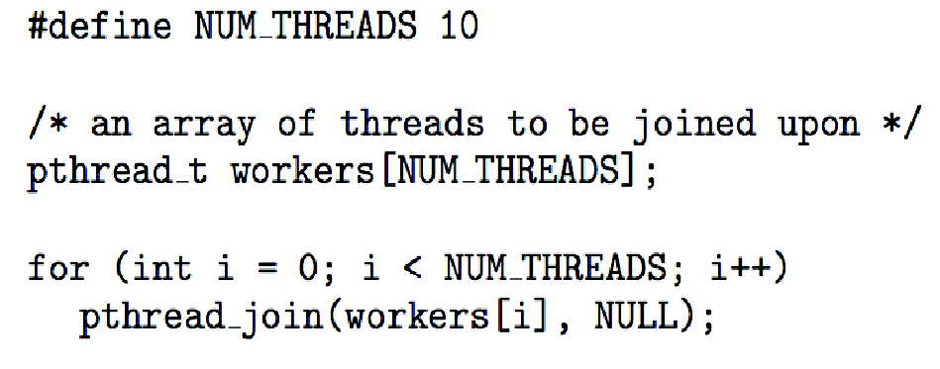
P threads Code for Joining 10 Threads

Slide 23
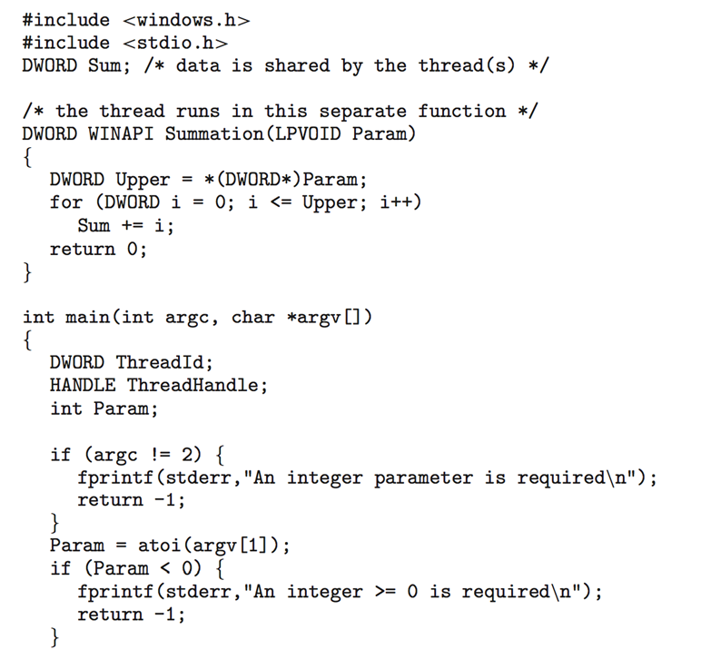
Windows Multithreaded C Program 1

Slide 24
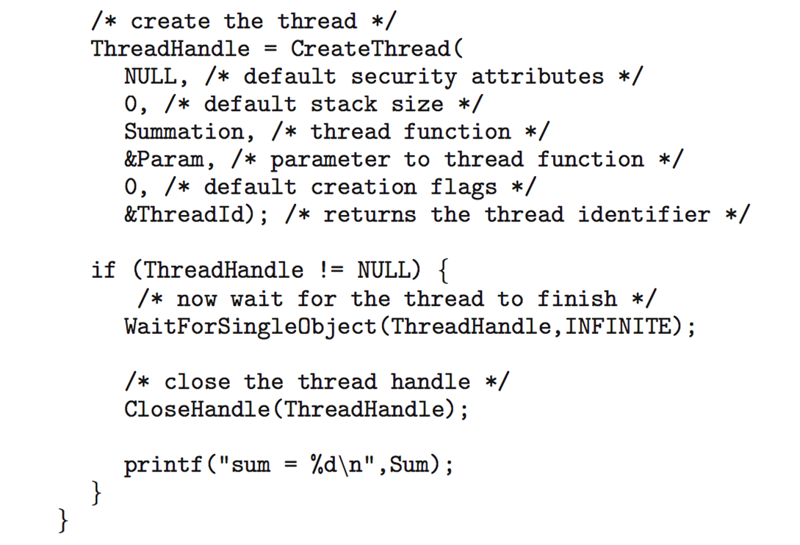
Windows Multithreaded C Program 2

Slide 25
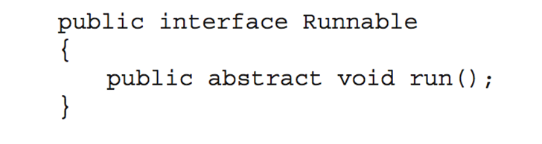
Java Threads
Java threads are managed by the J V M
Typically implemented using the threads model provided by underlying O S
Java threads may be created by:
Extending Thread class
Implementing the Runnable interface

Slide 26
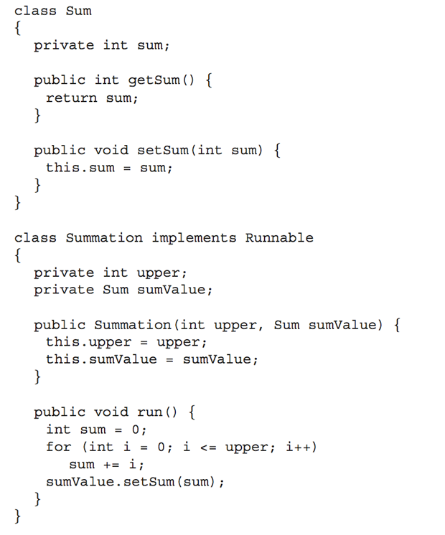
Java Multithreaded Program 1

Slide 27
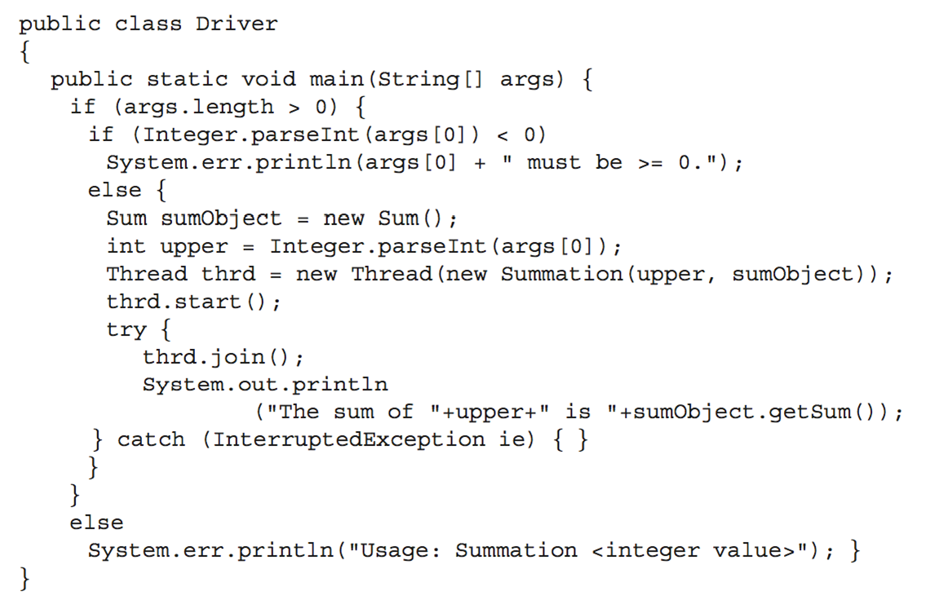
Java Multithreaded Program 2

Slide 28
Implicit Threading
Growing in popularity as numbers of threads increase, program correctness more difficult with explicit threads
Creation and management of threads done by compilers and run-time libraries rather than programmers
Three methods explored
Thread Pools
OpenM P
Grand Central Dispatch
Other methods include Microsoft Threading Building Blocks (T B B), java.util.concurrent package

Slide 29
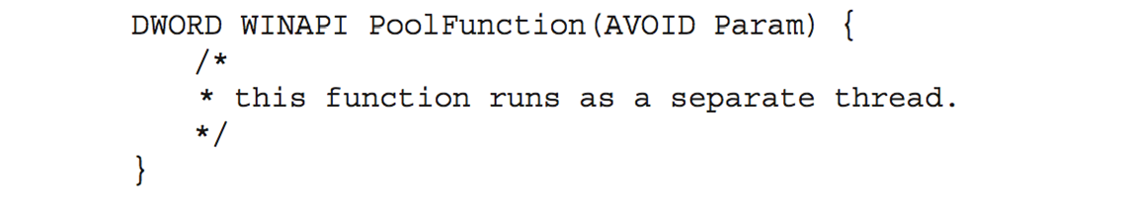
Thread Pools
Create a number of threads in a pool where they await work
Advantages:
Usually slightly faster to service a request with an existing thread than create a new thread
Allows the number of threads in the application(s) to be bound to the size of the pool
Separating task to be performed from mechanics of creating task allows different strategies for running task
i.e. Tasks could be scheduled to run periodically
Windows A P I supports thread pools:

Slide 30
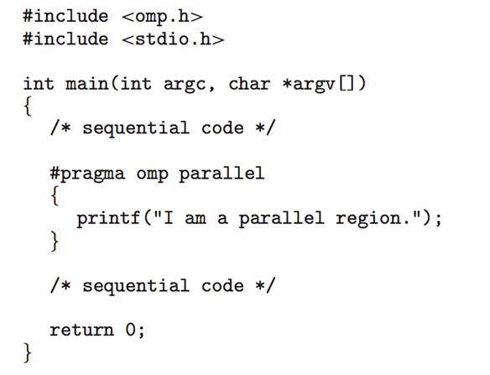
OpenMP
Set of compiler directives and an A P I for C, C++, F O R T R A N
Provides support for parallel programming in shared-memory environments
Identifies parallel regions – blocks of code that can run in parallel
#pragma omp parallel
Create as many threads as there are cores
#pragma omp parallel for
for(i=0;i<N;i++) {
c[i] = a[i] + b[i];
}
Run for loop in parallel

Slide 31
Grand Central Dispatch 1
Apple technology for Mac O S X and iO S operating systems
Extensions to C, C++ languages, A P I, and run-time library
Allows identification of parallel sections
Manages most of the details of threading
Block is in
Blocks placed in dispatch queue
Assigned to available thread in thread pool when removed from queue

Slide 32
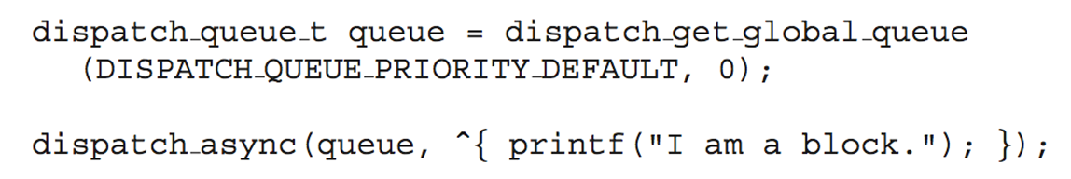
Grand Central Dispatch 2
Two types of dispatch queues:
serial – blocks removed in F I F O order, queue is per process, called main queue
Programmers can create additional serial queues within program
concurrent – removed in F I F O order but several may be removed at a time
Three system wide queues with priorities low, default, high

Slide 33
Threading Issues
Semantics of fork() and exec() system calls
Signal handling
Synchronous and asynchronous
Thread cancellation of target thread
Asynchronous or deferred
Thread-local storage
Scheduler Activations

Slide 34
Semantics of fork() and exec()
Does fork()duplicate only the calling thread or all threads?
Some U N I Xes have two versions of fork
exec() usually works as normal – replace the running process including all threads

Slide 35
Signal Handling 1
Signals are used in U N I X systems to notify a process that a particular event has occurred.
A signal handler is used to process signals
Signal is generated by particular event
Signal is delivered to a process
Signal is handled by one of two signal handlers:
default
user-defined
Every signal has default handler that kernel runs when handling signal
User-defined signal handler can override default
For single-threaded, signal delivered to process

Slide 36
Signal Handling 2
Where should a signal be delivered for multi-threaded?
Deliver the signal to the thread to which the signal applies
Deliver the signal to every thread in the process
Deliver the signal to certain threads in the process
Assign a specific thread to receive all signals for the process

Slide 37
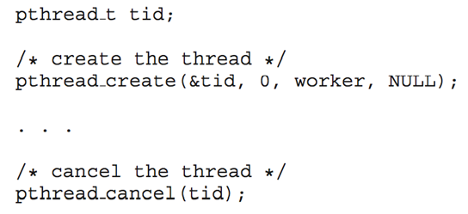
Thread Cancellation 1
Terminating a thread before it has finished
Thread to be canceled is target thread
Two general approaches:
Asynchronous cancellation terminates the target thread immediately
Deferred cancellation allows the target thread to periodically check if it should be cancelled
Pthread code to create and cancel a thread:

Slide 38
Thread Cancellation 2
Invoking thread cancellation requests cancellation, but actual cancellation depends on thread state
Mode | State | Type
Off | Disabled | ―
Deferred | Enabled | Deferred
Asynchronous | Enabled | Asynchronous
If thread has cancellation disabled, cancellation remains pending until thread enables it
Default type is deferred
Cancellation only occurs when thread reaches cancellation point
I.e. pthread_testcancel()
Then cleanup handler is invoked
On Linux systems, thread cancellation is handled through signals

Slide 39
Thread-Local Storage
Thread-local storage (T L S) allows each thread to have its own copy of data
Useful when you do not have control over the thread creation process (i.e., when using a thread pool)
Different from local variables
Local variables visible only during single function invocation
T L S visible across function invocations
Similar to static data
T L S is unique to each thread

Slide 40
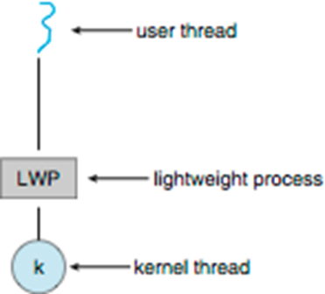
Scheduler Activations
Both M:M and Two-level models require communication to maintain the appropriate number of kernel threads allocated to the application
Typically use an intermediate data structure between user and kernel threads – lightweight process (L W P)
Appears to be a virtual processor on which process can schedule user thread to run
Each L W P attached to kernel thread
How many L W Ps to create?
Scheduler activations provide upcalls - a communication mechanism from the kernel to the upcall handler in the thread library
This communication allows an application to maintain the correct number kernel threads

Slide 41
Operating System Examples
Windows Threads
Linux Threads

Slide 42
Windows Threads 1
Windows implements the Windows A P I – primary A P I for Win 98, Win N T, Win 2000, Win X P, and Win 7
Implements the one-to-one mapping, kernel-level
Each thread contains
A thread id
Register set representing state of processor
Separate user and kernel stacks for when thread runs in user mode or kernel mode
Private data storage area used by run-time libraries and dynamic link libraries (D L Ls)
The register set, stacks, and private storage area are known as the context of the thread

Slide 43
Windows Threads 2
The primary data structures of a thread include:
E THREAD (executive thread block) – includes pointer to process to which thread belongs and to K THREAD, in kernel space
K THREAD (kernel thread block) – scheduling and synchronization info, kernel-mode stack, pointer to T E B, in kernel space
T E B (thread environment block) – thread id, user-mode stack, thread-local storage, in user space

Slide 44
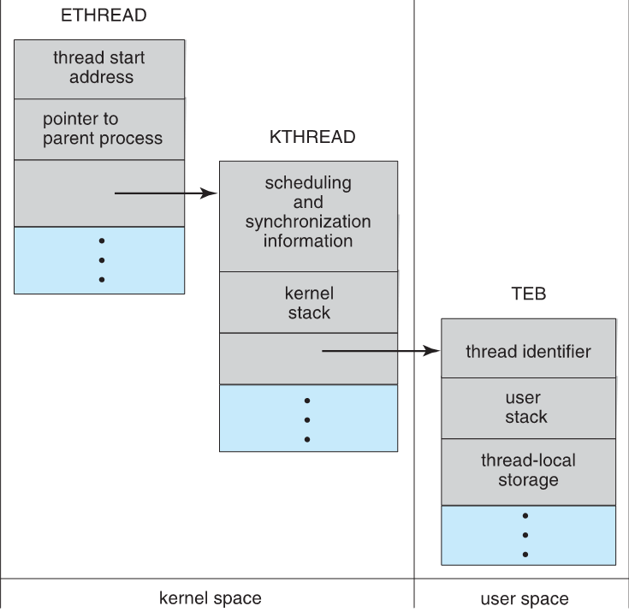
Windows Threads Data Structures

Slide 45
Linux Threads
Linux refers to them as tasks rather than threads
Thread creation is done through clone()system call
clone()allows a child task to share the address space of the parent task (process)
Flags control behavior
flag | meaning
CLONE_FS | File-system information is shared.
CLONE_VM | The same memory space is shared.
CLONE_SIGHAND | Signal handlers are shared.
CLONE_FILES | The set of open files is shared.
struct task_struct points to process data structures (shared or unique)

Slide 46
Copyright
Copyright © 2020 John Wiley & Sons, Inc.
All rights reserved. Reproduction or translation of this work beyond that permitted in Section 117 of the 1976 United States Act without the express written permission of the copyright owner is unlawful. Request for further information should be addressed to the Permissions Department, John Wiley & Sons, Inc. The purchaser may make back-up copies for his/her own use only and not for distribution or resale. The Publisher assumes no responsibility for errors, omissions, or damages, caused by the use of these programs or from the use of the information contained herein.

