Slide 1
Operating System Concepts
Tenth Edition
Silberschatz, Galvin and Gagne
Chapter 18
Virtual Machines

Slide 2
Chapter 18: Virtual Machines
Overview
History
Benefits and Features
Building Blocks
Types of Virtual Machines and Their Implementations
Virtualization and Operating-System Components
Examples

Slide 3
Chapter Objectives
Explore the history and benefits of virtual machines
Discuss the various virtual machine technologies
Describe the methods used to implement virtualization
Show the most common hardware features that support virtualization and explain how they are used by operating-system modules
Discuss current virtualization research areas

Slide 4
Overview
Fundamental idea – abstract hardware of a single computer into several different execution environments
Similar to layered approach
But layer creates virtual system (virtual machine, or V M) on which operation systems or applications can run
Several components
Host – underlying hardware system
Virtual machine manager (V M M) or hypervisor – creates and runs virtual machines by providing interface that is identical to the host
(Except in the case of paravirtualization)
Guest – process provided with virtual copy of the host
Usually an operating system
Single physical machine can run multiple operating systems concurrently, each in its own virtual machine

Slide 5
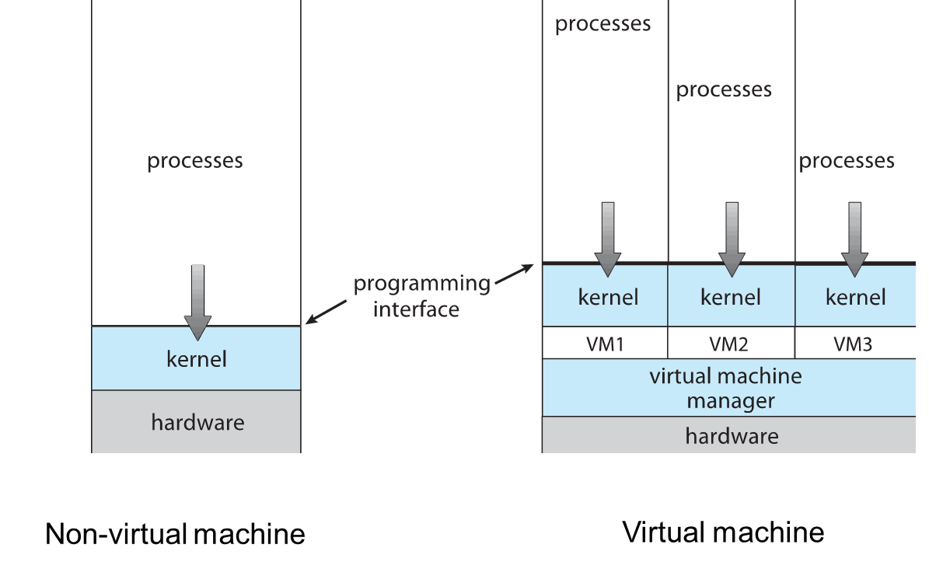
System Models

Slide 6
Implementation of V M Ms 1
Vary greatly, with options including:
Type 0 hypervisors - Hardware-based solutions that provide support for virtual machine creation and management via firmware
I B M L P A Rs and Oracle L D O Ms are examples
Type 1 hypervisors - Operating-system-like software built to provide virtualization
Including V Mware E S X, Joyent SmartO S, and Citrix XenServer
Type 1 hypervisors – Also includes general-purpose operating systems that provide standard functions as well as V M M functions
Including Microsoft Windows Server with HyperV and RedHat Linux with K V M
Type 2 hypervisors - Applications that run on standard operating systems but provide V M M features to guest operating systems
Includeing V Mware Workstation and Fusion, Parallels Desktop, and Oracle VirtualBox

Slide 7
Implementation of V M Ms 2
Other variations include:
Paravirtualization - Technique in which the guest operating system is modified to work in cooperation with the V M M to optimize performance
Programming-environment virtualization – V M Ms do not virtualize real hardware but instead create an optimized virtual system
Used by Oracle Java and Microsoft.Net
Emulators – Allow applications written for one hardware environment to run on a very different hardware environment, such as a different type of C P U
Application containment - Not virtualization at all but rather provides virtualization-like features by segregating applications from the operating system, making them more secure, manageable
Including Oracle Solaris Zones, B S D Jails, and I B M A I X W P A Rs
Much variation due to breadth, depth and importance of virtualization in modern computing

Slide 8
History
First appeared in IBM mainframes in 19 72
Allowed multiple users to share a batch-oriented system
Formal definition of virtualization helped move it beyond I B M
A V M M provides an environment for programs that is essentially identical to the original machine
Programs running within that environment show only minor performance decreases
The V M M is in complete control of system resources
In late 19 90s Intel C P Us fast enough for researchers to try virtualizing on general purpose P Cs
Xen and VMware created technologies, still used today
Virtualization has expanded to many OSes, C P Us, V M Ms

Slide 9
Benefits and Features 1
Host system protected from V Ms, V Ms protected from each other
I.e. A virus less likely to spread
Sharing is provided though via shared file system volume, network communication
Freeze, suspend, running V M
Then can move or copy somewhere else and resume
Snapshot of a given state, able to restore back to that state
Some V M Ms allow multiple snapshots per V M
Clone by creating copy and running both original and copy
Great for O S research, better system development efficiency
Run multiple, different OSes on a single machine
Consolidation, app dev, …

Slide 10
Benefits and Features 2
Templating – create an O S + application V M, provide it to customers, use it to create multiple instances of that combination
Live migration – move a running V M from one host to another!
No interruption of user access
All those features taken together -> cloud computing
Using A P Is, programs tell cloud infrastructure (servers, networking, storage) to create new guests, V Ms, virtual desktops

Slide 11
Building Blocks
Generally difficult to provide an exact duplicate of underlying machine
Especially if only dual-mode operation available on C P U
But getting easier over time as C P U features and support for V M M improves
Most V M Ms implement virtual C P U (V C P U) to represent state of C P U per guest as guest believes it to be
When guest context switched onto C P U by V M M, information from V C P U loaded and stored
Several techniques, as described in next slides

Slide 12
Building Block – Trap and Emulate
Dual mode C P U means guest executes in user mode
Kernel runs in kernel mode
Not safe to let guest kernel run in kernel mode too
So V M needs two modes – virtual user mode and virtual kernel mode
Both of which run in real user mode
Actions in guest that usually cause switch to kernel mode must cause switch to virtual kernel mode

Slide 13
Trap-and-Emulate
How does switch from virtual user mode to virtual kernel mode occur?
Attempting a privileged instruction in user mode causes an error -> trap
V M M gains control, analyzes error, executes operation as attempted by guest
Returns control to guest in user mode
Known as trap-and-emulate
Most virtualization products use this at least in part
User mode code in guest runs at same speed as if not a guest
But kernel mode privilege mode code runs slower due to trap-and-emulate
Especially a problem when multiple guests running, each needing trap-and-emulate
C P Us adding hardware support, mode C P U modes to improve virtualization performance

Slide 14
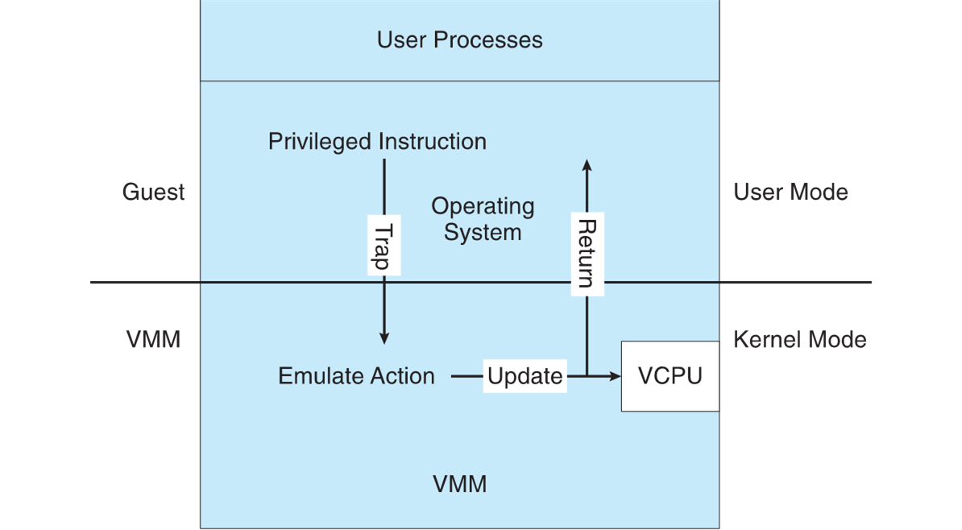
Trap-and-Emulate Virtualization Implementation

Slide 15
Building Block – Binary Translation
Some C P Us don’t have clean separation between privileged and nonprivileged instructions
Earlier Intel x86 C P Us are among them
Earliest Intel C P U designed for a calculator
Backward compatibility means difficult to improve
Consider Intel x86 popf instruction
Loads C P U flags register from contents of the stack
If C P U in privileged mode -> all flags replaced
If C P U in user mode -> on some flags replaced
No trap is generated

Slide 16
Binary Translation 1
Other similar problem instructions we will call special instructions
Caused trap-and-emulate method considered impossible until 19 98
Binary translation solves the problem
Basics are simple, but implementation very complex
If guest V C P U is in user mode, guest can run instructions natively
If guest V C P U in kernel mode (guest believes it is in kernel mode)
V M M examines every instruction guest is about to execute by reading a few instructions ahead of program counter
Non-special-instructions run natively
Special instructions translated into new set of instructions that perform equivalent task (for example changing the flags in the V C P U)

Slide 17
Binary Translation 2
Implemented by translation of code within V M M
Code reads native instructions dynamically from guest, on demand, generates native binary code that executes in place of original code
Performance of this method would be poor without optimizations
Products like V Mware use caching
Translate once, and when guest executes code containing special instruction cached translation used instead of translating again
Testing showed booting Windows X P as guest caused 950,000 translations, at 3 microseconds each, or 3 second (5 %) slowdown over native

Slide 18
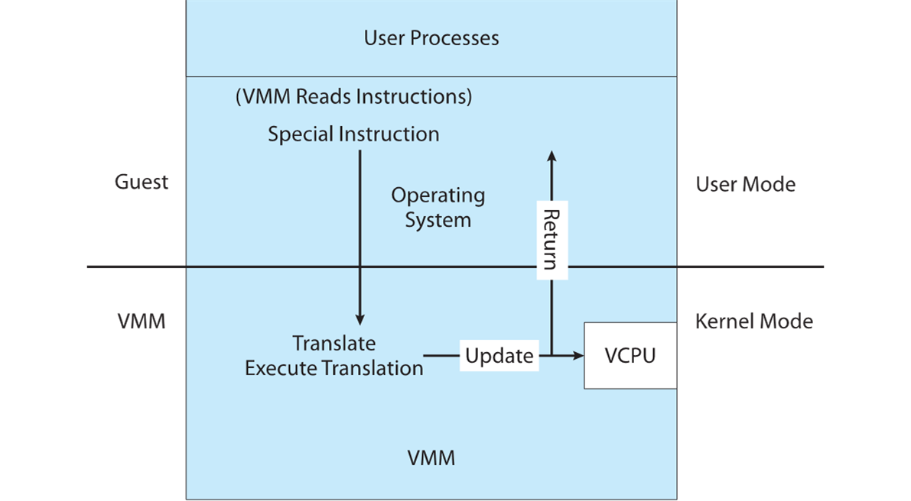
Binary Translation Virtualization Implementation

Slide 19
Nested Page Tables 1
Memory management another general challenge to V M M implementations
How can V M M keep page-table state for both guests believing they control the page tables and V M M that does control the tables?
Common method (for trap-and-emulate and binary translation) is nested page tables (N P Ts)
Each guest maintains page tables to translate virtual to physical addresses
V M M maintains per guest N P Ts to represent guest’s page-table state
Just as V C P U stores guest C P U state
When guest on C P U -> V M M makes that guest’s N P Ts the active system page tables
Guest tries to change page table -> V M M makes equivalent change to N P Ts and its own page tables
Can cause many more T L B misses -> much slower performance

Slide 20
Building Blocks – Hardware Assistance
All virtualization needs some H W support
More support -> more feature rich, stable, better performance of guests
Intel added new V T-x instructions in 2005 and A M D the A M D-V instructions in 2006
C P Us with these instructions remove need for binary translation
Generally define more C P U modes – “guest” and “host”
V M M can enable host mode, define characteristics of each guest V M, switch to guest mode and guest(s) on C P U(s)
In guest mode, guest O S thinks it is running natively, sees devices (as defined by V M M for that guest)
Access to virtualized device, priv instructions cause trap to V M M
C P U maintains V C P U, context switches it as needed
H W support for Nested Page Tables, D M A, interrupts as well over time

Slide 21
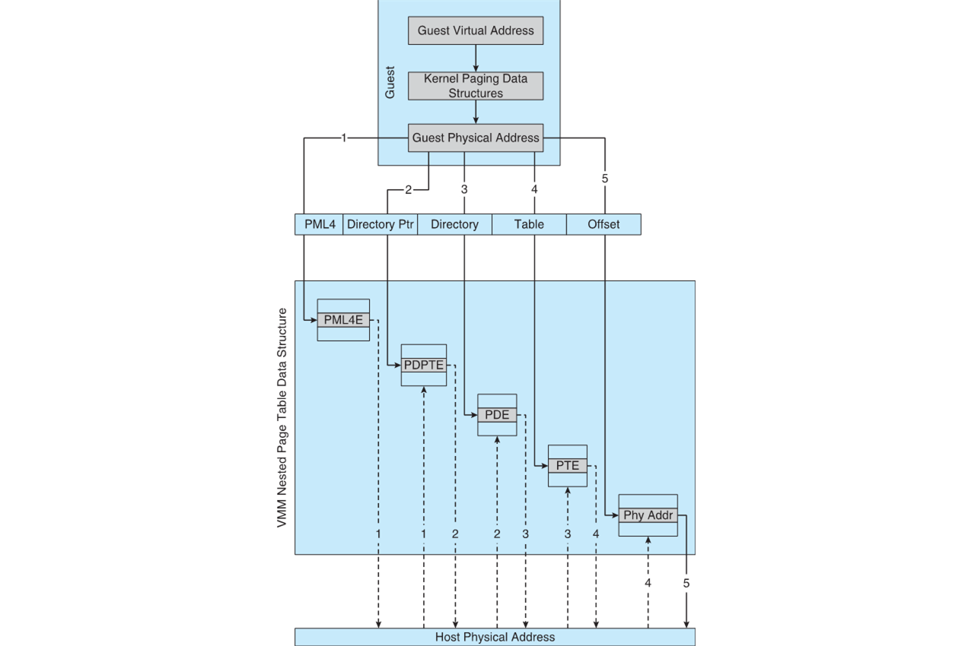
Nested Page Tables 2

Slide 22
Types of Virtual Machines and Implementations
Many variations as well as H W details
Assume V M Ms take advantage of HW features
H W features can simplify implementation, improve performance
Whatever the type, a V M has a lifecycle
Created by V M M
Resources assigned to it (number of cores, amount of memory, networking details, storage details)
In type 0 hypervisor, resources usually dedicated
Other types dedicate or share resources, or a mix
When no longer needed, V M can be deleted, freeing resouces
Steps simpler, faster than with a physical machine install
Can lead to virtual machine sprawl with lots of V Ms, history and state difficult to track

Slide 23
Types of V Ms – Type 0 Hypervisor
Old idea, under many names by H W manufacturers
“partitions”, “domains”
A HW feature implemented by firmware
OS need to nothing special, V M M is in firmware
Smaller feature set than other types
Each guest has dedicated H W
I/O a challenge as difficult to have enough devices, controllers to dedicate to each guest
Sometimes V M M implements a control partition running daemons that other guests communicate with for shared I/O
Can provide virtualization-within-virtualization (guest itself can be a V M M with guests
Other types have difficulty doing this

Slide 24
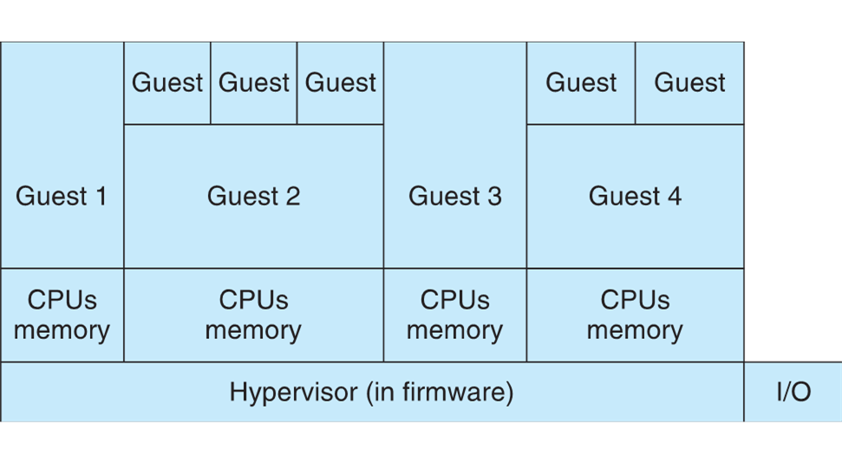
Type 0 Hypervisor

Slide 25
Types of V Ms – Type 1 Hypervisor 1
Commonly found in company datacenters
In a sense becoming “datacenter operating systems”
Datacenter managers control and manage OSes in new, sophisticated ways by controlling the Type 1 hypervisor
Consolidation of multiple OSes and apps onto less H W
Move guests between systems to balance performance
Snapshots and cloning

Slide 26
Types of V Ms – Type 1 Hypervisor 2
Special purpose operating systems that run natively on H W
Rather than providing system call interface, create run and manage guest OSes
Can run on Type 0 hypervisors but not on other Type 1s
Run in kernel mode
Guests generally don’t know they are running in a V M
Implement device drivers for host H W because no other component can
Also provide other traditional O S services like C P U and memory management

Slide 27
Types of V Ms – Type 1 Hypervisor 3
Another variation is a general purpose O S that also provides V M M functionality
RedHat Enterprise Linux with K V M, Windows with Hyper-V, Oracle Solaris
Perform normal duties as well as V M M duties
Typically less feature rich than dedicated Type 1 hypervisors
In many ways, treat guests OSes as just another process
Albeit with special handling when guest tries to execute special instructions

Slide 28
Types of V Ms – Type 2 Hypervisor
Less interesting from an O S perspective
Very little O S involvement in virtualization
V M M is simply another process, run and managed by host
Even the host doesn’t know they are a V M M running guests
Tend to have poorer overall performance because can’t take advantage of some H W features
But also a benefit because require no changes to host O S
Student could have Type 2 hypervisor on native host, run multiple guests, all on standard host O S such as Windows, Linux, MacO S

Slide 29
Types of V Ms – Paravirtualization 1
Does not fit the definition of virtualization – V M M not presenting an exact duplication of underlying hardware
But still useful!
V M M provides services that guest must be modified to use
Leads to increased performance
Less needed as hardware support for V Ms grows
Xen, leader in paravirtualized space, adds several techniques
For example, clean and simple device abstractions
Efficient I/O
Good communication between guest and V M M about device I/O
Each device has circular buffer shared by guest and V M M via shared memory

Slide 30
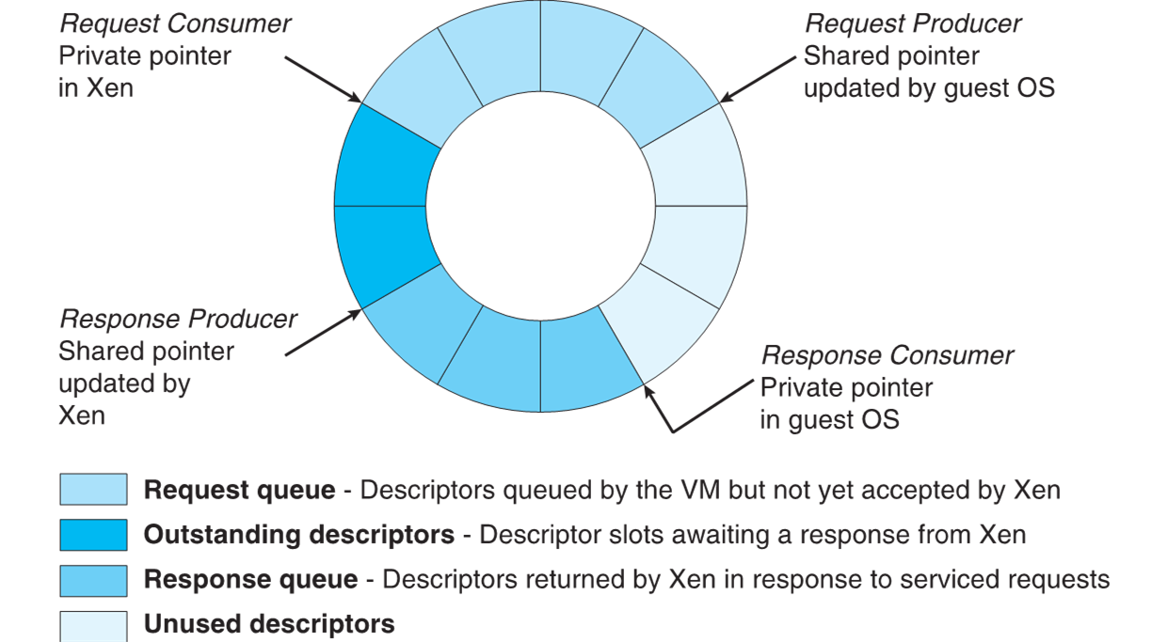
Xen I/O via Shared Circular Buffer

Slide 31
Types of V Ms – Paravirtualization 2
Xen, leader in paravirtualized space, adds several techniques (Cont.)
Memory management does not include nested page tables
Each guest has own read-only tables
Guest uses hypercall (call to hypervisor) when page-table changes needed
Paravirtualization allowed virtualization of older x86 C P Us (and others) without binary translation
Guest had to be modified to use run on paravirtualized V M M
But on modern C P Us Xen no longer requires guest modification -> no longer paravirtualization

Slide 32
Types of V Ms – Programming Environment Virtualization
Also not-really-virtualization but using same techniques, providing similar features
Programming language is designed to run within custom-built virtualized environment
For example Oracle Java has many features that depend on running in Java Virtual Machine (J V M)
In this case virtualization is defined as providing A P Is that define a set of features made available to a language and programs written in that language to provide an improved execution environment
J V M compiled to run on many systems (including some smart phones even)
Programs written in Java run in the J V M no matter the underlying system
Similar to interpreted languages

Slide 33
Types of V Ms – Emulation
Another (older) way for running one operating system on a different operating system
Virtualization requires underlying C P U to be same as guest was compiled for
Emulation allows guest to run on different C P U
Necessary to translate all guest instructions from guest C P U to native C P U
Emulation, not virtualization
Useful when host system has one architecture, guest compiled for other architecture
Company replacing outdated servers with new servers containing different C P U architecture, but still want to run old applications
Performance challenge – order of magnitude slower than native code
New machines faster than older machines so can reduce slowdown
Very popular – especially in gaming where old consoles emulated on new

Slide 34
Types of V Ms – Application Containment
Some goals of virtualization are segregation of apps, performance and resource management, easy start, stop, move, and management of them
Can do those things without full-fledged virtualization
If applications compiled for the host operating system, don’t need full virtualization to meet these goals
Oracle containers / zones for example create virtual layer between O S and apps
Only one kernel running – host O S
O S and devices are virtualized, providing resources within zone with impression that they are only processes on system
Each zone has its own applications; networking stack, addresses, and ports; user accounts, etc
C P U and memory resources divided between zones
Zone can have its own scheduler to use those resources

Slide 35
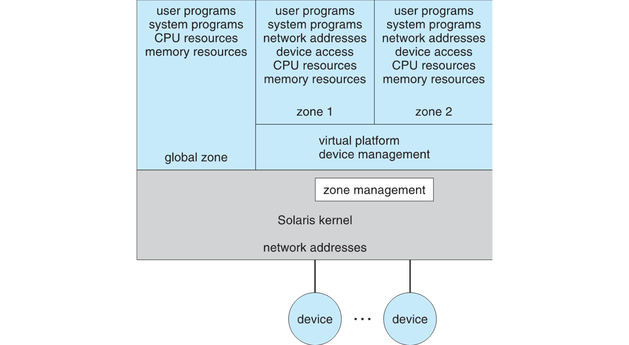
Solaris 10 with Two Zones

Slide 36
Virtualization and Operating-System Components
Now look at operating system aspects of virtualization
C P U scheduling, memory management, I/O, storage, and unique V M migration feature
How do V M Ms schedule C P U use when guests believe they have dedicated C P Us?
How can memory management work when many guests require large amounts of memory?

Slide 37
O S Component – C P U Scheduling 1
Even single-C P U systems act like multiprocessor ones when virtualized
One or more virtual C P Us per guest
Generally V M M has one or more physical C P Us and number of threads to run on them
Guests configured with certain number of V C P Us
Can be adjusted throughout life of V M
When enough C P Us for all guests -> V M M can allocate dedicated C P Us, each guest much like native operating system managing its C P Us
Usually not enough C P Us -> C P U overcommitment
V M M can use standard scheduling algorithms to put threads on C P Us
Some add fairness aspect

Slide 38
O S Component – C P U Scheduling 2
Cycle stealing by V M M and oversubscription of C P Us means guests don’t get C P U cycles they expect
Consider timesharing scheduler in a guest trying to schedule 100ms time slices -> each may take 100ms, 1 second, or longer
Poor response times for users of guest
Time-of-day clocks incorrect
Some V M Ms provide application to run in each guest to fix time-of-day and provide other integration features

Slide 39
O S Component – Memory Management
Also suffers from oversubscription -> requires extra management efficiency from V M M
For example, V Mware E S X guests have a configured amount of physical memory, then E S X uses 3 methods of memory management
Double-paging, in which the guest page table indicates a page is in a physical frame but the V M M moves some of those pages to backing store
Install a pseudo-device driver in each guest (it looks like a device driver to the guest kernel but really just adds kernel-mode code to the guest)
Balloon memory manager communicates with V M M and is told to allocate or deallocate memory to decrease or increase physical memory use of guest, causing guest O S to free or have more memory available
Deduplication by V M M determining if same page loaded more than once, memory mapping the same page into multiple guests

Slide 40
O S Component – I/O 1
Easier for V M Ms to integrate with guests because I/O has lots of variation
Already somewhat segregated / flexible via device drivers
V M M can provide new devices and device drivers
But overall I/O is complicated for V M Ms
Many short paths for I/O in standard OSes for improved performance
Less hypervisor needs to do for I/O for guests, the better
Possibilities include direct device access, D M A pass-through, direct interrupt delivery
Again, H W support needed for these

Slide 41
O S Component – I/O 2
Networking also complex as V M M and guests all need network access
V M M can bridge guest to network (allowing direct access)
And / or provide network address translation (N A T)
N A T address local to machine on which guest is running, V M M provides address translation to guest to hide its address

Slide 42
O S Component – Storage Management
Both boot disk and general data access need be provided by V M M
Need to support potentially dozens of guests per V M M (so standard disk partitioning not sufficient)
Type 1 – storage guest root disks and config information within file system provided by V M M as a disk image
Type 2 – store as files in file system provided by host O S
Duplicate file -> create new guest
Move file to another system -> move guest
Physical-to-virtual (P-to-V) convert native disk blocks into V M M format
Virtual-to-physical (V-to-P) convert from virtual format to native or disk format
V M M also needs to provide access to network attached storage (just networking) and other disk images, disk partitions, disks, etc

Slide 43
O S Component – Live Migration
Taking advantage of V M M features leads to new functionality not found on general operating systems such as live migration
Running guest can be moved between systems, without interrupting user access to the guest or its apps
Very useful for resource management, maintenance downtime windows, etc
The source V M M establishes a connection with the target V M M
The target creates a new guest by creating a new V C P U, etc
The source sends all read-only guest memory pages to the target
The source sends all read-write pages to the target, marking them as clean
The source repeats step 4, as during that step some pages were probably modified by the guest and are now dirty
When cycle of steps 4 and 5 becomes very short, source V M M freezes guest, sends V C P U’s final state, sends other state details, sends final dirty pages, and tells target to start running the guest
Once target acknowledges that guest running, source terminates guest

Slide 44
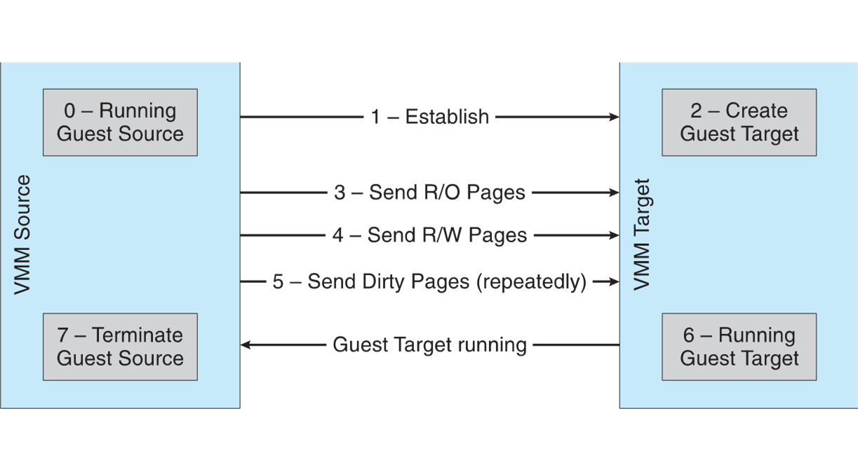
Live Migration of Guest Between Servers

Slide 45
Examples - V Mware
V Mware Workstation runs on x86, provides V M M for guests
Runs as application on other native, installed host operating system -> Type 2
Lots of guests possible, including Windows, Linux, etc all runnable concurrently (as resources allow)
Virtualization layer abstracts underlying H W, providing guest with is own virtual C P Us, memory, disk drives, network interfaces, etc
Physical disks can be provided to guests, or virtual physical disks (just files within host file system)

Slide 46
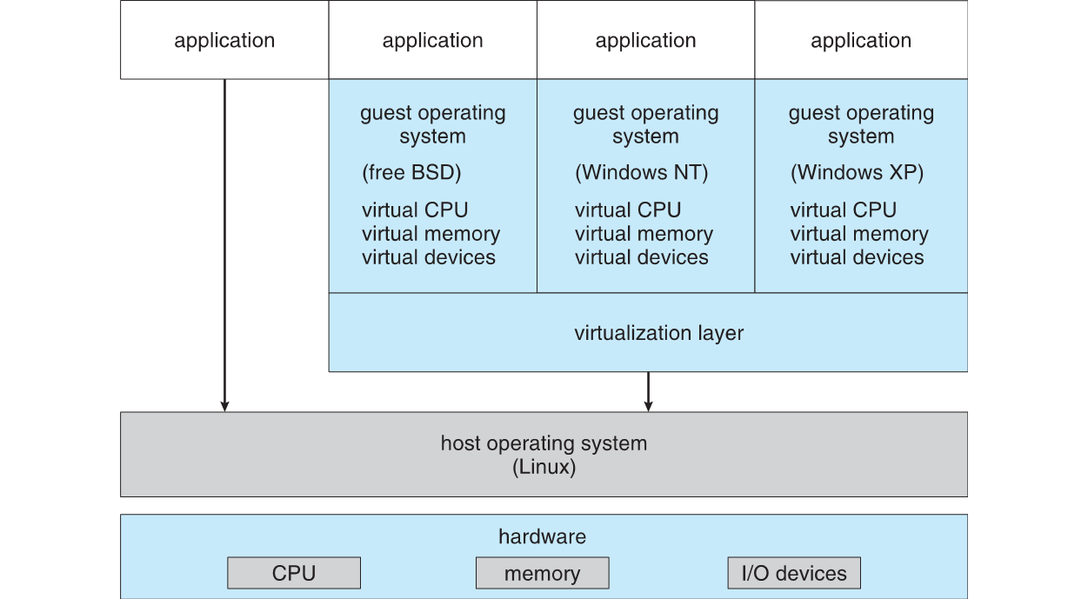
V Mware Workstation Architecture

Slide 47
Examples – Java Virtual Machine
Example of programming-environment virtualization
Very popular language / application environment invented by Sun Microsystems in 19 95
Write once, run anywhere
Includes language specification (Java), A P I library, Java virtual machine (J V M)
Java objects specified by class construct, Java program is one or more objects
Each Java object compiled into architecture-neutral bytecode output (.class) which J V M class loader loads
J V M compiled per architecture, reads bytecode and executes
Includes garbage collection to reclaim memory no longer in use
Made faster by just-in-time (J I T) compiler that turns bytecodes into native code and caches them

Slide 48
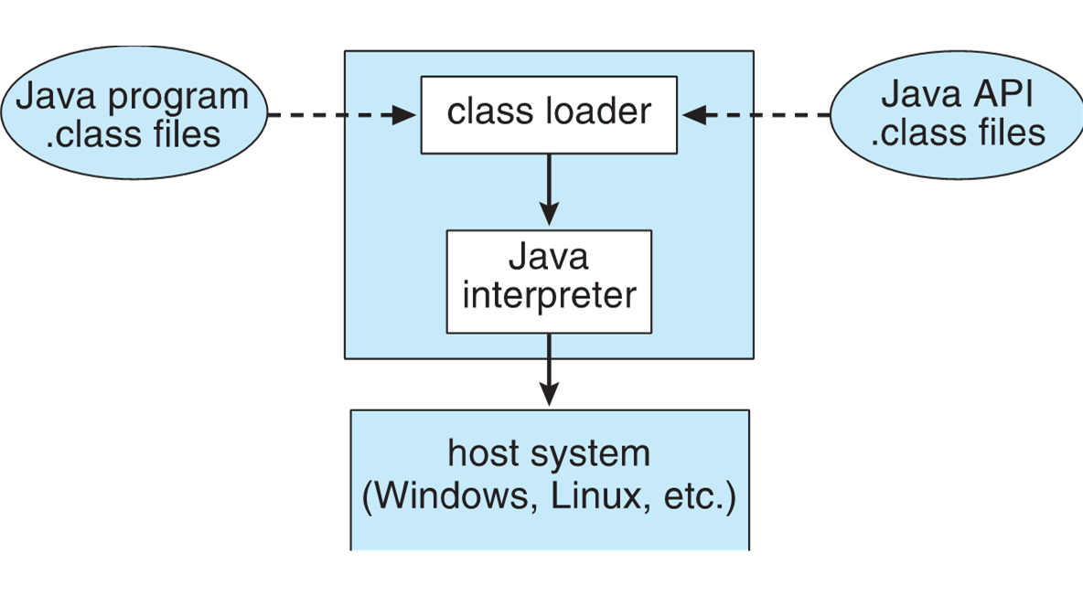
The Java Virtual Machine

Slide 49
Virtualization Research 1
Very popular technology with active research
Driven by uses such as server consolidation
Unikernels, built on library operating systems
Aim to improve efficiency and security
Specialized machine images using one address space, shrinking attack surface and resource footprint of deployed applications
In essence, compile application, libraries called, and used kernel services into single binary that runs in a virtual environment
Better control of processes available via projects like Quest-V
Real time execution and fault tolerance via virtualization instructions
Partitioning hypervisors partition physical resources amongst guests, fully-committing all resources (rather than overcommitting)
For example a Linux system that lacks real-time capabilities for safety- and security-critical tasks can be extended with a lightweight real-time O S running in its own V M

Slide 50
Virtualization Research 2
Separation hypervisors like Quest-V, each task runs in a virtual machine
Hypervisor initializes system and starts tasks but not involved in continuing operation
Each V M has its own resources the task manages
Tasks can be real time and more secure
Other examples are Xtratum, Siemens Jailhouse
Can build chip-level distributed system
Secure shared memory channels implemented via extended page tables for inter-task communication
Project targets include robotics, self-driving cars, Internet of Things

Slide 51
Copyright
Copyright © 2020 John Wiley & Sons, Inc.
All rights reserved. Reproduction or translation of this work beyond that permitted in Section 117 of the 1976 United States Act without the express written permission of the copyright owner is unlawful. Request for further information should be addressed to the Permissions Department, John Wiley & Sons, Inc. The purchaser may make back-up copies for his/her own use only and not for distribution or resale. The Publisher assumes no responsibility for errors, omissions, or damages, caused by the use of these programs or from the use of the information contained herein.

