Slide 1
Objective
Desiging a digital signal processor based system, operating in real-time, that can classify the lung sounds into two classes: healthy and pathological.

Slide 2
Motivation
Conventional stethoscopes selectively amplify of attenuate sounds within the spectrum of clinical interest.
Amplification tends to occur below 112 Hz and attenuation at higher frequencies.
Auscultation with a stethoscope is a subjective process that depends on the individual’s own hearing, experience and ability to differentiate between different sound patterns.
The procedure of electronic auscultation is neither invasive nor particularly expensive, so it would be suitable as an examination method for high-risk groups such as critical care patients, pregnant women and children (no X-ray).

Slide 3
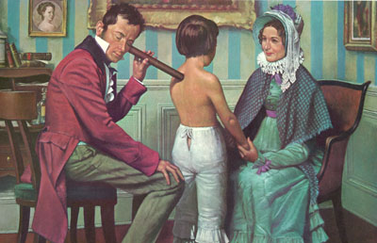
Historical Background
Before the invention of the stethoscope, lung sounds were detected
by direct placement of ear upon the chest. But this was impractical
if the patient was a young woman or obese.
All these factors led to the invention of the first stethoscope by the
French physician René Laënnec in 1816.
Laënnec while examining a young boy

Slide 4
BREATH SOUNDS
Normal Breath Sounds:
a) Normal Lung Sounds.
b) Normal Tracheal Sounds.
Abnormal Breath Sounds:
  a) Absent or reduced intensity breath sounds.
  b) Adventitious breath sounds, those additional sounds not
  normally present, are defined as either:
  i. continuous (wheezing if high pitched rhonchi if low pitched)
ii. discontinuous (fine crackles if high pitched,
coarse crackles if low pitched)

Slide 5
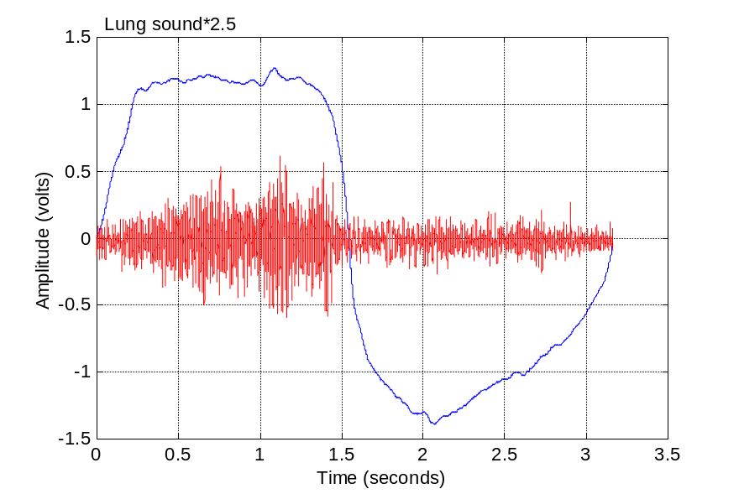

Normal Lung Sounds
Generated due to air turbulence in
the airways of the lungs.
Ttransmitted to the skin, after being
filtered by the lungs and the chest
wall, which act acoustically as
a low-pass filter.
Therefore, the nominal lung sounds
have their main frequency band up
to 200-250 Hz.

Slide 6
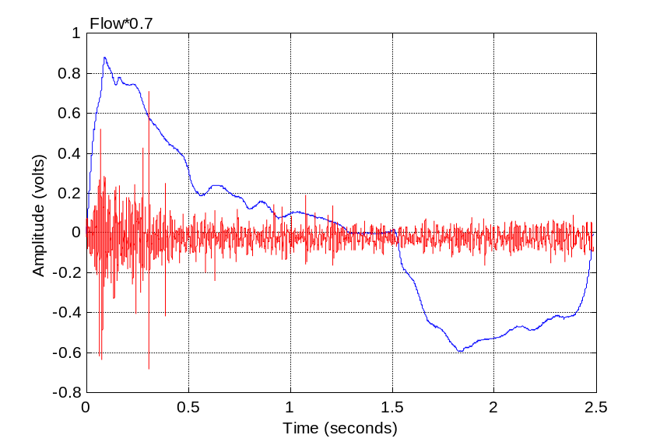
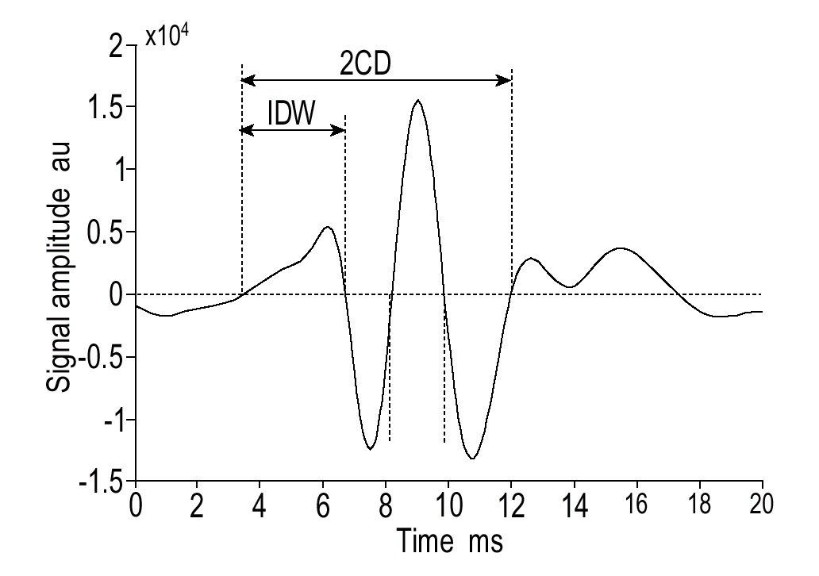
Crackles
Crackles are discontinuous lung sounds, explosive & transient in
character and occur frequently in cardiorespiratory diseases.
Their duration is less than 20 ms, and their frequency content typically
is wide, ranging from 100 to 2000 Hz or even higher.
It is assumed that the explosive opening of small airways, previously
held closed, causes these sounds.

Slide 7
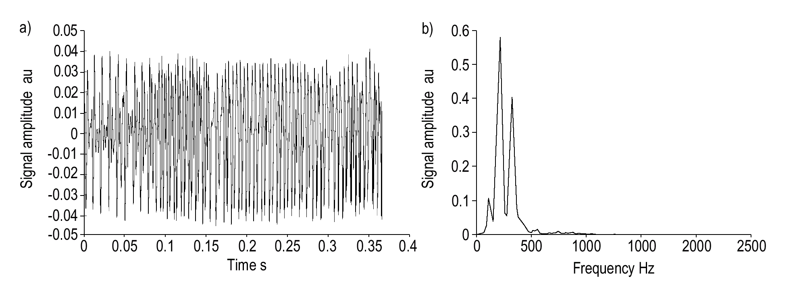
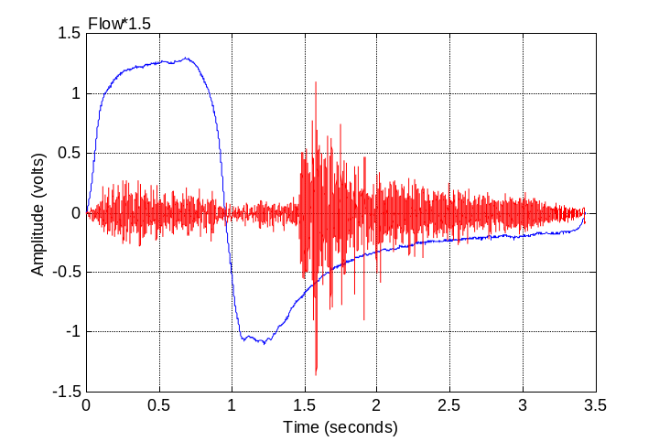
Wheezes
Wheezes are pseudoperiodic musical adventitious lung sounds.
Produced by fluttering of the airways, where the oscillations begin when
the airflow velocity reaches a critical value, called flutter velocity.
The dominant frequency and duration of a wheeze are usually greater than
100 Hz and 100 ms, respectively.
Its waveform resembles that of a sinusoidal sound → Sharp peak in the
frequency domain.

Slide 8
Modeling the Source of Lung Sounds
1. Periodic impulse describes the wheezes & rhonchus sources (periodic oscillations of the air and airway walls).
2. Random intermittent impulse describes the crackle sources (produced by opening/closing of airways or bubbling of air).
3. White non Gaussian noise describes the breath sound sources (produced by turbulent flow).
Lung Sound Source
Random Inter-
Mittent Impulse
Periodic
Impulse
White non-Gaussian Noise
Crackles
Wheezes
Breath Sounds
+

Slide 9
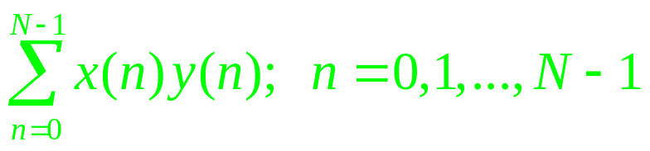
DIGITAL SIGNAL PROCESSOR ARCHITECTURE
DSP is a programmable special-purpose chip that is designed to take
a stream of digital data and perform complex signal processing algorithms.
The repetitive nature of the common signal processing routines are
taken into account in the architecture of a DSP.
The repetitive multiply-and-accumulate (MAC) operation is one of the
most common operations encountered in signal processing algorithms:
DSPs have dedicated hardware multipliers that perform the multiplication
of two data words within one clock cycle.

Slide 10
The memory space found in DSPs is separated into a data memory and
a program memory, each with dedicated address calculation circuitry
(Harvard architecture).
Program
Memory
Data Bus
CPU
Data Bus
Data
Memory
Address
Bus
Address
Bus
DSPs support circular addressing mode, which is used in algorithms that
require the sequential accessing of limited amount of data over and over.
Buffer Start
1
.
.
.
0
. . . . .
N-1
Buffer End
N-2
Memory Array

Slide 11
DSPs support pipelining of the instruction set so that more than one instruction
can be started at the same time in parallel.
X Data Bus
Y Data Bus
X
Mem.
Y
Mem.
N bits
N bits
Address
Calculation
Hardware
Multiplier
2N bits
Loop
Hardware
Program Memroy
Accumulator & ALU
Input
Registers
Shifter &
Output
Advanced DSPs include hardware loop units that provide loop counter (LC) and
loop end address (LA) registers through which it is possible to perform iterative
loops with low overhead.

Slide 12
Fixed-point and Floating-point DSPs
Based on how the they interpret numbers, DSPs can be categorized into two types: Fixed-point and floating-point DSPs.
Fixed-point DSPs treat the numbers as fractions in the range [-1,1).
In floating point DSPs they are expressed through the use of a mantissa and an exponent.
Since floating-point DSPs have wider dynamic range and there is no need for scaling, their programming is easier (catheter signal processing, magnetic resonance imaging (MRI) and computed tomography (CT) )
Fixed-point DSPs tend to be faster and cheaper, but their programming is harder (pixel processing applications such as X-ray, ultrasound).

Slide 13
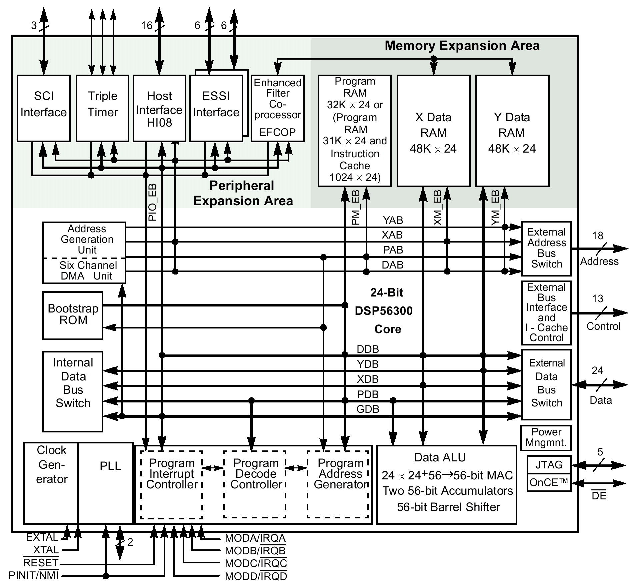
Motorola 56311 fixed-point DSP
Large on-chip RAM memory
of 128K 24-bit words
Includes a general-purpose
fully programmable
Enhanced Filter Coprocessor
(EFCOP)

Slide 14
Fractional Data Representation
A fraction satisfies the inequality: 0≤magnitude(fraction)<1.
. . . . . . . .
S
B₂₂
B₂₁
B₂₀
B₂
B₁
B₀
Sign
bit
The implied
binary point
The word values representable in DSP56311 should be in the range:
-1.0 ≤ data ≤ 0.9999998
Fixed-point arithmetic increases the possibility of overflow when the value exceeds the available dynamic range.
The expected worst case, resulting from the implementation of an algorithm, should be taken into account and the appropriate scaling should be applied where necessary.

Slide 15
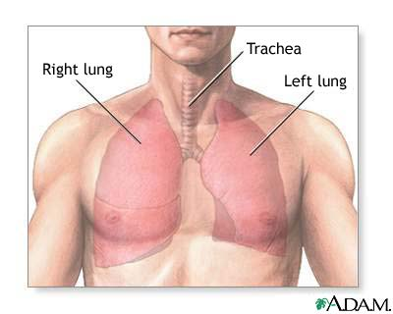
Block Diagram of System Hardware
MICROPHONE
FLOWMETER
AMPLIFIER & BANDPASS FILTER (80-2kHz)
AMPLIFIER & LOWPASS FILTER (50Hz)
A/D CONVERTER
DIGITAL SIGNAL PROCESSOR
POWER
AMPLIFIER
LCD
DISPLAY

Slide 16
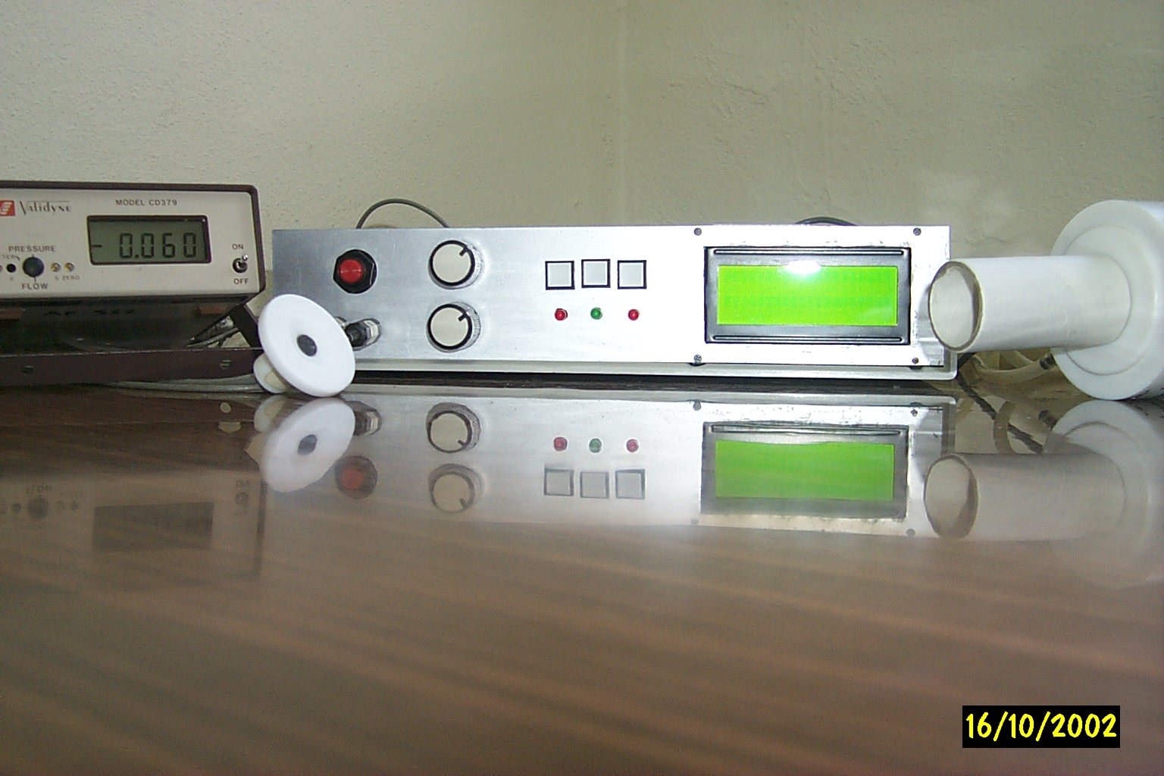
The respiratory sound classification system.
Select
Menu
Restart
LCD
Flowmeter
Microphone
Contrast
Volume

Slide 17
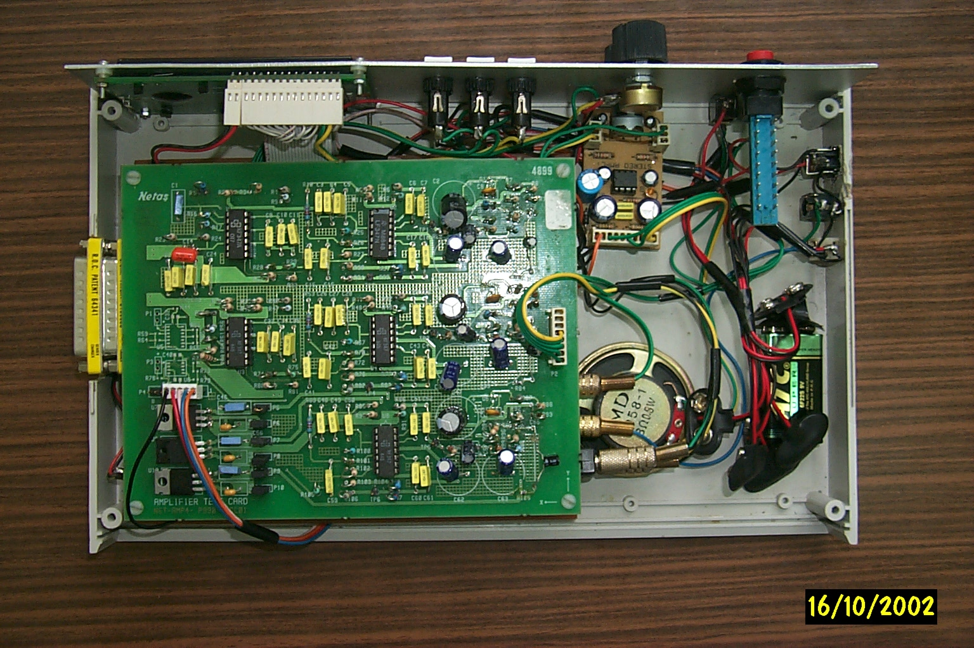
The internal structure of the Instrument
Power Amp.
Amplifier Card
(upper floor)
DSP56311 EVM
(lower floor)

Slide 18
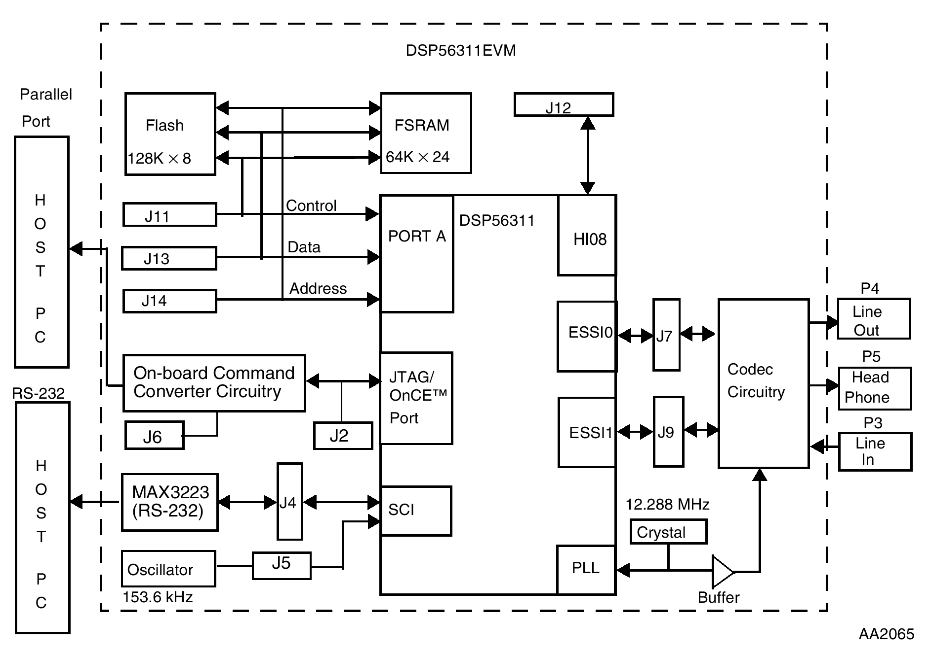
DSP56311 Evaluation Module
This module includes:
DSP56311 24-bit DSP,
64Kx24-bit FSRAM,
128Kx8-bit flash mem.,
16-bit CODEC,
command converter.

Slide 19
Functional block diagram of the system
Record Lung Sound
Power Amplifier
Amplification
& Filtering
& ADC
DIGITAL FIR FILTERING (optional)
Cycle
Labeling &
Segmentation
Flowmeter
Microphone
Itakura distance
Windowing &
Autocorr.
Euclidean distance
LPC Feature
Extraction
(Levinson-Durbin)
City block
distance
Mahalanobis
distance
Minimum
Distance
Decision
(Healthy or
Pathological)
k-nearest
neighbor
Majority
Voting

Slide 20
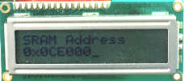
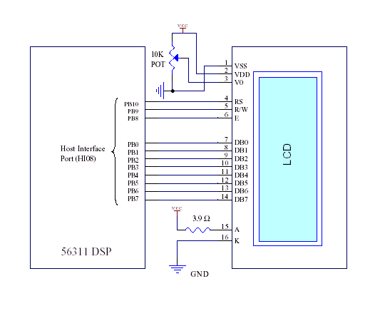
Displaying Messages on The LCD
‘4linex20 character’ LCD was used for displaying the menu options, diagnosis result and other messages that convey information regarding the current state of the system.
An initialization routine is used to set the interface length used to communicate with the LCD, the behavior and position of the cursor..
The control and data lines of the LCD were connected to the Host Interface of the DSP configured in the general purpose input/output mode.

Slide 21
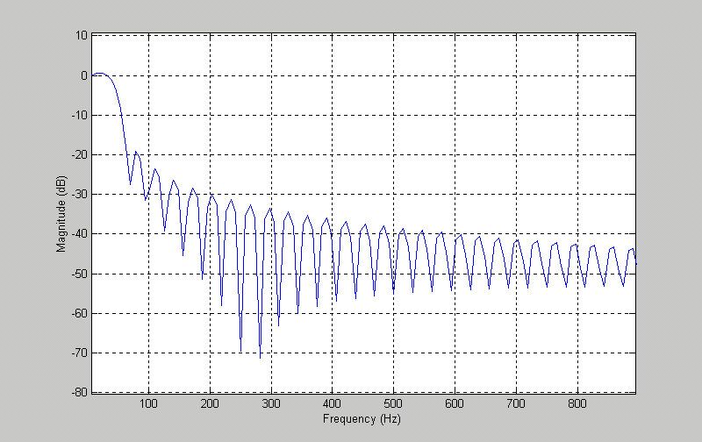
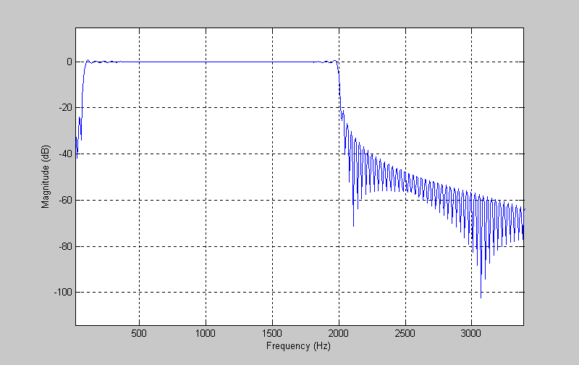
FIR Filtering
Digital FIR filtering capability was added to this device. These filters can be applied or removed as desired.
The Enhanced Filter Coprocessor (EFCOP) module found on the 56311 DSP was used to do the FIR filtering process
The coefficients for both of the designed filters were obtained using the Filter Design and Analysis Tool of Matlab 6.0 at a sampling frequency of 8kHz and using the windowing (boxcar) method
Frequency response of the lowpass filter
(50 Hz)
Frequency response of the bandpass filter
(80-2 kHz)

Slide 22
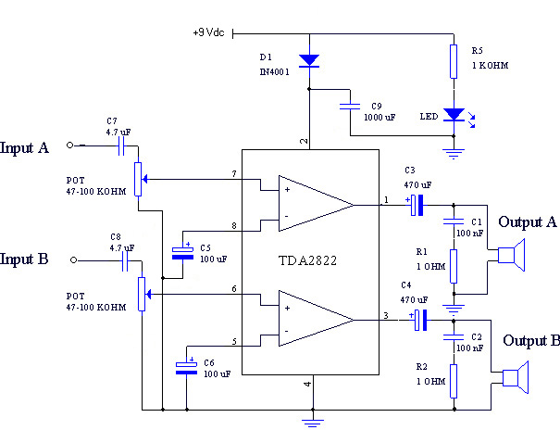
Recording and Listening to the Lung Sound
The ability to record a total of 64k lung sound samples (16 seconds) to the external fast static RAM found on the DSP56311 EVM.
The user may also choose to listen to this recorded sound later through a speaker/headphone added to the instrument.
A stereo 2x5 Watt audio amplifier kit was used to bring the output signal of the instrument up to a suitable level to drive the speaker/headphone

Slide 23
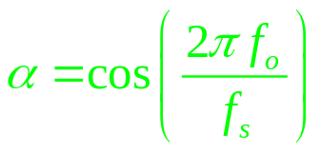
Digital Sine Wave Generator
A digital sine wave oscillator was used to generate a beep sound that indicates the starting and ending time of some system functions
Employs the idea of positive feedback that satisfies the following difference equation:
Z⁻¹
y
Z⁻¹
x
α
-1
+
Oscillator
output

Slide 24
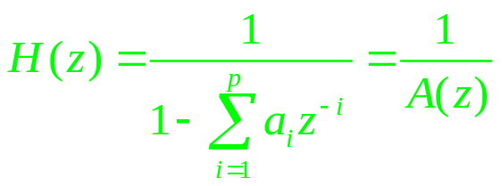
AUTOREGRESSIVE MODELING OF RESPIRATORY SOUNDS USING DSP
The lung sounds are assumed to be the input of an all-pole filter that models the transmission of these sounds through the parenchyma and chest wall.
Heart Sounds
Muscle & Skin Noise
Source of Lung Sounds
+
All-pole
Filter
+
Recorded Lung Sounds
Instrumentation Noise
The problem of linear prediction becomes determining the coefficients a_{k} that minimize the mean-squared prediction error over a short segment

Slide 25
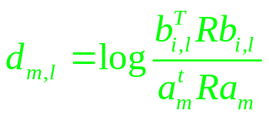


K-nearest neighbor Classifier
Healthy
Pathological
V₁
V₅
V₁₁
Vector to be classified
Itakura Metric:
Euclidean Metric:
City-block Metric:
b_{i,l} and a_{m} denote the LPC coefficients of the lth reference pattern of the ith class and the mth test pattern, respectively

Slide 26

Minimum Distance Classifier
Decision Boundary
x₂
ℜ₁
ℜ₂
d₁
Feature Vector x
d₂
μ₁
μ₂
x₁
Mahalanobis Metric:
Here β_{i} is the estimated mean feature vector and W_{i} is the ith class covariance matrix
Each class requires the storage of 6 inverse covariance matrices and six mean feature vectors, each one corresponding to one of the respiratory sub-phases.

Slide 27
% 40
Expiration
% 30
% 30
% 30
% 40
% 30
Inspiration
Early
Expiration
Mid
Expiration
Late
Expiration
Early Inspiration
Mid
Inspiration
Late
Inspiration
1,2,3,..........,10
21,22,.........,30
31,32,.........,40
51,52,.........,60
11,12,.........,20
41,42,........,50

Slide 28
Window+Autocorr+LPC of all the 60 segments
Classification with k-NN
Get the sample to be classified
segment in early insp. sub-phase?
segment in mid insp. sub-phase?
No
No
Segment belongs to late exp. sub-phase
.....…..........
Yes
Yes
Find the
k-NN
Find the
k-NN
Find the
k-NN
Reference library for early insp. sub-phase.
Reference library for mid insp. sub-phase.
...................
Reference library for late exp. sub-phase.
.....…..........
Classify the current segment according to the majority voting.
Finished all the 60 segments?
Classify the whole respiratory cycle
No
Yes

Slide 29
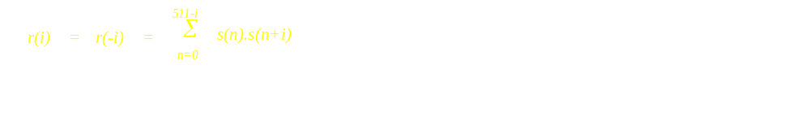

Calculating the Autocorrelation Coefficients
Since each autocorrelation value requires a relatively large amount of
multiplications and additions, there is a risk of getting an overflow
Benefit from the fact that the maximum autocorrelation value will occur at lag zero:
Normalize the autocorrelation coefficients of each frame by r(0)

Slide 30
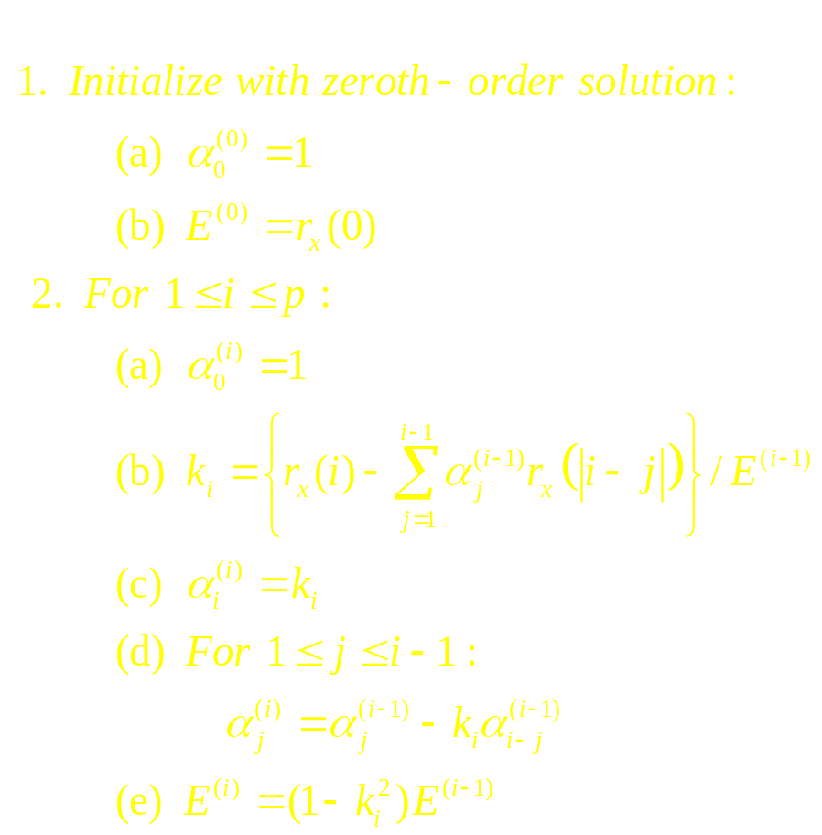
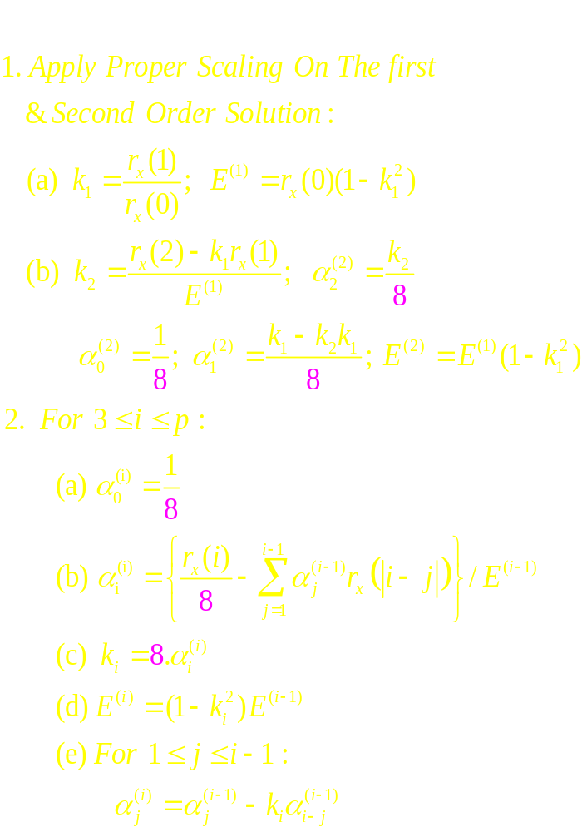
Fixed point implementation of Levinson-Durbin Algorithm
The calculated LPC coefficients are not guaranteed to be in the range [-1,+1).
Proper scaling should be applied where necessary in order to prevent internal overflows.
Simulation results showed that a scale down value of 1/8 is adequate to represent the LPC coefficients in the fractional number format without overflow.

Slide 31
Classification Results (Leave-One-Out)
21 non-smoking male subjects.
21 patients having various restrictive and obstructive respiratory diseases.
Classifier Name | Distance Measure | Sensivity (%) | Specifity (%) | Accuracy (%)
K-nearest neighbor | Itakura | 100 | 95.24 | 97.62
 | Euclidean | 52.38 | 100 | 76.19
 | City-block | 52.38 | 100 | 76.19
Minimum Distance | Mahalanobis | 57.14 | 61.9 | 59.52

Slide 32
Classification Results (Online)
11 non-smoking male subjects (1 female, 10 male)
9 patients having various restrictive or/and obstructive respiratory diseases (4 female, 5 male)
Classifier Name | Distance Measure | Sensivity (%) | Specifity (%) | Accuracy (%)
K-nearest neighbor | Itakura | 100 | 72.73 | 85
 | Euclidean | 88.89 | 90.91 | 90
 | City-block | 100 | 90.96 | 95

