Slide 1


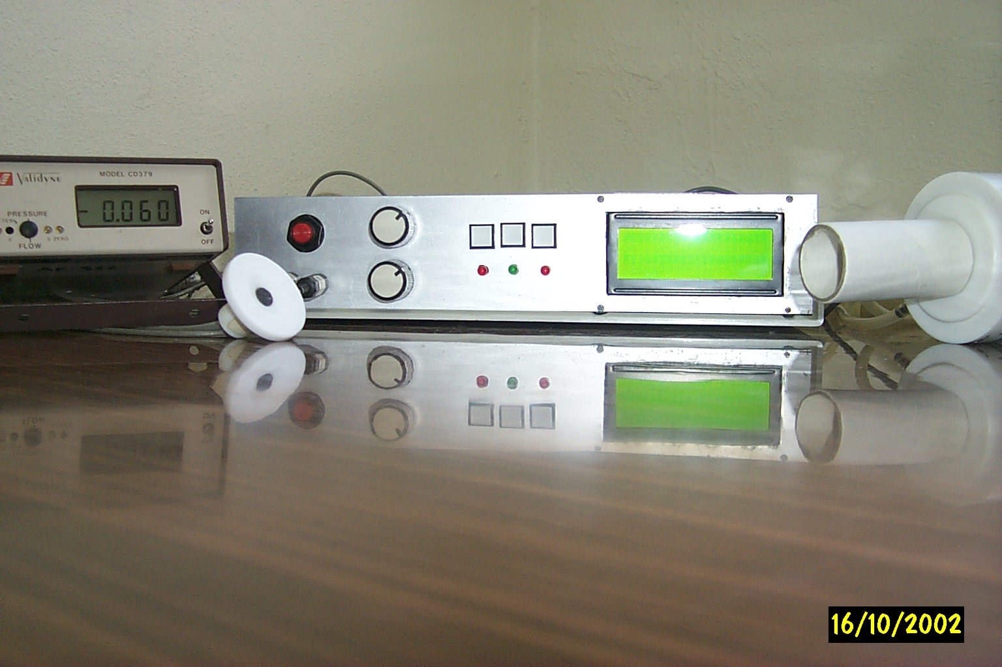
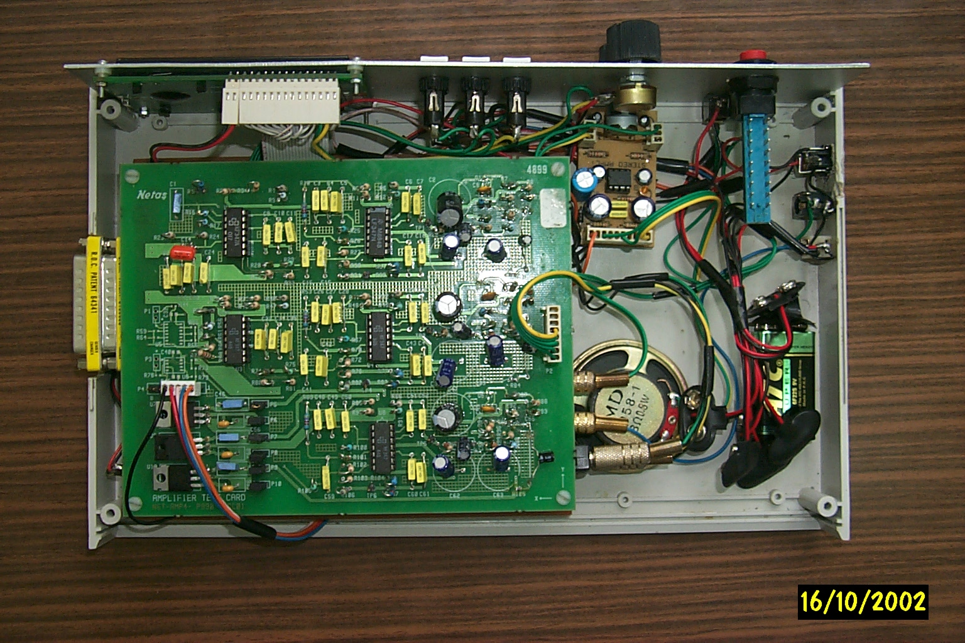
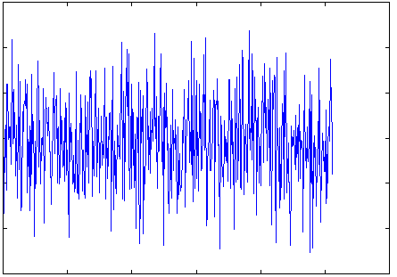
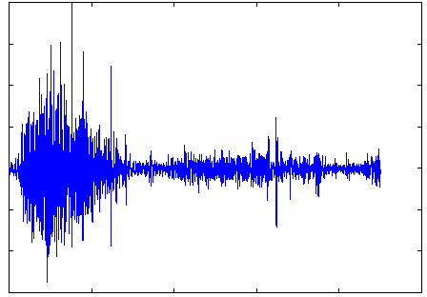
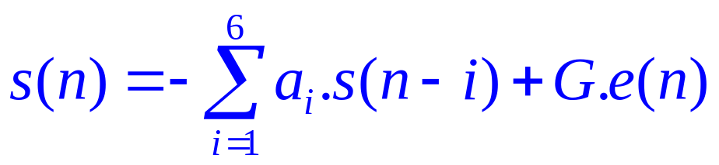

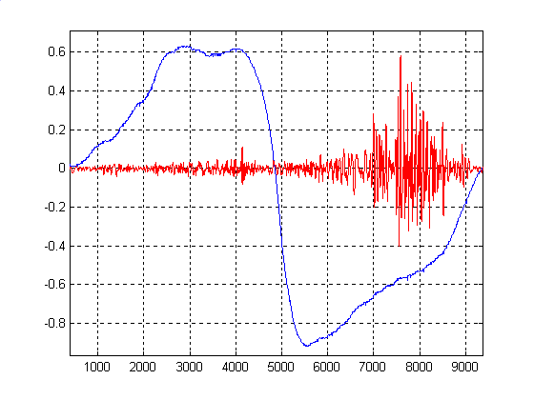
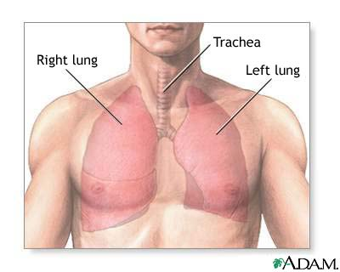
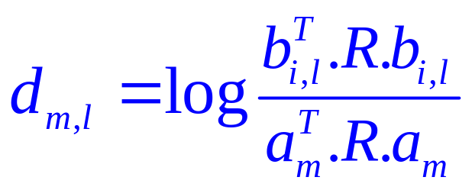

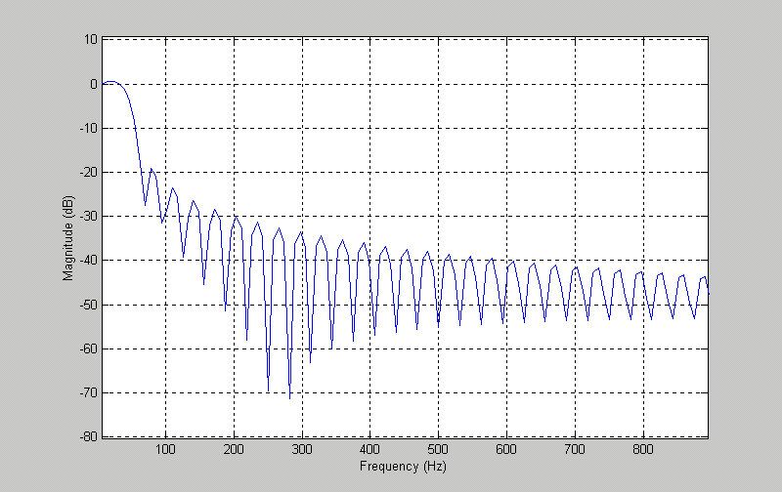
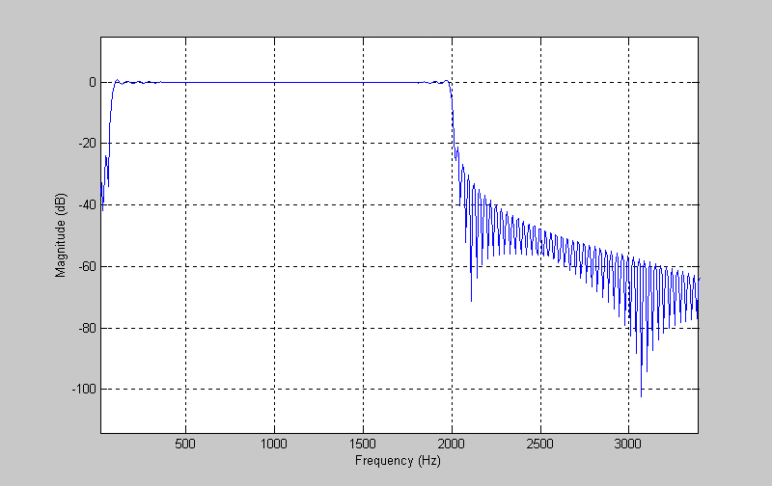
ONLINE CLASSIFICATION OF LUNG SOUNDS
USING DSP
Yasemin P. Kahya¹, Sameer Alsmadi²
¹Department of Electrical and Electronics Engineering, ²Biomedical Engineering Institute, Bogazici University, Bebek 80815, Istanbul-Turkey
ABSTRACT
Select
G
1-a₁z⁻¹- a₂z⁻² …-a₆z⁻⁶
In this work a real-time diagnosis system, based on Motorola’s 56311 Digital Signal Processor (DSP) , is used for the classification of lung sounds into two classes: healthy and pathological. The instrument has two inputs the first of which is from a microphone placed on the chest of the patient while the other is from a flowmeter that is used to label the lung sounds as belonging to the inspiration or expiration phase. The sampled lung sound of a full respiration cycle is divided into 6 sub-phases with the help of the flowmeter signal, and each sub-phase is divided further into 10 overlapping segments. Each segment is modeled by an Auto Regressive (AR) model of order 6 by means of the Levinson-Durbin algorithm. The classification process is done using two classifiers: k-Nearest Neighbor (k-NN) classifier with Itakura and Euclidean distance measures, and Minimum distance classifier with the Mahalanobis distance measure. The software was written entirely in assembly language and the result of the classification process is displayed on a character display (LCD) .
Menu
Restart
LCD
Flowmeter
White noise
Transfer Function of The
Respiratory System
Lung Sound
Microphone
which the respiratory sounds are regarded as the response of this filter when excited by white noise (Fig. 9). Thus, a lung sound sample s(n) can be estimated as a linear combination of previous lung sound samples according to the following difference equation:
Contrast
Volume
Figure 2 The Respiratory Sound Classification System
Figure 3 The Internal Structure of The System
Amplification
& filtering
&ADC
cycle
Labeling &
Segmentation
Figure 7 The respiratory sound waveforms with the corresponding flow signal recorded simultaneously from a pathological lung. The system is able to detect the starting and ending time of the resiratory cycle to be used in the classification process. As soon as this cycle is detected, the system starts recording the respiratory sound and the corresponding flow signal.
Where a_{i} is the ith filter coefficient, G is the filter gain, e(n) is the excitation input. The efficient Levinson-Durbin algorithm was employed to find the LPC coefficients for each of the 60 segments.
Flow
DIGITAL FIR FILTERING
Lung
Sound
The k-nearest-neighbor (k-nn) and the minimum distance classifiers were used for the classification process. A simple majority voting algorithm was used to determine the class of each segment. A k value of 5 was chosen. 5-nn was applied to each segment in the six respiration phases. The votes of both classes were added and the class with the maximum number of votes was chosen as the classification result of the whole respiration cycle.
Sound
METHODOLOGY
Itakura distance
measure
Windowing &
Autocorrelation
Healthy
Pathological
Euclidean
distance measure
LPC Feature
Extraction
(Levinson-Durbin)
Flow
Signal
Mahalanobis
distance measure
Vector to be classified
MICROPHONE
FLOWMETER
Figure 10 The ‘5-nearest neighbour’
classifier
Minimum
Distance
Decision
(Healthy or
Pathological)
% 30
% 40
% 30
Expiration
K-nn was based on the Itakura distance measure, which is defined as:
k-nearest
neighbour
Majority
Voting
Inspiration
% 30
% 40
% 30
AMPLIFIER & BANDPASS FILTER (80-2kHz)
AMPLIFIER & LOWPASS FILTER (50Hz)
Figure 4 Functional Block Diagram of The System
where a_{m} is the LPC vector identified from the m.th test segment, b_{i,l} is the lth reference LPC vector of the ith class and R is the autocorrelation matrix. The Mahalanobis distance measure used with the minimum distance classifer is defined as:
Three push-buttons, connected to the external interrupt lines of the DSP (Menu, Select and Retest buttons), are used to select the desired classifier type and the distance measure to be used in the diagnosis process. The device also supports the ability of recording a total of 16 seconds of lung sound. The user may choose to listen to this recorded sound by selecting the appropriate menu item and pressing the same push-buttons. The user may also choose to apply or remove digital filters on both of the lung and flow signals
Early
Expiration
Mid
Expiration
Late
Expiration
A/D CONVERTER
Early
Inspiration
Mid
Inspiration
Late
Inspiration
where β_{m}^{(x)} the feature vector of the segment to be classified, β_{i} is the estimated mean feature vector and W_{i} is the ith class covariance matrix.
DIGITAL SIGNAL PROCESSOR
1,2,3,..........,10
11,12,.........,20
21,22,.........,30
31,32,.........,40
41,42,........,50
51,52,.........,60
CONCLUSION
High speed DSPs are making it possible to apply complex signal processing algorithms on respiratory sounds in real time. In this study, a real time DSP based system was designed for the classification of lung sounds as belonging to only two classes and very encouraging results were obtained. In a further study, the classification of three classes will be investigated. These are: restrictive, obstructive and healthy lung sounds.
ACKNOWLEDGMENT: This work was supported by Bogazici University Research Fund .
REFERENCES
[1] H. Pasterkamp, S.S. Kraman, G.R. Wodicka, “Respiratory Sounds Advances Beyond the Stethoscope,” Am J Respir Crit Care Med, vol. 156, pp. 974-987, 1997.
[2] DSP 56311 User’s Manual, DSP56311UM/D Revision 1.0, Motorola Inc., October 1999
[3] B. Sankur, Y. P. Kahya, E.Ç. Guler, and T. Engin, “Comparison of AR based algorithms for respiratory sound classification,” Comput Biol Med, vol. 23, No. 4, pp. 67 – 76, January 1994.
[4] P. Papamichalis, “Practical Approaches to Speech Coding,” Prentice Hall, New Jersey, pp. 113-124, 1987.
[5] A. Cohen, “Biomedical Signal Processing,” CRC Press, Florida, vol. 2, pp. 50-60, 1988
[6] M. Allerhand, “Knowledge-Based Speech Pattern Recognition,” Kogan Page, London, pp. 49-131, 1987.
POWER
AMPLIFIER
LCD
DISPLAY
Figure 8 The process of finding the ten 25% overlapping segments from each sub-phase of the stored full respiratory cycle, thus resulting in a total of 60 segments from which the LPC coefficients are going to be extracted and used in the classificationn process.
Figure 1 A simplified block diagram of the designed system. The lung sound is acquired using an electret air-coupled microphone attached to the posterior base of the lung and then is amplified with a low noise amplifier. Next, the lung sound is passed through an active bandpass filter having a flat frequency response between 80-2kHz. The flow signal is acquired by using a Fleisch type flowmeter. After that, it is passed through a lowpass filter having a cutoff frequency of 50 Hz. Both input channels were sampled at a sampling rate of 8 kHz but the sampling rate of the flow signal was reduced by decimation to 125 Hz.
Figure 5 Frequency response of a FIR low-pass filter with a cutoff frequency of 50 Hz (for the flow signal)
Figure 6 Frequency response of 256-coefficient bandpass FIR filter (for the lung sound)
MODELING AND CLASSIFICATION OF
RESPIRATORY SOUNDS
The coefficients for both of the designed filters were obtained using the Filter Design and Analysis Tool of Matlab 6.0 with the windowing (boxcar) method.
The respiratory system can be modeled by an all pole filter of order 6, in
LUNG ACOUSTICS LABORATORY

