Slide 1

SEMANTIC SEARCH
Semantic Search in Java
PostgreSQL + pgvector without a separate vector database
Krzysztof Kozłowski
Notes:
Topic: semantic search in Java with PostgreSQL and pgvector.

Slide 2
STARTING POINT
The question we are answering
How do you find a document when the user uses different words than the author?
User query
Document content
“the application has too few
database connections”
“HikariCP configuration
and pool exhaustion”
meaning
Semantic search should recognize that these two texts describe the same problem.

Slide 3
TWO DIFFERENT SIGNALS
Keyword search vs semantic search
Keywords find matches. Embeddings find similarity in meaning.
Keyword search | Semantic search
ILIKE / FTS | vector + distance metric
“HikariCP” must appear in the text | the model links “connection pool” to HikariCP
great for names, codes, and phrases | good for questions and paraphrases
Use them together when both and precision and meaning matter.

Slide 4
REPRESENTING MEANING
Embeddings
The model turns text into a point in numerical space.
model
embedding
[0.021, -0.143,
0.761, …, 0.118]
„HikariCP and the JDBC connection pool”
An embedding is numerical representation meaning data — for example, text, an image or audio —
in the form a vector of numbers.
For example model embedding can turn words into something like this:
"pies" → [0.12, 0.84, -0.31, ...]
"puppy" → [0.15, 0.79, -0.28, ...]
"car" → [-0.72, 0.11, 0.63, ...]

Slide 5
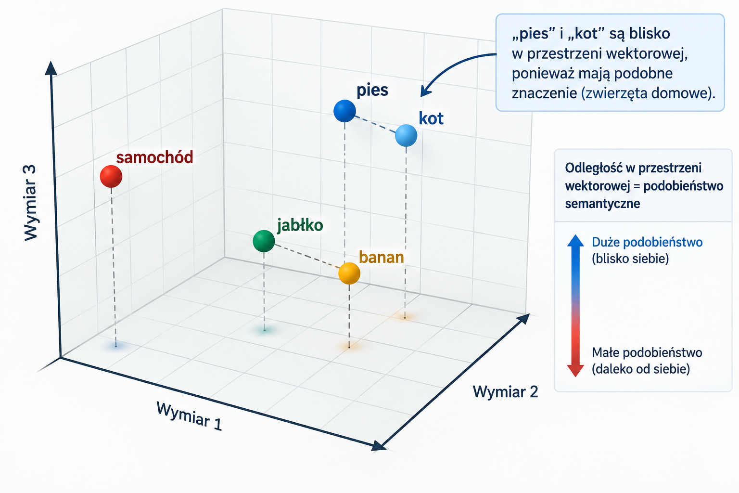
Embeddings
Similar meaning are close to each other in space vector space.

Slide 6
FROM TEXT TO RESULTS
Solution architecture
pgvector does not generate embeddings. It stores, indexes, and compares vectors.
document text
or query
BGE-M3
local service
embedding
float[]
PostgreSQL
+ pgvector
BGE-M3 to model embedding created by BAAI (Beijing Academy of Artificial Intelligence). Its job includes turning text into embedding
pgvector = an extension of PostgreSQL that enables storing embeddings and searching data into similarity semantic
Java connects these elements in one application flow.
GET /search?q=pool+problem
↓
EmbeddingService → SQL → top K
article(
title TEXT,
content TEXT,
embedding VECTOR(1024)
)

Slide 7
MINIMAL CONFIGURATION
PostgreSQL + pgvector
CREATE EXTENSION IF NOT EXISTS vector;
CREATE TABLE article (
id BIGSERIAL PRIMARY KEY,
title TEXT NOT NULL,
content TEXT NOT NULL,
category TEXT NOT NULL,
embedding VECTOR(1024),
search_tsv TSVECTOR
);
What we get in one data model
text and relationships in PostgreSQL
a vector column next to domain data
SQL for filtering and ranking
one backup, monitoring, and deployment process
The column of type TSVECTOR is used in PostgreSQL for classic Full-Text Search (FTS).
PostgreSQL, among other things, splits text into tokens, removes some irrelevant words and reduces words to forms that make more effective them searching.
VECTOR(1024) must match the model dimension.

Slide 8
APPLICATION LAYER
Generating embeddings in Java
The key contract is small. You can replace the model later.
public interface EmbeddingClient {
float[] embed(String text);
}
@Service
class ArticleService {
public long create(CreateArticleRequest request) {
var textToEmbed = request.title() + "\n" + request.content();
var embedding = embeddingClient.embed(textToEmbed);
var article =
repository.save(
new ArticleEntity(request.title(), request.content(), request.category(), embedding));
return article.getId();
}
}
BGE-M3
local service
multilingual
Alternative: Spring AI + external API
The key distinction is: model ≠ vector database.

Slide 9
DISTANCE-BASED SEARCH
Similarity search in SQL
SELECT id, title, content,
embedding <=> :query_embedding AS distance
FROM article
WHERE category = :category
ORDER BY embedding <=> :query_embedding
LIMIT 5;
pgvector operators
<->
Euclidean distance
<#>
negative inner product
<=>
cosine distance
Euclidean distance measures physical distance between points in space.
Cosine distance focuses above all into angle between vectors, a does not into ich length
Negative inner product is negative product scalar two vectors. pgvector is the third popular metric alongside Euclidean and cosine distance.
With normalized vectors ranking by cosine and Euclidean is in practice equivalent
Use the same metric for the index and the query.

Slide 10
ONE QUERY, TWO WAYS TO SEARCH
Practical example
Query: “the application has too few database connections”
Keyword / ILIKE
Semantic search
WHERE content ILIKE '%database connections%'
ORDER BY embedding <=> :q
LIMIT 5
meaning
the result depends on the exact words
may return “HikariCP configuration”

Slide 11
ACCELERATING ANN SEARCH
HNSW
Without an index, PostgreSQL compares the query with every vector.
Exact search
query
HNSW
compare all
navigate a graph of similar points
HNSW = Hierarchical Navigable Small World
ANN: faster, but the result is approximate
Instead of comparing embedding the query with all embeddings in the database, HNSW builds a graph, along which which you can can quickly „navigate” toward toward the most similar vectors.
You can is compare it to finding an address:
country → city → district → street → building
instead of checking every building in Poland.
ANN (Approximate Nearest Neighbor) gives up the guarantee of finding the exact set nearest vectors in exchange for much faster searching.
Therefore „approximate” does not mean, that pgvector returns an approximate value of the embedding or distance. Approximate is the process of selecting candidates — the algorithm can does not find all actually nearest neighbors.

Slide 12
CONFIGURATION AND TRADE-OFF
HNSW index in pgvector
CREATE INDEX article_embedding_hnsw_idx
ON article
USING hnsw (embedding vector_cosine_ops);
What does the index change?
latency
decreases for large datasets
memory
the index takes space
build
building takes time
Exact search
ANN / HNSW
recall
the result may be approximate
full comparison
precision > cost
similarity graph
speed > accuracy
Choose the index for scale and quality requirements, not simply because you use embeddings.

Slide 13
THE BIGGEST ADVANTAGE OF ONE POSTGRESQL
Relational filters + vector search
SELECT id, title, content
FROM article
WHERE company_id = :companyId
AND status = 'PUBLISHED'
AND language = 'PL'
ORDER BY embedding <=> :q
LIMIT 10;
This is still SQL
tenant / company
status
language
publication time
Domain filters and similarity work in one query.
Less synchronization between systems. One place for auditing and access control.

Slide 14
A VECTOR DOES NOT REPLACE EVERYTHING
Full Text Search and hybrid search
FTS wins when the exact word matters. Vectors win when meaning matters.
Full Text Search
lexemes / ranking
hybrid
rank fusion
Vector Search
embedding / distance
Examples
class name, error number, exact phrase
question, paraphrase, problem description
final_score = 0.4 * fts_rank
+ 0.6 * semantic_score

Slide 15
CONTENT AND VECTOR MUST STAY TOGETHER
Updating embeddings
Changing `content` without recalculating the embedding creates an inconsistent record.
UPDATE article
SET content = :newContent
WHERE id = :id;
event / outbox
embedding worker
UPDATE
embedding
In practice, add
model version
Regeneration is a data process, not a one-time migration.
recalculation status
retry and idempotency

Slide 16
ARCHITECTURE DECISION
When does pgvector make sense?
pgvector | separate vector DB
data already lives in PostgreSQL | very large vector scale
you need SQL filters and relationships | search is the main product
you want simple deployment | you need specialized ANN features
Check question
Does a separate system add more value than operational cost?

Slide 17
SUMMARY
Semantic search can look like ordinary SQL
the model generates the embedding
pgvector stores and compares vectors
HNSW accelerates ANN search
relational filters stay in PostgreSQL
hybrid search combines keywords and meaning

