Slide 1
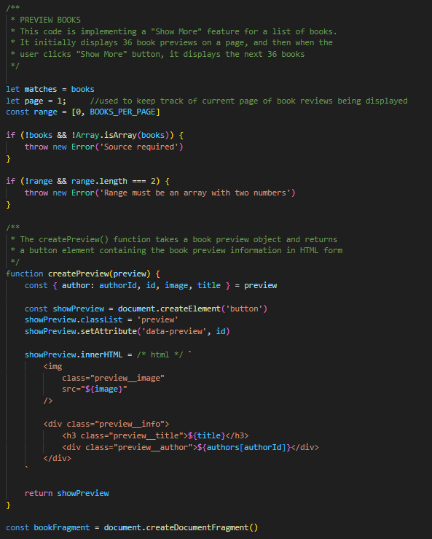
Preview Books

Slide 2
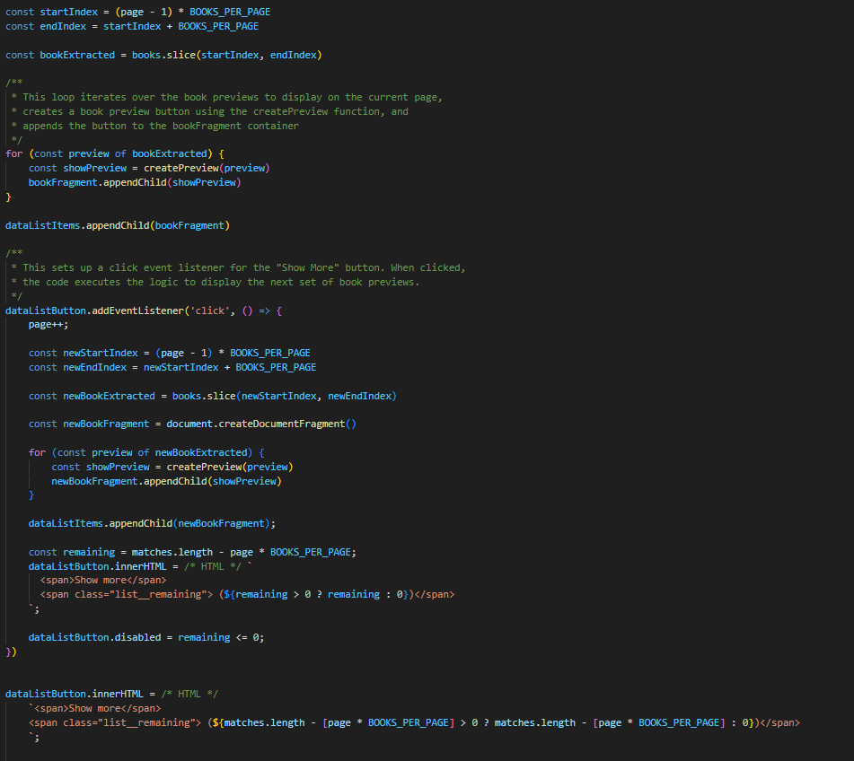
Book Preview
(Showing More)

Slide 3
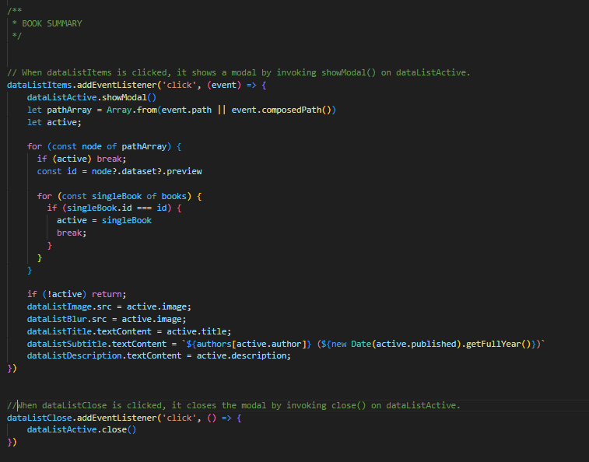
Book Summary

Slide 4
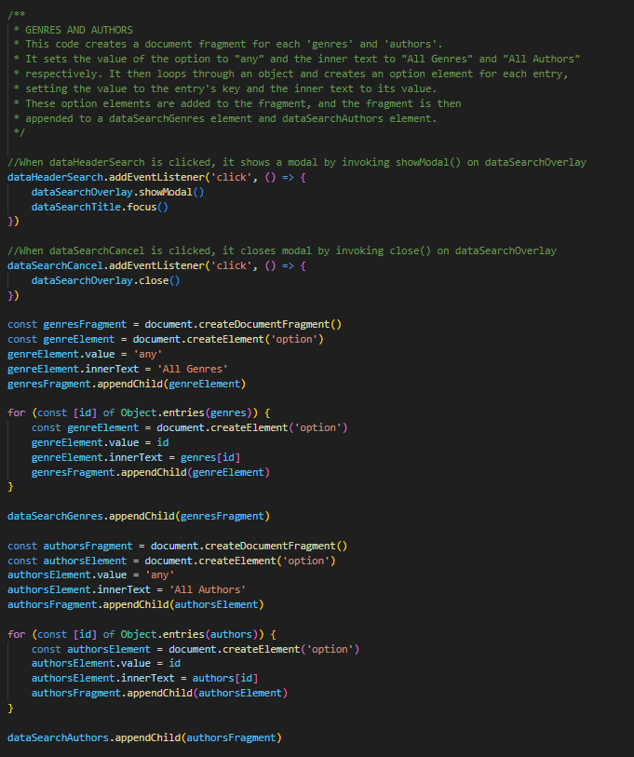
Genres and Authors

Slide 5
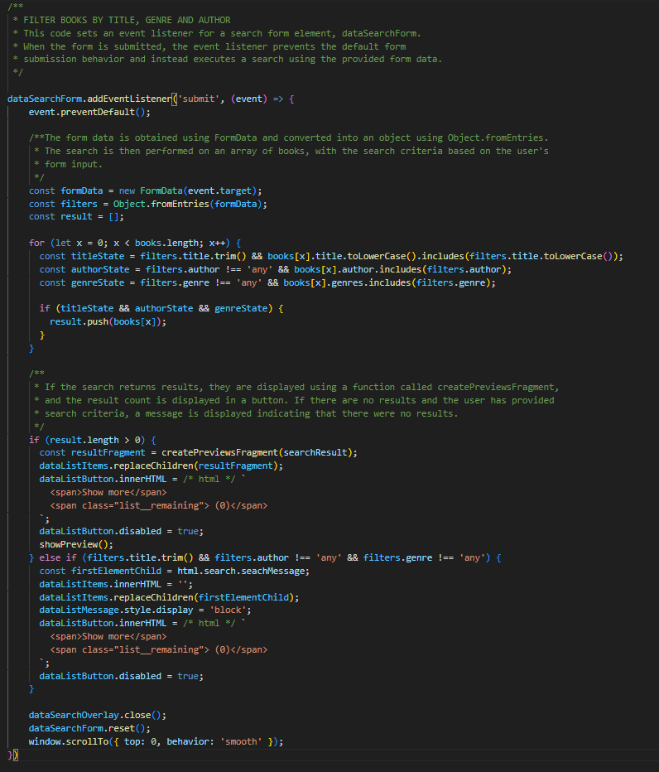
Filter Books
By text, genre and author

Slide 6
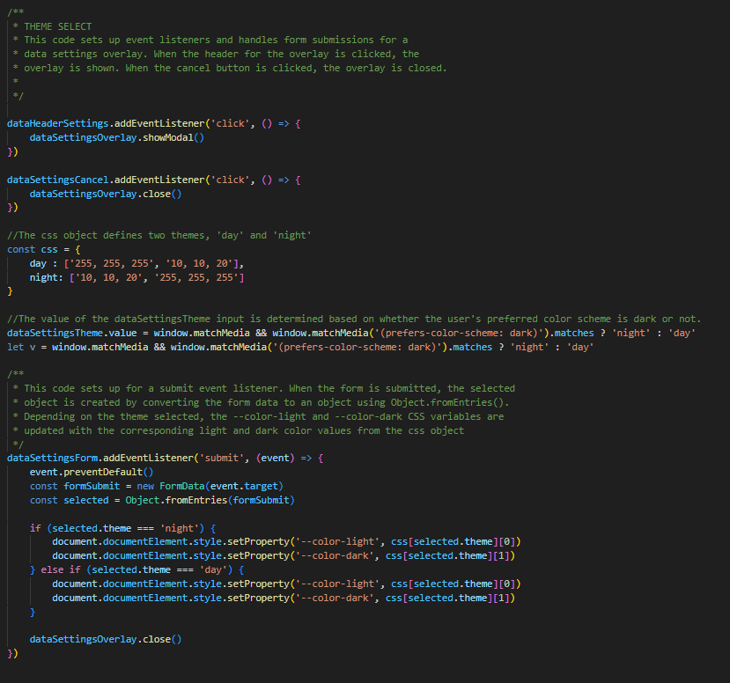
Theme Selection

