Slide 1

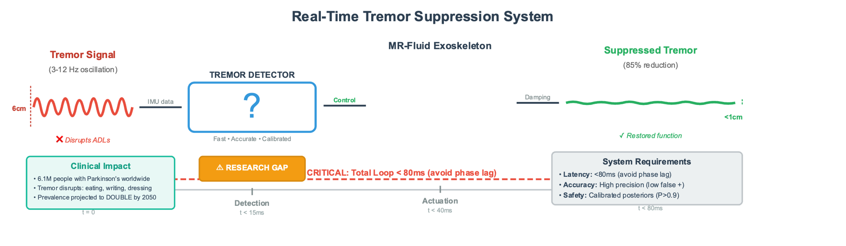
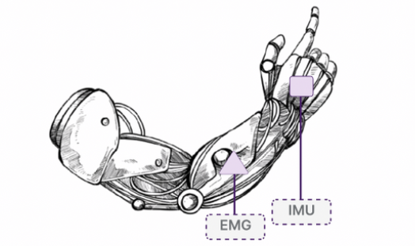

Hybrid ST-GCN/HMM Tremor Detector for a Wearable MR-Fluid Exoskeleton
Toufic Jrab¹
¹Department of Bioengineering, McGill University, QC Canada
toufic.jrab@mail.mcgill.ca
Spatio-temporal graph convolutional network:
learns motion patterns
two-state Hidden Markov Model:
enforces physiological dwell time
Our Solution:
Bayesian network:
adds noise-robust priors

Slide 2
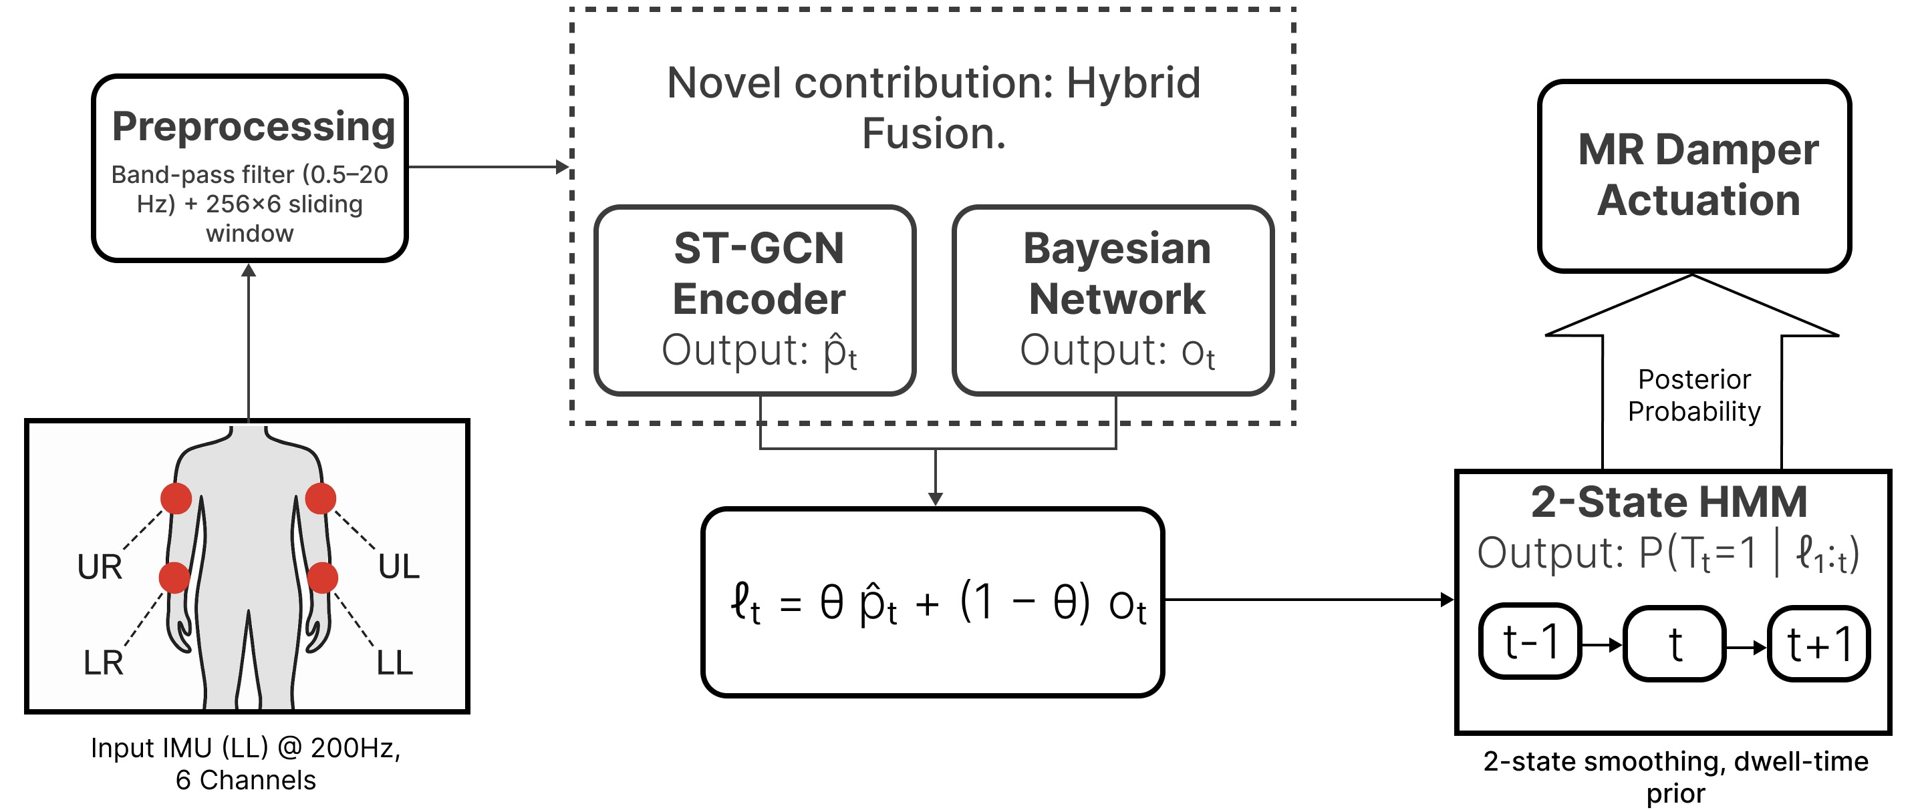
Briefly…
Results
Dataset
Accuracy+
22k params+
low latency!
Pipeline

