Slide 1



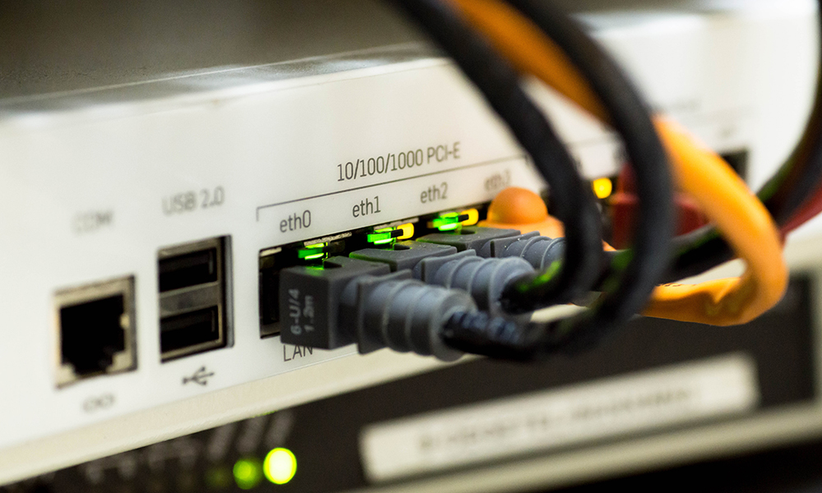

CSC 1010 Networks & Internet
Dr. Mohammed Amine TOGOU
Devices
1

Slide 2



Learning outcomes
• Identify the network devices that can be used to create networks
• Describe the characteristics and roles of these devices
2
CSC 1010: Networks & Internet | Devices

Slide 3
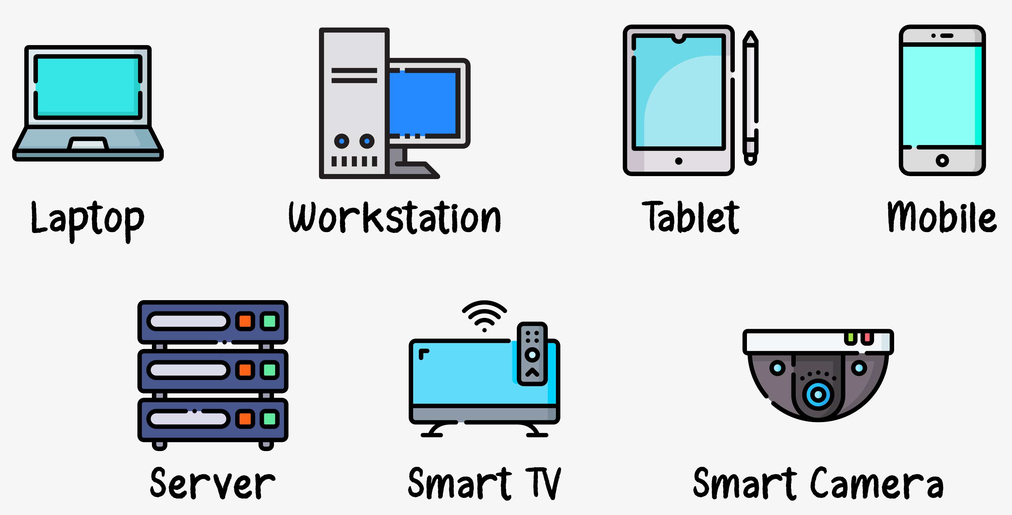
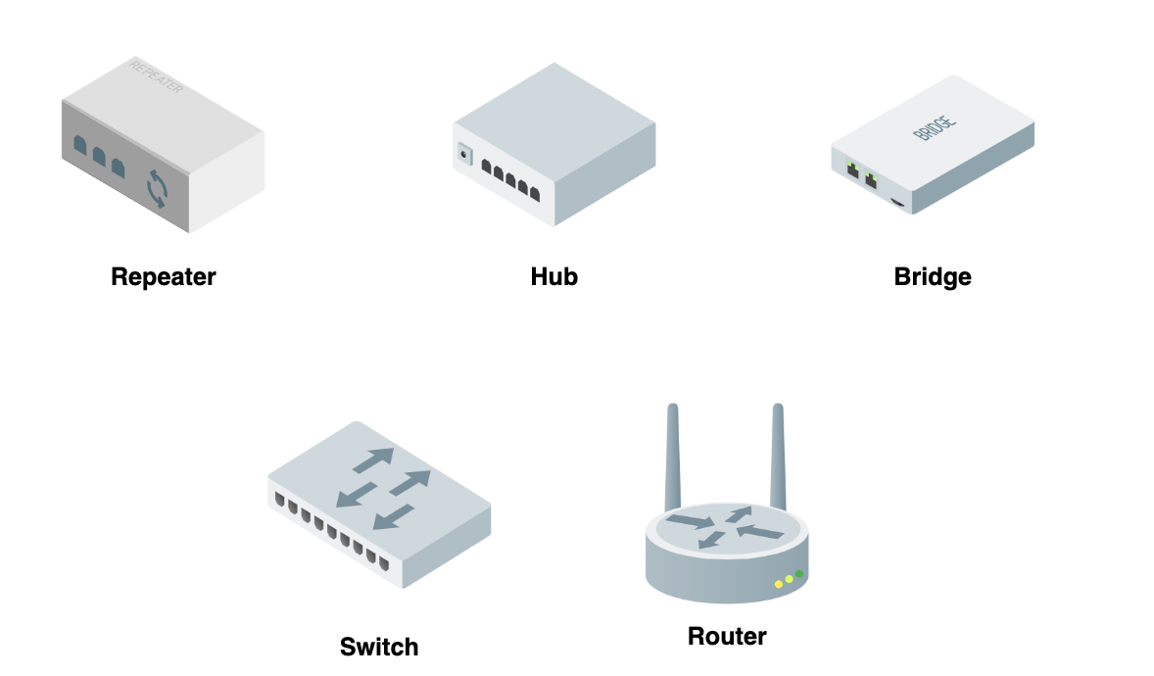
Devices
Physical devices used to enable communication and access services
They have different characteristics
They play different roles
3
CSC1010: Networks & Internet | Devices

Slide 4
End devices
These devices either initiate data transmission or serve as its destination
They have the full protocol stack of the TCP/IP model
They allow multiple applications to run and exchange information
4
CSC1010: Networks & Internet | Devices

Slide 5
Network devices
These devices forward data between the transmitter and the receiver
They do not have the full protocol stack of the TCP/IP model
They play different roles
5
CSC1010: Networks & Internet | Devices

Slide 6
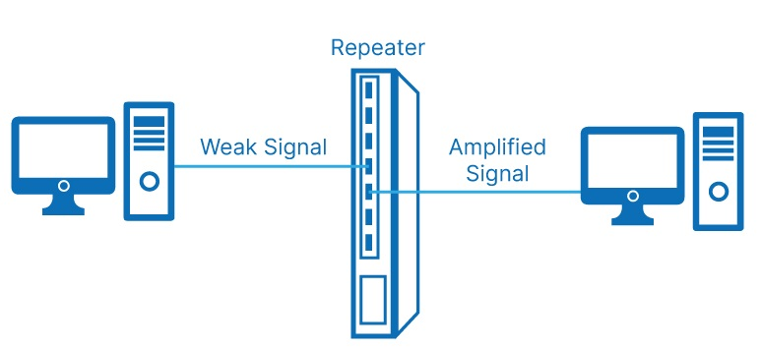
Repeater
It operates at the physical layer
It amplify and regenerate the signal
Aim: extend the distance at which the signal can be transmitted
It usually have 2 ports
6
CSC1010: Networks & Internet | Devices

Slide 7
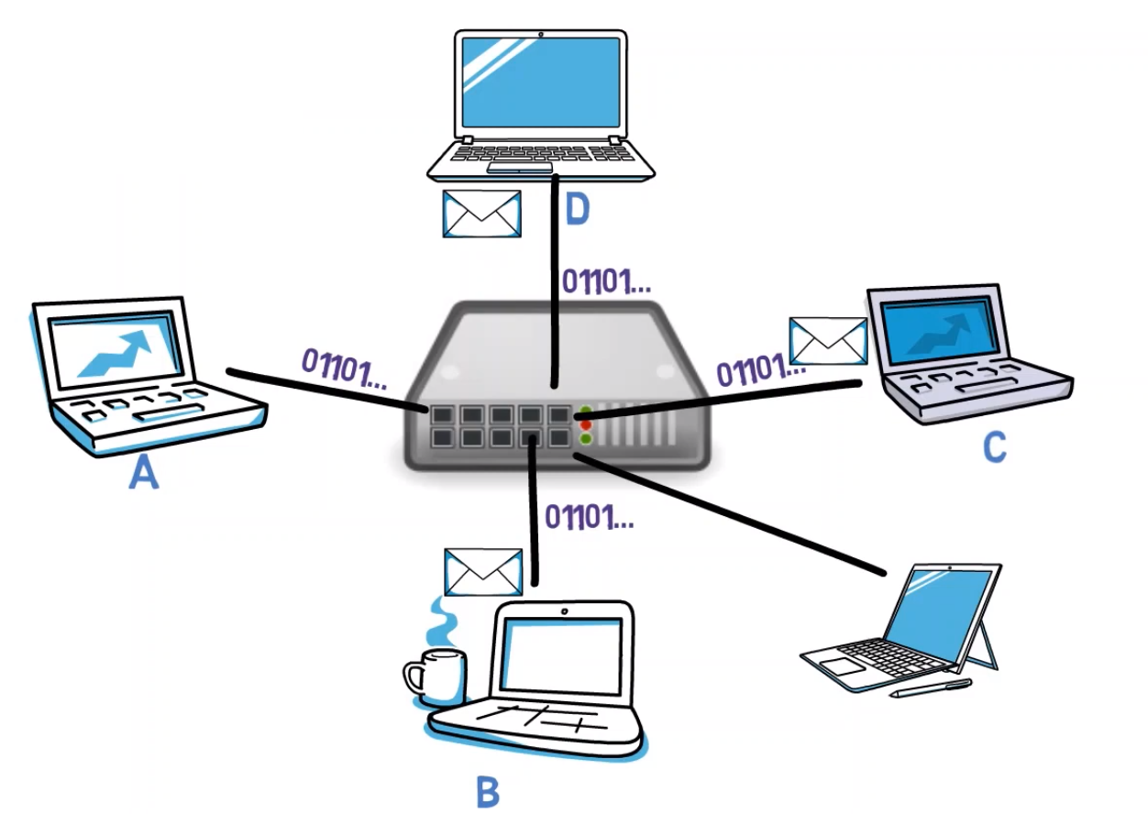
Hub
It operates at the physical layer
It is basically a multi-port repeater
Data received from one port will be sent to all connected devices
It has no intelligence
7
CSC1010: Networks & Internet | Devices

Slide 8
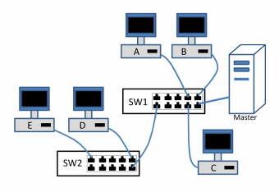
Switch
It operates at the Data Link layer
It connects multiple segments of a LAN
It filters data based on MAC address and forward it through the appropriate port
It can also perform error checking before forwarding data
Some switches operate at the Network layer. They are called Layer 3 switches
8
CSC1010: Networks & Internet | Devices

Slide 9
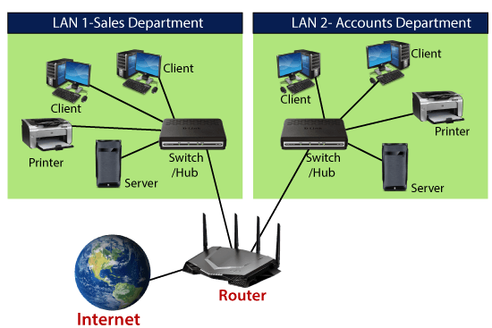
Router
It operates at the Network layer
It routes data based on IP addresses
It connects LANs and WANs
It maintains routing tables, used to route data from source to destination
It can also perform error checking before forwarding data
9
CSC1010: Networks & Internet | Devices

Slide 10

THANK YOU
CSC 1010: Networks & Internet | Devices

