Slide 1





CSC 1010 Networks & Internet
Dr. Mohammed Amine TOGOU
Hypertext Transfer Protocol
1

Slide 2



Learning outcomes
• Describe the services provided by HTTP
• List the HTTP requests and when can be used
• Explain the HTTP response codes
2
CSC 1010: Networks and Internet | HTTP

Slide 3
Web browsing – data encapsulation
User data
www.dcu.ie
TCP/IP Model
PDU
Application
HTTP header
User data
3
CSC1010: Networks and Internet | HTTP

Slide 4
Hypertext Transfer Protocol (HTTP)
Think of it as the language of the web
Was released in 1991
Uses a client-server architecture
HTTP packets can transport just about anything
HTML, XML, JSON
4
CSC1010: Networks and Internet | HTTP

Slide 5
Uniform Resource Locator (URL)
HTTP requires a URL to be passed to it
A URL is more than just a domain name
It includes a protocol, a path, and some parameters
Parameter
https://loop.dcu.ie/course/view.php?id=57757
Protocol
Domain Name
Path
File Name
Parameter Value
5
CSC1010: Networks and Internet | HTTP

Slide 6
HTTP Request Methods
HTTP defines several request methods
You might know about some of them if you have used rails or Django in previous projects
The most common request is GET
Request a resource from a server
POST is used to submit data
Usually used in web forms
6
CSC1010: Networks and Internet | HTTP

Slide 7
HTTP Request Methods
HEAD
Asks for a response identical to a GET request, but without the response body
e.g., checking the size of a file to be downloaded beforehand
PUT
Updates a resource with a new version
PATCH
Specifies how a resource should be updated
DELETE
Removes a resource
7
CSC1010: Networks and Internet | HTTP

Slide 8
HTTP Response Codes
When an HTTP request is made, it returns a response code
The first digit specifies the class of the response
1xx – Information
2xx – Success
3xx – Redirection
4xx – Client error
5xx – Server error
8
CSC1010: Networks and Internet | HTTP

Slide 9
HTTP Response Codes – 2xx
This is generally the one you want to see
As a website owner, you need to make sure that all pages and resources return 2xx status codes
200 – OK: request succeeded
202 – Accepted: request has been accepted for processing, but the processing has not been finished yet
204 – No Content: there is no content to send for this request
If the response code != 200 → something is wrong
9
CSC1010: Networks and Internet | HTTP

Slide 10
HTTP Response Codes – 3xx
It indicates that the request was successfully received, but the resource was found elsewhere
301 – Moved permanently: the URL of the requested resource has changed, and the new URL is given in the response
304 – Not modified: informs the client that the response has not been modified → used for caching purposes
305 – Use proxy: instructs a client that it should connect to a proxy and then repeat the same request for security reasons
10
CSC1010: Networks and Internet | HTTP

Slide 11
HTTP Response Codes – 4xx
It means that the request contains bad syntax, or that resources cannot be reached for some reason
401 – Unauthorised: only authenticated clients can get the requested resource
403 – Forbidden: client has no right to access the resource
404 – Not found: the server can’t find the requested resource
11
CSC1010: Networks and Internet | HTTP

Slide 12
HTTP Response Codes – 5xx
While the request appears to be valid, the server could not complete the request due to some issues
500 – Internal server error: generic error → something wrong on the server
501 – Not implemented: the request method is not supported by the server and cannot be handled
503 – Service unavailable: server is overloaded or down for maintenance
12
CSC1010: Networks and Internet | HTTP

Slide 13
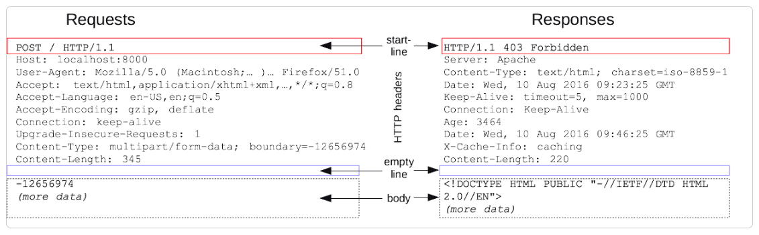
HTTP Request / Response Structure
13
CSC1010: Networks and Internet | HTTP

Slide 14
HTTP Request / Response Structure
HTTP requests/responses share similar structure:
A start-line (single line) describing the requests to be implemented and its status (successful/failure)
HTTP headers specifying the request or describing the body included in the message
A blank line indicating all meta-information for the request has been sent
An optional body containing data associated with the request (like content of an HTML form)
14
CSC1010: Networks and Internet | HTTP

Slide 15
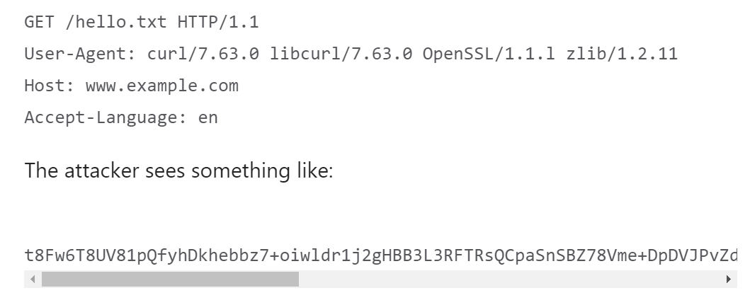
HTTPS
HTTP with encryption and verification
Uses Transport Layer Security (TLS)/Secure Socket Layer (SSL)
encrypt normal HTTP requests and responses
digitally sign those requests and responses
15
CSC1010: Networks and Internet | HTTP

Slide 16

THANK YOU
CSC 1010: Networks and Internet | HTTP

