Slide 1
Job Search
A short guide for Codex and Claude Code
Your AI helps organize the search.
You review the facts and documents.
Open the GitHub guide
Notes:
Start here: https://github.com/toughdave/job-search
A guide to skill version 1.3.0, checked 12 September 2026. The AI needs local file access and the candidate’s real answers.

Slide 2
1. Open your AI app
Choose one desktop app and sign in.
Codex
Claude Code
Download the ChatGPT desktop app,
then choose Codex inside it.
Download Claude, then open Code
and select Local.
Mac download page (Apple Silicon)
Mac or Windows downloads
Windows download page
Claude Code setup and account requirements
Already installed? Continue to your project. Labels and availability can vary by version.
02
Notes:
Official download and setup sources: https://learn.chatgpt.com/docs/app
https://learn.chatgpt.com/docs/windows/windows-app#download-the-chatgpt-desktop-app
https://claude.com/download
https://code.claude.com/docs/en/desktop-quickstart
Workflow source: https://github.com/toughdave/job-search
Guide checked 12 September 2026.

Slide 3
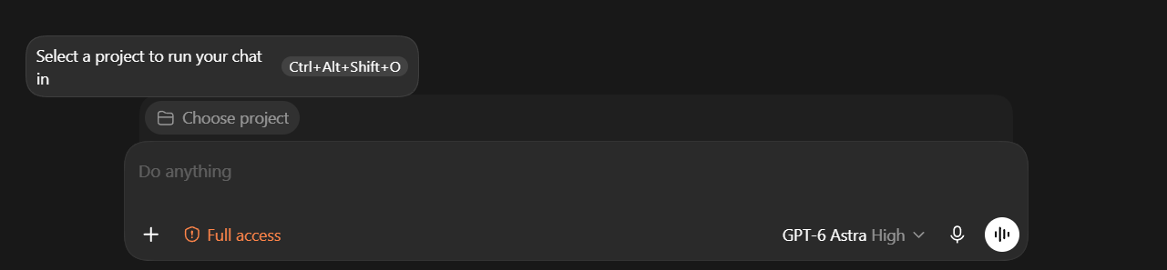
a. Choose your project
In Codex, click Choose project above the message box.
Choose an existing job-search project, or create a new one.
Use a dedicated folder such as My Job Search.
03
Notes:
Screenshot supplied by the repository owner: docs/images/codex-choose-project.png
Workflow source: https://github.com/toughdave/job-search
Guide checked 12 September 2026.

Slide 4
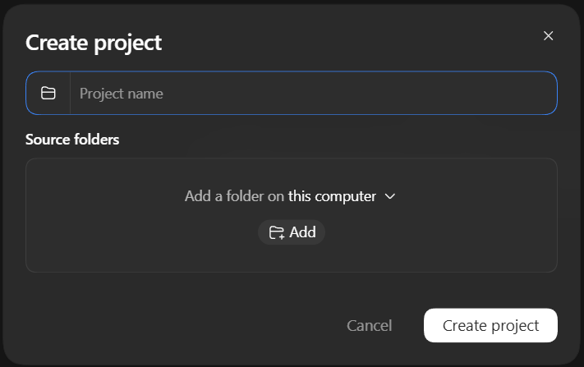
b. Select or create your folder
In Codex Create project:
Enter My Job Search.
Under Source folders, click Add.
Select your folder, then click
Create project.
Need a new folder?
Create it in Documents using
File Explorer or Finder first.
Claude Code: Local, then Select folder.
04
Notes:
Screenshot supplied by the repository owner: docs/images/codex-create-project.png
Claude setup: https://code.claude.com/docs/en/desktop-quickstart
Workflow source: https://github.com/toughdave/job-search
Guide checked 12 September 2026.

Slide 5
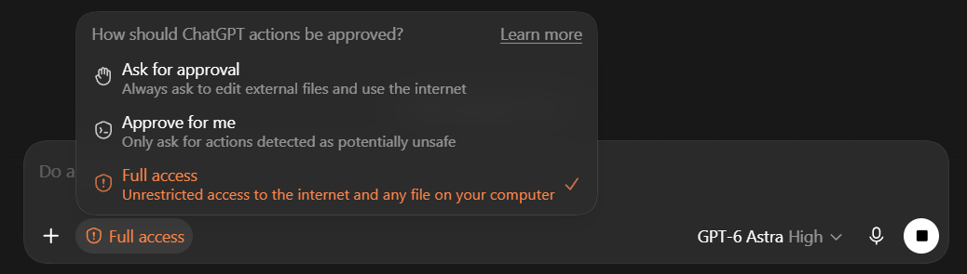
c. Codex: Full access
Click the permission label below your message.
Select Full access, as shown.
Full access allows internet and file access across your computer,
including files outside the selected project.
05
Notes:
https://learn.chatgpt.com/docs/agent-approvals-security
Screenshot supplied by the repository owner: docs/images/codex-permissions.png
Workflow source: https://github.com/toughdave/job-search
Guide checked 12 September 2026.

Slide 6
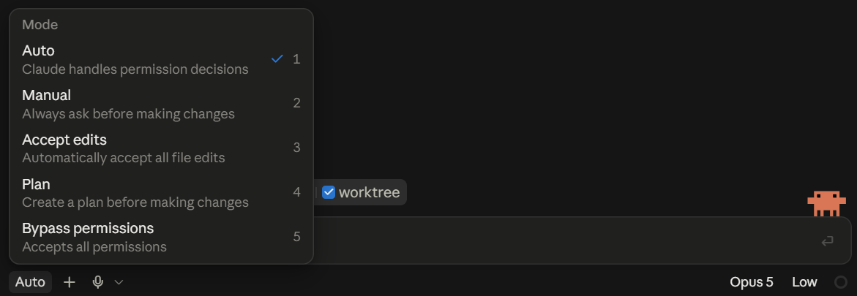
d. Claude Code: Auto
Click the mode label below your message. Select Auto.
Claude handles permission decisions with background safety checks.
Some actions can still require your input.
06
Notes:
https://code.claude.com/docs/en/desktop#choose-a-permission-mode
Screenshot supplied by the repository owner: docs/images/claude-permissions.png
Workflow source: https://github.com/toughdave/job-search
Guide checked 12 September 2026.

Slide 7
2. Your resume
If you have one
Attach your PDF or Word file before sending the first message.
If attachments are unavailable, paste its full file location.
If you do not have one
Add: “I do not have a resume yet. Help me build one.”
The AI checks that it can read the file. It can also build a resume from your real experience.
07
Notes:
Workflow source: https://github.com/toughdave/job-search
Guide checked 12 September 2026.

Slide 8
3. Your first message
Copy both lines into the same message box as your resume:
Install https://github.com/toughdave/job-search for this project.
Then use job-search to start my search.
Add your resume location or no-resume sentence if needed.
Press Send once. Follow any installation approval or restart request.
Copy from the README
08
Notes:
Workflow source: https://github.com/toughdave/job-search
Guide checked 12 September 2026.

Slide 9
4. A short conversation
The AI asks about one employer and role at a time.
Example: Cedar Clinic, Office Assistant, 2022-2024
“At Cedar Clinic, tell me about one scheduling
problem you handled as an office assistant.”
Explain what you did and what happened. Honest qualitative
results are useful. The AI asks only for missing details.
No resume? It builds your work history with you and checks for any other employers.
09
Notes:
Workflow source: https://github.com/toughdave/job-search
Guide checked 12 September 2026.

Slide 10
Your weekday morning search
a. Review the job titles and search sites the AI suggests.
b. Choose a schedule. The starting suggestion is
weekdays at 9 a.m. in your confirmed timezone.
c. Let the AI save the instructions and set up the task.
You can change the time or keep searches manual.
Keep your computer awake and the desktop app running for local searches.
10
Notes:
Scheduling sources: https://learn.chatgpt.com/docs/automations
https://code.claude.com/docs/en/desktop-scheduled-tasks
Workflow source: https://github.com/toughdave/job-search
Guide checked 12 September 2026.

Slide 11
Review and change your routine
Codex desktop: Scheduled
Claude Code Desktop: Code → Routines
The AI checks unfinished applications and new listings,
then prepares suitable drafts for your review.
“Move my daily search to 8 a.m.”
“Pause my scheduled search.”
Read the daily-search guide
11
Notes:
Scheduling sources: https://learn.chatgpt.com/docs/automations
https://code.claude.com/docs/en/desktop-scheduled-tasks
https://code.claude.com/docs/en/scheduled-tasks
Workflow source: https://github.com/toughdave/job-search
Guide checked 12 September 2026.

Slide 12
5. Your first draft
When enough is known, the AI prepares useful documents
and keeps your search records in a separate private location.
Open the files and check your experience, dates and contact details.
Give corrections in the conversation.
“That role was volunteering. Please correct it.”
Review the employer and final documents before authorizing a submission.
12
Notes:
Workflow source: https://github.com/toughdave/job-search
Guide checked 12 September 2026.

Slide 13
Summon the installed skill
Codex / ChatGPT desktop
Type @ and choose job-search. If your composer offers a $
skill picker, choose job-search there.
Codex CLI or IDE: $job-search
Claude Code: /job-search
Add “Start my search” or “Continue my job search”, then send.
Use the AI message box after installation, in the same project.
If the picker cannot find it, send: “Use job-search.” Ask the AI to check installation if needed.
13
Notes:
Official invocation sources: https://learn.chatgpt.com/docs/build-skills#how-chatgpt-and-codex-use-skills
https://code.claude.com/docs/en/skills
Workflow source: https://github.com/toughdave/job-search
Guide checked 12 September 2026.

Slide 14
6. Next time
a. Reopen the same local project and conversation.
b. Summon job-search, then send:
Continue my job search.
c. Continue from your saved progress.
Supply an updated resume when it changes.
For an independent occupation search, use a new project with separate records.
14
Notes:
Workflow source: https://github.com/toughdave/job-search
Guide checked 12 September 2026.

Slide 15
If something stops you
Skill missing?
Cannot save?
“Check whether job-search is installed
in this project and help me load it.”
Check the selected folder and file
permissions. Approve the specific
access request if you want it to proceed.
New chat cannot find your records?
Provide the private records location the AI gave you. Say:
“Resume my existing search here; do not start over.”
Full guide, downloads and troubleshooting
15
Notes:
Workflow source: https://github.com/toughdave/job-search
Guide checked 12 September 2026.

