Slide 1
A Two-Stage Siamese Network Model for Offline Handwritten Signature Verification
Slide: 01
Team #06
Presented by: 23166028 Md. Touhidul Islam
ST/RA: Sadiul Arefin Rafi / Md Sabbir Hossain

Slide 2
Introduction
Slide: 02
Handwritten signatures are widely used for identity verification
Challenging to differentiate between genuine signatures and skilled forgeries
The proposed two-stage Siamese network model.
The model simultaneously verifies original and enhanced handwritten signatures.
The Focal Loss is utilized to handle the extreme imbalance datasets.
The study extends the proposed model to the Chinese signature dataset in a real environment.
Provide insights for future works.

Slide 3
Literature Review
Slide: 03
Many studies often use texture features extraction such as
gray-level co-occurrence matrix [1]
Local Binary Patterns [2]
directional-based features such as directional-pdf [3]
histogram of oriented gradients [4];
Li, L et al. [5] proposed a region-based deep convolutional Siamese network for feature and metric learning.
Wei et al. [6] proposed an inverse discriminative network that is capable of intensifying the effective information of signatures
Mustafa et al. [7] proposed a two-channel CNN as a feature extractor, with each channel representing the reference and query signatures, respectively.

Slide 4
Limitations of Existing Models
Slide: 04
Handwritten signatures are often treated as static images, neglecting the deep signature style.
Imbalance in the distribution of positive and negative signatures is overlooked.
Limited sample sizes for each writer and high similarity between real and forged signatures in real scenarios.
Existing models rely on synthetic data that may not accurately represent real-world signatures.

Slide 5
Unique Approach of Proposed Model
Slide: 05
Introduce two-stage Siamese network module to verify the offline-handwritten signature.
It employs the Focal loss to deal with the extreme imbalance between positive and negative offline signatures.
First attempt to study the Chinese signatures with a real Chinese signature dataset.

Slide 6
Datasets
Slide: 06
CEDAR
BHSig-B
BHSig-H
CHINESE
Language: English
People: 55 Signatures: 2640
Total Sample: 46,860
Positive:Negative : 276:576
Language: Bengali
People: 100 Signatures: 5400
Total Sample: 99,600
Positive:Negative : 276:720
Language: Hindi
People: 160
Signatures: 8640
Total Sample: 159,360
Positive:Negative : 276:720
Language: Chinese
People: 500 Signatures: 2000
Total Sample: 1500
Positive:Negative : 840:660

Slide 7
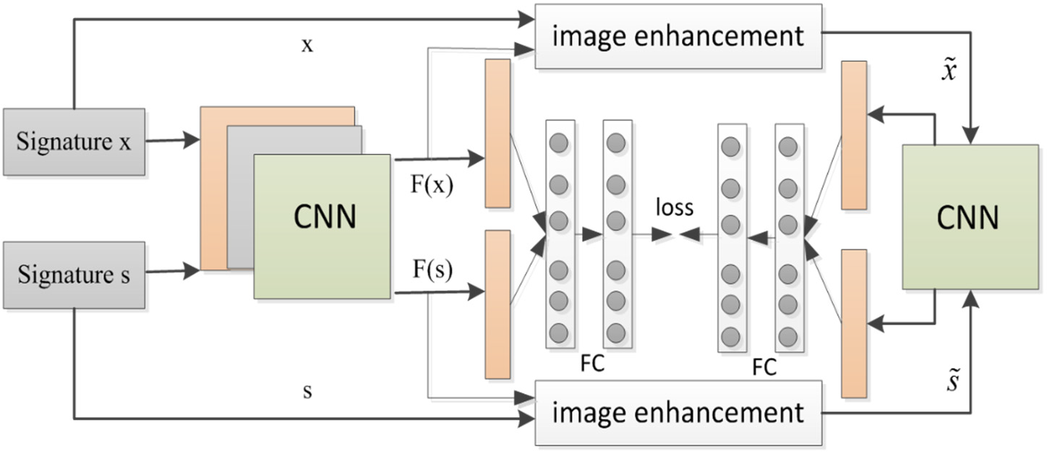
Proposed Two-Stage Siamese Neural Network
Slide: 07
Contains a two-stage Siamese neural network and consists of three modules:
Convolutional neural feature extractor
Image enhancement module
Objective function module
Two-stage convolutional neural network contains:
verification of the original two handwritten signatures
verification of the handwritten signature after data enhancement
Focal loss as a loss function:
focus on stroke information rather than background information

Slide 8
Results
Slide: 08
CEDAR Signature Dataset:
Accuracy: 95.66%
BHSIG-Bengali Signature Datasets:
Accuracy: 90.64%
BHSIG-Hindi Signature Datasets:
Accuracy: 88.98%
Chinese Signature Dataset:
Accuracy:70.31

Slide 9
Future Work
Slide: 09
The study of Chinese handwriting signatures and improving the accuracy of Chinese handwriting identification.
For example:
Stroke crossing
Connection
Collocation

Slide 10
Conclusion
Slide: 10
The study presents a two-stage Siamese neural network model that effectively addresses the problem of offline handwritten signature verification.
End-to-end image enhancement learning and the Focal Loss function achieves better performance than the state-of-the-art models.

Slide 11
References
Slide: 11
Ruiz, V.; Linares, I.; Sanchez, A.; Velez, J.F. Offline handwritten signature verification using compositional synthetic generation of signatures and Siamese Neural Networks. Neurocomputing 2020, 374, 30–41.
Hu, J.; Chen, Y. Offline Signature Verification Using Real Adaboost Classifier Combination of Pseudo-dynamic Features. In Proceedings of the International Conference on Document Analysis & Recognition, Washington, DC, USA, 25–28 August 2013; pp. 1345–1349.
Hafemann, L.; Sabourin, R.; Oliveira, L. Learning Features for Offline Handwritten Signature Verification using Deep Convolutional neural networks. Pattern Recognit. 2017, 70, 163–176.
Jain, A.; Singh, S.K.; Singh, K.P. Signature verification using geometrical features and artificial neural network classifier. Neural Comput. Appl. 2020, 12, 6999–7010.
Li, L.; Huang, L.; Yin, F.; Chen, Y. Offline signature verification using a region based deep metric learning network. Pattern Recognit. 2021, 118, 108009.
Wei, P.; Li, H.; Hu, P. Inverse Discriminative Networks for Handwritten Signature Verification. In Proceedings of the IEEE/CVF Conference on Computer Vision and Pattern Recognition (CVPR), Long Beach, CA, USA, 15–20 June 2019; pp. 5757–5765.
Li, C.; Lin, F.; Wang, Z.; Yu, G.; Yuan, L.; Wang, H. DeepHSV: User-Independent Offline Signature Verification Using Two-Channel CNN. In Proceedings of the International Conference on Document Analysis and Recognition (ICDAR), Sydney, Australia, 20–25 September 2019; pp. 166–171.

