Slide 1
Quicksort

Slide 2
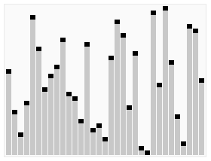
Let’s play a game
Problem: Arrange these sticks in order of increasing length in shortest time
Possible solution:
If there is only one stick then we don’t need to do anything
otherwise
Pick a stick say P
Compare each stick with P and place sticks shorter than P to the left and those longer than P to the right
So now we know for sure the position of P in the final arrangement (right after the shorter sticks)
Repeat the process for then sticks to the left of P and then for those to the right of P

Slide 3
Let’s play a game

Slide 4
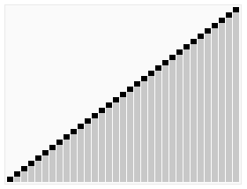
Let’s play a game
VOILÁ !! THIS IS THE FASTEST SOLUTION INDEED !!! THIS IS QUICKSORT !!

Slide 5

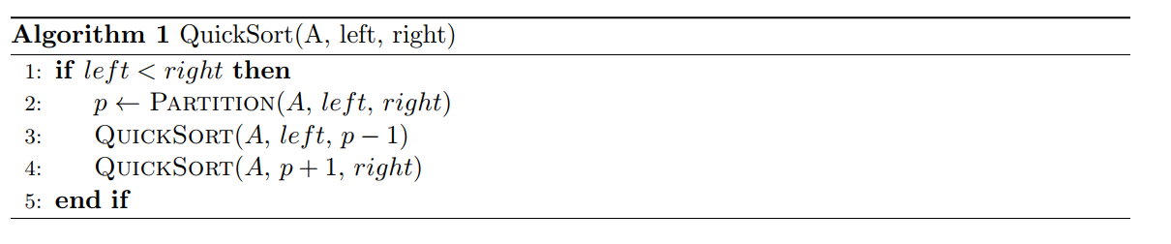
Quicksort algorithm
QuickSort: Given an array of n elements (e.g., integers):
if array only contains one element, return
else
Partition procedure returns position of the pivot (rightmost) element in the sorted array
Hence elements are partitioned into two sub-arrays:
Left subarray contains elements less than or equal (<=) to pivot
Right subarray contains elements greater (>) than pivot
QuickSort left subarray
QuickSort right subarray
return results

Slide 6

Let’s sort these numbers with quicksort
2
1
4
1
5
9
2
6
5
3
QuickSort: Given an array of n elements (e.g., integers):
if array only contains one element, return
else
Partition procedure returns position of the pivot (rightmost) element in the sorted array
Hence elements are partitioned into two sub-arrays:
Left subarray contains elements less than or equal (<=) to pivot
Right subarray contains elements greater (>) than pivot
QuickSort left subarray
QuickSort right subarray
return results
2,1,4,1,5,9,2,6,5,3
2,1,1,2
<=
3
<
9,4,6,5,5
4,5
<=
5
<
6,9
2,1,1
2
<=
4
<=
5
6
<=
9
1
1
<
2
<=
1
1
2
2
3
4
5
5
6
9

Slide 7
PARTITION PROCEDURE
2
1
4
1
5
9
2
6
5
3
Scan array elements one by one
if current element <= pivot
swap it with the element in currently available leftmost position

Slide 8
PARTITION PROCEDURE
Pivot
2
1
4
1
5
9
2
6
5
3
Scan array elements one by one
if current element <= pivot
swap it with the element in currently available leftmost position

Slide 9
PARTITION PROCEDURE
Pivot
2
1
4
1
5
9
2
6
5
3
Scan array elements one by one
if current element <= pivot
swap it with the element in currently available leftmost position

Slide 10
PARTITION PROCEDURE
Pivot
2
1
4
1
5
9
2
6
5
3
Scan array elements one by one
if current element <= pivot
swap it with the element in currently available leftmost position

Slide 11
PARTITION PROCEDURE
Pivot
2
1
4
1
5
9
2
6
5
3
Scan array elements one by one
if current element <= pivot
swap it with the element in currently available leftmost position

Slide 12
PARTITION PROCEDURE
Pivot
2
1
4
1
5
9
2
6
5
3
Scan array elements one by one
if current element <= pivot
swap it with the element in currently available leftmost position

Slide 13
PARTITION PROCEDURE
Pivot
2
1
4
1
5
9
2
6
5
3
Scan array elements one by one
if current element <= pivot
swap it with the element in currently available leftmost position

Slide 14
PARTITION PROCEDURE
Pivot
2
1
4
1
5
9
2
6
5
3
Scan array elements one by one
if current element <= pivot
swap it with the element in currently available leftmost position

Slide 15
PARTITION PROCEDURE
Pivot
2
1
4
1
5
9
2
6
5
3
Scan array elements one by one
if current element <= pivot
swap it with the element in currently available leftmost position

Slide 16
PARTITION PROCEDURE
Pivot
2
1
4
1
5
9
2
6
5
3
Scan array elements one by one
if current element <= pivot
swap it with the element in currently available leftmost position

Slide 17
PARTITION PROCEDURE
Pivot
2
1
1
4
5
9
2
6
5
3
Scan array elements one by one
if current element <= pivot
swap it with the element in currently available leftmost position

Slide 18
PARTITION PROCEDURE
Pivot
2
1
1
4
5
9
2
6
5
3
Scan array elements one by one
if current element <= pivot
swap it with the element in currently available leftmost position

Slide 19
PARTITION PROCEDURE
Pivot
2
1
1
4
5
9
2
6
5
3
Scan array elements one by one
if current element <= pivot
swap it with the element in currently available leftmost position

Slide 20
PARTITION PROCEDURE
Pivot
2
1
1
4
5
9
2
6
5
3
Scan array elements one by one
if current element <= pivot
swap it with the element in currently available leftmost position

Slide 21

PARTITION PROCEDURE
Pivot
2
1
1
4
5
9
2
6
5
3
Scan array elements one by one
if current element <= pivot
swap it with the element in currently available leftmost position

Slide 22
PARTITION PROCEDURE
Pivot
2
1
1
2
5
9
4
6
5
3
Scan array elements one by one
if current element <= pivot
swap it with the element in currently available leftmost position

Slide 23
PARTITION PROCEDURE
Pivot
2
1
1
2
5
9
4
6
5
3
Scan array elements one by one
if current element <= pivot
swap it with the element in currently available leftmost position

Slide 24
PARTITION PROCEDURE
Pivot
2
1
1
2
5
9
4
6
5
3
Scan array elements one by one
if current element <= pivot
swap it with the element in currently available leftmost position

Slide 25
PARTITION PROCEDURE
Pivot
2
1
1
2
5
9
4
6
5
3
Scan array elements one by one
if current element <= pivot
swap it with the element in currently available leftmost position

Slide 26
PARTITION PROCEDURE
Subarray of elements <= Pivot (3)
Pivot
2
1
1
2
3
9
4
6
5
5
Final position of the pivot element
Subarray of elements > Pivot (3)

Slide 27
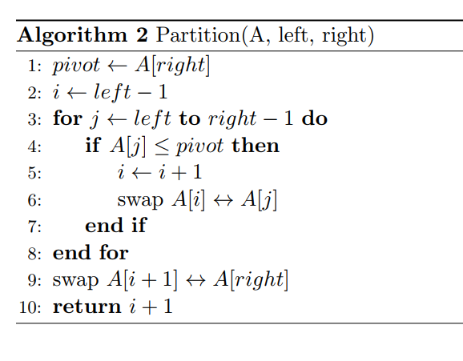
Partition pseudocode
A = input array
p = leftmost index
r = rightmost index
Partition (A, p, r):
x = A[r]
i = p-1 (left marker)
for j = p to r-1:
if (A[j]<=x):
i = i+1
exchange A[i] with A[j]
exchange A[i+1] with A[r]
return i+1

Slide 28
PARTITION pseudocode
Pivot
We call Partition (A, 1, 10), p=1, r=10
x = A[10] = 3 = Pivot
i=0 (Left Marker)
2
1
4
1
5
9
2
6
5
3
Partition (A, p, r):
x = A[r]
i = p-1
for j = p to r-1:
if (A[j]<=x):
i = i+1
exchange A[i] with A[j]
exchange A[i+1] with A[r]
return i+1

Slide 29
PARTITION pseudocode
p = 1
r = 10
x = 3
i = 0 (Left Marker)
j = 1
Pivot
2
1
4
1
5
9
2
6
5
3
Partition (A, p, r):
x = A[r]
i = p-1
for j = p to r-1:
if (A[j]<=x):
i = i+1
exchange A[i] with A[j]
exchange A[i+1] with A[r]
return i+1

Slide 30
PARTITION pseudocode
p = 1
r = 10
x = 3
i = 1 (Left Marker)
j = 1
Pivot
2
1
4
1
5
9
2
6
5
3
Partition (A, p, r):
x = A[r]
i = p-1
for j = p to r-1:
if (A[j]<=x):
i = i+1
exchange A[i] with A[j]
exchange A[i+1] with A[r]
return i+1

Slide 31
PARTITION pseudocode
p = 1
r = 10
x = 3
i = 1 (Left Marker)
j = 2
Pivot
2
1
4
1
5
9
2
6
5
3
Partition (A, p, r):
x = A[r]
i = p-1
for j = p to r-1:
if (A[j]<=x):
i = i+1
exchange A[i] with A[j]
exchange A[i+1] with A[r]
return i+1

Slide 32
PARTITION pseudocode
p = 1
r = 10
x = 3
i = 2 (Left Marker)
j = 2
Pivot
2
1
4
1
5
9
2
6
5
3
Partition (A, p, r):
x = A[r]
i = p-1
for j = p to r-1:
if (A[j]<=x):
i = i+1
exchange A[i] with A[j]
exchange A[i+1] with A[r]
return i+1

Slide 33
PARTITION pseudocode
p = 1
r = 10
x = 3
i = 2 (Left Marker)
j = 3
Pivot
2
1
4
1
5
9
2
6
5
3
Partition (A, p, r):
x = A[r]
i = p-1
for j = p to r-1:
if (A[j]<=x):
i = i+1
exchange A[i] with A[j]
exchange A[i+1] with A[r]
return i+1

Slide 34
PARTITION pseudocode
p = 1
r = 10
x = 3
i = 2 (Left Marker)
j = 4
Pivot
2
1
4
1
5
9
2
6
5
3
Partition (A, p, r):
x = A[r]
i = p-1
for j = p to r-1:
if (A[j]<=x):
i = i+1
exchange A[i] with A[j]
exchange A[i+1] with A[r]
return i+1

Slide 35
PARTITION pseudocode
p = 1
r = 10
x = 3
i = 3 (Left Marker)
j = 4
Pivot
2
1
4
1
5
9
2
6
5
3
Partition (A, p, r):
x = A[r]
i = p-1
for j = p to r-1:
if (A[j]<=x):
i = i+1
exchange A[i] with A[j]
exchange A[i+1] with A[r]
return i+1

Slide 36
PARTITION pseudocode
p = 1
r = 10
x = 3
i = 3 (Left Marker)
j = 4
Pivot
2
1
4
1
5
9
2
6
5
3
Partition (A, p, r):
x = A[r]
i = p-1
for j = p to r-1:
if (A[j]<=x):
i = i+1
exchange A[i] with A[j]
exchange A[i+1] with A[r]
return i+1

Slide 37
PARTITION pseudocode
p = 1
r = 10
x = 3
i = 3 (Left Marker)
j = 5
Pivot
2
1
1
4
5
9
2
6
5
3
Partition (A, p, r):
x = A[r]
i = p-1
for j = p to r-1:
if (A[j]<=x):
i = i+1
exchange A[i] with A[j]
exchange A[i+1] with A[r]
return i+1

Slide 38
PARTITION pseudocode
p = 1
r = 10
x = 3
i = 3 (Left Marker)
j = 6
Pivot
2
1
1
4
5
9
2
6
5
3
Partition (A, p, r):
x = A[r]
i = p-1
for j = p to r-1:
if (A[j]<=x):
i = i+1
exchange A[i] with A[j]
exchange A[i+1] with A[r]
return i+1

Slide 39
PARTITION pseudocode
p = 1
r = 10
x = 3
i = 3 (Left Marker)
j = 7
Pivot
2
1
1
4
5
9
2
6
5
3
Partition (A, p, r):
x = A[r]
i = p-1
for j = p to r-1:
if (A[j]<=x):
i = i+1
exchange A[i] with A[j]
exchange A[i+1] with A[r]
return i+1

Slide 40
PARTITION pseudocode
p = 1
r = 10
x = 3
i = 4 (Left Marker)
j = 7
Pivot
2
1
1
4
5
9
2
6
5
3
Partition (A, p, r):
x = A[r]
i = p-1
for j = p to r-1:
if (A[j]<=x):
i = i+1
exchange A[i] with A[j]
exchange A[i+1] with A[r]
return i+1

Slide 41
PARTITION pseudocode
p = 1
r = 10
x = 3
i = 4 (Left Marker)
j = 7
Pivot
2
1
1
4
5
9
2
6
5
3
Partition (A, p, r):
x = A[r]
i = p-1
for j = p to r-1:
if (A[j]<=x):
i = i+1
exchange A[i] with A[j]
exchange A[i+1] with A[r]
return i+1

Slide 42
PARTITION pseudocode
p = 1
r = 10
x = 3
i = 4 (Left Marker)
j = 8
Pivot
2
1
1
2
5
9
4
6
5
3
Partition (A, p, r):
x = A[r]
i = p-1
for j = p to r-1:
if (A[j]<=x):
i = i+1
exchange A[i] with A[j]
exchange A[i+1] with A[r]
return i+1

Slide 43
PARTITION pseudocode
p = 1
r = 10
x = 3
i = 4 (Left Marker)
j = 9
Pivot
2
1
1
2
5
9
4
6
5
3
Partition (A, p, r):
x = A[r]
i = p-1
for j = p to r-1:
if (A[j]<=x):
i = i+1
exchange A[i] with A[j]
exchange A[i+1] with A[r]
return i+1

Slide 44
PARTITION pseudocode
p = 1
r = 10
x = 3
i = 4 (Left Marker)
j = 10, so loop breaks
Pivot
2
1
1
2
5
9
4
6
5
3
Partition (A, p, r):
x = A[r]
i = p-1
for j = p to r-1:
if (A[j]<=x):
i = i+1
exchange A[i] with A[j]
exchange A[i+1] with A[r]
return i+1

Slide 45
PARTITION pseudocode
p = 1
r = 10
x = 3
i = 4 (Left Marker)
j = 10, so loop breaks
Pivot
2
1
1
2
5
9
4
6
5
3
Partition (A, p, r):
x = A[r]
i = p-1
for j = p to r-1:
if (A[j]<=x):
i = i+1
exchange A[i] with A[j]
exchange A[i+1] with A[r]
return i+1

Slide 46
PARTITION pseudocode
p = 1
r = 10
x = 3
i = 4
Partition (A, 1, 10) returns 5
2
1
1
2
3
9
4
6
5
5
Partition (A, p, r):
x = A[r]
i = p-1
for j = p to r-1:
if (A[j]<=x):
i = i+1
exchange A[i] with A[j]
exchange A[i+1] with A[r]
return i+1

Slide 47
PARTITION pseudocode
Subarray of elements <= Pivot (3)
Pivot
2
1
1
2
3
9
4
6
5
5
Final position of the pivot element
Subarray of elements > Pivot (3)

Slide 48
What’s NEXT AFTER PARTITION
2
1
1
2
3
9
4
6
5
5
QuickSort: Given an array of n elements (e.g., integers):
if array only contains one element, return
else
Partition procedure returns position of the pivot (rightmost) element in the sorted array
Hence elements are partitioned into two sub-arrays:
Left subarray contains elements less than or equal (<=) to pivot
Right subarray contains elements greater (>) than pivot
QuickSort left subarray
QuickSort right subarray
return results

Slide 49
What’s NEXT AFTER PARTITION
2
1
1
2
3
9
4
6
5
5
QuickSort: Given an array of n elements (e.g., integers):
if array only contains one element, return
else
Partition procedure returns position of the pivot (rightmost) element in the sorted array
Hence elements are partitioned into two sub-arrays:
Left subarray contains elements less than or equal (<=) to pivot
Right subarray contains elements greater (>) than pivot
QuickSort left subarray
QuickSort right subarray
return results

Slide 50
What’s NEXT AFTER PARTITION
1
1
2
2
3
9
4
6
5
5
QuickSort: Given an array of n elements (e.g., integers):
if array only contains one element, return
else
Partition procedure returns position of the pivot (rightmost) element in the sorted array
Hence elements are partitioned into two sub-arrays:
Left subarray contains elements less than or equal (<=) to pivot
Right subarray contains elements greater (>) than pivot
QuickSort left subarray
QuickSort right subarray
return results

Slide 51
What’s NEXT AFTER PARTITION
1
1
2
2
3
4
5
5
6
9
QuickSort: Given an array of n elements (e.g., integers):
if array only contains one element, return
else
Partition procedure returns position of the pivot (rightmost) element in the sorted array
Hence elements are partitioned into two sub-arrays:
Left subarray contains elements less than or equal (<=) to pivot
Right subarray contains elements greater (>) than pivot
QuickSort left subarray
QuickSort right subarray
return results

Slide 52
Thank you for listening to my presentation
Any Questions?

