Slide 1

CSE 445 · MACHINE LEARNING · SECTION 03 · SUMMER 2026
MedFeatureStore
A Reusable, Database-Backed Feature Repository for Multi-Disease
Medical Image Classification with Classical ML & Explainable AI
PROJECT TEAM
Touhid Ara Himu : ID 2312187642
Md. Shahriar Rakib Rabbi : ID 2321937642
Tasnuva Islam Ayona : ID 2233379642
Faculty: Dr. Mohammad Ashrafuzzaman Khan (AzK)

Slide 2
01 · PROJECT TOPIC
What is MedFeatureStore?
A reusable, database-backed feature-engineering and classification system for medical images. Instead of re-computing image features every time a model is trained, MedFeatureStore extracts a 1,803-dimensional handcrafted feature vector once per image and permanently stores it in a normalized SQLite database — the same “feature store” idea used in production MLOps, applied here to raw medical images.
WHY IT MATTERS
Feature extraction is the slowest, most repeated step in classical medical-imaging ML storing it once removes that bottleneck.
Any classical ML model can then query the store, train, and be compared — without ever touching the raw pixels again.
Two unrelated diseases share one pipeline, proving the store generalizes across imaging modalities.
⚕
Chest X-Ray — Pneumonia
◉
Brain MRI — Tumor Type
Classical ML + SHAP keeps every prediction explainable important for clinical trust.
Binary classification
4-class classification
NORMAL vs. PNEUMONIA
Kaggle: paultimothymooney
Glioma · Meningioma · Pituitary · No Tumor
Kaggle: masoudnickparvar
Ships as a live Streamlit diagnostic dashboard, not just a notebook.
MEDFEATURESTORE · PROJECT TOPIC
2

Slide 3
02 · OBJECTIVES
Objectives & What We Achieved
Build a reusable feature store
KEY OUTCOMES
1
1,803-dim vectors for 1,594 images in an 8-table normalized SQLite DB.
87.6%
Best chest X-ray accuracy (Random Forest)
2
Compare classical ML models fairly
6 algorithms trained per disease with a leak-free, stratified 80/20 split.
81.6%
Best brain MRI accuracy (Random Forest)
3
Prove reuse is actually faster
Feature-store reuse measured 28.7× faster than re-extracting every run.
28.7×
Faster via feature-store reuse vs. recompute
4
Make predictions explainable
SHAP TreeExplainer shows which features drive each prediction.
Deploy a usable diagnostic tool
1,803
Handcrafted features stored per image
5
Streamlit app: upload an image → live class + confidence in seconds.
MEDFEATURESTORE · OBJECTIVES
3

Slide 4
03 · RELATED WORK
Related Work & How This Project Differs
Handcrafted-Feature + Classical ML
Deep-Learning / CNN Approaches
Feature Stores in MLOps
Prior medical-imaging studies commonly pair texture descriptors (GLCM, LBP, HOG) with SVM / Random Forest / KNN for pneumonia and brain-tumor classification — the same feature families and model family used here.
Most recent literature favors transfer-learning CNNs (ResNet, VGG, EfficientNet) for these same two datasets, trading interpretability and compute cost for typically higher accuracy than classical pipelines.
Feature-store platforms are standard for tabular/structured data pipelines in industry, but are rarely applied to persist raw image-derived feature vectors for reproducible ML research.
POSITIONING
Similar to prior work: same handcrafted feature families (statistical, histogram, GLCM, LBP, HOG) and classical classifiers, achieving competitive — if slightly lower than deep-CNN — accuracy.
Different from prior work: persists features once in a normalized 8-table SQLite database for versioned reuse across models/experiments (measured 28.7× speed-up), adds SHAP explainability on top of a classical model, and ships as a live two-disease Streamlit diagnostic app steps most baseline classical-ML papers skip.
MEDFEATURESTORE · RELATED WORK
4

Slide 5
04 · METHODS
Data Preparation & Feature Engineering
DATASET FUNNEL
Dataset
Raw
Sub-sampled
After Clean-up
1,803-DIM FEATURE VECTOR
Chest X-Ray (2 classes)
17,568
600
402
Statistical
8
mean, std, var, skew, kurtosis, min/max, median
Brain MRI (4 classes)
7,200
1,200
1,192
Histogram
16
1,594 clean images total — corrupted files and MD5-hash duplicates removed before feature extraction.
16-bin grayscale intensity distribution
PREPROCESSING
GLCM texture
≈40
Resize to 128×128 → RGB + grayscale conversion → pixel normalization to [0, 1] → 81:19 train/test split (stratified, random_state = 42)
contrast, correlation, energy, homogeneity
LBP
11
8-TABLE NORMALIZED SCHEMA (SQLite)
uniform local binary pattern bins
datasets
diseases
classes
images
feature_extractors
HOG
≈1,728
extracted_features
experiments
model_results
gradient-orientation shape descriptor (dominant share)
Each image is extracted once and joined across tables by ID — enabling reuse without recomputation.
MEDFEATURESTORE · METHODS
5

Slide 6
04 · METHODS
End-to-End Pipeline & Modeling
PIPELINE
Raw
Images
>
Preprocess
& Clean
>
Extract
Features
>
SQLite
Feature Store
>
Split &
Scale
>
Train 6
Models
>
Explain
(SHAP)
>
Deploy
(Streamlit)
The SQLite feature store (highlighted) is the reusable core: every downstream model reads from it instead of recomputing pixels → features.
MODELS TRAINED PER DISEASE (× 2 DATASETS)
SVM (RBF)
Random Forest
KNN
Logistic Regression
Decision Tree
Naive Bayes
Protocol: StandardScaler fit on TRAIN only (no leakage) → GridSearchCV hyperparameter tuning for SVM & Random Forest → evaluated on held-out test set with Accuracy, Precision, Recall, F1, ROC-AUC, and training/prediction time → best model per disease saved with joblib for deployment.
MEDFEATURESTORE · METHODS
6

Slide 7
05 · RESULTS
Model Performance Comparison
87.7%
Chest X-ray best accuracy (Random Forest)
81.6%
Brain MRI best accuracy (Random Forest)
28.7×
Feature-store reuse speed-up (3 repeated runs)
TAKEAWAY
Random Forest and SVM are consistently the top two models on both tasks. Naive Bayes is weakest, especially on the harder 4-class brain-tumor task (58.9% accuracy) — texture features are not linearly/independently separable enough for its assumptions.
MEDFEATURESTORE · RESULTS
7

Slide 8
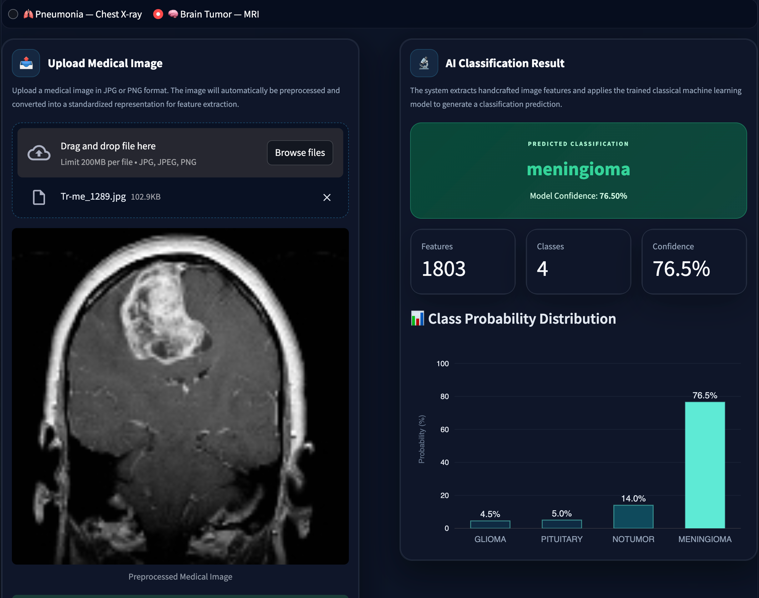
05 · RESULTS
Explainability & Live Deployment
SHAP EXPLAINABILITY
A SHAP TreeExplainer was applied to the best Random Forest model, computing per-feature contribution values on held-out test images. This gives both a global view (which of the 1,803 features matter most overall — dominated by HOG edge/shape and GLCM texture features) and a local view (why one specific image was classified a certain way), turning a classical “black box” into an auditable, clinically-defensible decision.
LIVE STREAMLIT DASHBOARD
Upload a chest X-ray or brain MRI image directly in the browser
Image is preprocessed and run through the saved best model in real time
Returns predicted class, model confidence, and full class-probability distribution
Same app + database backend serves both disease pipelines
MEDFEATURESTORE · RESULTS
Live prediction: meningioma classified at 76.5% confidence
8

