Slide 1
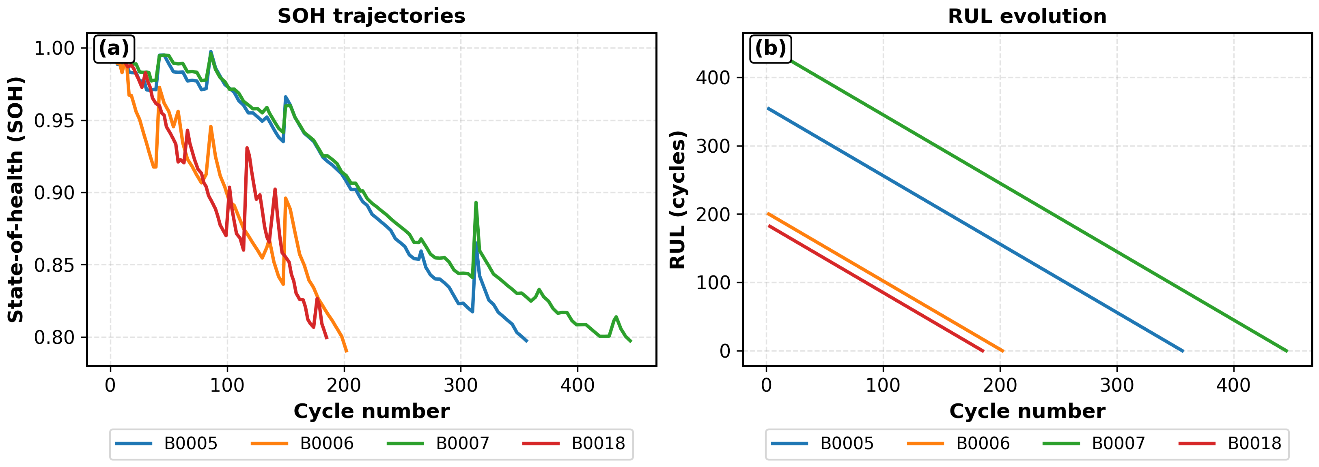
Fig. 1. Motivation: Lifetime indicators vs operational need
(a) SOH and RUL

