Slide 1
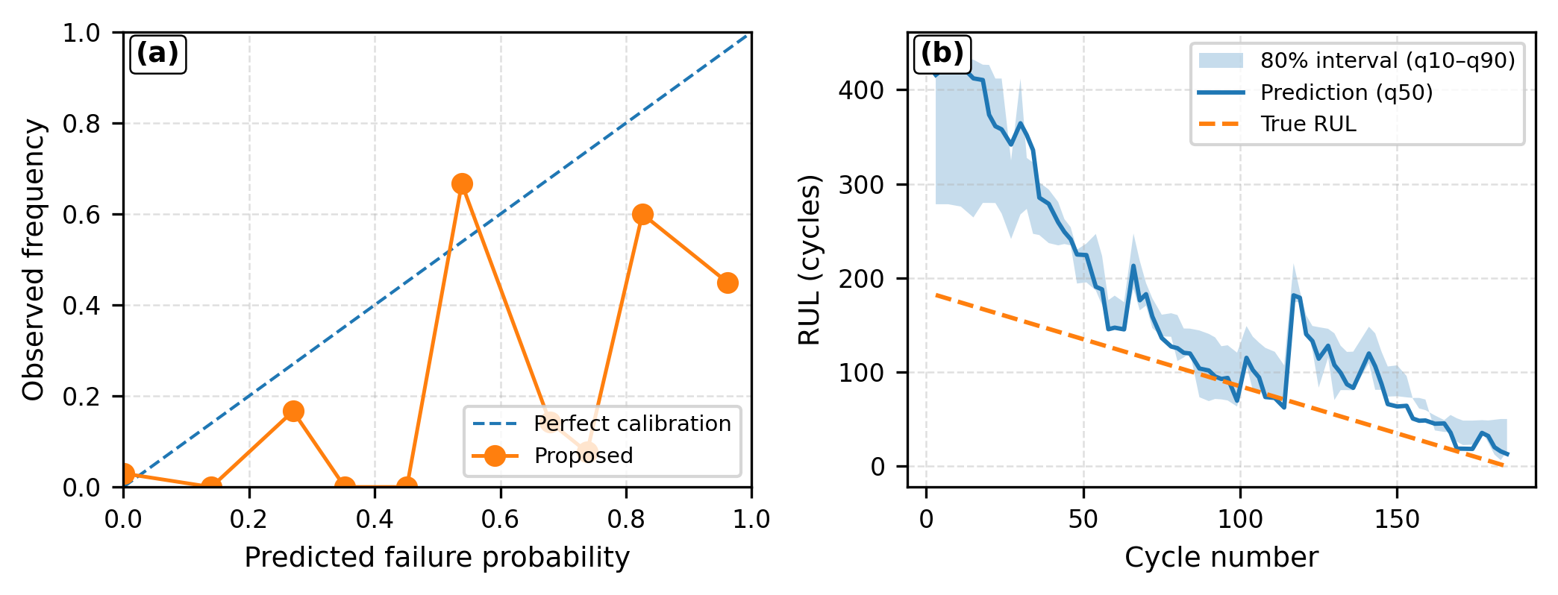
Fig. 2. Probability trustworthiness for operational decisions
(a) Calibration and uncertainty

