Slide 1
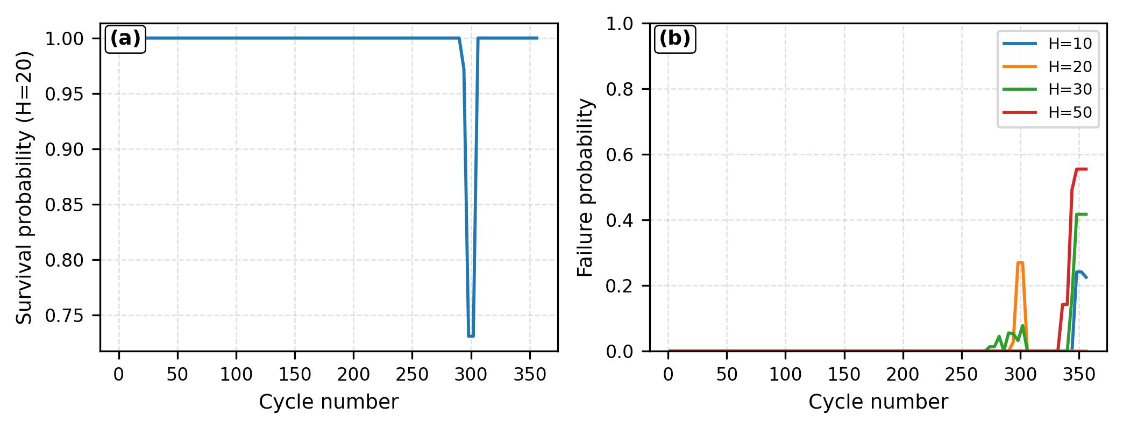
Fig. 3. Multi-horizon operational reliability behavior
(a) Multi-horizon risk

