Slide 1
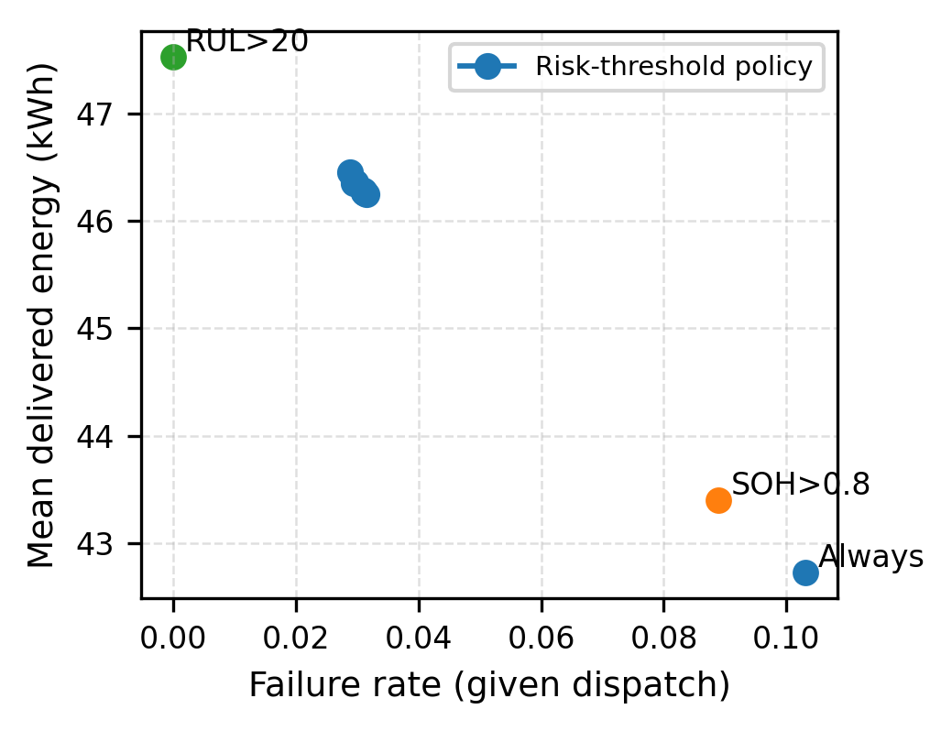
Fig. 4. Operational value: safety-utilization trade-off
(a) Reliability-flexibility trade-off

