Slide 1
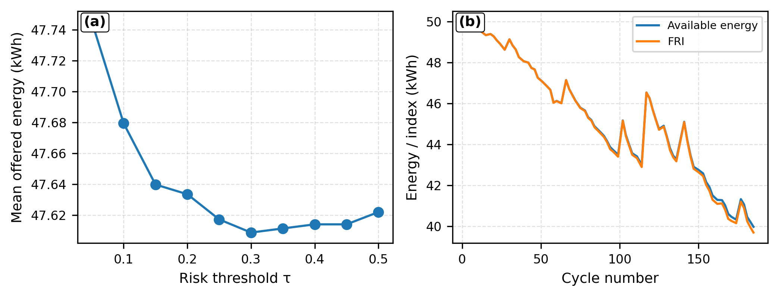
Fig. 5. How the reliability signal becomes an operational constraint
(a) Policy and FRI

