Slide 1
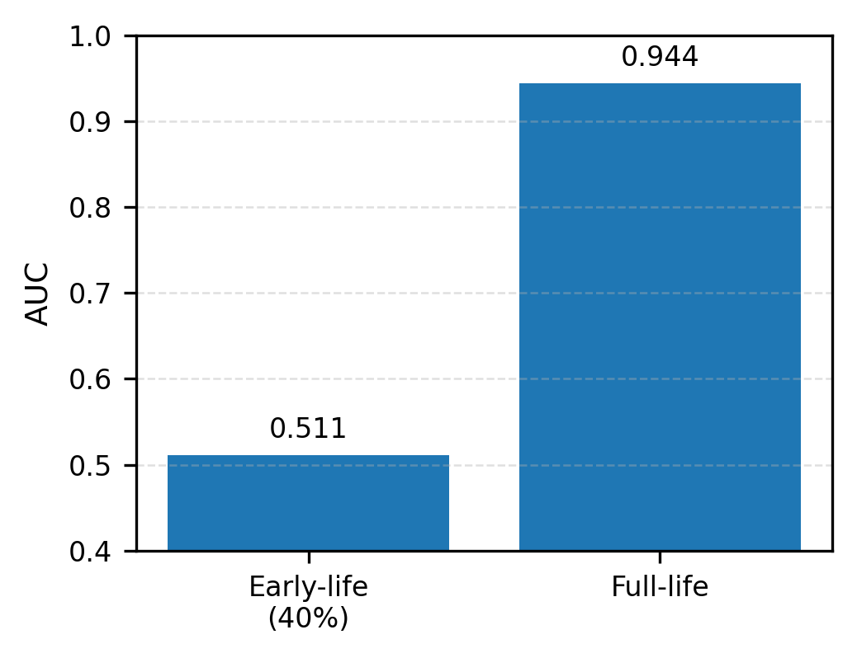
Fig. 6. Observability limits and method insight
(a) Early-life observability

