Slide 1
Multi-Horizon Hazard Models for Battery Failure Prediction
Within-Dataset Reliability and Cross-Chemistry Transferability Hussain Touhid Siddiquee et al. · Department of EEE, Leading University, Sylhet

Slide 2
1
Motivation
The original framework demonstrated feasibility — but several critical questions remain unanswered
Shikdar & Laaksonen (2026): multi-horizon hazard classification on NASA 18650 using HGB — AUC 0.87–0.90
Limited to one model class, one chemistry, no cross-dataset validation
Two open questions:
1. How sensitive are results to model choice (XGBoost, LightGBM, RF) and calibration method?
2. Do models trained on one chemistry (LCO) transfer to another (LFP)?

Slide 3
2
The Composite Failure Label
Failure = SOH drop OR voltage sag. Both must cross a per-cell baseline.
Two independent failure criteria — either triggers a positive label:
• State-of-Health (SOH) ≤ 0.80 of initial capacity
• Average voltage sag < 94% of early-life baseline (first 10 cycles)
Once triggered, label remains positive for all subsequent cycles
Voltage sag catches impedance-driven failures that precede capacity fade
LFP cells: no useful voltage sag (flat plateau at 2.7 V cutoff)

Slide 4
3
Datasets & Models
Dataset | Cells | Chemistry | Total Cycles | Cycles/Cell | Profile
NASA 18650 | 37 | LCO | ~1,000 | ~300 | Random walk, accelerated
CALCE LCO/CX2 | 7 | LCO | 8,733 | 775–1,952 | 1C/1C, slow degradation
Oxford LFP | 5 | LFP | ~1,500 | ~300 | 1C/1C, very stable
Models: XGBoost (depth=4, 300 trees, lr=0.05) · LightGBM (depth=4, 300 trees, lr=0.05) · Random Forest (depth=6, 300 trees) · GRU (1 layer, 8 hidden, W=10, lr=0.005) — compact to avoid overfitting
Tree features: cycle, avg/min voltage, avg current, avg temp, duration, SOH
GRU features: cycle, avg/min voltage, SOH (cross-chem drops avg_current, avg_temp, duration)
All tree-based hyperparameters matched to original study

Slide 5
4
Evaluation Protocol
Two parallel experiments: within-dataset reliability + cross-chemistry transfer
Within-dataset: 5-fold GroupKFold by cell — no cell leaks across folds
Horizons: H ∈ {10, 20, 30, 50} — label positive if failure within [t, t+H)
Calibration: isotonic vs Platt (sigmoid) — cross-chem reports raw AUC (calibration unreliable under distribution shift)
Metrics: AUC (discrimination) + Brier score (calibration + discrimination)
Cross-chemistry: train on all LCO, test on all LFP — 3 variants (NASA, CALCE, ALL)
Feature ablation: with SOH vs without SOH — to isolate SOH contribution

Slide 6
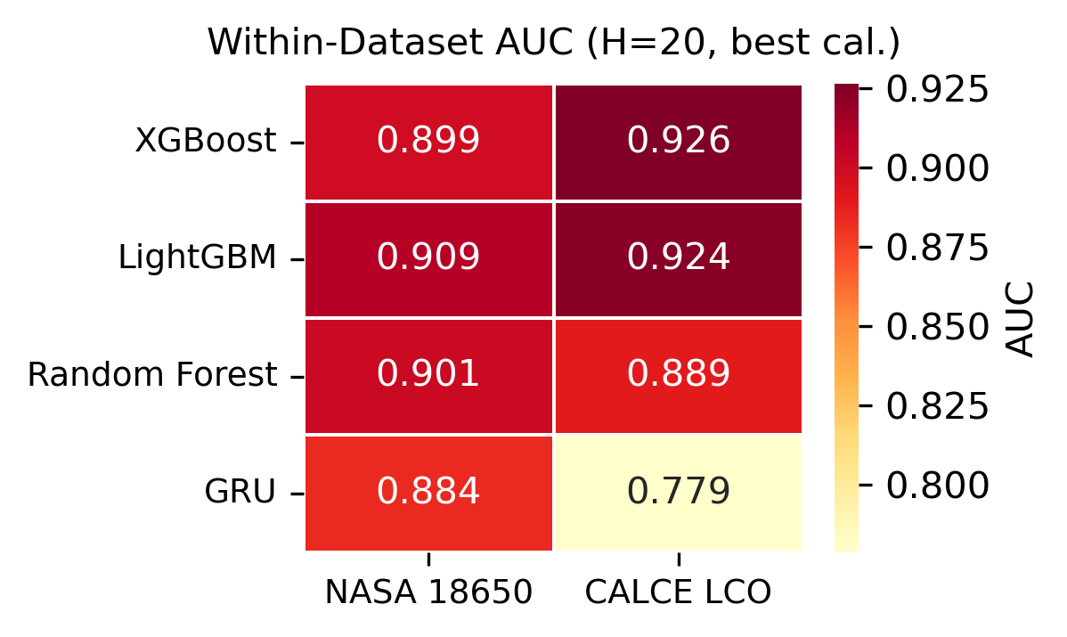
5
Finding 1: Within-Dataset AUC (H=20)

Slide 7
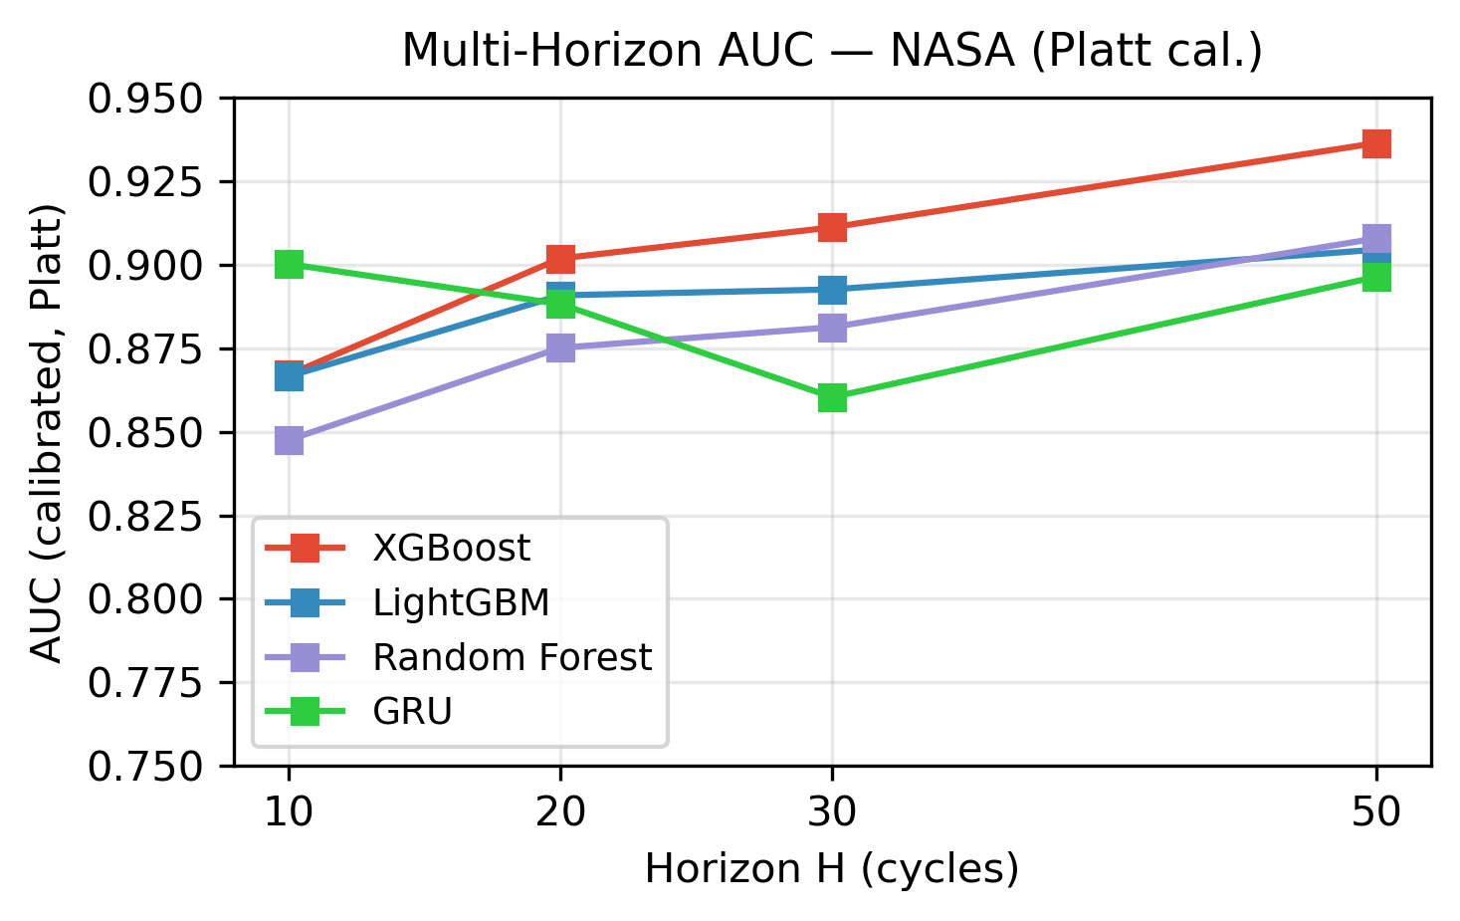
6
Finding 2: Multi-Horizon Performance (NASA)

Slide 8
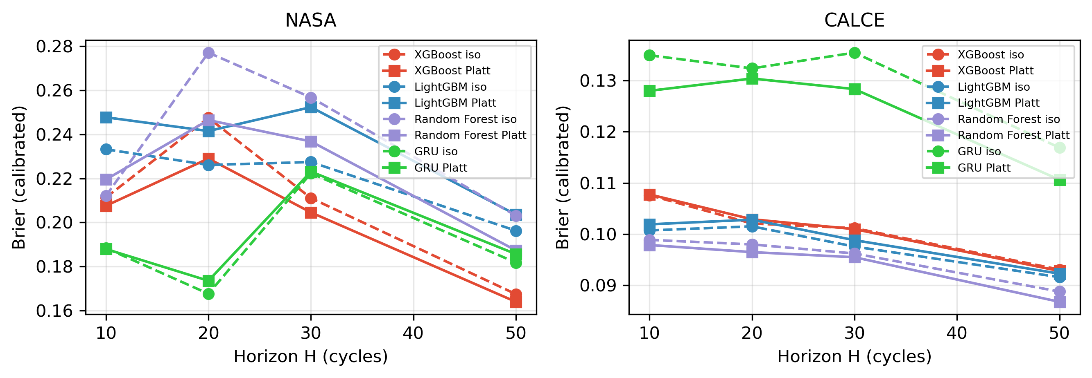
7
Finding 3: Platt vs Isotonic — NASA
NASA (left panel of Fig 2):
Platt AUC: 0.890 vs Isotonic AUC: 0.840
Platt Brier: 0.213 vs Isotonic Brier: 0.214
AUC gap is modest on NASA. Isotonic
partially degrades discrimination on
noisier predictions.

Slide 9
8
Finding 3: Platt vs Isotonic — CALCE
CALCE (right panel of Fig 2):
Platt AUC: 0.904 vs Isotonic AUC: 0.694
AUC gap is dramatic on CALCE
Brier is nearly identical: 0.105 for both
The advantage is in discrimination,
not calibration — isotonic produces
degenerate probabilities on long-tailed data.
Fair comparison: both calibrators use
same underlying model's outputs

Slide 10
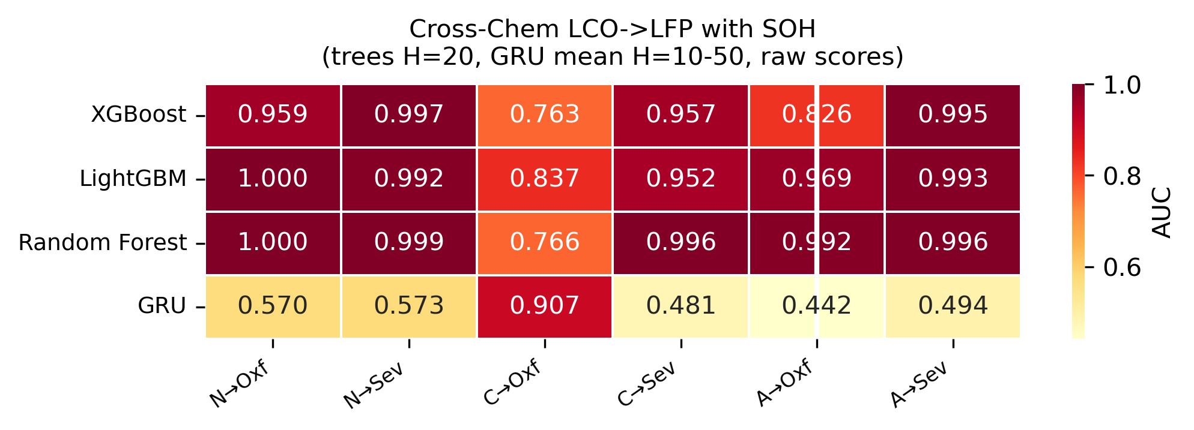
9
Finding 4a: Cross-Chemistry Transfer — With SOH
Raw AUC 0.84–1.00
Per-cell mean ± std across test cells (trees H=20)
Oxford (5 cells) → same pattern
Severson (141 cells) → 0.99+ Platt AUC
NASA→LFP:
0.96–1.00 (σ=0.00–0.03), 0.40 (GRU mean)
CALCE→LFP:
0.84–0.89 (σ=0.00–0.17), 0.32 (GRU mean)
ALL→LFP:
0.98–1.00 (σ=0.00–0.23), 0.26 (GRU mean)
GRU values for CALCE-inclusive sets show
reversal (AUC≈0.03–0.12): CALCE's 92% failure
rate biases the decision boundary → inverted
ranking on Oxford. Not random noise; a
substantive class-imbalance transfer failure.
Distributed state entangles SOH with voltage/cycle
BUT — even with SOH, sequence models
are less able to exploit it than tree-based models

Slide 11
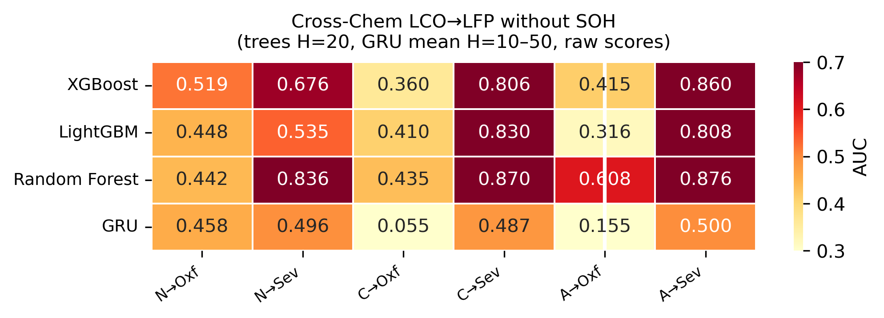
10
Finding 4b: Cross-Chemistry Transfer — Without SOH
Raw AUC 0.08–0.62 (incl. GRU)
Per-cell mean ± std (trees H=20)
Oxford raw: 0.33–0.62 | Severson raw: 0.60–0.75
Trees: near-random (0.33–0.75) across all configs
GRU: reversal in CALCE-inclusive sets
(AUC≈0.12–0.43) from class-imbalance-
driven domain mismatch, not random noise
NASA→LFP (tree):
0.52–0.54 (σ=0.00–0.01)
CALCE→LFP (tree):
0.46–0.62 (σ=0.00–0.22)
ALL→LFP (tree):
0.33–0.47 (σ=0.00–0.25)
No model class — tree-based or sequence-aware —
achieves above-chance AUC once SOH is removed

Slide 12
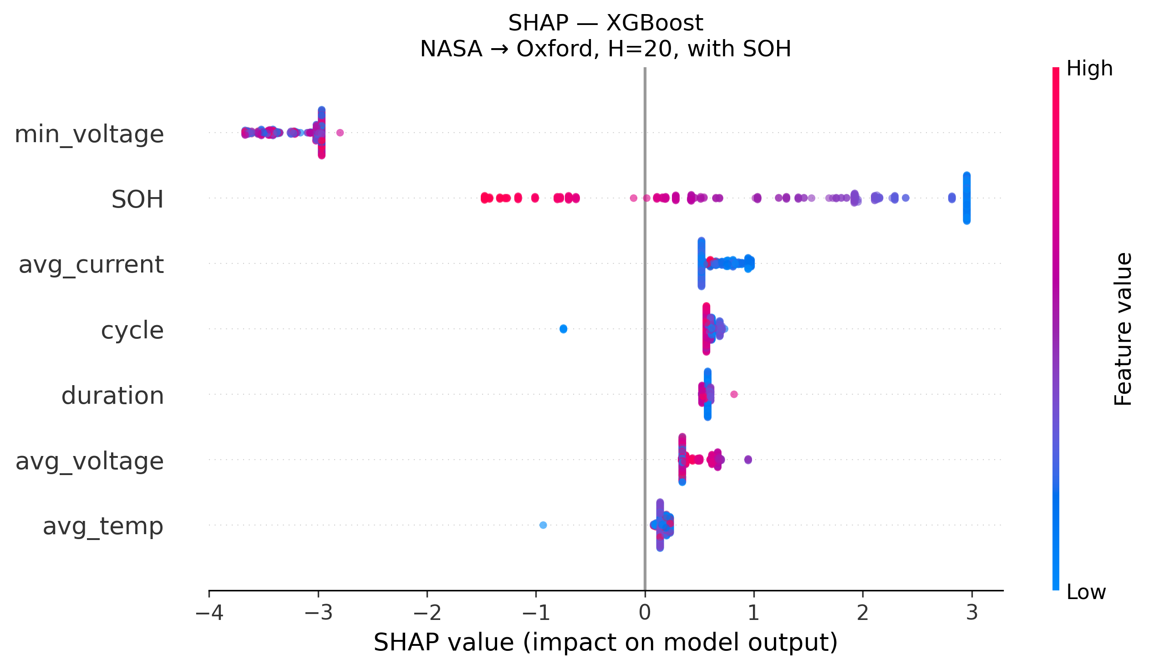
11
SHAP: XGBoost — SOH Dominates

Slide 13
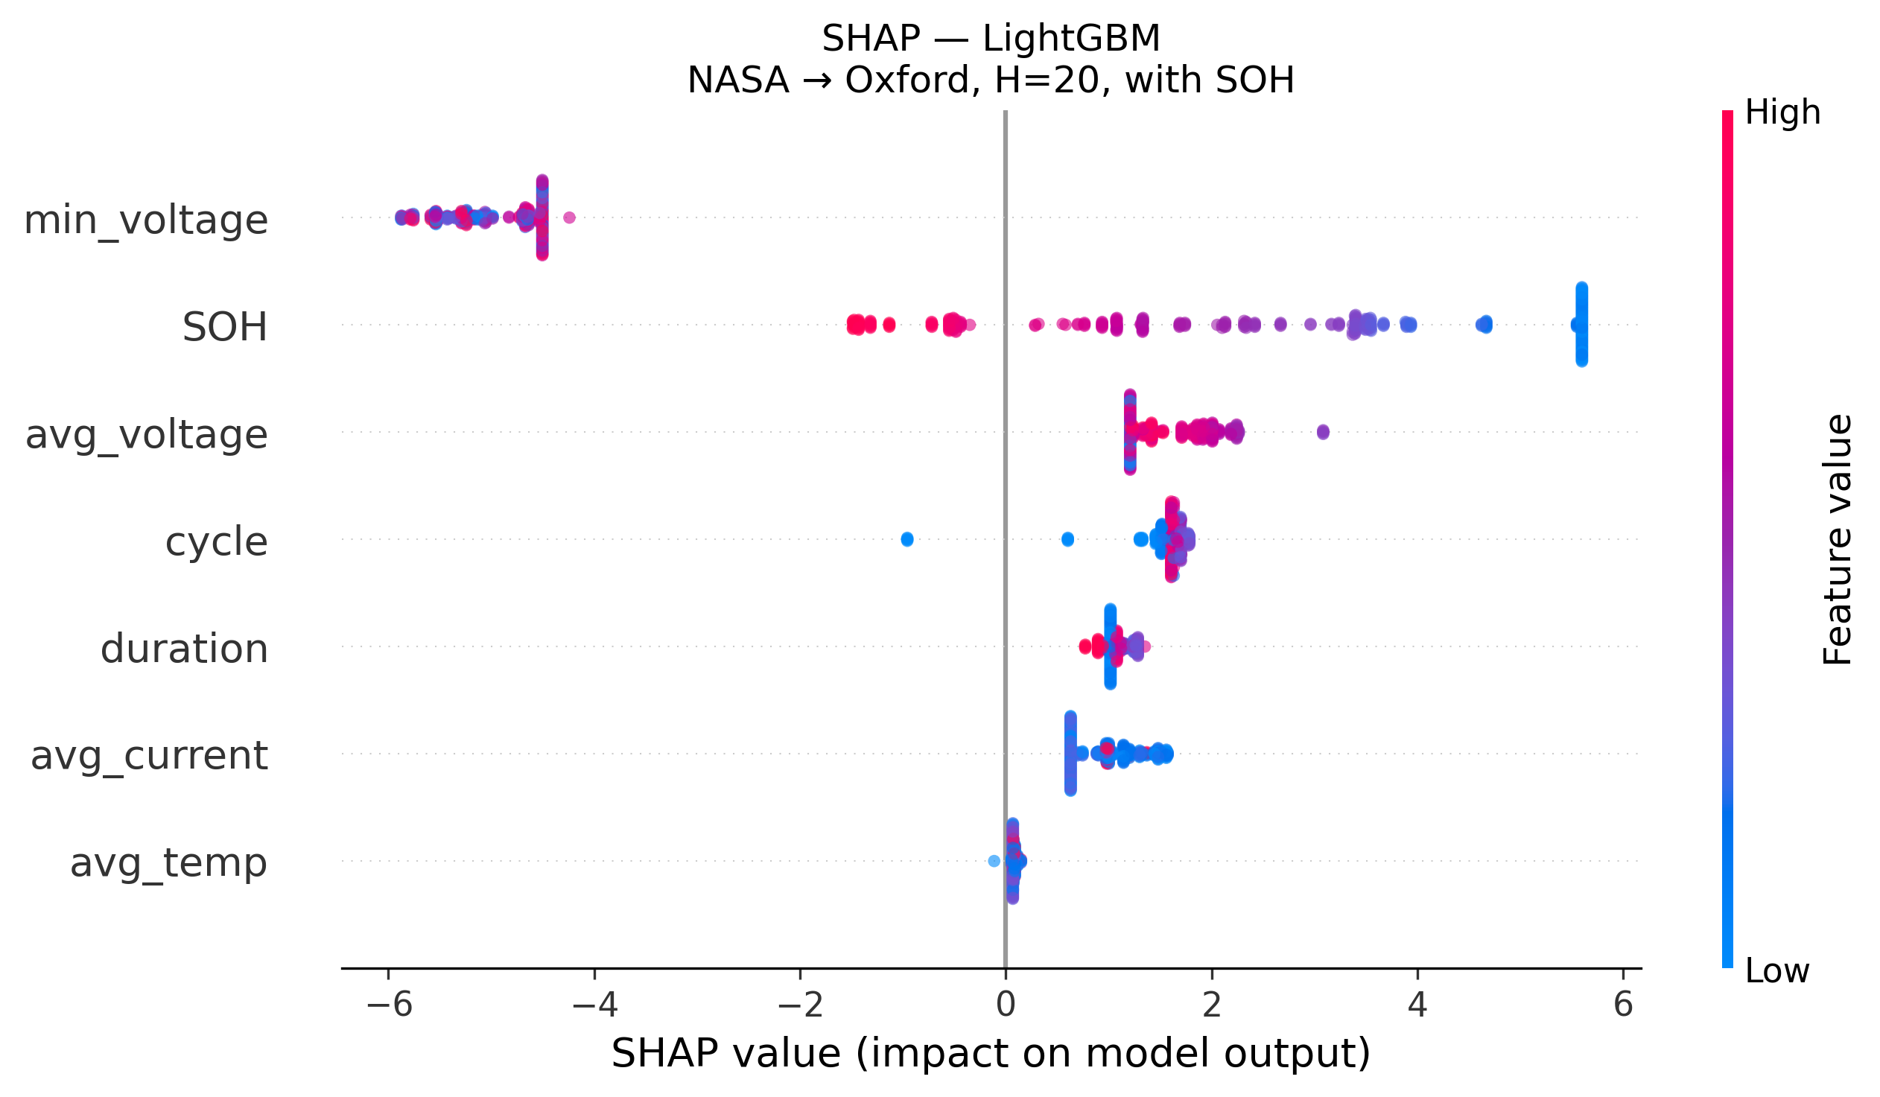
12
SHAP: LightGBM — SOH Dominates

Slide 14
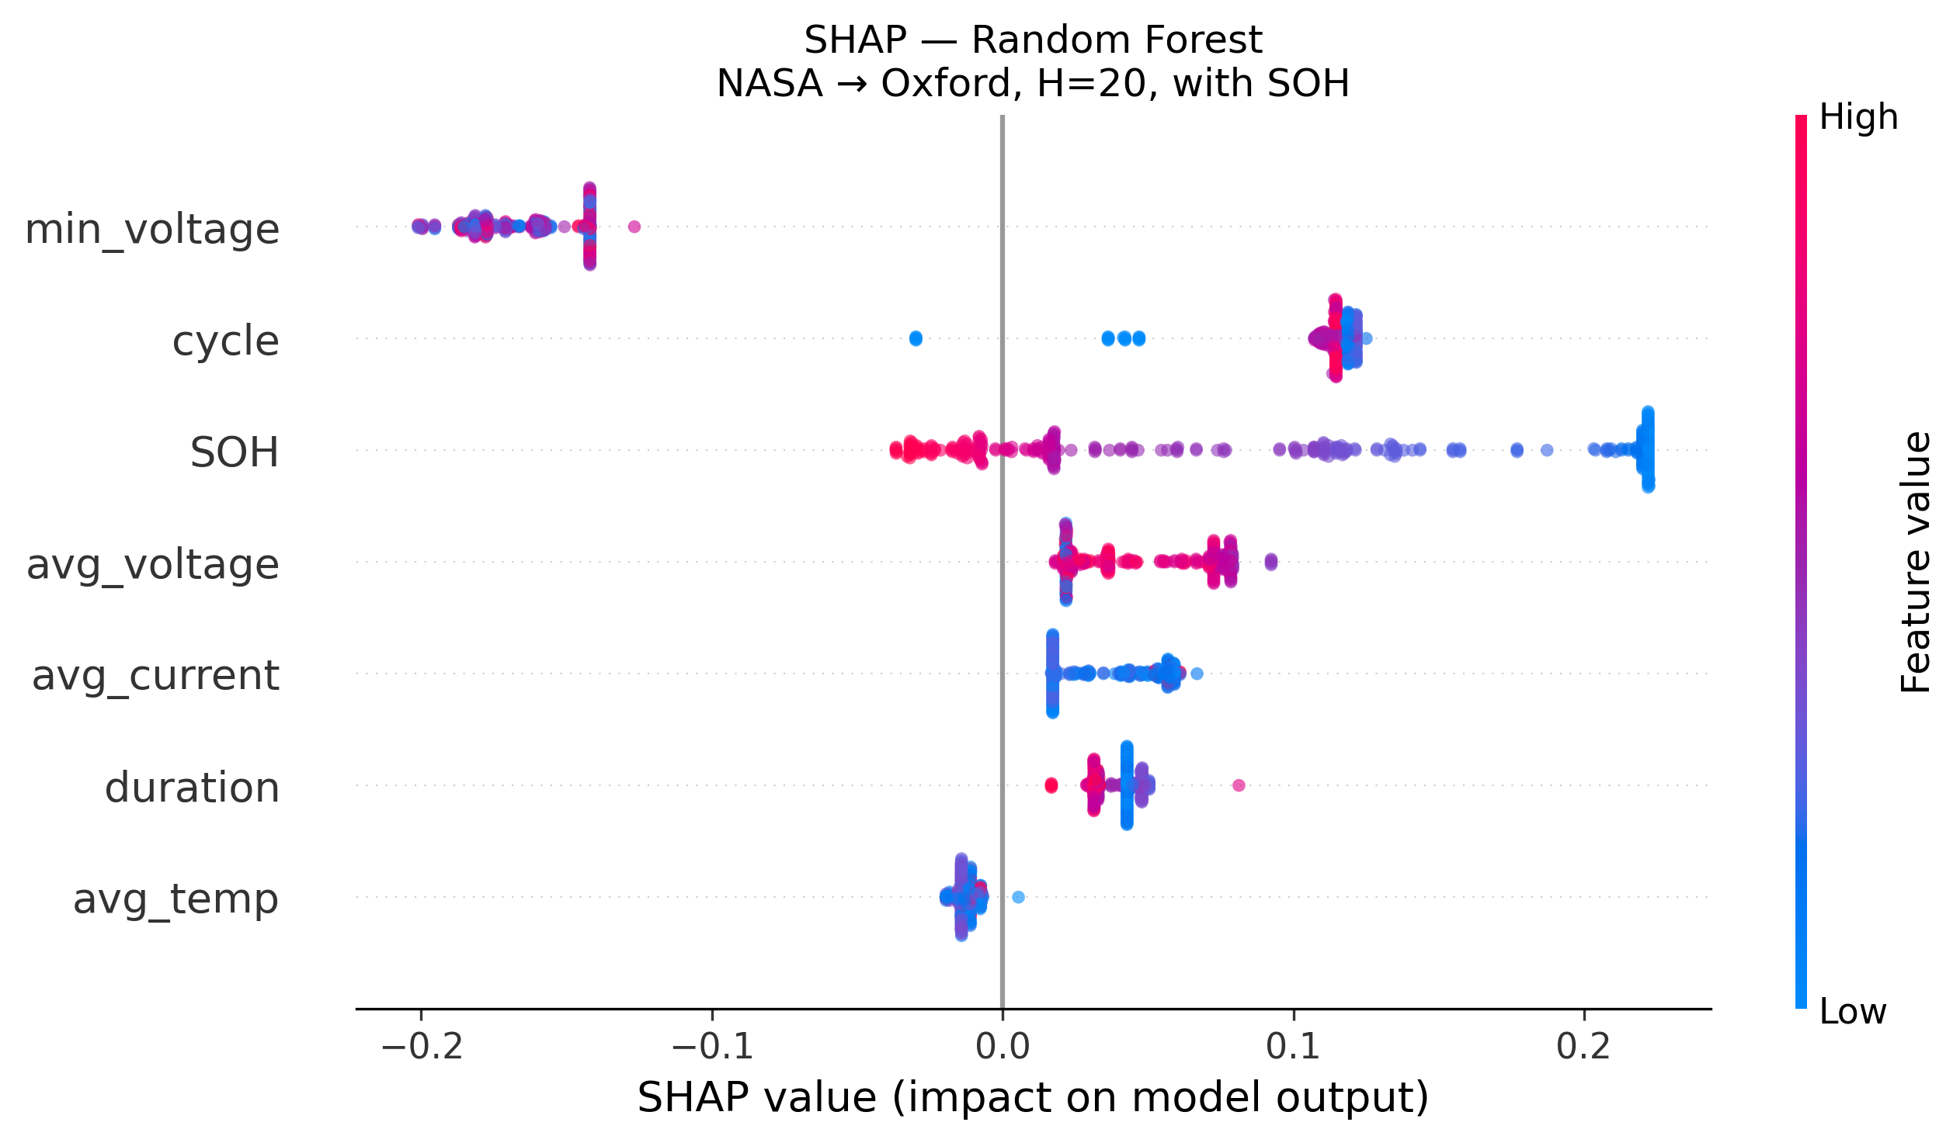
13
SHAP: Random Forest — SOH Dominates

Slide 15
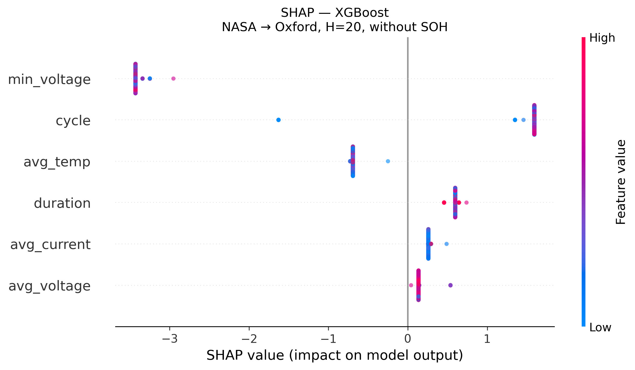
14
SHAP: XGBoost — All Features Collapse Without SOH

Slide 16
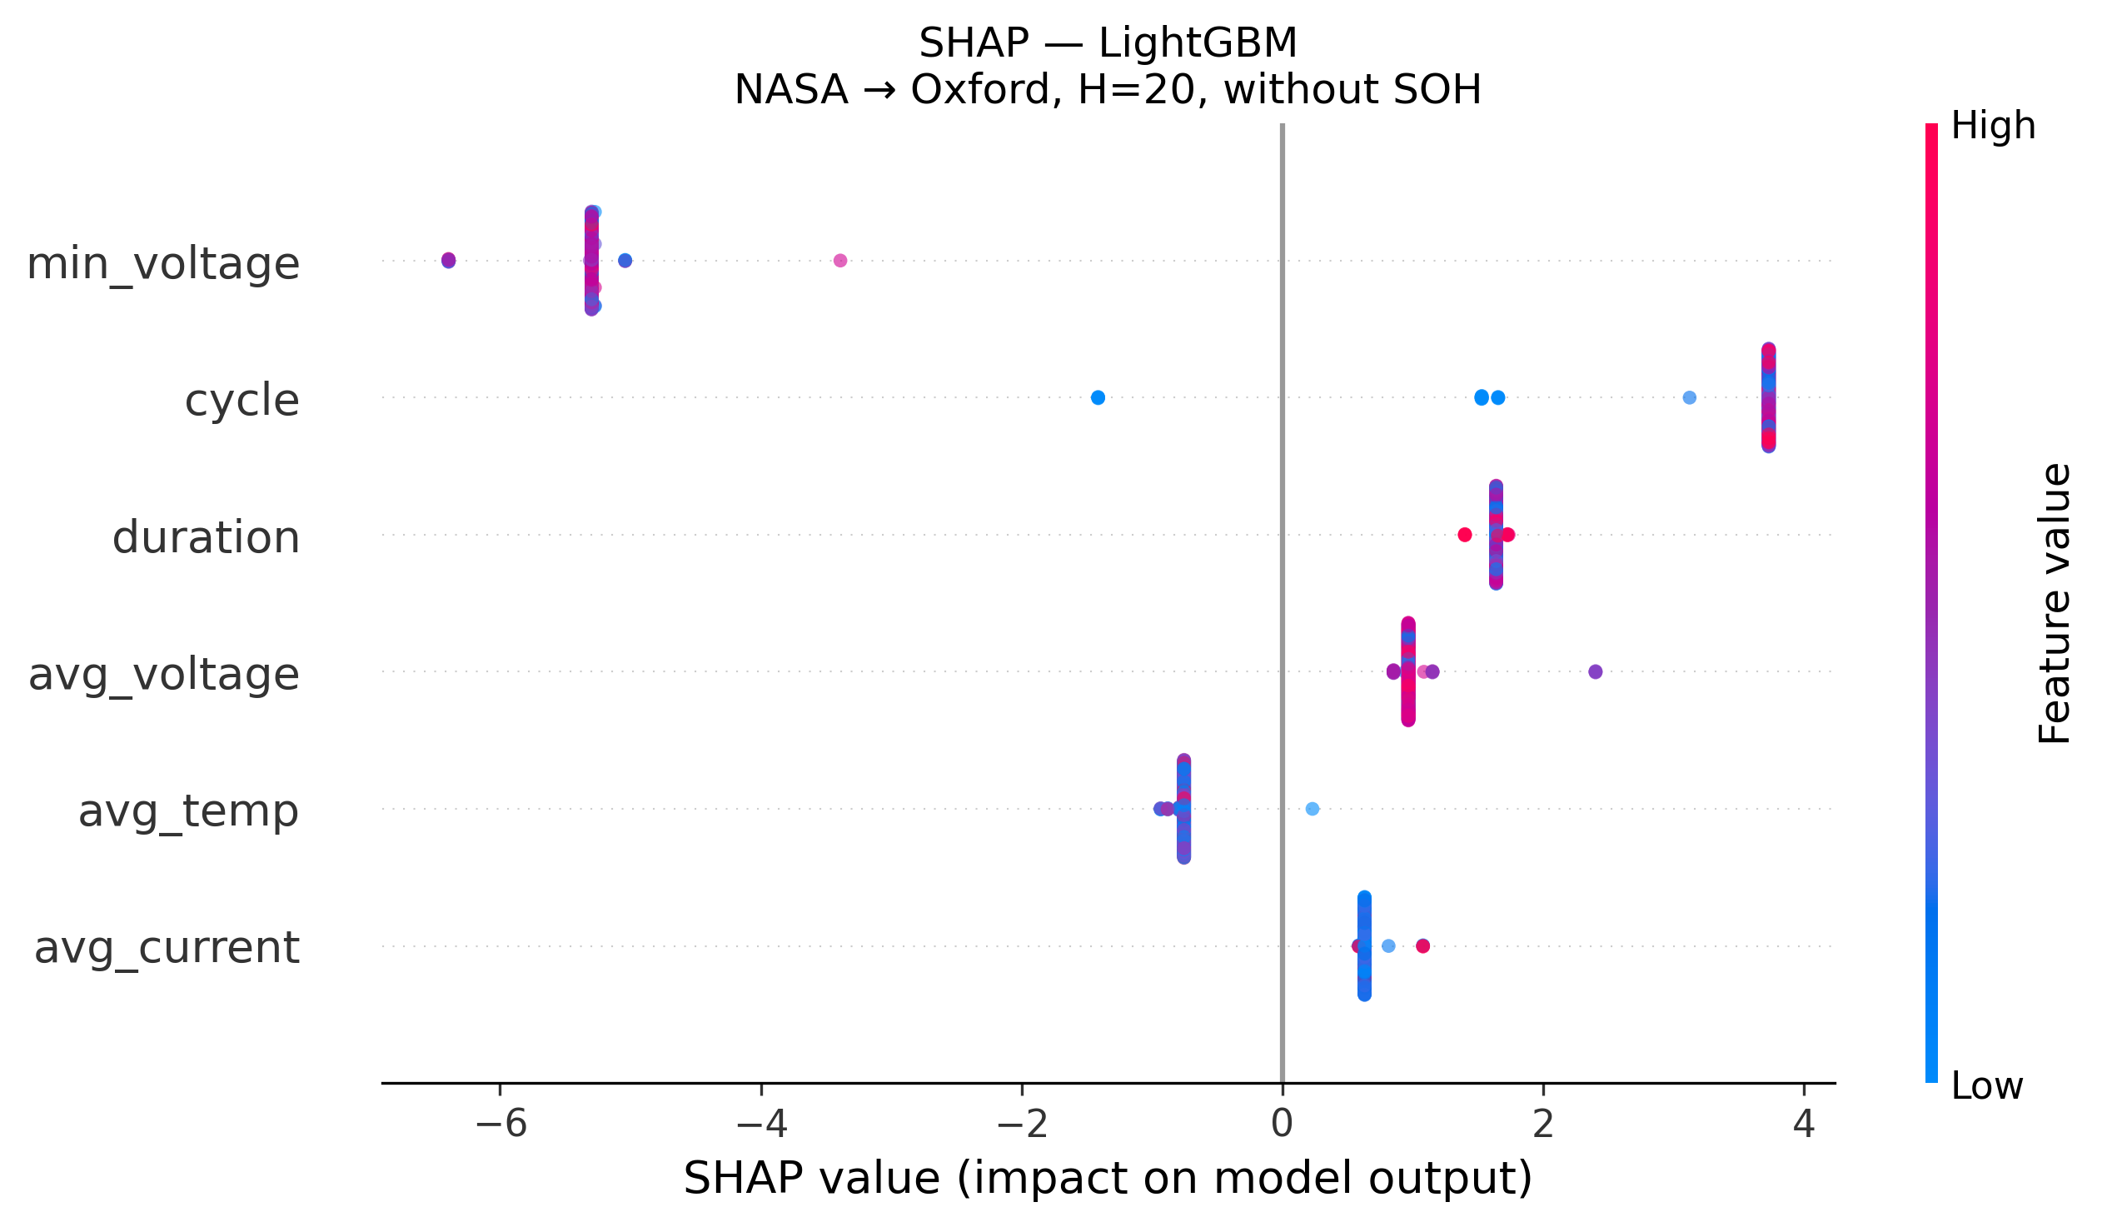
15
SHAP: LightGBM — All Features Collapse Without SOH

Slide 17
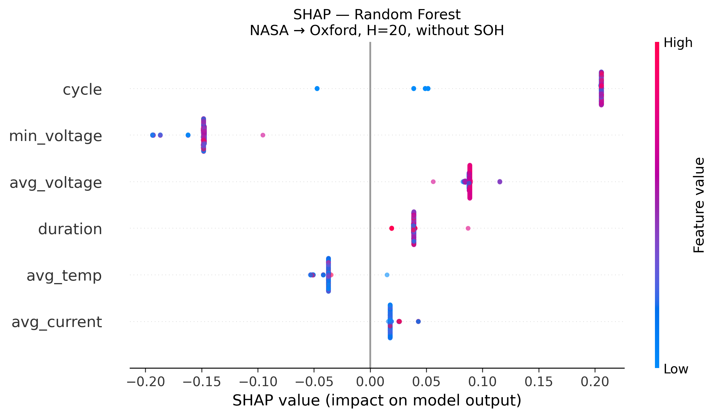
16
SHAP: Random Forest — All Features Collapse Without SOH

Slide 18
17
Statistical Significance — DeLong Test
DeLong nonparametric test compares paired AUC values
SOH Ablation (ALL LCO→LFP, H=20):
Oxford (5 cells):
XGBoost: 0.917 → 0.429 p = 7.2×10⁻⁵¹ ✓
LightGBM: 0.971 → 0.332 p = 2.6×10⁻⁶⁴ ✓
Random Forest: 0.989 → 0.581 p = 6.5×10⁻³⁶ ✓
Severson (141 cells):
XGBoost: 0.896 → 0.750 p < 10⁻¹⁰⁰ ✓
LightGBM: 0.882 → 0.718 p < 10⁻¹⁰⁰ ✓
Random Forest: 0.889 → 0.746 p < 10⁻¹⁰⁰ ✓
All models, both LFP targets: p < 10⁻³⁶ — decisive
SOH-ablation gap is not due to chance
Within-dataset (CALCE): all model pairs p < 10⁻⁵
Within-dataset (NASA): only XGB vs LGBM reaches p=0.014

Slide 19
18
Why? The SOH-as-Lookup-Table Mechanism
When SOH is available as a feature: • Model learns: SOH=0.85 means ~50 cycles to failure from LCO training data • LFP cells traverse similar SOH trajectories • Model applies the same learned mapping — predictions correlate with SOH, not with LFP-specific degradation • Result: high AUC, but no actual chemistry transfer When SOH is removed: voltage/current/temperature patterns alone carry no transferable signal LCO→LFP GRU finding: even with SOH, compressed 8-unit hidden state must share capacity across SOH, voltage, and cycle — under shift the entangled noise corrupts SOH signal. Tree-model isolated splits avoid this entirely — architecture design matters as much as capacity.
SOH is not a transferable feature — it is a chemistry-specific capacity-to-RUL lookup table

Slide 20
19
Key Takeaway
Cross-chemistry transfer of hazard-based battery failure prediction remains an open problem.
Within-dataset reliability is strong (AUC ≥ 0.85, including GRU). But no model class — tree-based or sequence-aware — achieves genuine cross-chemistry transfer without SOH. Practitioners should not expect LCO-trained hazard models to generalize to LFP without chemistry-specific retraining or domain adaptation.

Slide 21
20
Limitations
Oxford LFP: only 5 cells (partially mitigated by Severson LFP, 141 cells — reproduces all qualitative findings)
Cross-chemistry: unidirectional only (LCO→LFP); may not generalize to LCO→NMC, NMC→LFP
GRU cross-chem unstable across H (e.g., CALCE→Oxford ranges 0.022–0.978); mean-H reported in figures
Brier gap with published paper: published Brier 0.032 vs reproducible 0.17–0.26 (noted in discrepancy note)
Voltage sag feature dead for LFP: always at 2.7 V cutoff — no useful signal
Calibration fails under cross-chem distribution shift: isotonic collapses AUC (0.98→0.51), Platt unstable — raw AUC used
Promising directions: physics-informed features (ICA/DVA), few-shot fine-tuning, domain adaptation minimizing LCO↔LFP distribution gap

Slide 22
21
Next Steps
Train on larger multi-chemistry datasets with balanced cell counts across chemistries
Develop learned feature representations designed explicitly for chemistry invariance (e.g., domain-adversarial training)
Bidirectional transfer evaluation: LCO↔NMC, NMC↔LFP, LCO↔LFP
Sequence models with explicit invariance objectives (GRU tested — fails without SOH; need domain-adversarial)
Reproduce and close the Brier gap with the published paper

