Slide 1
Multi-Horizon Hazard Models for Battery Failure Prediction
Can we predict battery failure across different chemistries? Hussain Touhid Siddiquee et al. · Department of EEE, Leading University, Sylhet

Slide 2
The Problem
Batteries fail over time — we want to predict failure before it happens
This helps EVs, phones, and grid storage operate safely
Previous work tested only ONE battery type (LCO laptop batteries)
Question 1: Do different AI models give different results?
Question 2: Can we train on one chemistry and predict on another?

Slide 3
What Does “Failure” Mean?
We check two vital signs, like a doctor checking health:
1. State-of-Health (SOH) — battery capacity dropped below 80%
2. Voltage Sag — power drops suddenly before capacity fades
Either one triggered = “failure” label
Once triggered, stays triggered — batteries don’t heal

Slide 4
The Batteries We Tested
NASA 18650: 37 LCO cells (laptop chemistry), ~300 cycles each
CALCE LCO/CX2: 7 LCO cells, 775–1952 cycles each
Oxford LFP: 5 LFP cells (EV chemistry), ~300 cycles each
LCO → train. LFP → test. Train on LCO, predict on LFP? That’s the key question.

Slide 5
How We Tested
Four AI models: XGBoost, LightGBM, Random Forest, GRU (sequence model)
GRU: 1 layer, 8 hidden units (compact to avoid overfitting), sliding window of 10 cycles per cell
Four prediction windows: 10, 20, 30, 50 cycles ahead
Two calibration methods: isotonic (freehand) vs Platt (smooth curve)
⚠ Critical: test with SOH feature AND without it

Slide 6
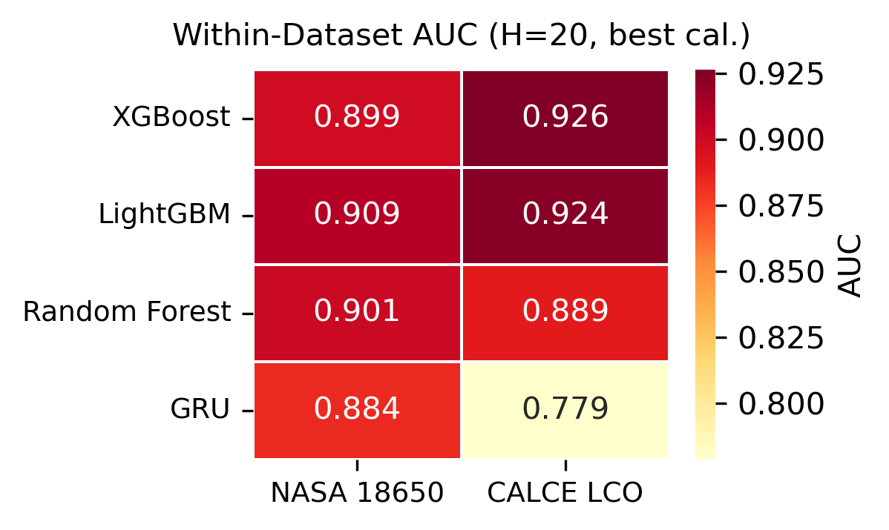
Finding 1: Works on Known Batteries
All models (including GRU) score AUC ≥ 0.85 on NASA and CALCE — the framework is reliable on familiar chemistries

Slide 7
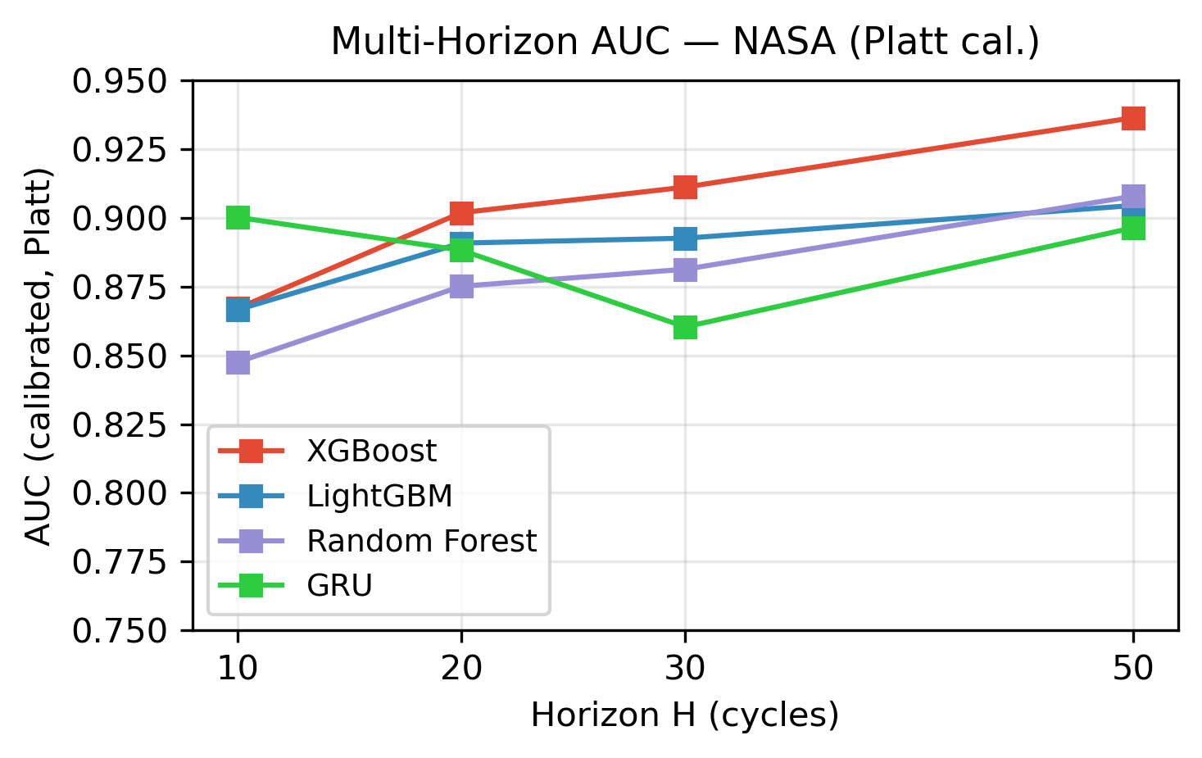
Finding 2: Longer Windows = Easier
Predicting 50 cycles ahead is easier than 10 — more time gives more data to work with

Slide 8
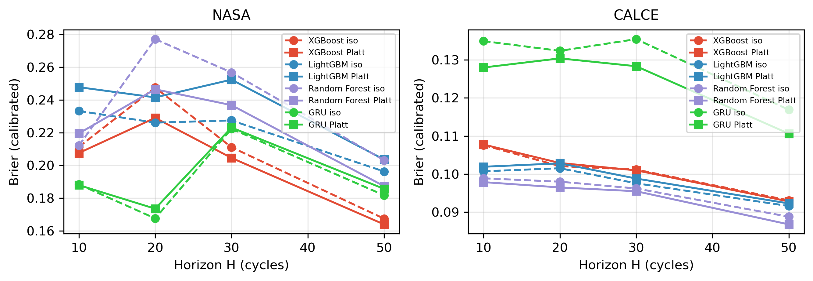
Finding 3: Getting Probabilities Right
Platt calibration (solid lines) always beats isotonic (dashed). Especially important for CALCE.

Slide 9
Why Platt Calibration is Better
Think of isotonic as drawing a freehand squiggle to fit the data:
• Follows every bump — works fine on small, clean datasets
• But overfits on messy, long-tailed data (like CALCE’s 8733 cycles)
Platt uses a smooth S-curve instead:
• Like taking a step back and seeing the big picture
• More robust — it doesn’t chase noise
CALCE: Platt AUC=0.904 vs isotonic AUC=0.694 (discrimination gain); Brier nearly identical at 0.105

Slide 10
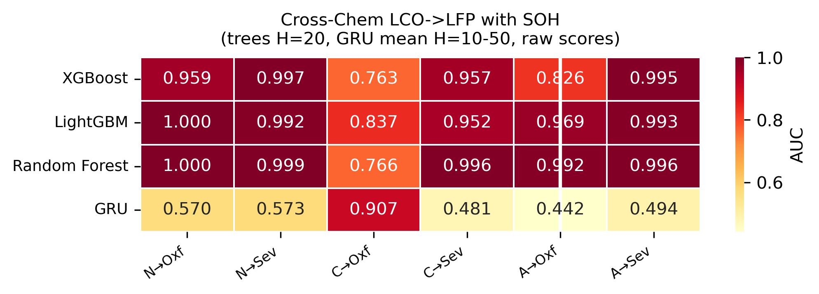
Finding 4a: Looks Like It Works…
With SOH (raw AUC, trees H=20, GRU mean H): tree models 0.84–1.00; GRU 0.26–0.40. CALCE-inclusive GRU reversal (AUC≈0.03–0.12) signals class-imbalance transfer failure, not noise

Slide 11
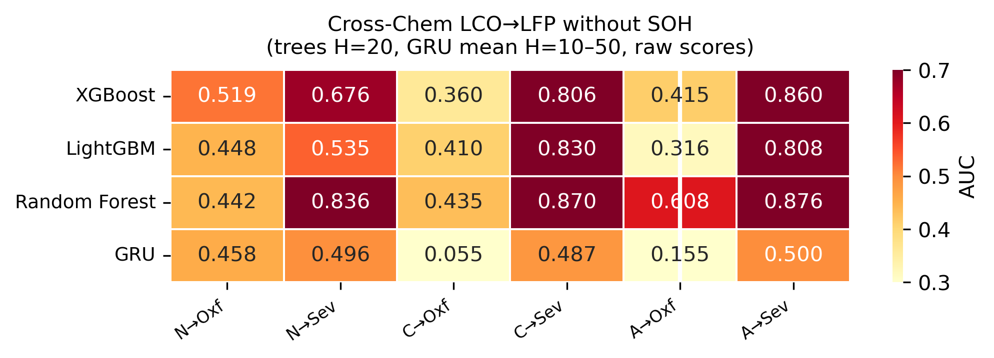
Finding 4b: …But It’s a Trick
Without SOH: trees near-random (0.33–0.62); GRU near-random across all configs (AUC≈0.08–0.42 mean-H) — substantive transfer failure, not label-polarity choice

Slide 12
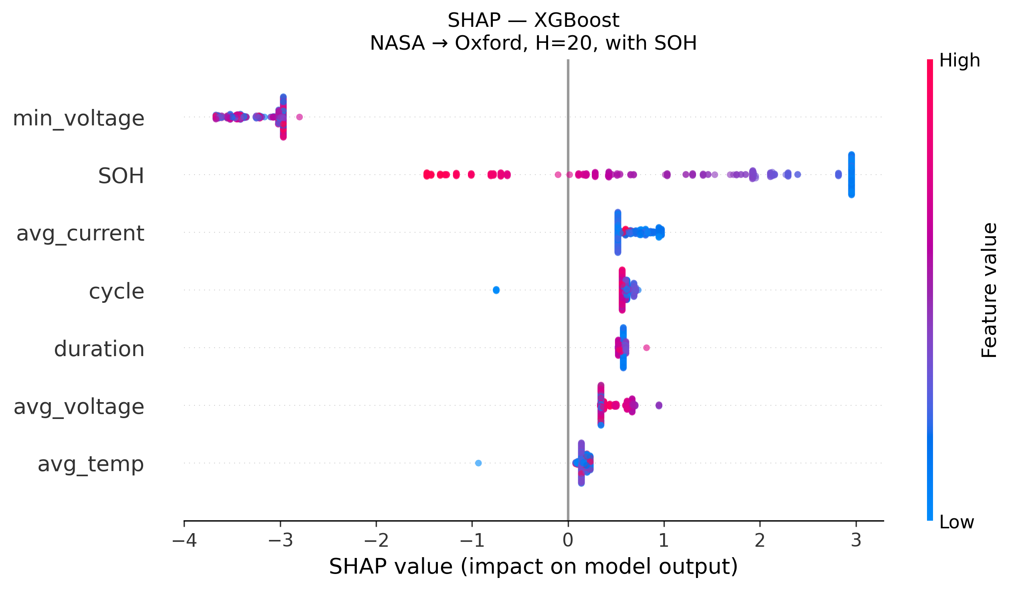
SHAP: XGBoost — SOH Dominates
SHAP analysis: SOH dominates XGBoost split decisions in cross-chemistry transfer (NASA→Oxford, H=20)

Slide 13
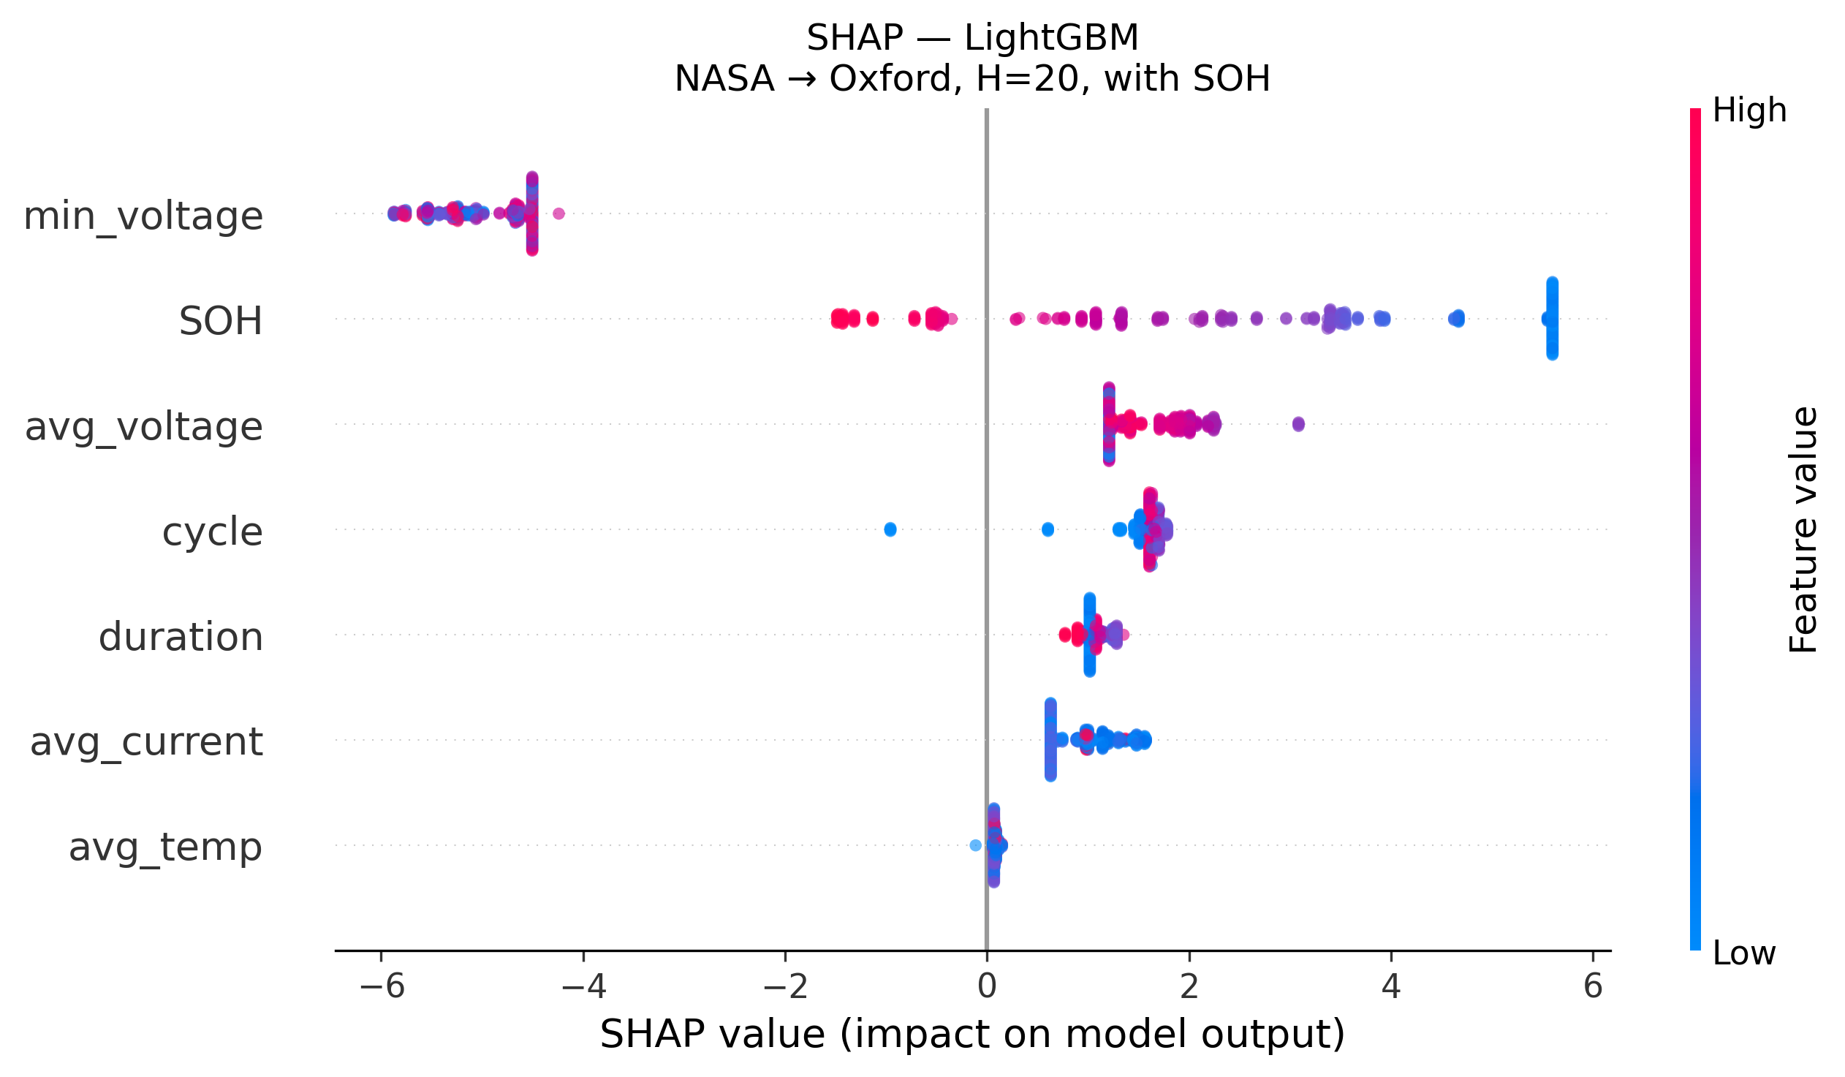
SHAP: LightGBM — SOH Dominates
SHAP analysis: SOH dominates LightGBM split decisions in cross-chemistry transfer (NASA→Oxford, H=20)

Slide 14
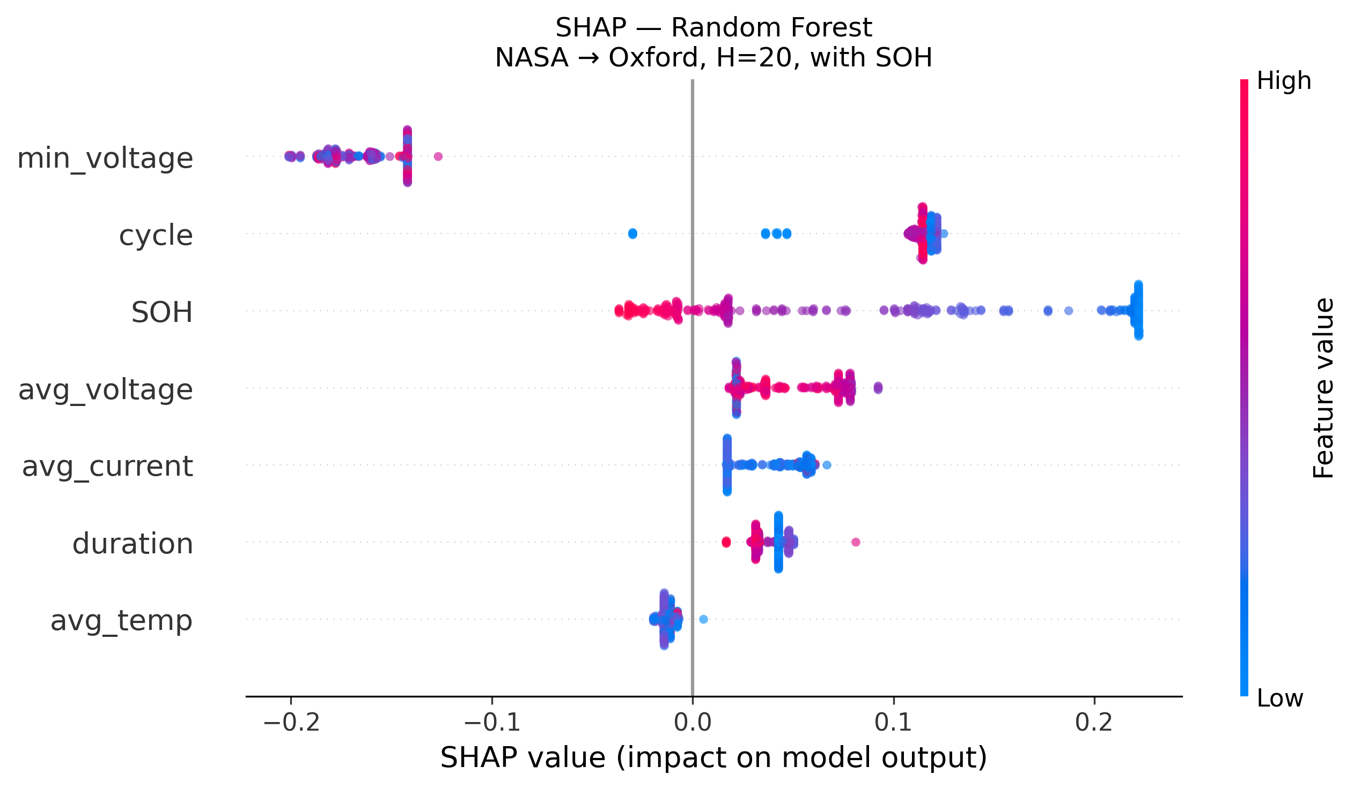
SHAP: Random Forest — SOH Dominates
SHAP analysis: SOH dominates Random Forest split decisions in cross-chemistry transfer (NASA→Oxford, H=20)

Slide 15
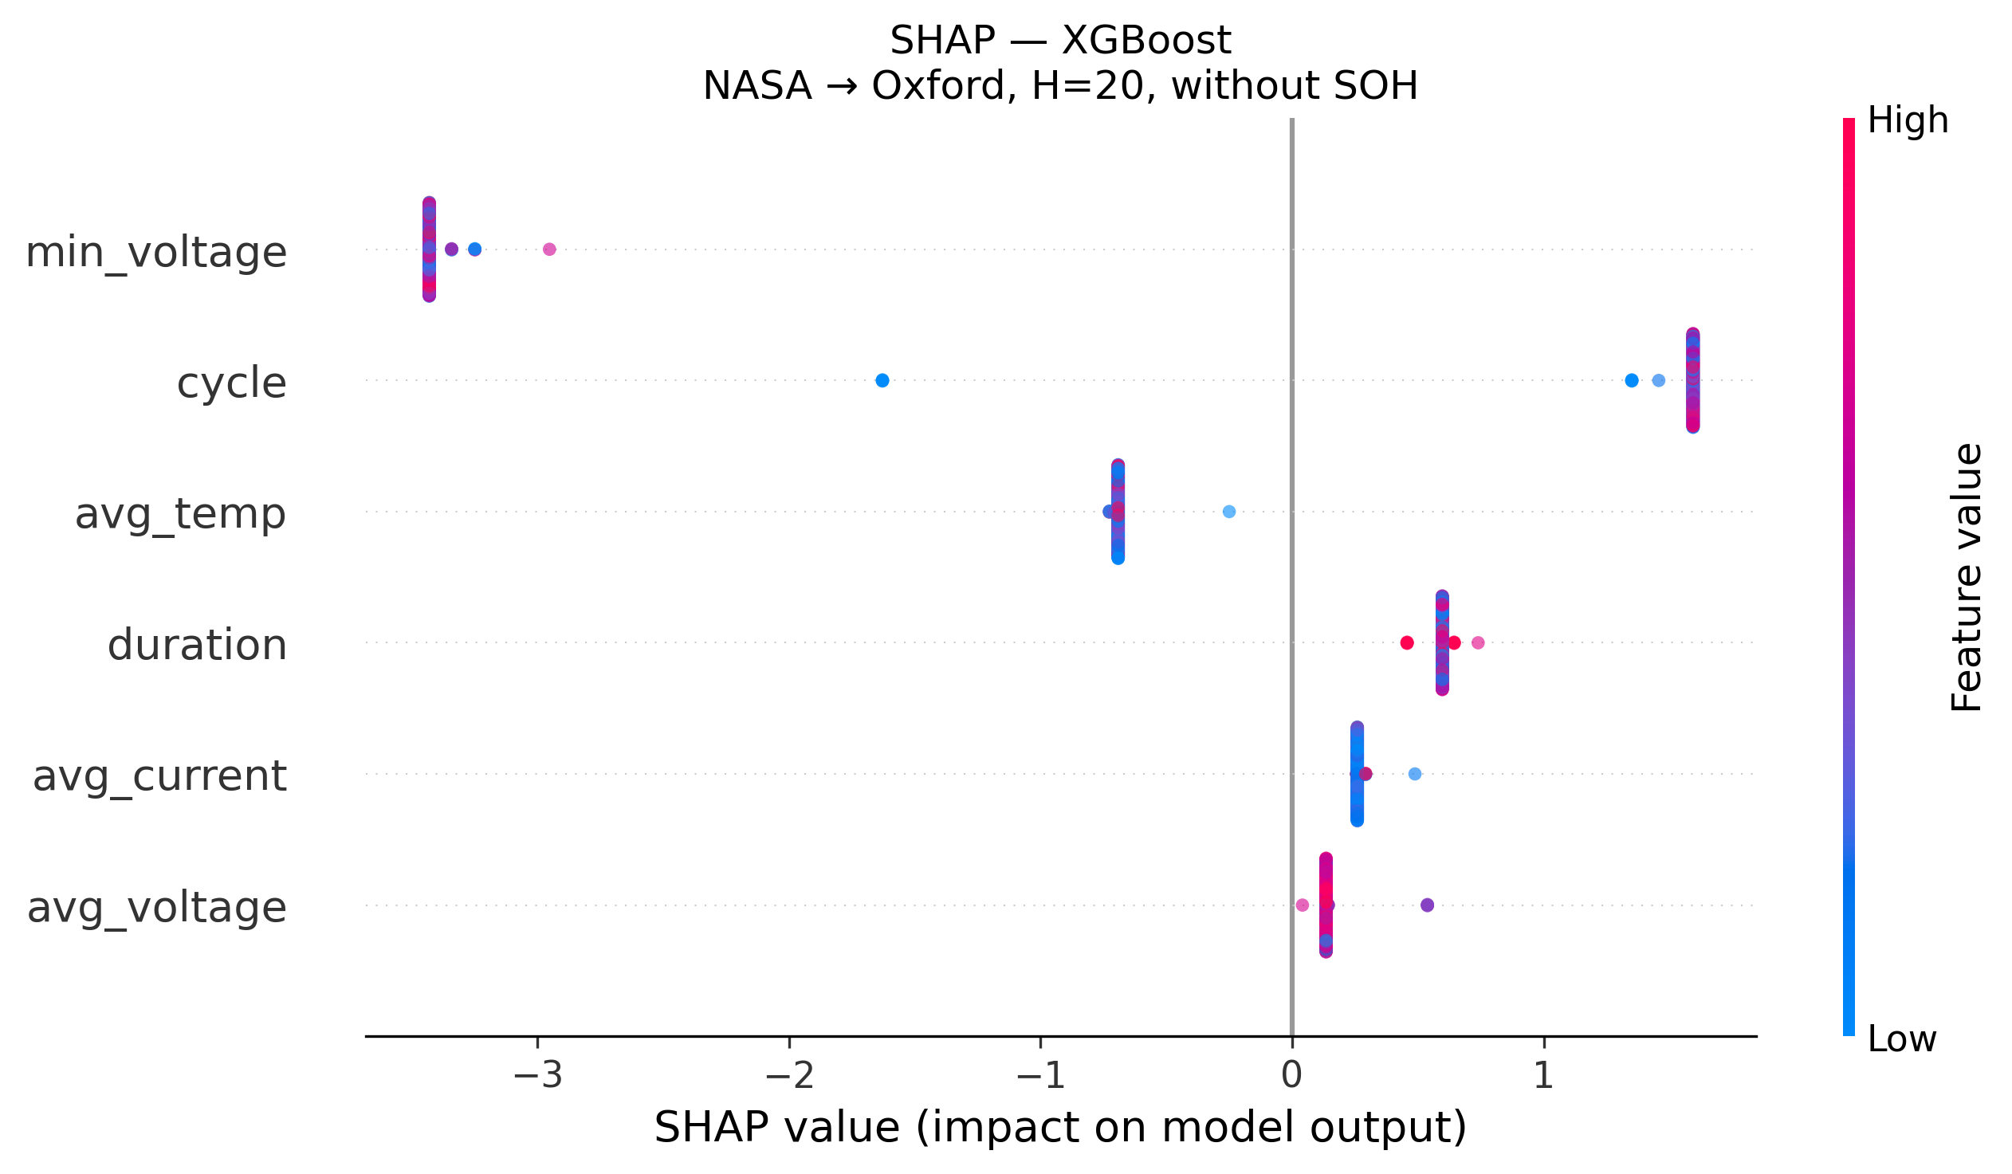
SHAP: XGBoost — All Features Collapse Without SOH
Without SOH, XGBoost SHAP values collapse to near-zero spread — no meaningful feature ranking (NASA→Oxford, H=20)

Slide 16
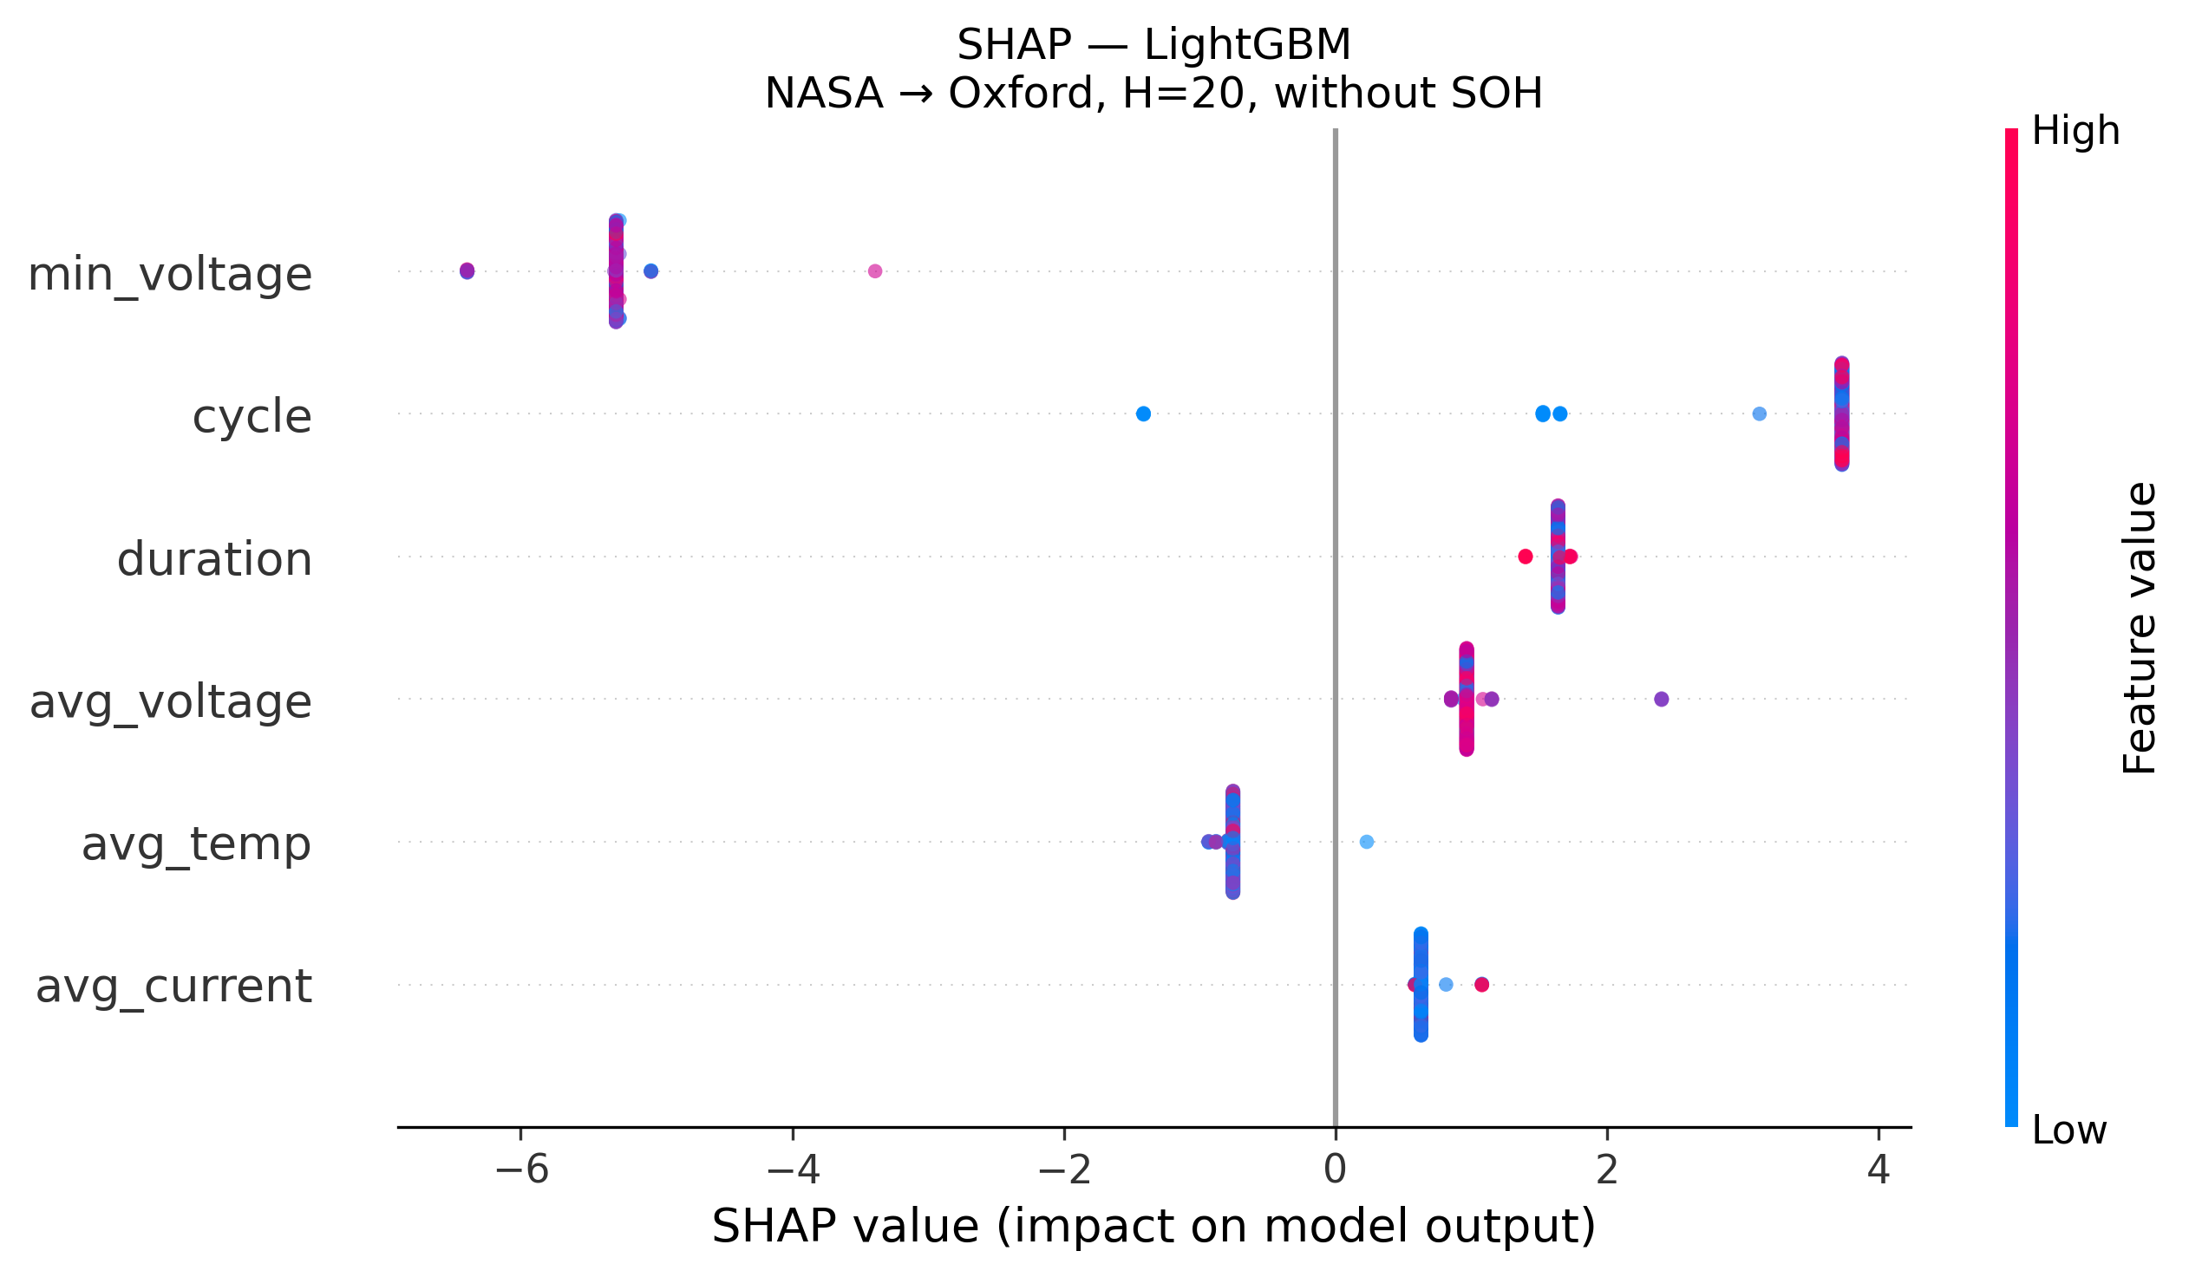
SHAP: LightGBM — All Features Collapse Without SOH
Without SOH, LightGBM SHAP values collapse to near-zero spread — no meaningful feature ranking (NASA→Oxford, H=20)

Slide 17
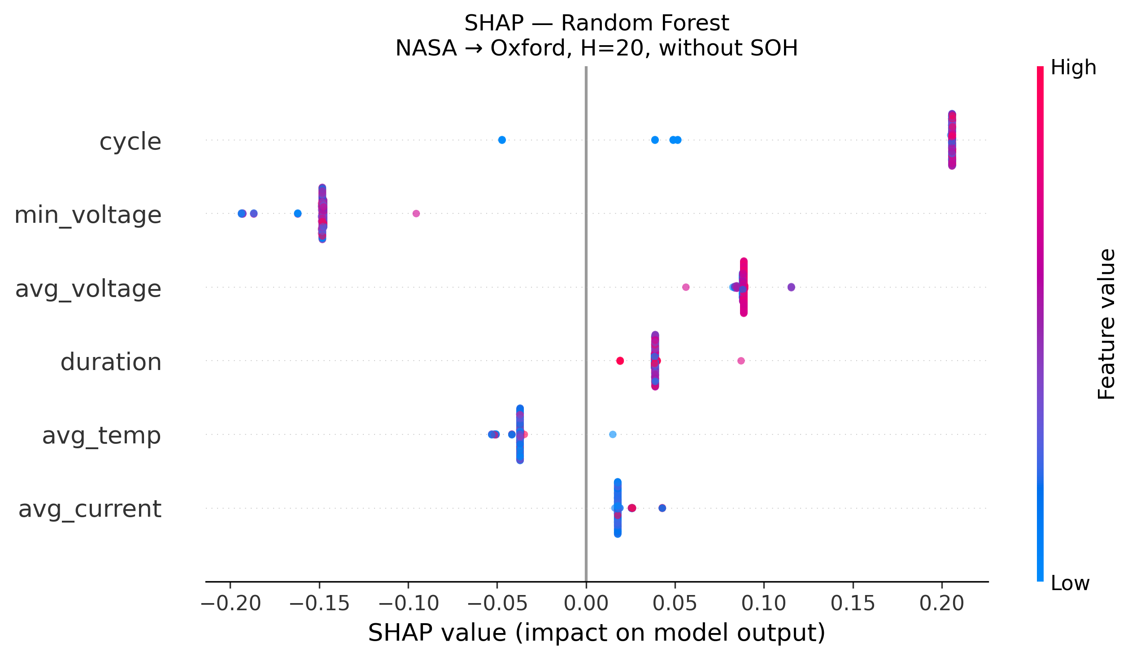
SHAP: Random Forest — All Features Collapse Without SOH
Without SOH, Random Forest SHAP values collapse to near-zero spread — no meaningful feature ranking (NASA→Oxford, H=20)

Slide 18
The “SOH Lookup Table”
When the model has SOH, it learns this rule:
“SOH = 85% → about 50 more cycles before failure”
It memorizes this from LCO training data
LFP batteries happen to have similar SOH values…
…so the model applies the same wrong rule to LFP
Result: predictions look good (high AUC)
But: the model learned nothing about LFP itself — just reused a lookup table
GRU reveals architecture-specific fragility: 8-unit hidden state shares capacity across SOH + voltage + cycle → under shift, entangled noise corrupts SOH signal. AUC swing 0.011–0.986 within a single config — the instability itself is the finding.

Slide 19
What This Means
The hazard framework works reliably within the same battery chemistry (AUC ≥ 0.85, including GRU).
But cross-chemistry transfer remains an open problem for all model classes. You cannot train on LCO and deploy on LFP without SOH — and SOH is a chemistry-specific lookup key.

Slide 20
Caveats
Oxford LFP: only 5 cells — mitigated by Severson (141 cells) but both LFP only
Severson LFP: fast-charging protocol (4C discharge), voltage sag uniformly uninformative across both LFP datasets
Tested one direction only (LCO → LFP)
GRU cross-chem instability (AUC range 0.011–0.986 within one config) from distributed hidden-state entanglement under covariate shift — an informative negative result showing GRUs poorly suited to cross-chem in single-seed setting
Voltage sag useless for LFP (flat voltage plateau)
Published Brier scores could not be reproduced (code mismatch)
Calibration fails under cross-chem distribution shift: isotonic collapses AUC (0.98→0.51); raw AUC used instead
SHAP confirms SOH is the sole driver of cross-chem AUC: removing SOH collapses all SHAP values to near-zero (Figs 15–17)
Promising: physics-informed features (ICA/DVA), few-shot fine-tuning, domain adaptation minimizing LCO↔LFP gap

Slide 21
Next Steps
Test on larger datasets with more battery types
Design features that are “chemistry-agnostic”
GRU single-seed instability is itself the finding: distributed representations fail under chemistry shift. Multi-seed analysis + domain-adversarial training deferred
Test both directions: LCO→LFP AND LFP→LCO

