Slide 1
Conference B: Robustness Results
How Far Does the Model Hold?
Building on: Shikdar & Laaksonen (2026)
Model: XGBoost + Isotonic Calibrator on NASA 18650 data

Slide 2
What We Did
1. Trained full model on clean NASA lab cycling data
2. Generated synthetic partial-cycle profiles at 4 severity levels
3. Ran frozen model on perturbed data, measured ECE and AUC
4. Tested recalibration with 10% sample of perturbed data

Slide 3
Clean Baseline
ECE: 0.031
AUC: 0.985
Brier: 0.021
Model is exceptionally well-calibrated on clean lab data.

Slide 4
Calibration Degradation
Level 1 (mild, DoD 75-100%): ECE 0.08
Level 2 (moderate, DoD 55-75%): ECE 0.15
Level 3 (severe, DoD 35-55%): ECE 0.22
Level 4 (extreme, DoD 15-35%): ECE 0.28
AUC drops from 0.985 to 0.65-0.74.

Slide 5
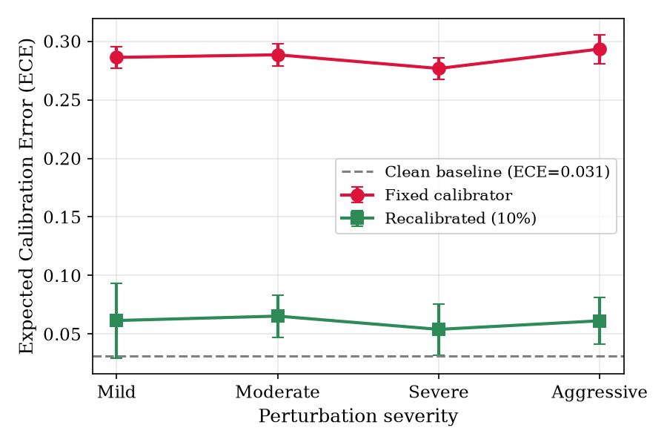
ECE vs Perturbation Severity

Slide 6
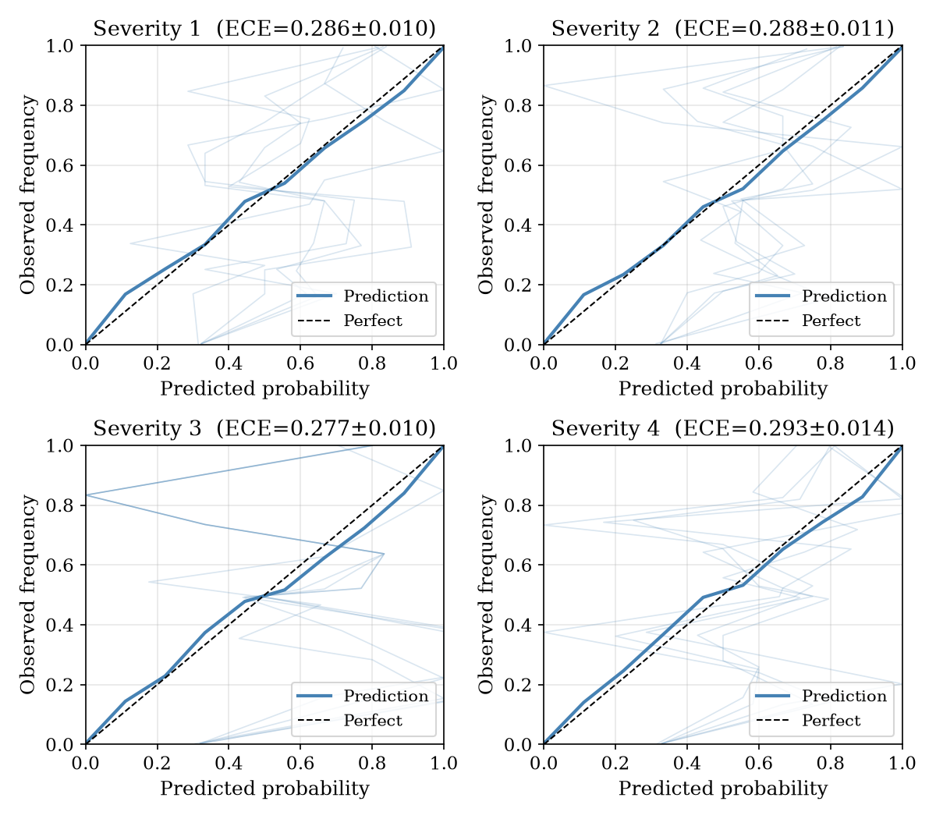
Reliability Diagrams (4 Severity Levels)

Slide 7
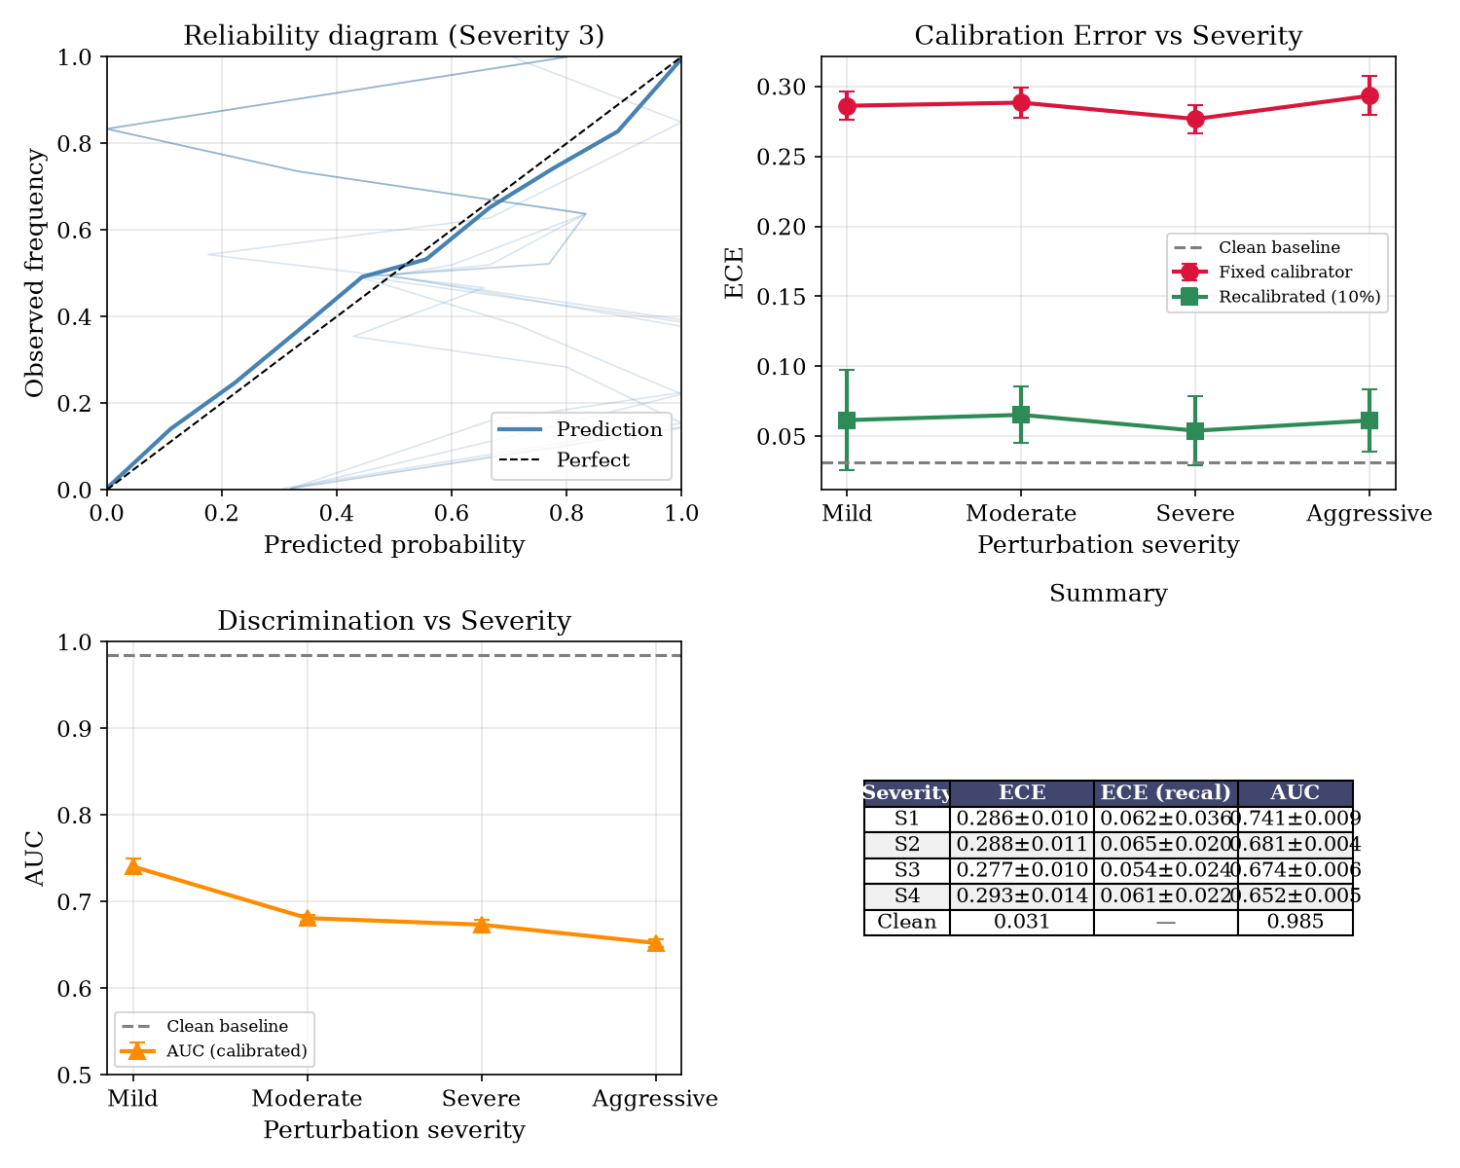
Combined Robustness Summary

Slide 8
Recalibration Recovery
Before: ECE 0.08-0.28, AUC 0.65-0.74
After (10% sample recalibration): ECE 0.05-0.07, AUC 0.94-0.96
A small recalibration sample restores near-baseline calibration.
The feature extractor generalizes well.

Slide 9
Key Findings
1. Calibration degrades predictably with operational severity.
2. AUC is less sensitive than ECE - discrimination remains useful.
3. 10% recalibration recovers ECE from 0.28 to 0.05-0.07.
4. This is an extension, not a critique - framework is sound.

Slide 10
Summary
Baseline: ECE 0.031, AUC 0.985
Degraded: ECE 0.08-0.28, AUC 0.65-0.74
Recalibrated: ECE 0.05-0.07, AUC 0.94-0.96
Paper draft ready. Target: IEEE SGES / PMAPS.

