Slide 1
How Far Does the Model Hold?
Robustness of Multihorizon Battery Failure Intelligence Under Realistic Conditions
Shikdar & Laaksonen — University of Vaasa
1 / 15

Slide 2
MOTIVATION
Lab results don't travel
The published hazard model was trained on clean lab data: full cycles, fixed C-rates, controlled temperatures.
Real BESS operation is fundamentally different:
Does calibration survive when the model meets real data?
• Partial cycling — varying depths of discharge
• Temperature noise — sensor drift, thermal gradients
• Irregular rest — variable idle between cycles
2 / 15

Slide 3
APPROACH
Systematic robustness test across four severity levels
Perturb lab data → apply frozen model → measure calibration → test recalibration
3 / 15

Slide 4
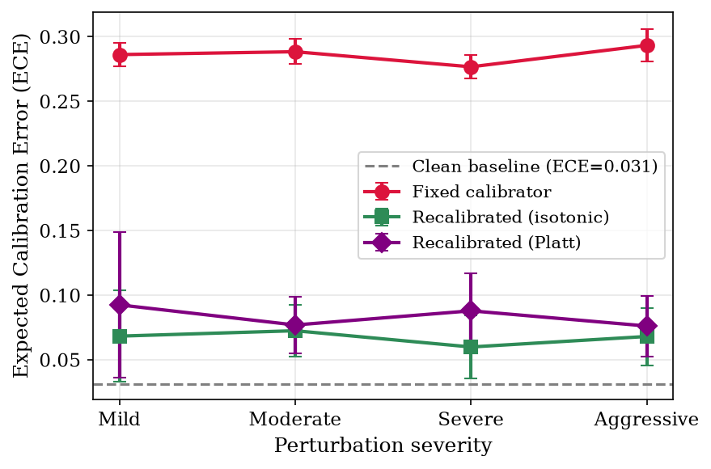
EXPERIMENTAL DESIGN
Perturbation methodology
NASA discharge curves truncated at random DoD, with Gaussian temperature noise and proportional rest noise.
Level | DoD range | Temp noise
1 | 75–100% | ±0.5°C
2 | 55–75% | ±1.0°C
3 | 35–55% | ±2.0°C
4 | 15–35% | ±3.0°C
5 seeds per level · 20 perturbed datasets · 20,560 records
4 / 15

Slide 5
KEY FINDING
Calibration degrades ~9×
0.031
0.28
0.65–0.74
S1 saturates
Clean baseline ECE
Perturbed ECE
Perturbed AUC
Near-max loss
H=20, lab conditions
Severity 1–4, H=20
Down from 0.985
Even 75–100% DoD
• ECE jumps 0.031 → 0.277–0.293 — a nine-fold increase at H=20
• Degradation saturates at Severity 1: even minimal partial cycling causes near-max loss
• AUC drops more gracefully (0.985 → 0.65–0.74): discrimination ≠ calibration
5 / 15

Slide 6
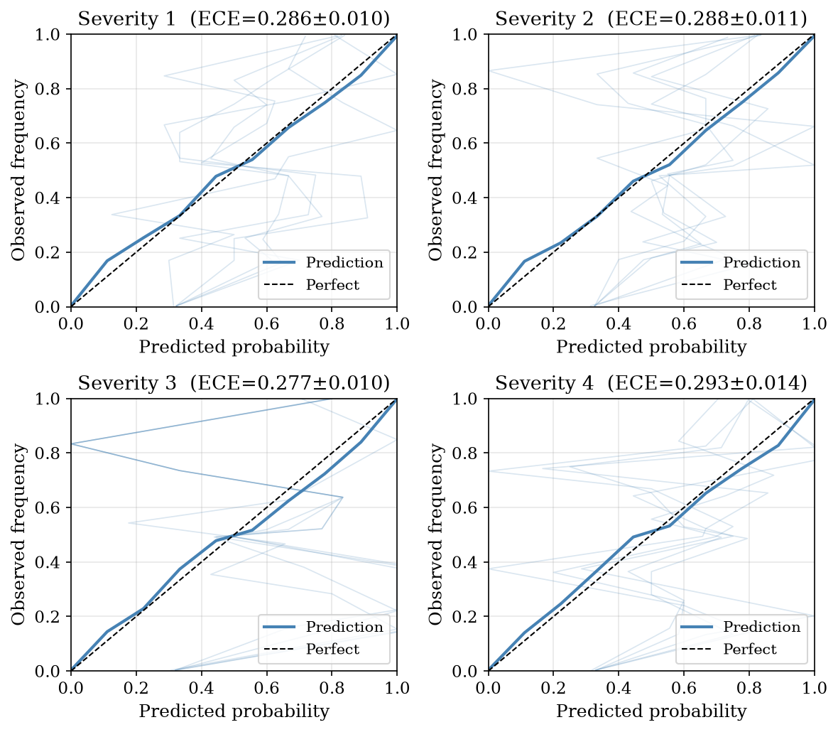
DIAGNOSIS
Root cause: Vmin shift
The primary driver is a shift in the minimum voltage feature under partial cycling.
2.3 V
3.2 V
Full discharge
75% DoD truncation
A 39% increase — the XGBoost model learned thresholds on clean ranges; the isotonic calibrator can't adapt to the shifted distribution.
6 / 15

Slide 7
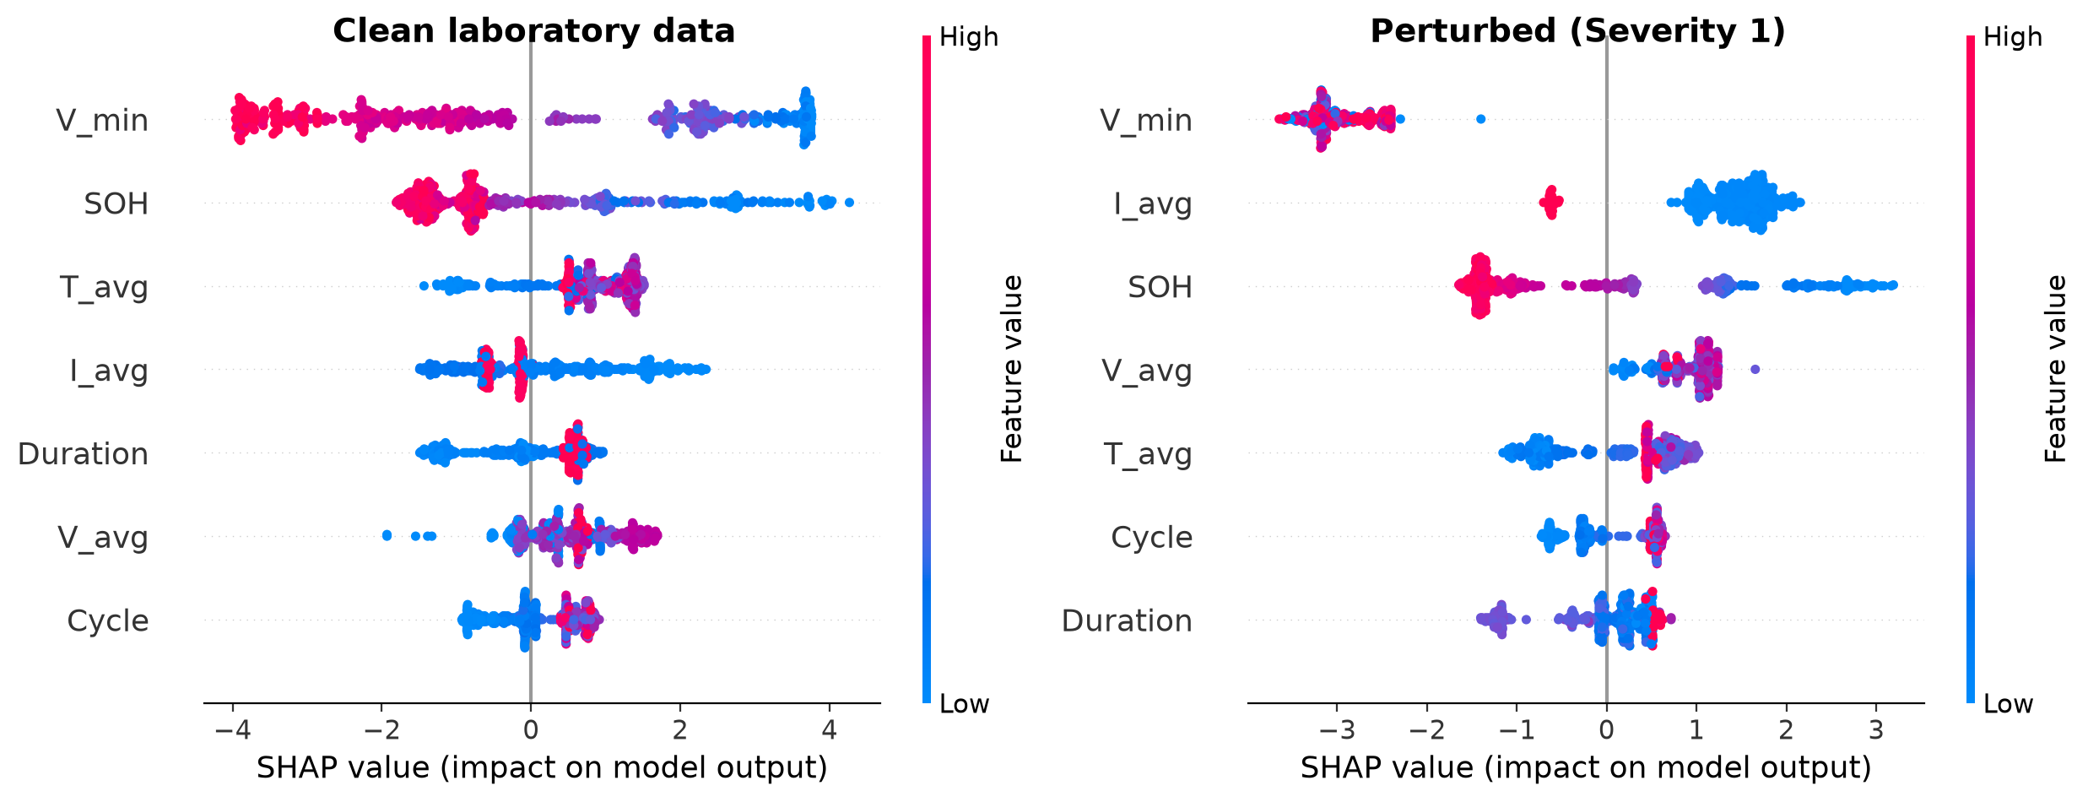
EVIDENCE
SHAP confirms Vmin dominance
Vmin is the dominant feature under both clean and perturbed regimes. Under perturbation, every feature distribution shifts, breaking the calibrator.
7 / 15

Slide 8
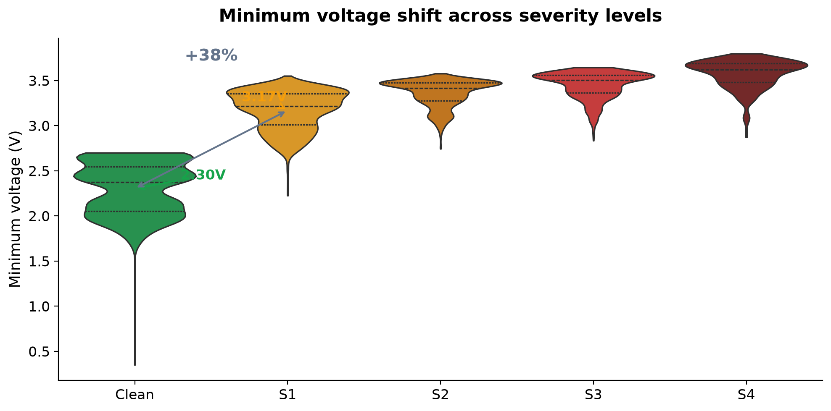
DIAGNOSIS
Feature shift across severities
8 / 15

Slide 9
KEY RESULT
Recalibration on 10% recovers 71–88% of the gap
ECE drops from ~0.28 to 0.06–0.09 Evaluated on held-out data
9 / 15

Slide 10
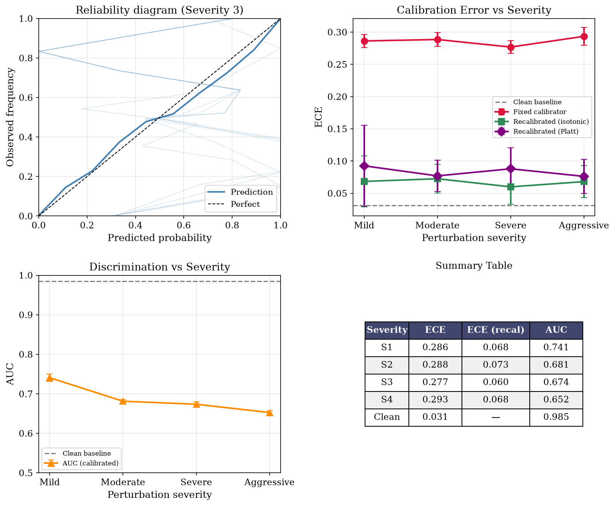
EVIDENCE
Recalibration: held-out evaluation
All three recalibration methods recover calibration on held-out data. Mean±std across 5 seeds × 4 severities:
Horizon | Clean ECE | Perturbed | Isotonic | Platt | Temp.
H=10 | 0.010 | 0.297±0.017 | 0.067±0.022 | 0.064±0.013 | 0.074±0.020
H=20 | 0.031 | 0.286±0.012 | 0.067±0.027 | 0.083±0.037 | 0.086±0.023
H=30 | 0.013 | 0.299±0.014 | 0.081±0.024 | 0.079±0.036 | 0.113±0.027
H=50 | 0.023 | 0.362±0.022 | 0.086±0.028 | 0.076±0.036 | 0.159±0.021
Isotonic and Platt comparable at all horizons; temperature scaling underperforms at H=30+
10 / 15

Slide 11
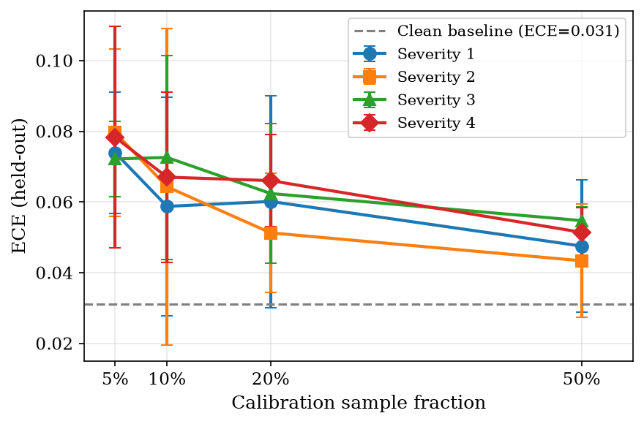
ABLATION
Sample-size sweep: 5%–50%
ECE decreases monotonically with sample fraction. The 10% fraction used throughout sits at the elbow — diminishing returns above 20%.
11 / 15

Slide 12
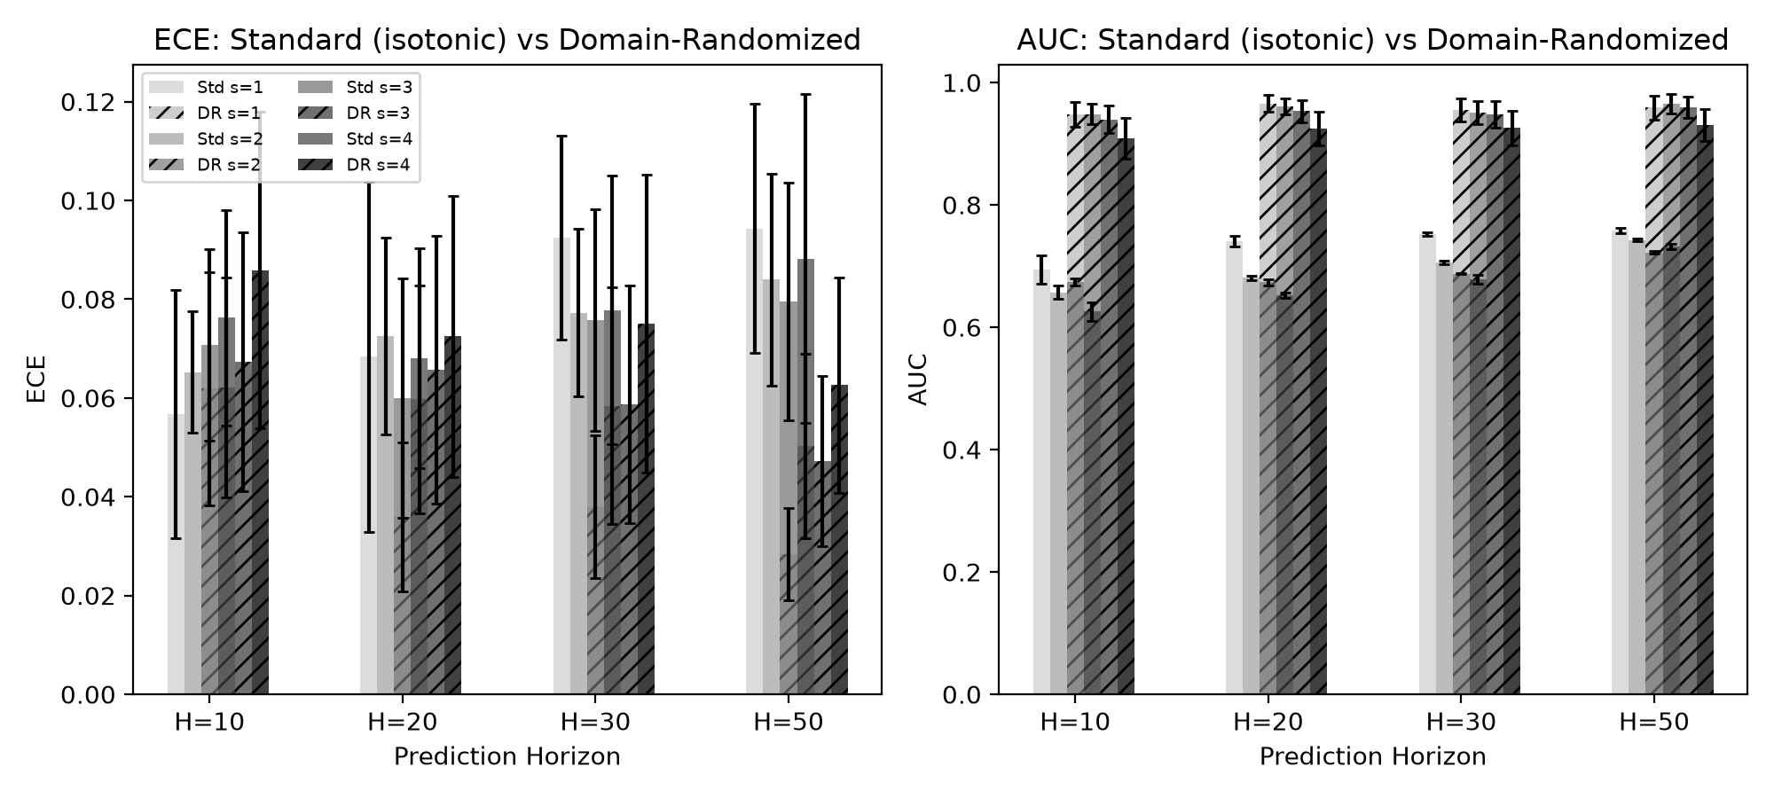
ROBUSTNESS
Domain randomization: modest extra gain
Trade-off
Training on perturbed data provides additional protection at longer horizons.
• 4× training data overhead
• ~10 min extra training
• Same base classifier
• Harder to explain in ops
For most deployments: recalibration alone suffices
DR+H=50 ECE=0.047 vs. standard+isotonic H=50 ECE=0.087 (45% reduction). Minimal gain at H=10.
12 / 15

Slide 13
FRAMEWORK
Three operating zones
● Safe
● Warning
● Unsafe
ECE < 0.05
ECE 0.05–0.10
ECE > 0.10
Clean lab conditions only
Recalibrated operation 10% operational sample
Direct deployment under any partial cycling (ECE > 0.27)
Direct deployment under partial cycling pushes ECE > 0.27 — firmly in the unsafe zone
13 / 15

Slide 14
ACTION
Practical deployment path
1. Deploy the frozen XGBoost model as-is
2. Collect 50–100 operational cycles from normal BESS operation
3. Fit a new isotonic regression on these cycles
4. Deploy the recalibrated model — no base classifier retraining needed
10%
operational sample
at the elbow of
the ECE curve
No original training data required · No additional feature engineering
14 / 15

Slide 15
TAKEAWAY
Calibration is fragile. Recalibration is practical.
Multihorizon hazard models are not inherently robust to operational distribution shift, but a lightweight recalibration step suffices for field deployment.
Shikdar & Laaksonen — University of Vaasa, Finland
15 / 15

