Slide 1
SOLAR CELLS · COMPUTER MODELS · GROUP SEMINAR
Guardrails for the record race: what a CsPbI3 cell can honestly claim
Hussain Touhid Siddiquee & Md. Abdul Malek Fahim · Dept. of EEE, Leading University
We checked how much of a record solar-cell number is real, and how much comes from optimistic settings.
24.9% best case → 20.8% honest case
Guardrails for the Record Race 1 / 20
Notes:
Open with the punchline in plain words: two numbers, not one. 24.9 is the best our simulation could build inside fixed rules; 20.8 is the number for real-world dirt. Ask the room which one they would publish.

Slide 2
THE PROBLEM
Computer models now beat the best real solar cells — on paper
▪ The best certified cesium-lead-iodide cell turns 22.02 percent of sunlight into electricity.
▪ Computer simulations of similar cells claim over 24 percent.
▪ The gap is not fraud. It is hidden assumptions: missing dirt, perfect contacts, ideal materials.
Guardrails for the Record Race 2 / 20
Notes:
Set up the puzzle simply: the computer beats the lab, but only because the computer is allowed to assume a perfect world.

Slide 3
WHERE OUR SETTINGS COME FROM
Every setting we used comes from a published table
Cell | Voltage | Current | Fill factor
Hossain 2022, printed (17.90%) | 0.997 V | 21.07 | 85.2%
Our rebuild (18.99%) | 1.122 V | 19.68 | 86.0%
▪ In 2022, the Hossain team tested 96 layer combinations and picked the winning stack.
▪ In 2023 they tuned it fully and printed every setting, so anyone can rebuild it.
▪ We rebuilt their cell in software and landed nearby — then added the dirt layers they left out.
Guardrails for the Record Race 3 / 20
Notes:
Provenance in one sentence: nothing in our files is invented; everything traces to a printed table, and our additions are stated.

Slide 4
THE DEVICE
The cell has five layers, and we model the dirt between them
Layer | Thickness | Setting
Transparent front contact (ITO) | — | energy level 4.0 eV
Electron-carrying layer (titanium dioxide) | 30 nm | doping 9e17, energy 3.7 eV at best
Light absorber (cesium lead iodide) | 2.2 µm | doping 3e16, defects 1e12, gap 1.65 eV
Hole-carrying layer (CBTS) | 100 nm | doping 1e18, energy 3.9 eV at best
Nickel back contact | — | energy level 5.5 eV
Dirt traps at both joints | — | a fixed, stated amount at each boundary
Names in brackets are the materials: ITO = transparent conductor, CBTS = copper barium tin sulfide. nm = billionth of a meter, µm = thousandth of a millimeter, eV = energy unit. Doping and defect numbers are atoms per cubic centimeter, written as powers of ten (9e17 means 9 followed by 17 zeros).
Guardrails for the Record Race 4 / 20
Notes:
Where two layers meet, electrons get trapped and lost — that is what an interface block models. Deleting this row is how inflated numbers are made.

Slide 5
METHOD · THE SIMULATOR
We set up the simulator so it cannot flatter us
▪ We simulate standard sunlight at room temperature.
▪ When we change the light-absorbing gap, the absorption edge moves with it, as in real physics.
▪ Electrical resistance is simulated inside the software, never subtracted by hand afterwards.
▪ Anything that absorbs light in the contact layers is left out in the open, not hidden.
Guardrails for the Record Race 5 / 20
Notes:
Each choice closes one cheating route: self-consistent gaps, scripted resistance, visible optics.

Slide 6
METHOD · CAREFUL COMPUTING
Tiny input mistakes can invent fake record cells
▪ The files store metric units but the command line expects practical units. Mixing them overdoses the cell a million-fold and invents ghost cells near 27 percent.
▪ One command for trap sizes silently switches the traps off instead of resizing them.
▪ We rerun key cells at finer resolution. Differences below 0.017 points do not count.
Guardrails for the Record Race 6 / 20
Notes:
We publish our mistakes as findings. Both traps gave plausible-looking efficiencies, which is what makes them dangerous.

Slide 7
METHOD · THE CAMPAIGN
We ran hundreds of simulations and saved every one
Stage | Runs | What it found
Broad grid + refinement | 96 + 36 | 23.50% best with standard settings
Energy-lineup map | 36 | 24.95% at the best lineup
Automatic search (limited box) | 104 | nothing fair beats the grid best
Sensitivity + checks + resistance | 56 + … | what matters flips with dirt level
Guardrails for the Record Race 7 / 20
Notes:
Layers of searching: broad grid, then the energy lineup surprise, then a search that could not reach the winner because its box excluded it — stated as a limitation.

Slide 8
THE RECORD RACE
Real cells improve slowly, simulations jump fast
9
24%
7
8
6
4
5
20%
10
3
2
16%
12%
1
2016 → 2026 · dot number color = track (green measured, orange simulated, dark this work)
1. 10.8% QD 2016
2. 17.9% Hossain 22
3. 19.06% Hossain 23
4. 21.43% inverted cert.
5. 22.02% cert.
6. 23.1% ZnO/Spiro sim
7. 24.17% Nazli sim
8. 24.24% Oyedele sim
9. 24.95% bound (us)
10. 20.82% defensible (us)
Guardrails for the Record Race 8 / 20
Notes:
Green climbs slowly because fabrication gets better. Orange jumps because assumptions get looser. Our two ringed points sit on opposite sides of the certified record.

Slide 9
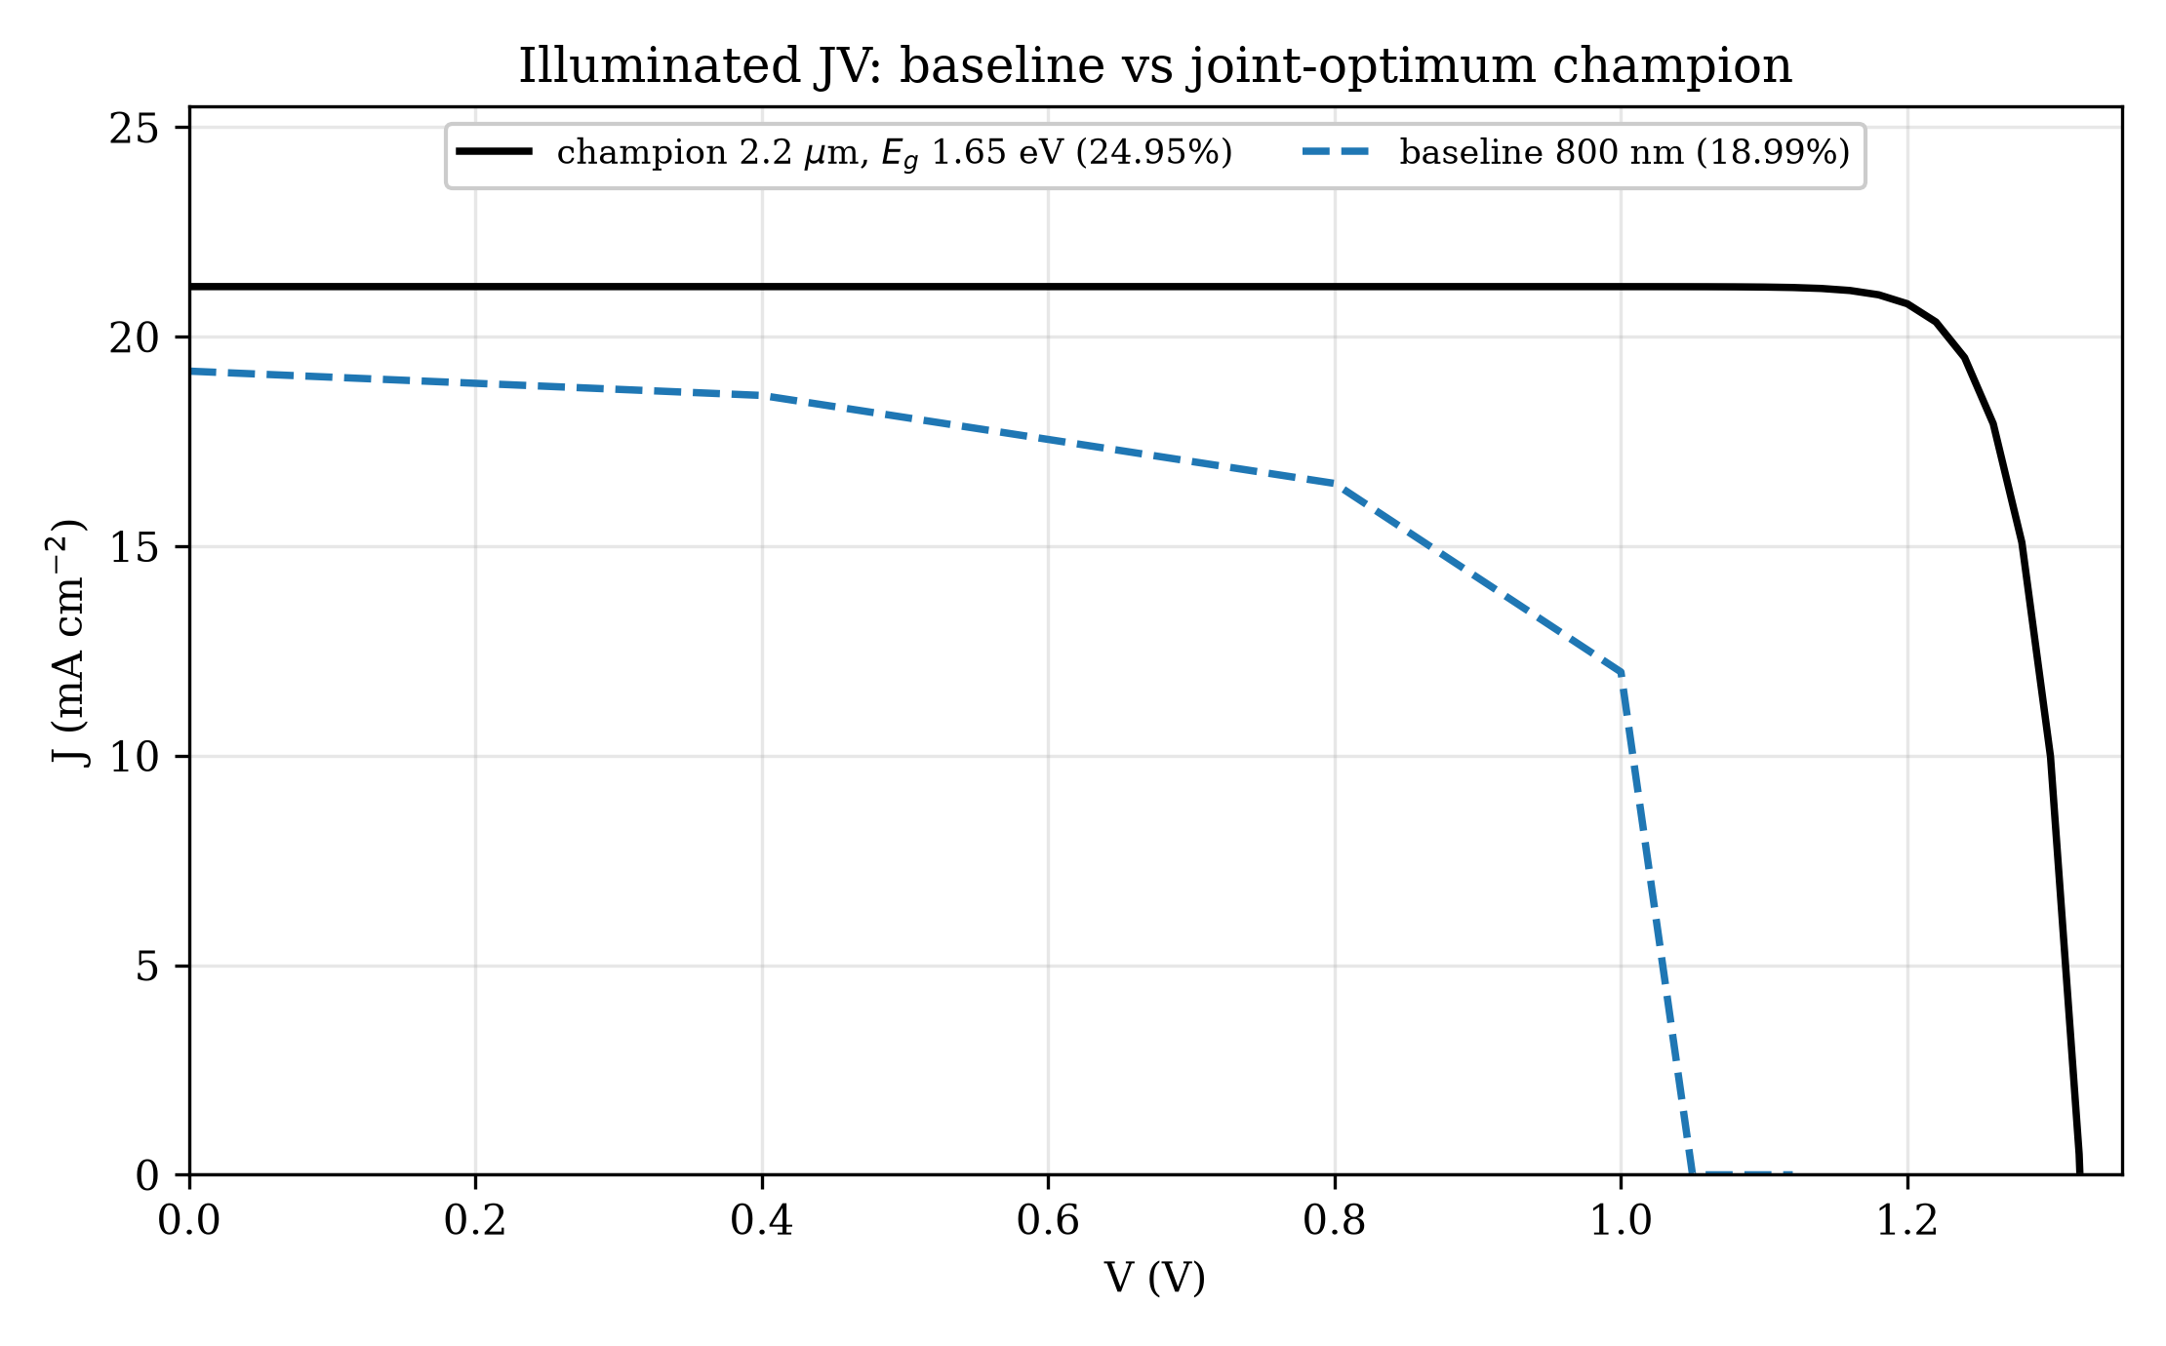
RESULT · THE UPPER BOUND
Our best fair cell reaches 24.95 percent
▪ It produces 1.321 volts at 21.20 milliamps per square centimeter.
▪ Thick absorber, cleanest allowed dirt, lowest gap, tuned energy lineup.
▪ Every setting sits at the extreme edge — a ceiling, not a promise.
Guardrails for the Record Race 9 / 20
Notes:
Read the curve, then the small print. Best the box allows is exactly why it cannot headline alone.

Slide 10
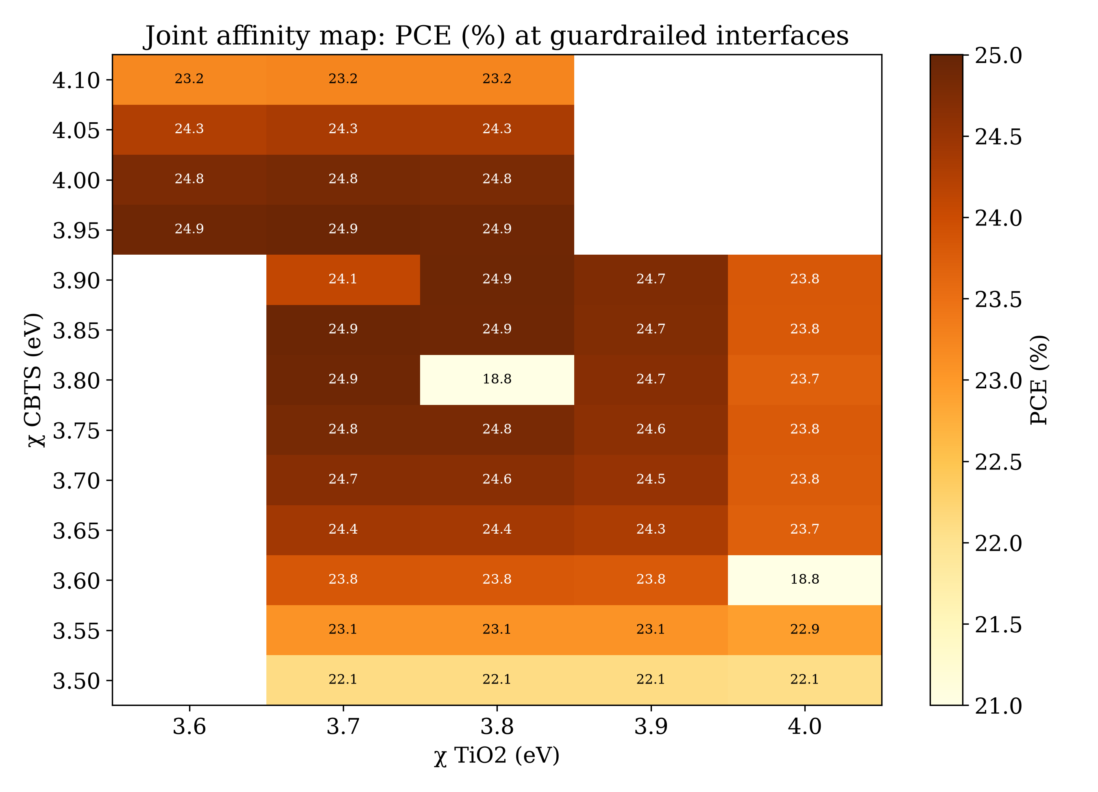
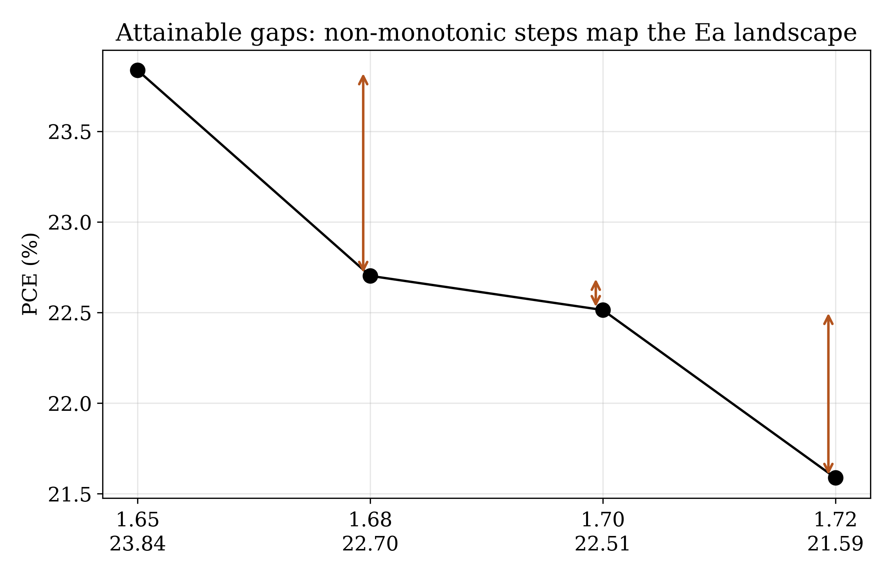
RESULT · WHY THE LINEUP MATTERS
Tiny energy shifts decide the efficiency
Guardrails for the Record Race 10 / 20
Notes:
The surprise of the campaign: moving layer energy levels changes how hard trapped charges must work to escape, and efficiency climbs even past textbook rules. The winning values are aggressive — stated, not hidden.

Slide 11
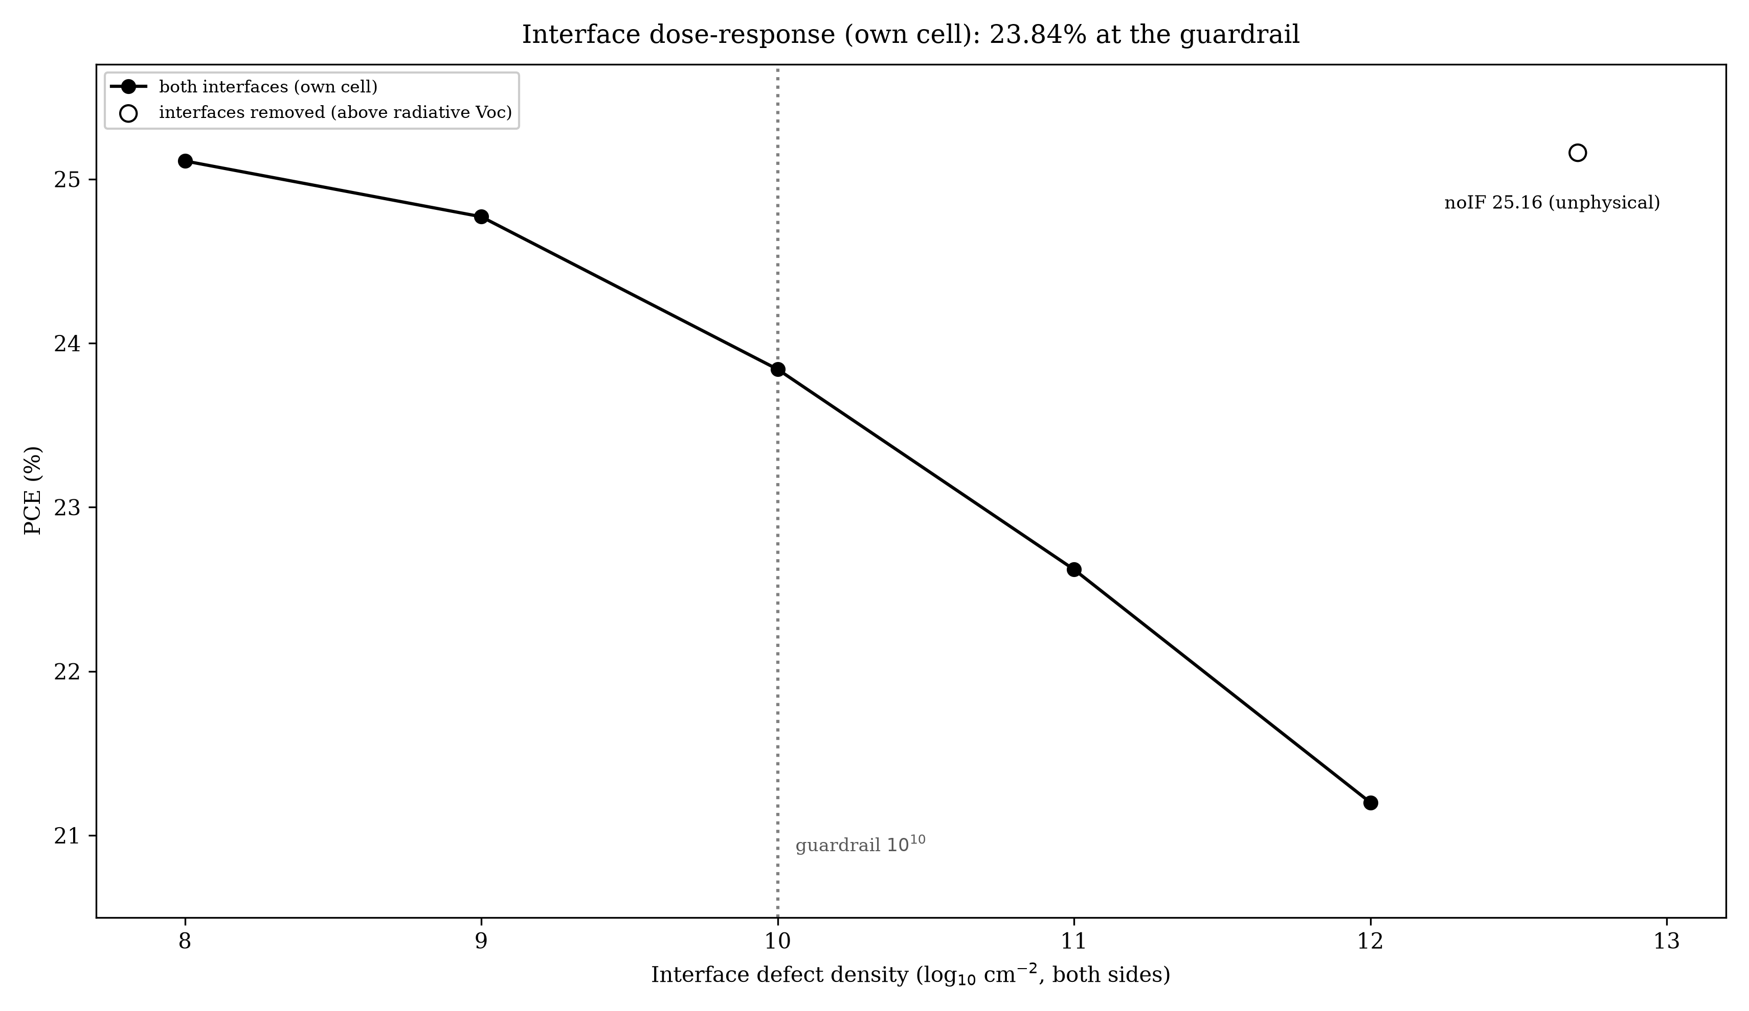
RESULT · DIRTY JOINTS
Dirty joints cost four percentage points
▪ From almost-clean to very dirty joints, our own cell falls from 25.11 to 21.20 percent.
▪ We do not place other teams' numbers on our curve: their cells differ and their tables are incomplete.
Guardrails for the Record Race 11 / 20
Notes:
Four points across four decades of dirt. Placing others here would be an accusation dressed as analysis, so we refuse.

Slide 12
RESULT · THE SPEED LIMIT
Physics sets a voltage ceiling, and our cell obeys it
▪ From our own light-absorption model, no cell of this gap can exceed 1.371 volts.
▪ Our champion stops at 1.321 volts. Cells with deleted joints crowd right up against the ceiling.
▪ A band with no margin anywhere is not evidence of a working cell.
Guardrails for the Record Race 12 / 20
Notes:
Computed from our absorption, not a textbook. The old rulebook ceiling sat above the physical limit, so we retired it and said so.

Slide 13
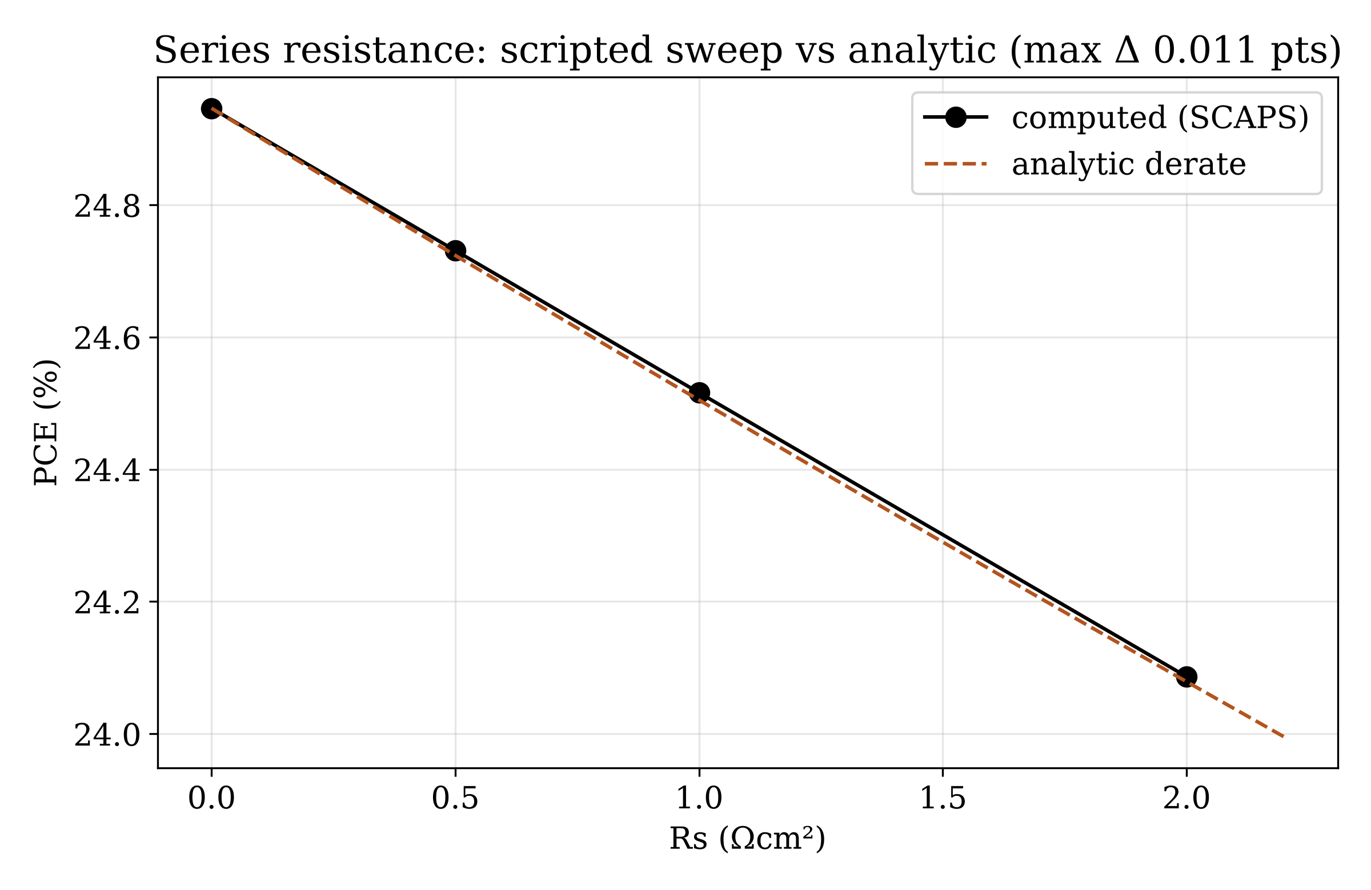
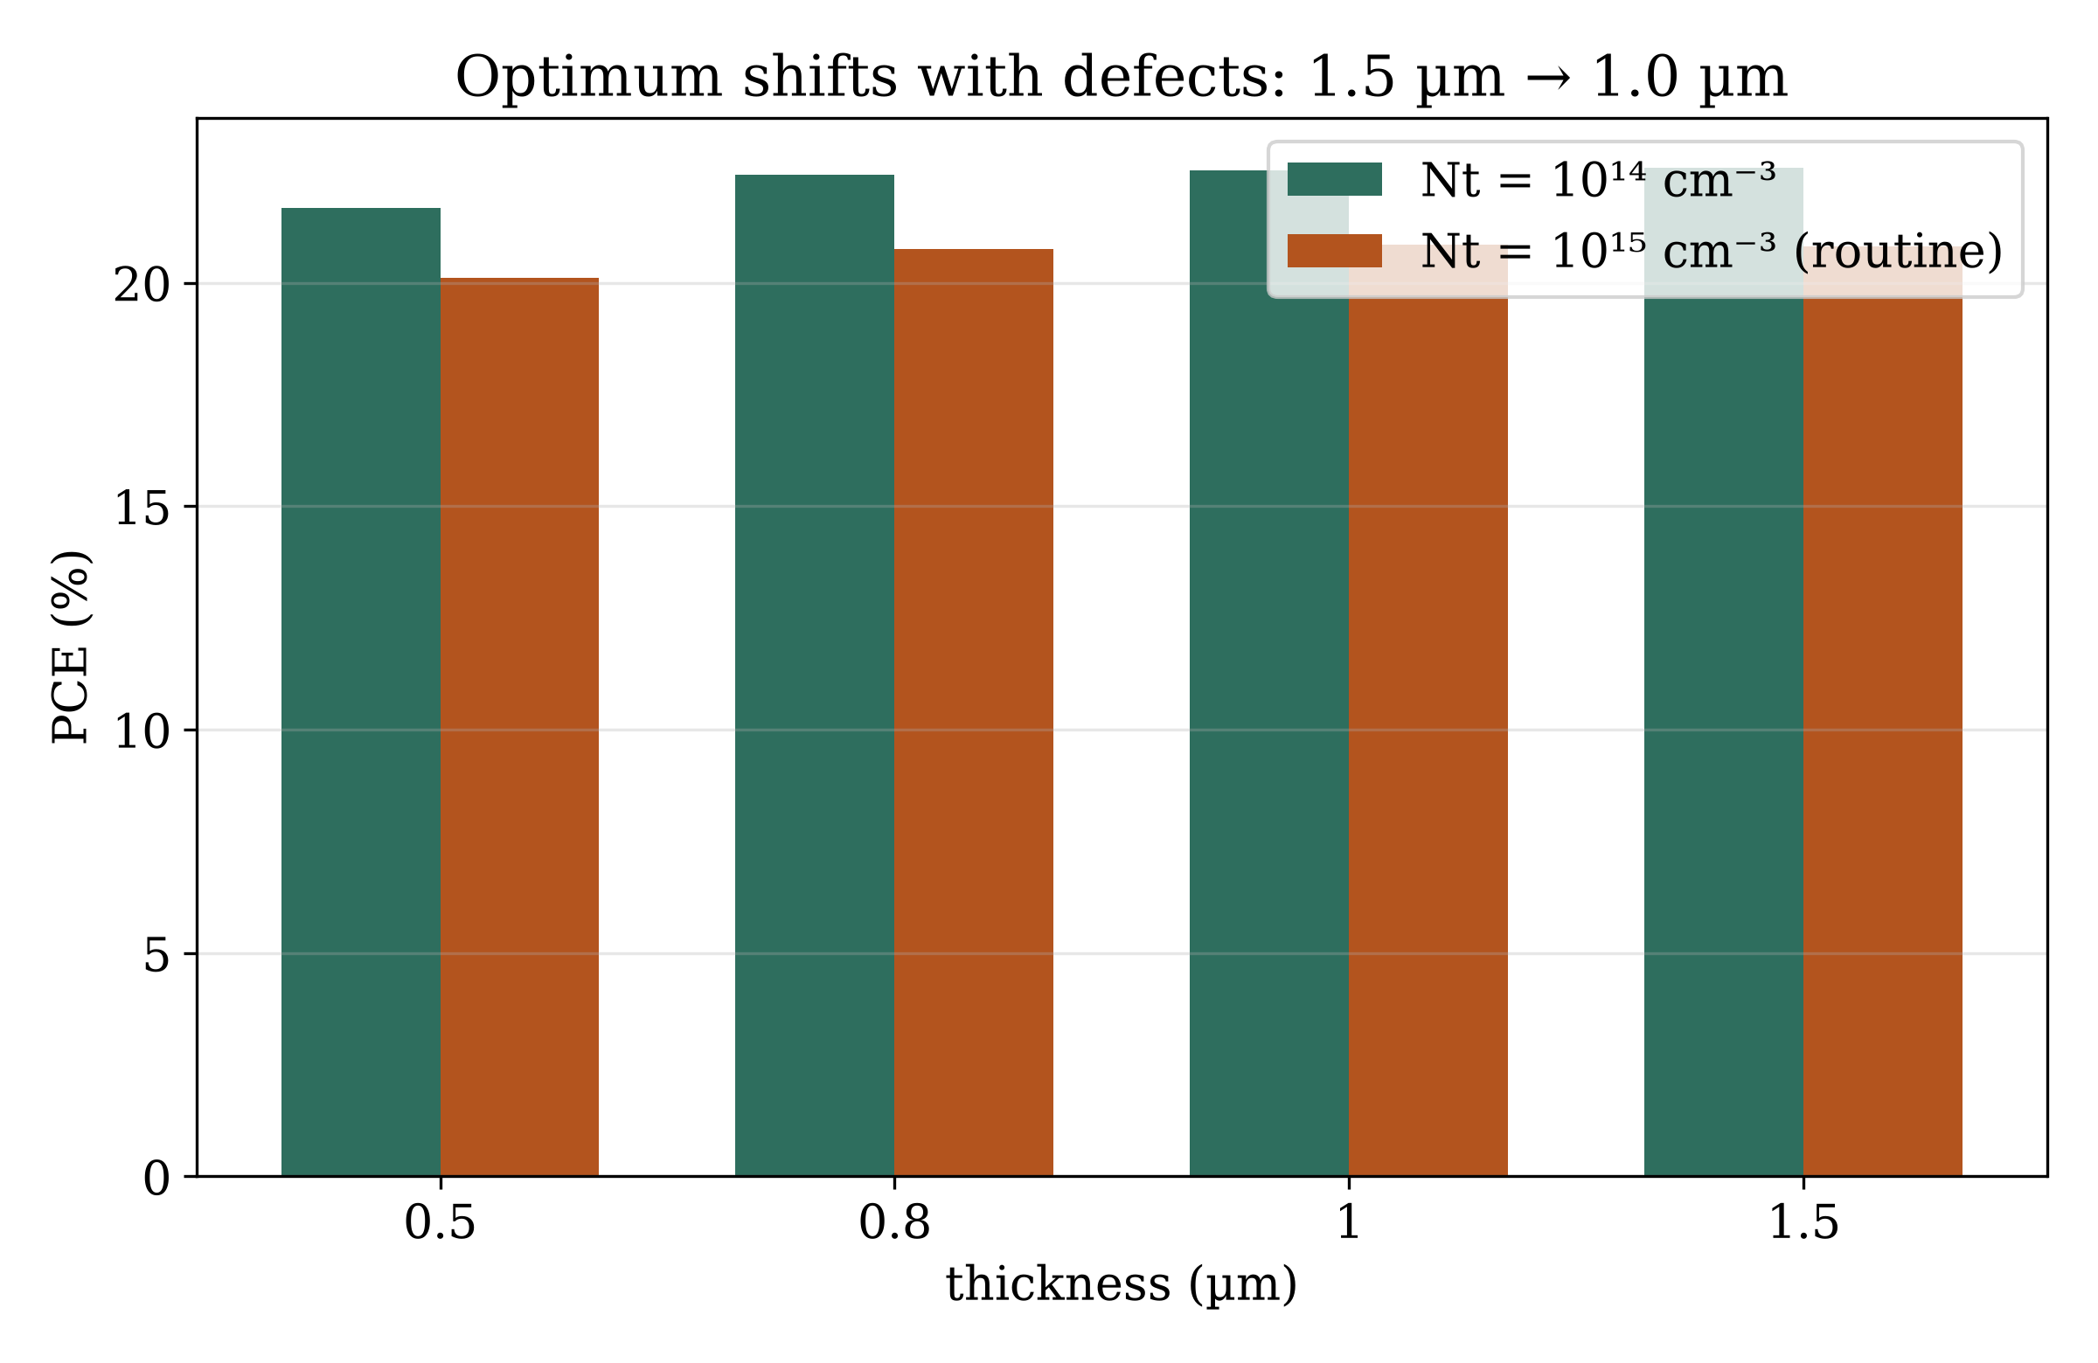
RESULT · THE HONEST NUMBER
A realistically dirty cell gives 20.82 percent
Guardrails for the Record Race 13 / 20
Notes:
The answer for an experimentalist. The best thickness moves with dirt level — invisible to one-variable-at-a-time testing. With realistic resistance: 20.42.

Slide 14
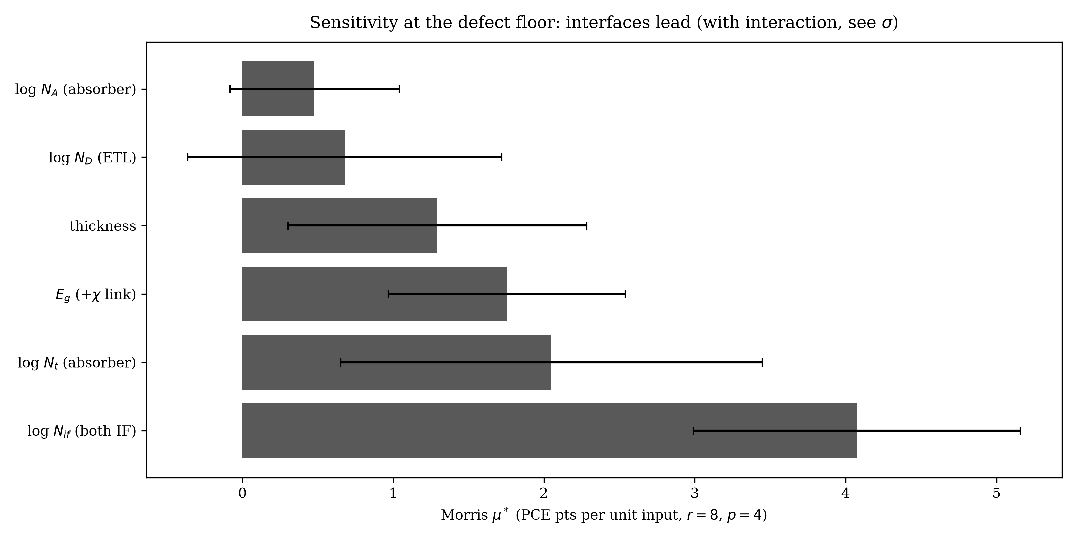
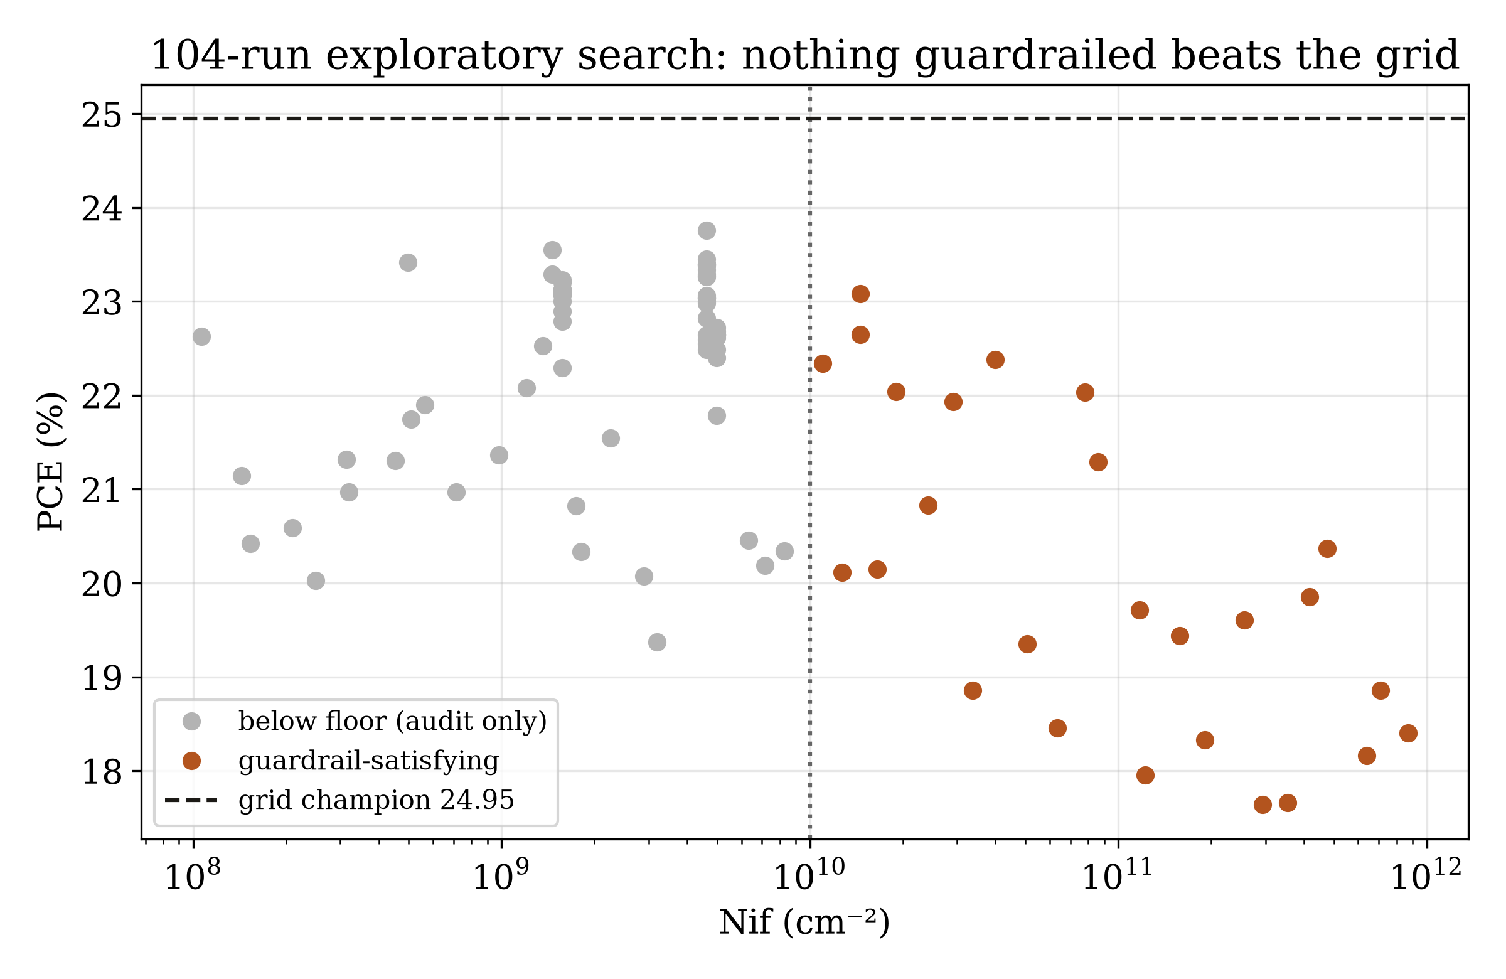
RESULT · WHAT MATTERS MOST
It depends on how dirty the cell is
Guardrails for the Record Race 14 / 20
Notes:
In ultra-clean cells joints win by 2 points; in everyday cells bulk dirt wins and joints go flat. There is no single most-important factor.

Slide 15
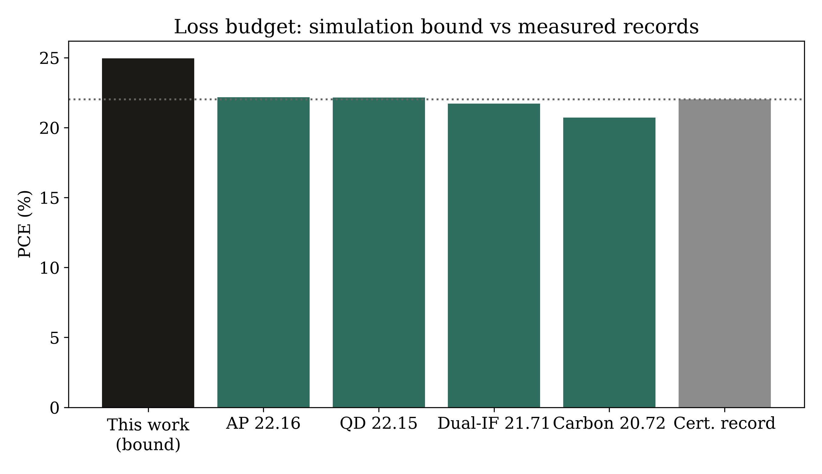
RESULT · AGAINST THE REAL WORLD
Our extra points come from fill factor, not voltage
▪ Our voltage is ordinary — real records already reach 1.27 to 1.29 volts.
▪ The six-point fill-factor gap has three possible causes, and we do not pretend to know which dominates.
Guardrails for the Record Race 15 / 20
Notes:
Read left to right with the room: voltage ordinary, current ordinary, squareness of the curve is where simulation exceeds experiment.

Slide 16
METHOD · FAIR COMPARISON
Compare lifetimes, not just dirt counts
Dirt level | Lifetime / surface speed
Cleanest allowed | charges live 100 microseconds
Everyday dirt | charges live 0.1 microseconds
Joint floor | surface speed 100 cm/s
▪ Dirt count times trap size is what physics actually sees.
▪ Lifetimes and surface speeds let studies compare fairly — and our 100-microsecond floor is far cleaner than the best real films.
Guardrails for the Record Race 16 / 20
Notes:
Counts alone cannot be compared across studies; we proved the equivalence digit-for-digit. The floor's cleanliness is admitted, not hidden.

Slide 17
HONESTY · SOFTWARE TRAPS
Two software traps that invent fake cells
▪ Mixing metric and practical units overdoses the cell a million-fold and invents ghost cells near 27 percent.
▪ One trap-size command silently switches the traps off instead of resizing them.
▪ Rule: build structure in files, and always read every scripted value back before believing a run.
Guardrails for the Record Race 17 / 20
Notes:
Plausible-looking efficiencies from pure input errors — that is what makes them dangerous. One-line rule to defeat both.

Slide 18
CONTRIBUTION · A STANDARD
A checklist so future studies can be compared
▪ State joint dirt plus trap size — or the lifetime and surface speed.
▪ State which unit system every number uses, and the resistance basis.
▪ State both contact energy levels, and which affinities were surveyed versus adopted.
▪ State the radiative ceiling used, and archive every input file.
Guardrails for the Record Race 18 / 20
Notes:
Eight disclosure items, each a place where silence moves the headline by points. Propose it as a reviewer checklist.

Slide 19
LIMITS
What this work cannot tell you
▪ No search method proves our best cell is the global best — it is the best we evaluated.
▪ We model steady electricity only: no aging, no moisture damage, no crystal decay.
▪ We never fitted the model to a real measured cell, so the comparison table compares rather than calibrates.
Guardrails for the Record Race 19 / 20
Notes:
A paper that prices others' assumptions prices its own. Questions belong here.

Slide 20
TAKEAWAY
Claim 20.8. Cite 24.9 as a limit.
▪ Every number archived, every assumption priced, every receipt regenerable from scripts.
▪ github.com/touhidsiddiqueeraj-bit/cspbi3-cbts-guardrailed
Guardrails for the Record Race 20 / 20
Notes:
One sentence to leave the room with. Then the live demo: open the champion file in SCAPS and read the number off the screen.

