Slide 1
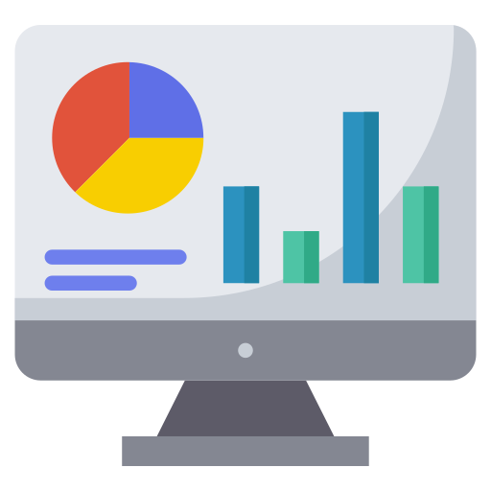
Overview
The dashboards are receiving data from two types of API, one is MQTT Broker and another one is REST API.
Temperature Sensor
MQTT Broker
Done by me
Soil Sensor
HDC
REST API
Done by Shamim vai
Smart River

Slide 2
Overview
See Temperature sensor dashboard here: Temp Sensor Dashboard
See Soil sensor dashboard here: Soil Sensor Dashboard
After connecting with MQTT Broker, data is stored in Node-RED at regular interval.
These data are stored in MongoDB database in a predefined format.
If any data is missing, a log is kept in the database in a separate table.
In the dashboards, time series data are displayed.
On the first load, users will only see data from last 1 day.
They have a filter option to pickup date ranges and to load the data in the dashboards.
The reset button sets the view to last 1 day.
The process is documented at Confluence (here).

Slide 3
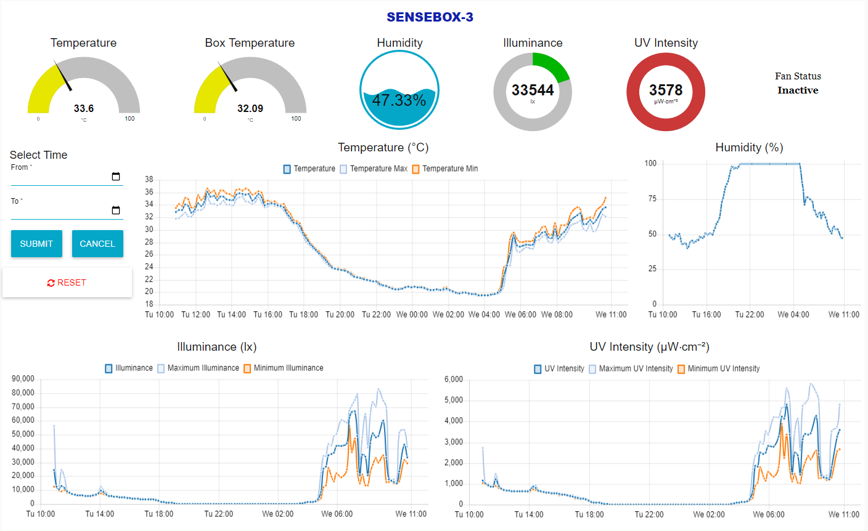
Some Screenshots of Temp Sensor Dashboard

Slide 4
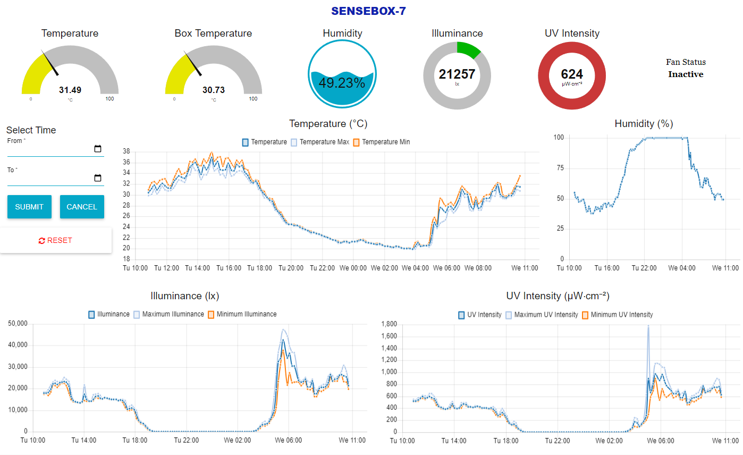
Some Screenshots of Temp Sensor Dashboard

Slide 5
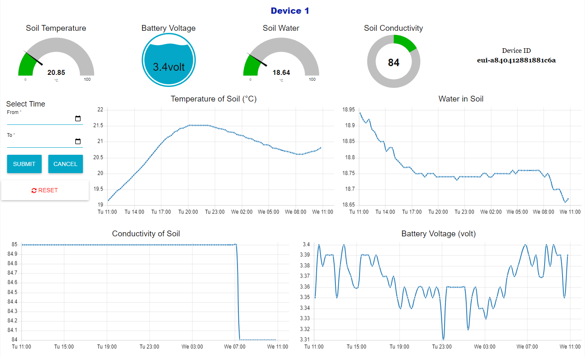
Some Screenshots of Soil Sensor Dashboard

Slide 6
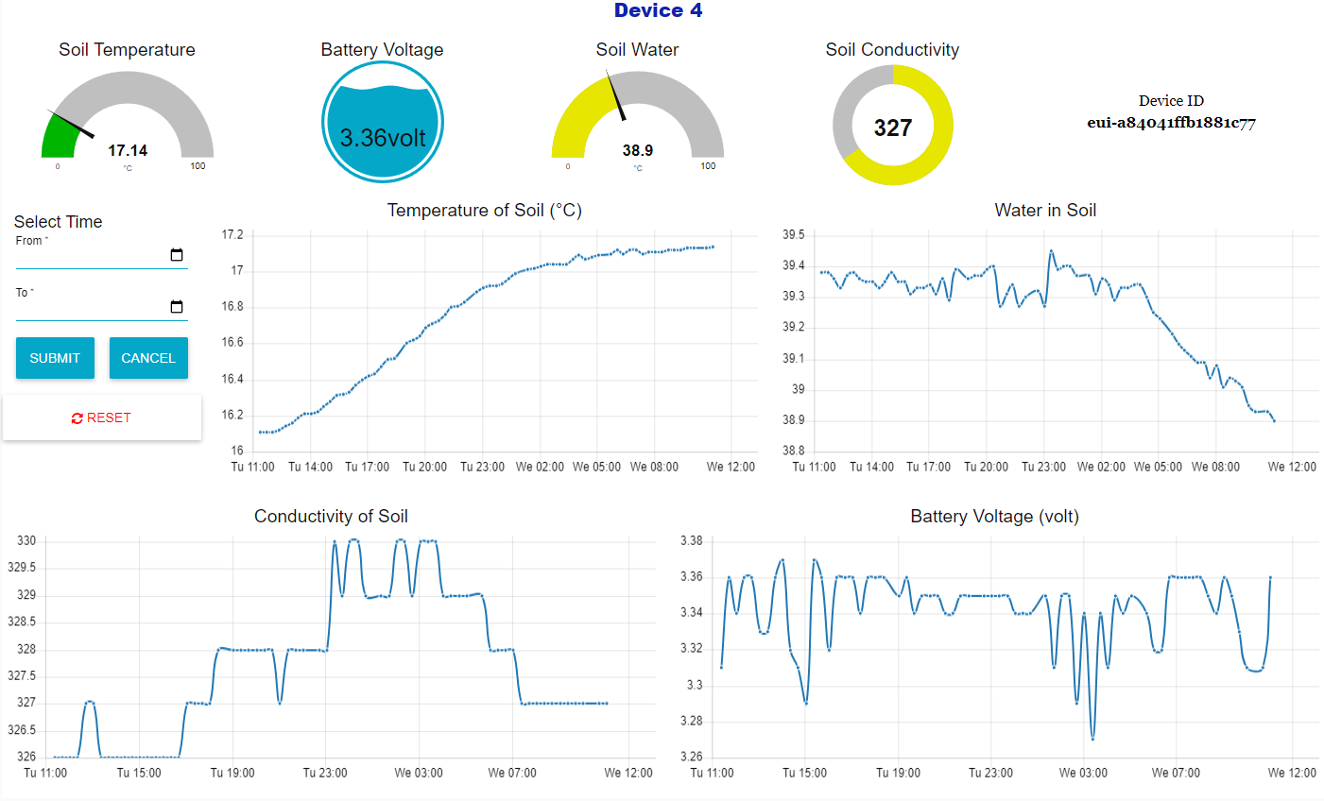
Some Screenshots of Soil Sensor Dashboard

