Slide 1
Differences between members and casual riders for Cyclistic
Touch Hun
July 4, 2022

Slide 2
Problem:
Solution:
Differences between members and casual riders
Data Analysis on the differences between members and casual riders to promote the annual membership

Slide 3
Analytical goals
WHY: Quantity impact on differences in using bikes among causual riders and members.
HOW: Identify what Cyclistic want to know about

Slide 4
Analytical goals
WHY: Quantity impact on differences in using bikes among causual riders and members.
HOW: Identify what Cyclistic want to know about

Slide 5
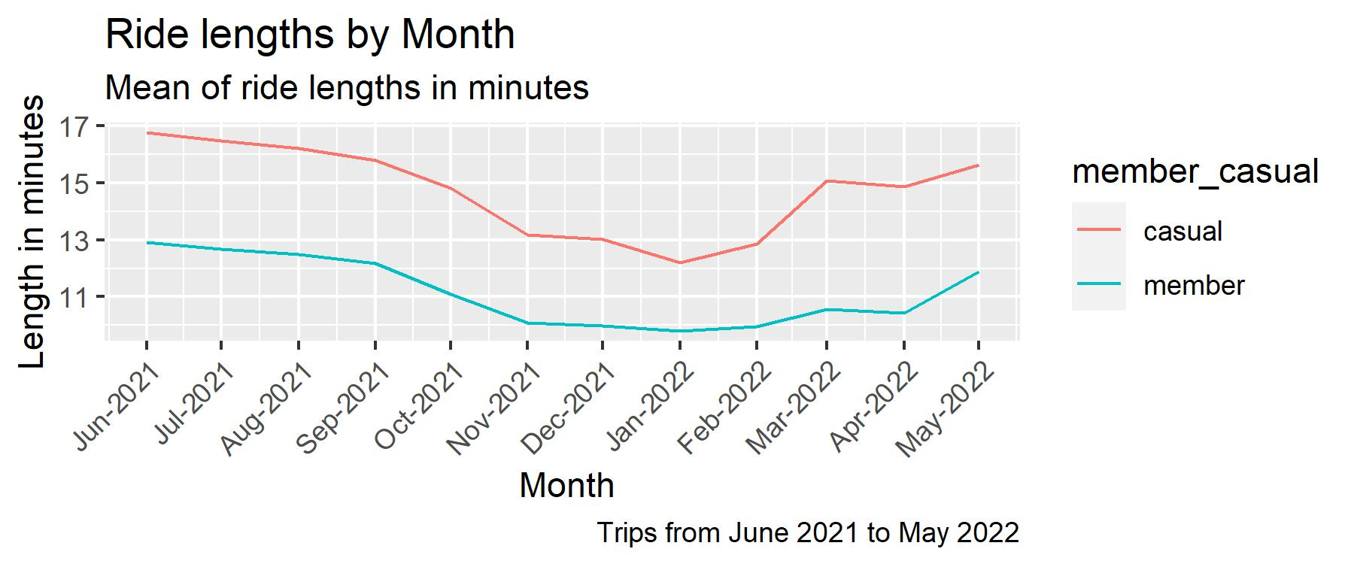
Upward Trend
Ride length have been increasing since January 2022.
Source: Historical data of trips from 2021 to 2022

Slide 6
16
minutes
+4 mins
The Reason
Onverage, casual riders use bikes more than members as
their counter part by +4 minutes
This impacts the likelihood of being of annual members.
12 mintes
Casual Riders
Members
Source: Historical data of trips from 2021 to 2022

Slide 7
Thus, we need to increase membership promotions among casual riders to get access to the annual membership.

Slide 8
Analytical goals
WHY: Quantity impact on casual riders for membership
HOW: Identify what they should subscribe for membership.

Slide 9
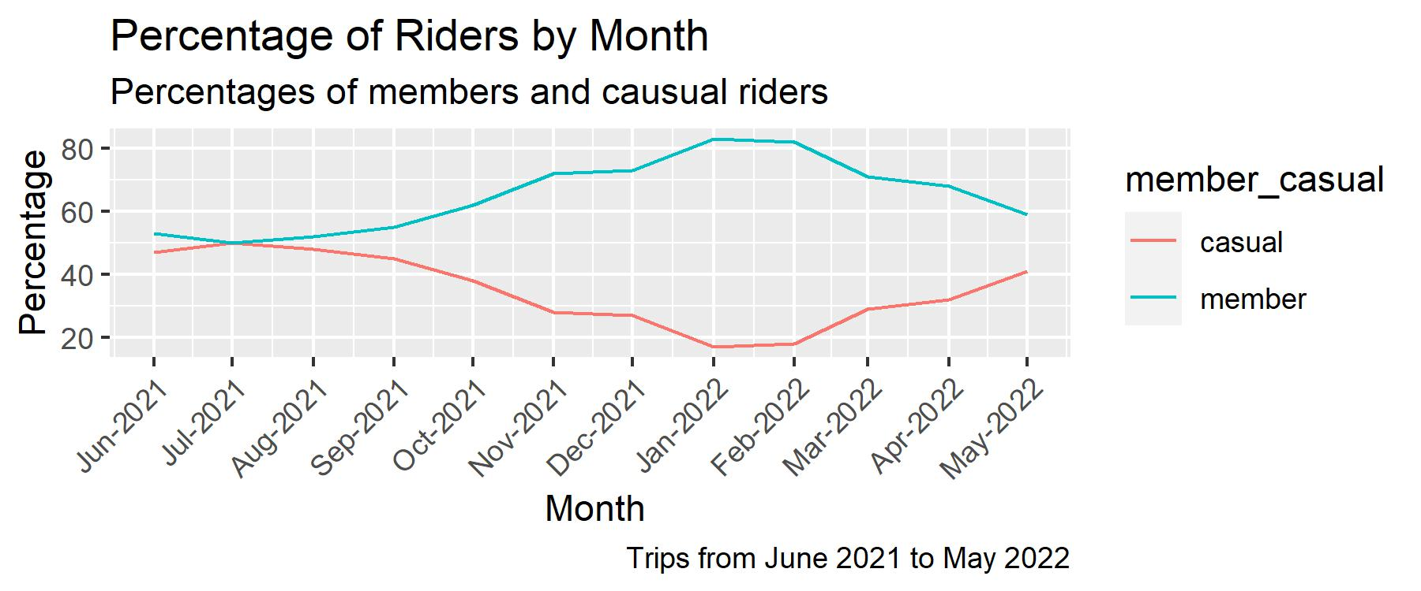
Bike Variety
There are 3 main categories of biking:
reclining bikes, hand tricycles, and cargo bikes. They can attract different riders to biking.
Source: Historical data of trips from 2021 to 2022

Slide 10
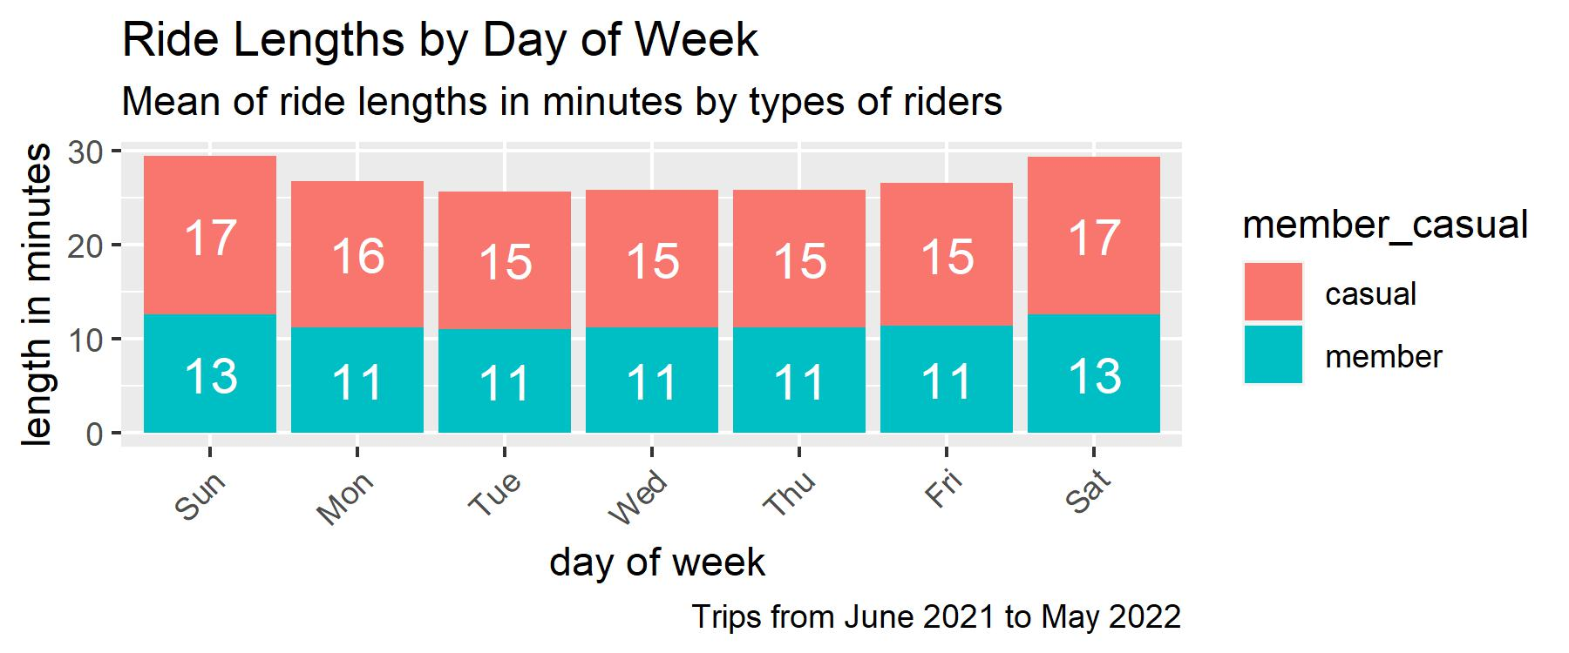
Prioritize the annual membership
Currently, casual rider are more interested in biking even more than the member. Every day of the week,
They bike more than members do.
16
Source: Historical data of trips from 2021 to 2022

Slide 11
Thus, we should start promotion and prioritize our membership subscription

Slide 12
In Summary
WHY: Casual riders use the bike differently from the members.
HOW: (1)They ride longer based on the monthly and daily data.
(2). Their tendency of subscribing is upward monthly.

Slide 13
Recommendation
(1). Annual promotion is likely successful based on the casual rider’s trend line of increasing percentages of riders.
(2). Their geo-location background is similar to that of the members based on their starting points of trips. There are there is no problem for the casual riders to use the bikes at the current stations.
(3). Their usage patterns are similar to those of the members by considering the ride lengths by days of the week. Their trip lengths are even longer, so they can save more if they subscribe their annual membership.

Slide 14
Thank You.

