Slide 1
TEAM MEMBERS
TEAM SIZE: 4
PRERANA WADER
VEDANTI GAVALI
TOUKEER F KAMATE(Leader)
SURAJ R INCHAL

Slide 2
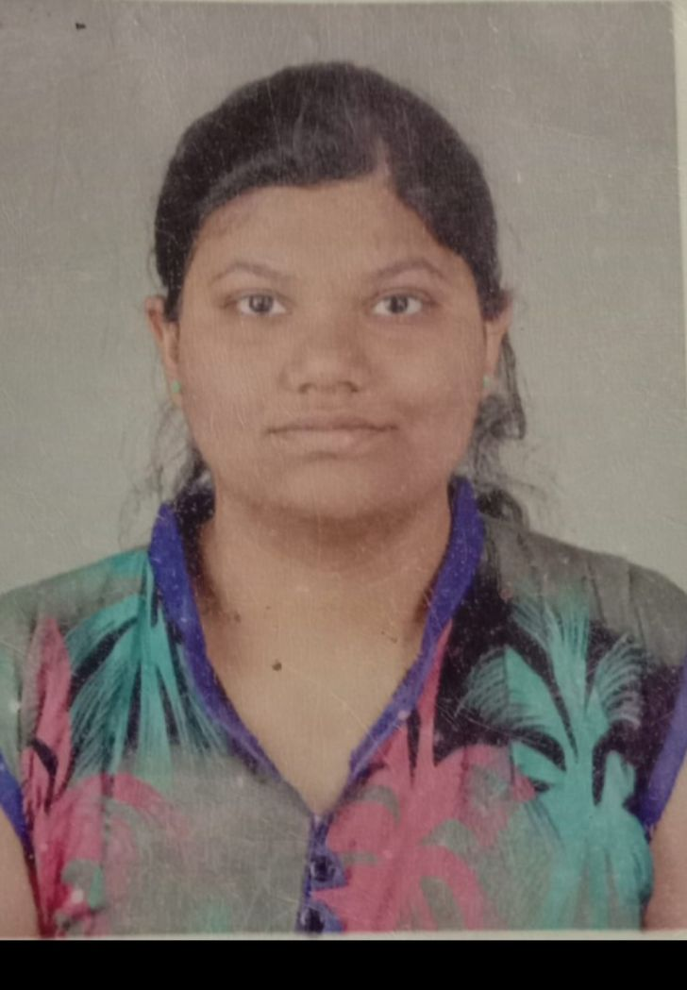
ROLES OF MEMBER
Analysing the model
Skills: ML , Python coding
TOUKEER KAMATE
Active resource feeder and coding
Skills: C
VEDANTI GAVALI
Visualization and presentation
Skills: C
PRERANA WADER
Data cleaning
Skills: Data reading, Python coding
SURAJ INCHAL

Slide 3

GOOGLE COLAB
GOOGLE COLABRATORY IS A GO TO TOOL FOR BUILDING AI/ML MODELS.THE PALTFORM IS A HOSTED JUPYTER NOTEBOOK SERVICE POWERED BY GOOGLE CLOUD.DEVELOPERS CAN ACCESS FREE GPU’S AND TPU’S OF THE SERVICES.

Slide 4
SOLUTION ARCHITECTURE
Starting with analysing the given dataset and looking forward for cleaning the dataset .Splitting the data
Developing a sequential model
Implementing LSTM layers ,dense layers
Trained the model and saved the model
The saved model and its weights were later used for the prediction
Finally generation of sonnet.
DATA READING AND CLEANING
TRAINING THE MODEL
PERDICTION AND TESTING

Slide 5
STEP BY STEP PROCESS
Reading the data ,converting the sentences into lower case and splitting it .
Cleaning the data, example eliminating the non English words , symbols , unnecessary characters and punctuation.
Implementing the suitable training model and performing the training process
We trained the model on a given dataset.txt
Save the trained model
We used the trained model to generate the sonnet on the second dataset.txt file
Generate-Sonnets Using a character-level language model to generate sonnets.

