Slide 1
Agile

Slide 2
Agile software development
Agile software development is an approach to software development under which requirements and solutions evolve through the collaborative effort of self-organizing and cross-functional teams and their customer(s)/end user(s). It advocates adaptive planning, evolutionary development, early delivery, and continual improvement, and it encourages rapid and flexible response to change.
The term agile (sometimes written Agile) was popularized, in this context, by the Manifesto for Agile Software Development. The values and principles espoused in this manifesto were derived from and underpin a broad range of software development frameworks, including Scrum and Kanban.
Agile software development methods support a broad range of the software development life cycle. Some focus on the practices (e.g., XP, pragmatic programming, agile modeling), while some focus on managing the flow of work (e.g., Scrum, Kanban). Some support activities for requirements specification and development (e.g., FDD), while some seek to cover the full development life cycle (e.g., DSDM, RUP).

Slide 3
Scrum

Slide 4
Scrum
Scrum is a framework for project management that emphasizes teamwork, accountability and iterative progress toward a well-defined goal. The framework begins with a simple premise: Start with what can be seen or known. After that, track the progress and tweak as necessary. The three pillars of Scrum are transparency, inspection and adaptation.

Slide 5
Scrum
The framework, which is often part of Agile software development, is named for a rugby formation. Everyone plays a role. When it comes to product development, Scrum roles include product owner, Scrum master and Scrum development team.
Product owner: This team member serves as the liaison between the development team and its customers. The product owner is responsible for ensuring expectations for the completed product have been communicated and agreed upon.
Scrum master: This team member serves as a facilitator. The Scrum master is responsible for ensuring that Scrum best practices are carried out and the project is able to move forward.
Scrum development team: This is a group that works together for creating and testing incremental releases of the final product.

Slide 6
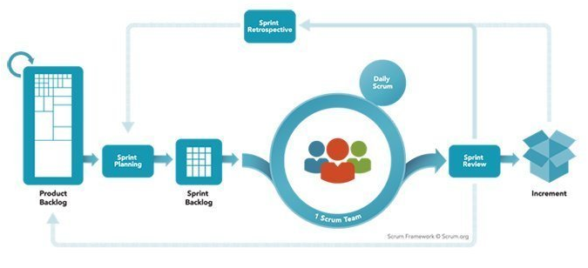
Scrum
The Scrum process
The Scrum process encourages practitioners to work with what they have and continually evaluate what is working and what is not working. Communication, which is an important part of the process, is carried out through meetings, called Events. Scrum Events include:
Daily Scrum . The Daily Scrum is a short stand-up meeting that happens at the same place and time each day. At each meeting, the team reviews work that was completed the previous day and plans what work will be done in the next 24 hours. This is the time for team members to speak up about any problems that might prevent project completion.
Sprint Planning Meeting. A Sprint refers to the time frame in which work must be completed, and it's often 30 days. Everyone participates in setting the goals, and at the end, at least one increment -- a usable piece of software -- should be produced.
Sprint Review. This is the time to show off the increment.
Sprint Retrospective. A Sprint Retrospective is a meeting that's held after a Sprint ends. During this meeting, everyone reflects on the Sprint process. A team-building exercise may also be offered. An important goal of a Sprint Retrospective is continuous improvement.

Slide 7
Scrum
Scrum artifacts
An artifact is something of historical interest that deserves to be looked at again. In Scrum product development, artifacts are used to see what's been done and what is still in the queue. Scrum artifacts, which include product backlog, Sprint backlog, product increment and burn-down, are useful to look at in Sprint Planning Meetings.
Product backlog. This refers to what remains on the "to be done" list. During a product backlog grooming session, the development team works with the business owner to prioritize work that has been backlogged. The product backlog may be fine-tuned during a process called backlog refinement.
Sprint backlog. This is a list of tasks that must be completed before selected product backlog items can be delivered. These are divided in to time-based user stories.
Product increment. This refers to what's been accomplished during a Sprint -- all the product backlog items -- as well as what's been created during all previous Sprints. The product increment reflects how much progress has been made.
Burn-down. The burn-down is a visual representation of the amount of work that still needs to be completed. A burn-down chart has a Y axis (work) and an X axis (time). Ideally, the chart illustrates a downward trend, as the amount of work still left to do over time burns down to zero.

Slide 8
Scrum
The history of Scrum
The basis for the Scrum framework in software development was first introduced in 1986 by Hirotaka Takeuchi and Ikujiro Nonaka in an article published by The Harvard Business Review. In the article, which was entitled "The New New Product Development Game," the authors used metaphors to describe two different approaches to managing product development. Some teams were like runners in a relay race, passing the baton along, working in a straight line. Other teams were rugby players, playing a single game and passing things back and forth, as necessary.
Takeuchi and Nonaka concluded the relay-race approach, as exemplified by the NASA Phased Program Planning system, was outdated. They believed the rugby style would give companies the tools necessary to compete in a multinational business world.
Jeff Sutherland, John Scumniotales and Jeff McKenna are said to have tried Scrum software development at Easel Corp. in 1993. In 1995, Ken Schwaber and Sutherland, working with others -- including McKenna and Scumniotales -- presented an influential white paper at OOPSLA, entitled "SCRUM Development Process." The result was a sea change that made developers question the effectiveness of the classic Waterfall software development model. According to Scrum.org, over 70% of all Agile teams today use Scrum or a Scrum hybrid.

Slide 9
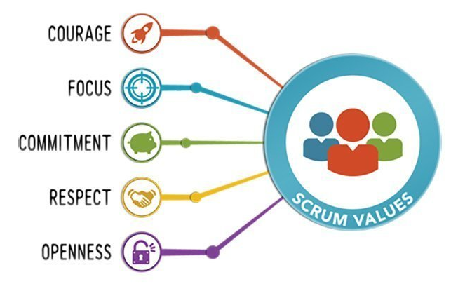
Scrum
Scrum values
The three pillars of Scrum -- transparency, inspection and adaptation -- are supported by five values: commitment, courage, focus, openness and respect.
Commitment: The team is self-directed, and all members are dedicated to completing work that has been agreed upon.
Courage: The team operates as a single entity and succeeds or fails together.
Focus: The team limits distractions and concentrates on what work needs to be done today.
Openness: The team is given time to gather and share what has been successful and what needs to be improved.
Respect: The team is composed of members who have different strengths, and each individual's strengths are respected. There is no finger-pointing when discussing how to fix what is not working.

