Slide 1

Automated robust first peak detection in a time signal using computational intelligence
Computational Intelligence
Prof. Andreas Pech
Presented by
Debasish Dutta
Md Toriquzzaman Touqir
Sonia Akter

Slide 2
Overview
Introduction
Signal Processing Approach (Library and Functions)
First peak detection in Signal Processing Approach
Noise filtering
Output

Slide 3
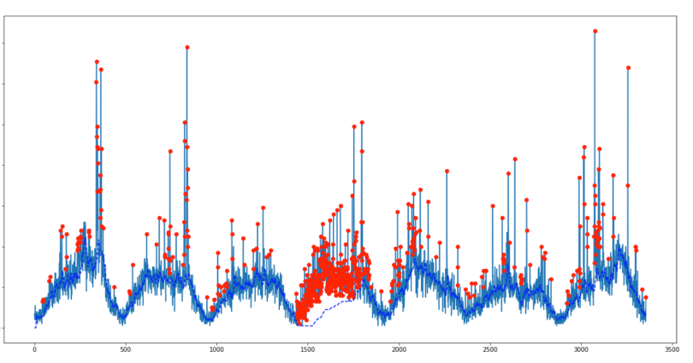
Introduction
In scientific data processing, peak identification in a signal is a well-known prerequisite for measuring their locations, heights, widths, and/or regions.
Peak detection is a crucial stage in computational intelligence-based signal processing applications.

Slide 4
Signal Processing Approach (Library and Functions)
We utilized the SciPy library in our model to find the signal's initial peak.
The NumPy package, which offers quick and easy N-dimensional array manipulation, is required by the SciPy library. The SciPy library offers a variety of effective and user-friendly numerical operations, including those for numerical integration and optimization. It is designed to operate with NumPy arrays.

Slide 5
Signal Processing Approach (Library and Functions)
from scipy.signal import find_peaks
from matplotlib import pyplot as plt
import numpy as np
import tkinter as tk
import pandas as pd
from tkinter import filedialog
scipy.signal.find_peaks
This method uses a straightforward comparison of surrounding values to determine all local maxima given a 1-D array. By defining requirements for a peak's attributes, it is possible to choose a subset of these peaks voluntarily.

Slide 6
Signal Processing Approach (Library and Functions)
pandas as pd
Pandas is a Python module that offers expressive, quick, and flexible data structures that make dealing with "relational" or "labeled" data simple and straightforward.There are certain string values in the test file we were provided. To convert all the numbers to float64, we utilize pandas.

Slide 7
Signal Processing Approach (Library and Functions)
Use tkinter as aThe built-in Python interface to the Tcl/Tk GUI toolkit is the tkinter package, sometimes known as the "Tk interface."Import FileDialog with TkinterWhen handling files, this method provides a dialog that may be used.To construct a Graphical User Interface for uploading our test file, we utilized this package.

Slide 8
First Peak Detection in Signal Processing Approach
def draw_peaks(pulses, y_axis, peak_pos, peak_h):
print(f"First peak position: {peak_pos[0]}, height: {peak_h[0]}")
fig = plt.figure()
ax = fig.subplots()
ax.plot(pulses, y_axis)
ax.scatter(peak_pos[0], peak_h[0], color='r', s=15, marker='D', label='Maxima')
plt.show()
def read_xlsx_file(path, starting_column, row_number):
df = pd.read_excel(path)
selected_row = df.iloc[row_number - 1, starting_column:].values
return selected_row.astype(float)
def get_pulse_data():
file_path = input('Provide the file path: ')
starting_col = int(input('Provide the starting column(e.g. 6, 17 etc.): '))
selected_row = int(input('Provide the row you want to find peak(e.g. 30): '))
yaxis = np.array(read_xlsx_file(file_path, starting_col, selected_row))
pulses = np.array(list(range(0, len(yaxis))))
return pulses, yaxis
if _name_ == '_main_':
x, y = get_pulse_data()
if x is not None and y is not None:
peaks = find_all_peaks(y)
peak_positions, peak_heights = remove_noisy_peaks(x, peaks)
draw_peaks(x, y, peak_positions, peak_heights)

Slide 9
Noise Handling
def remove_noisy_peaks(pulses, found_peaks):
peak_heights = found_peaks[1]['peak_heights']
peak_positions = pulses[found_peaks[0]]
remove_noisy_peaks(pulses, found_peaks):
Although remove_noisy_peaks appears to be a bespoke function for processing some pulse and peak related data, the precise implementation would rely on the particular data structures and context being utilized.

Slide 10
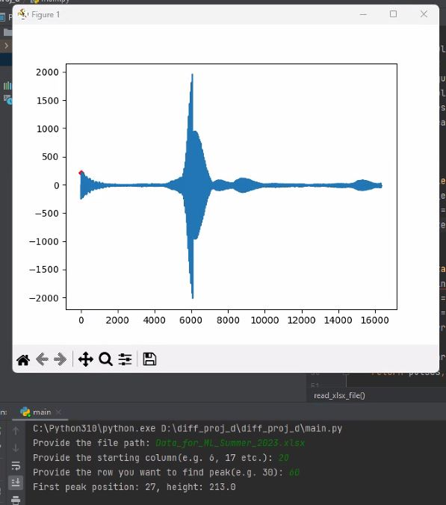
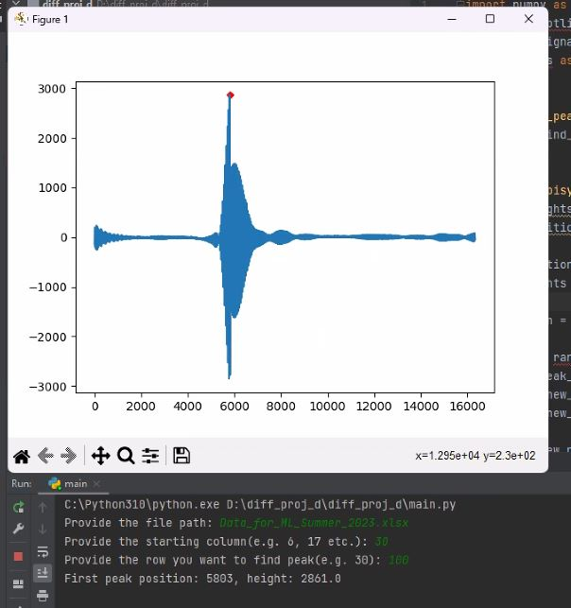
Output (first peak after noise filtering)

Slide 11
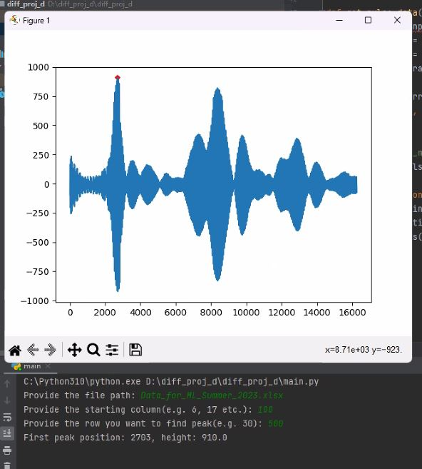
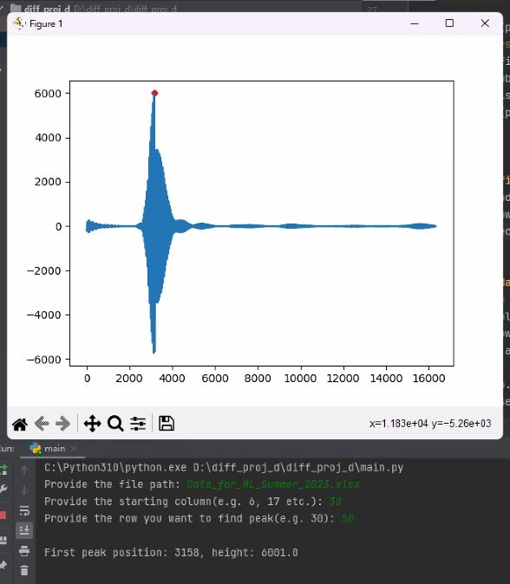
Output (first peak after noise filtering)

Slide 12
Question?

