Slide 1
Some good and bad visualizations!
By Eva

Slide 2
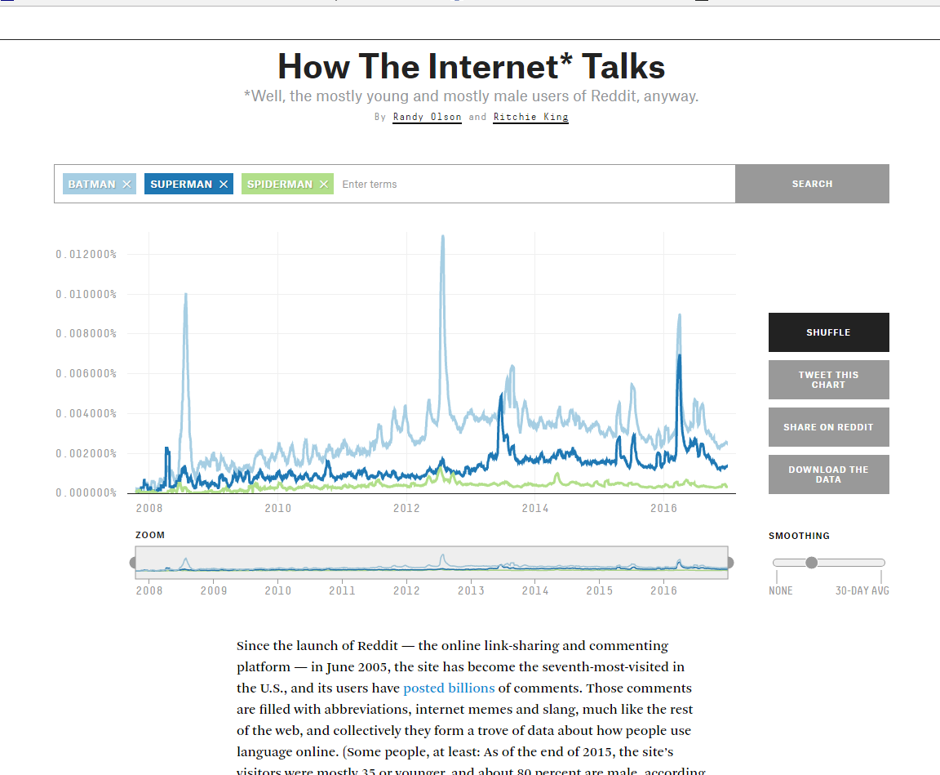
Internet Language Trends Over 8 Years
Source: FiveThirtyEight
GOOD OR BAD: Cool and good!
Analyzing words trends in Reddit comments from late 2007 – Dec. 2016
https://projects.fivethirtyeight.com/reddit-ngram/?keyword=yuge&start=20071015&end=20161231&smoothing=10

Slide 3
Why cool and good?
Simple – can look at as many terms as you want, color coordinated by search term
Scale – can change based on what makes sense
Smoothing – outliers
Honest about scope of data – Reddit users, young men
Not cool and good:
Y-axis?
Don’t have sense of overall scale
If plot highly used term with not used term, not usful

Slide 4
Rows, columns, EPT
Originally: Microdata (comments)
Filter - word
Aggregate by day
EPT – same scale/origin, color
Comment 1 | 12/21/14 12:01:03 | Oh
Comment 1 | 12/21/14 12:01:03 | my
Comment 1 | 12/21/14 12:01:03 | word!
Comment 2 | 5/05/09 16:55:45 | Thx
Comment 2 | 5/05/09 16:55:45 | lol
Comment 2 | 5/05/09 16:55:45 | bye
Comment 2 | 5/05/09 16:55:45 | dum

Slide 5
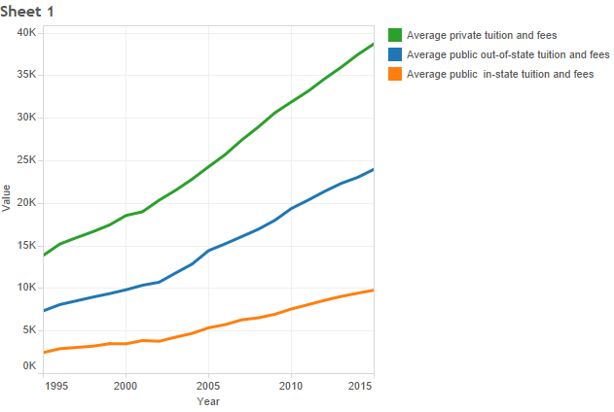
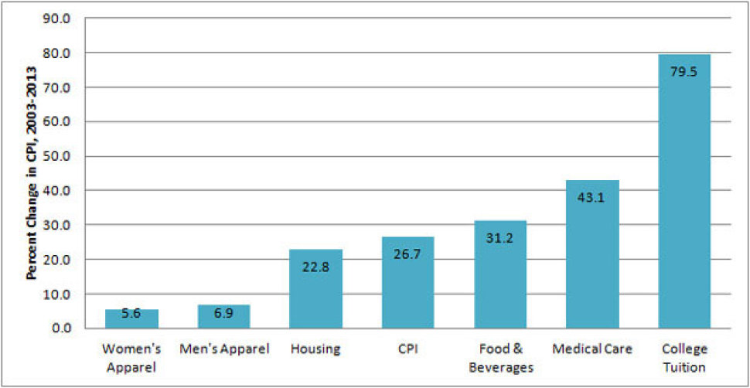
No comparison vs comparison
GOOD OR BAD: Bad-ish, then better
Sheet 1: comparing tuition values between private, public out of state, and public in state tuition
Other graph: comparing changes in the consumer price index between different expenses, better to see dramatic increase for college tuition

Slide 6
Why not good and a bit good?
Sheet 1:
A bit misleading – not including relevant information
Inflation or not?
Second graph:
Accounts for inflation
Includes CPI as bar
Doesn’t explain CPI

Slide 7
Rows, columns, EPT
Sheet 1:
Originally individual colleges/universities per year, with type of institution (private, public out-of-state, public in-state)
Then aggregate with the average tuition per year per type
EPT: Common scale, color
College Name | Year | Type | Tuition ($)
Georgetown Univ. | 1999 | Private | 20,000
Georgetown Univ. | 2000 | Private | 21,000
Georgetown Univ. | 2001 | Private | 23,000

