Slide 1
Air Quality Monitoring System (AQMS)
CSE303
Section 3
Group 4
Submitted by:
Mushfiqur Alam Bhuiyan – 2020301
Toushif Hossain - 1920404
Azwad Fawad Hasan - 2020222
Tanjina Sikder Tonny - 1931150
Seeyam Akhter - 1920181
Md. Al-Abid Supto - 1921719

Slide 2
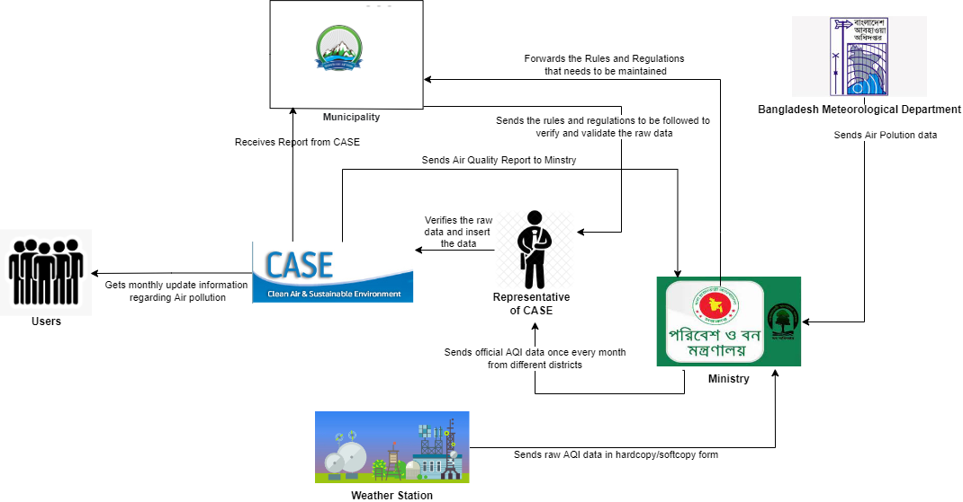
ANALYSIS PHASE
RICH PICTURE (AS IS)

Slide 3
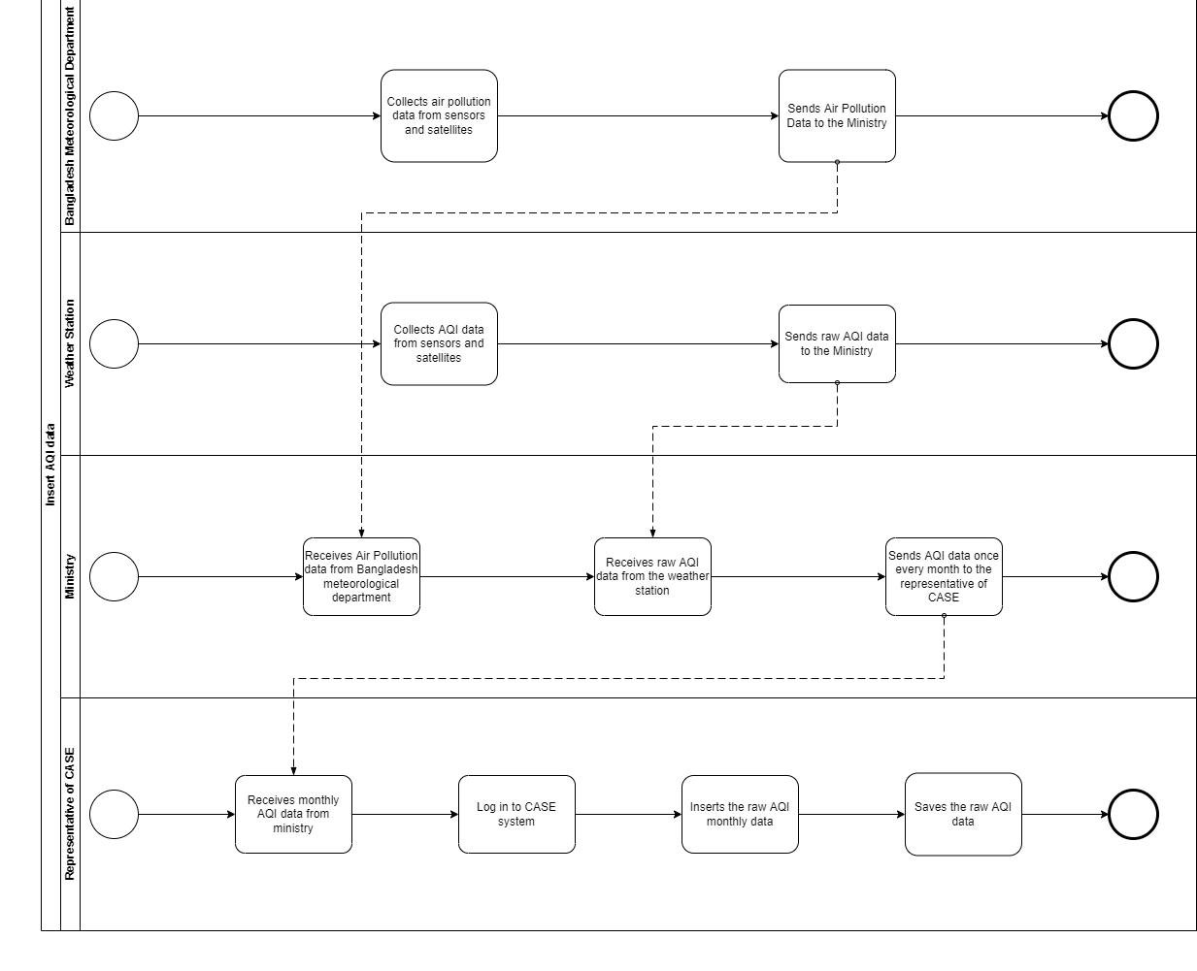
Six Element Analysis (AS IS)
Business Process Modelling (AS IS)

Slide 4
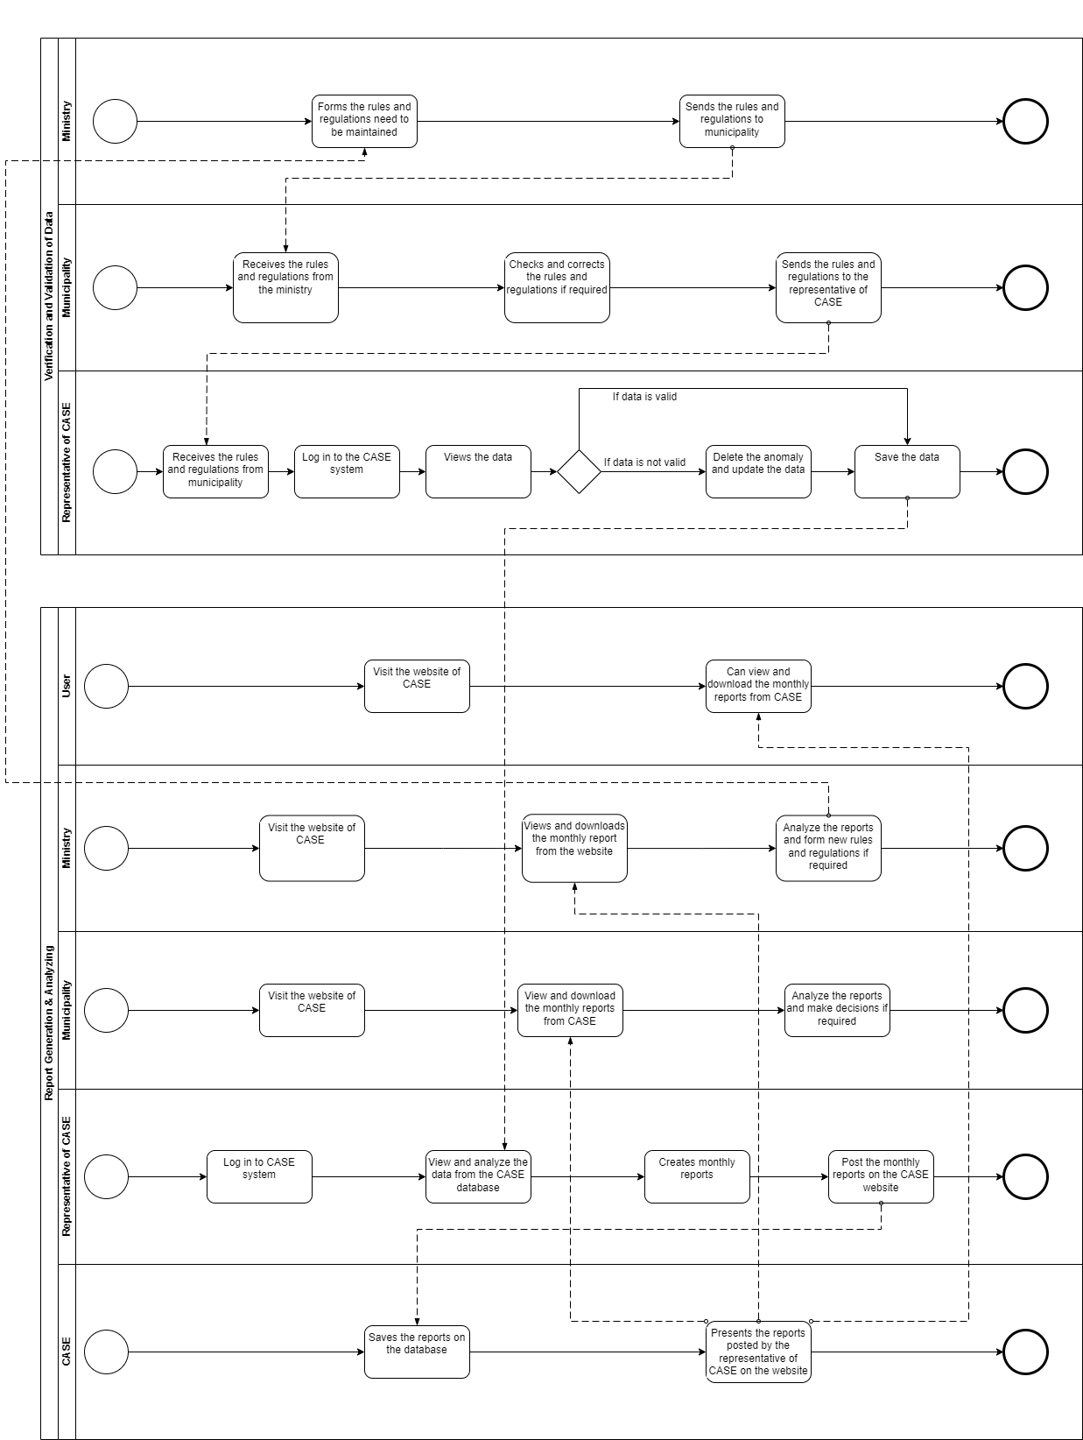

Slide 5
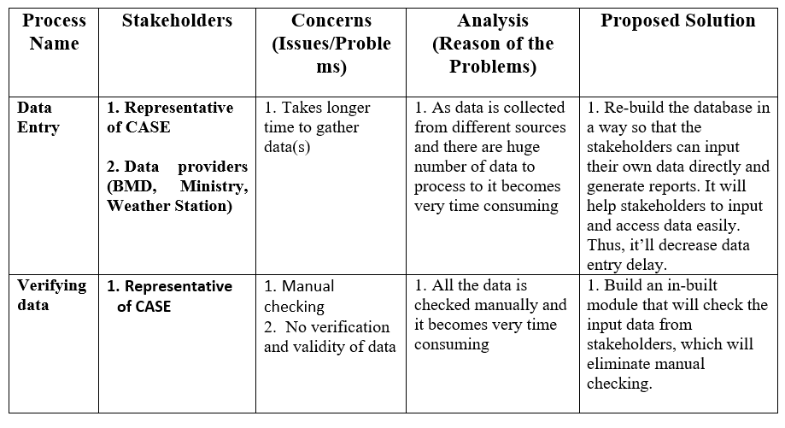
Problem Analysis of the Existing System

Slide 6
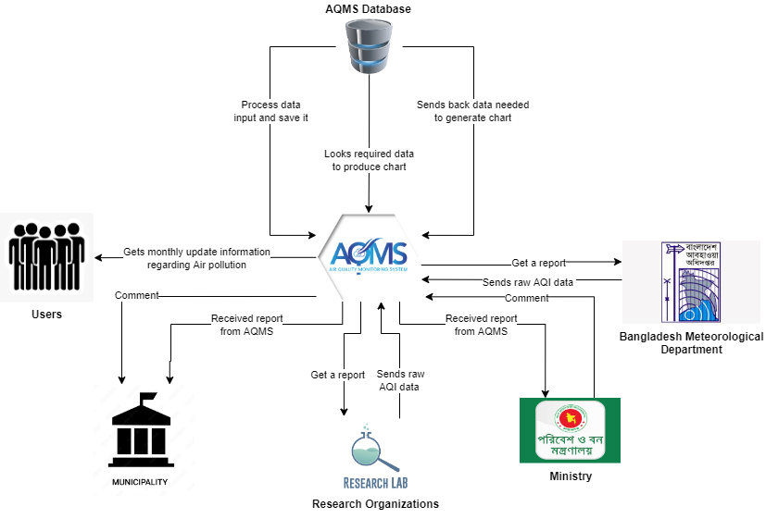
RICH PICTURE (PROPOSED)

Slide 7
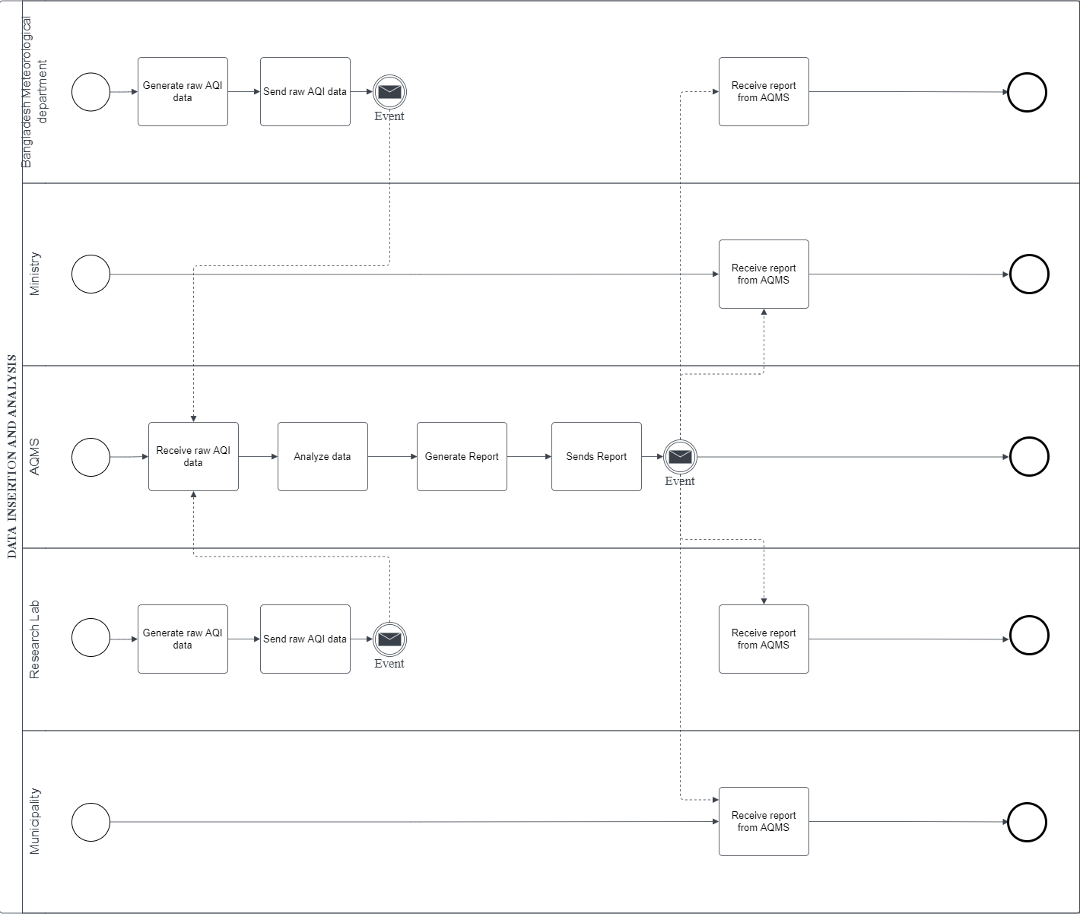
Six Element Analysis (Proposed)
Business Process Modelling (Proposed)

Slide 8
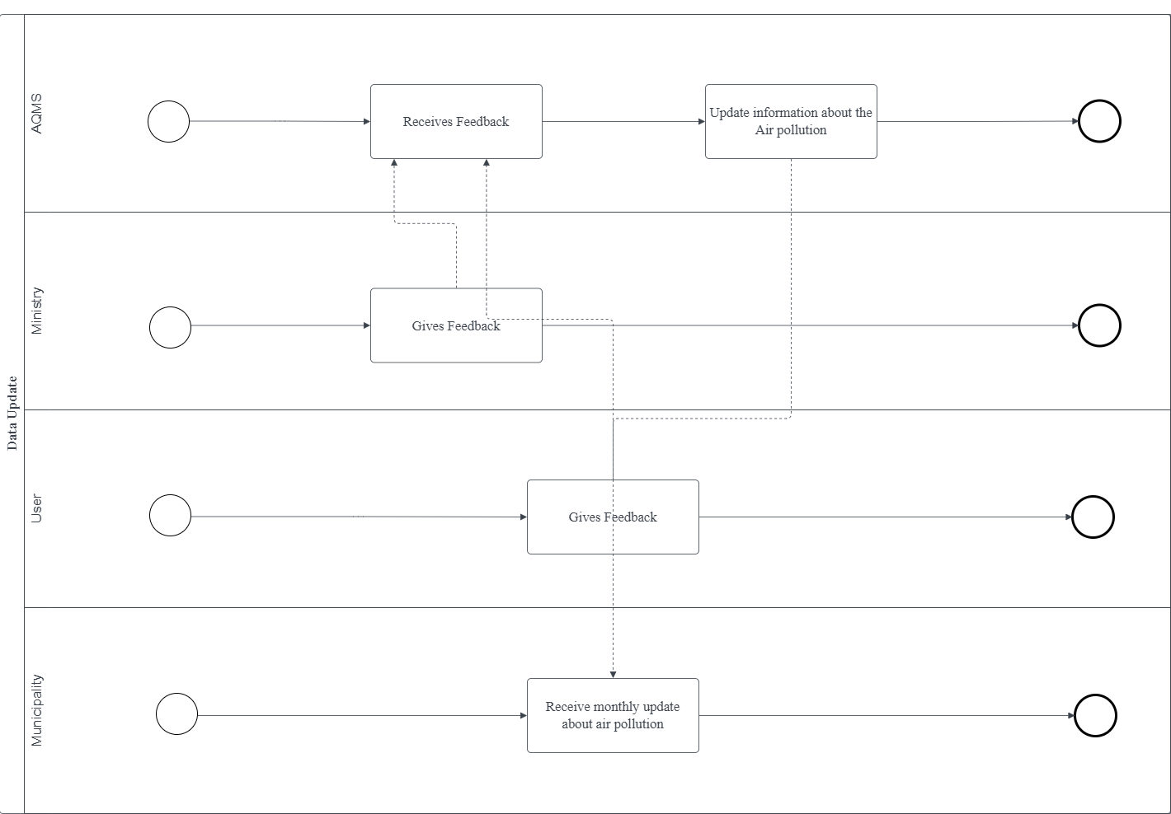

Slide 9
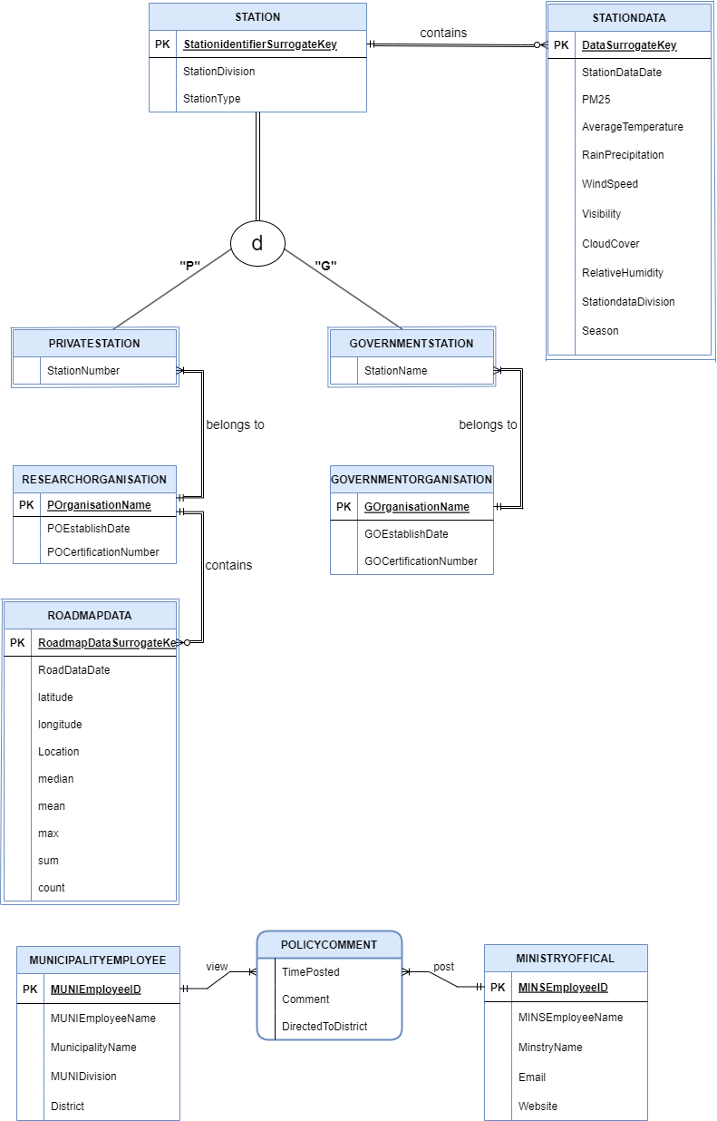
DESIGN PHASE
Extended Entity Relation Diagram (EERD)

Slide 10
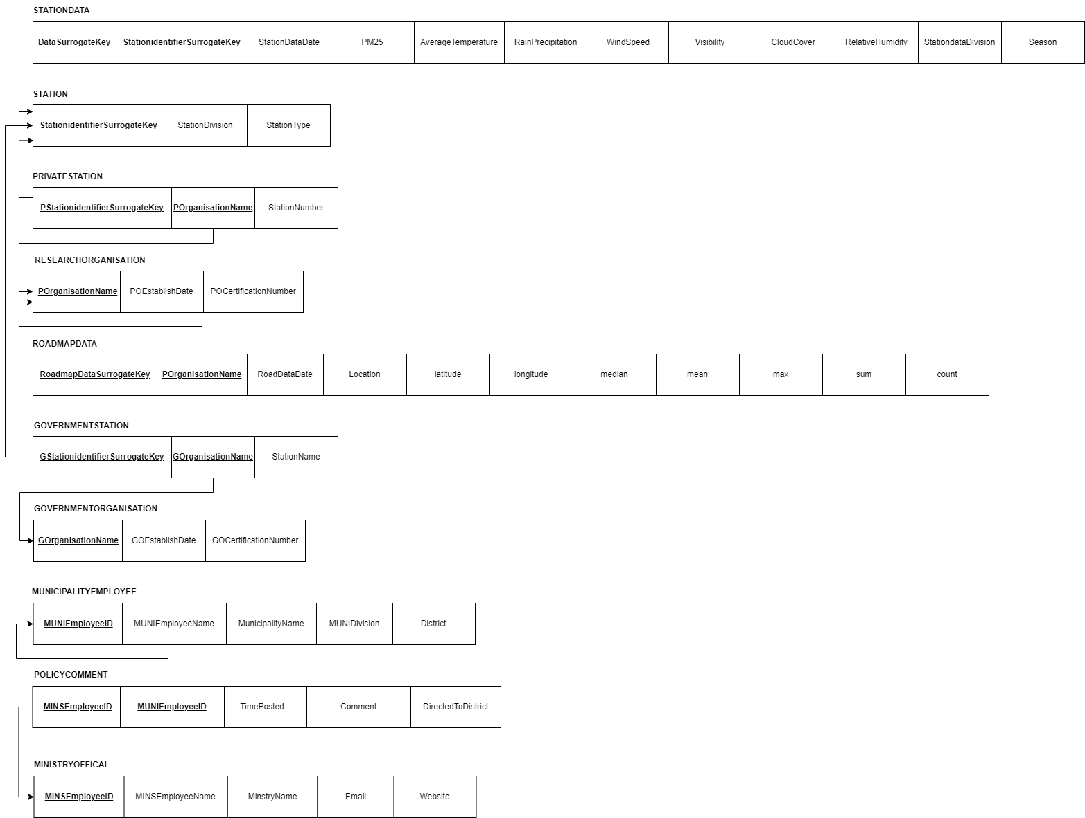
Relation Schema

Slide 11
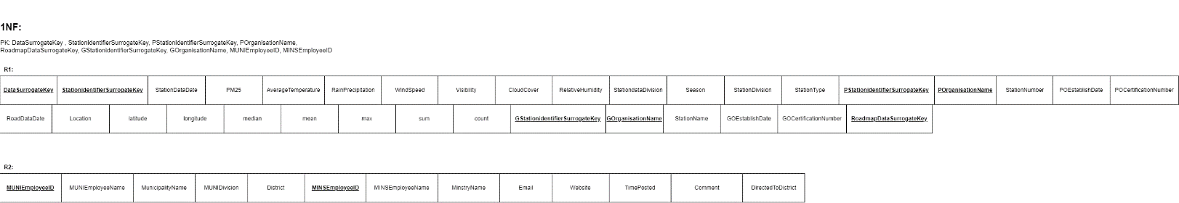
Normalization

Slide 12
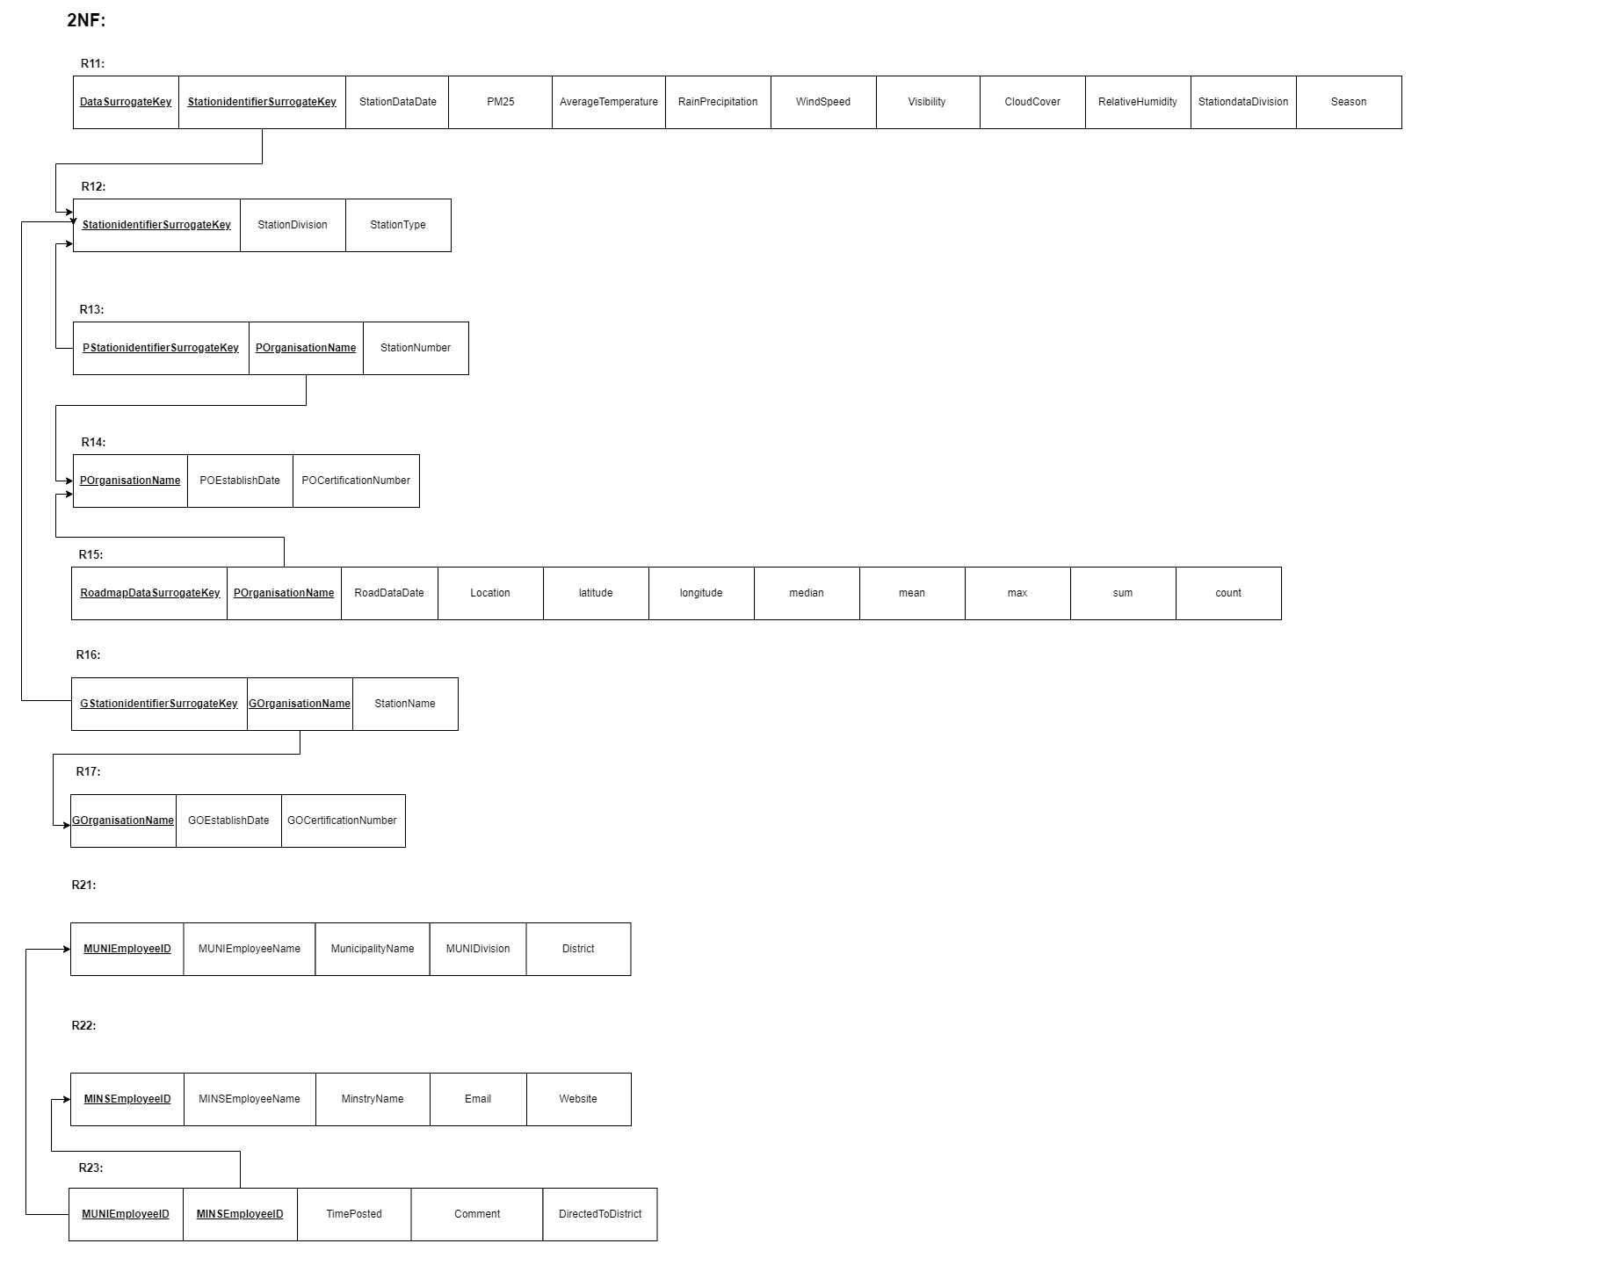

Slide 13
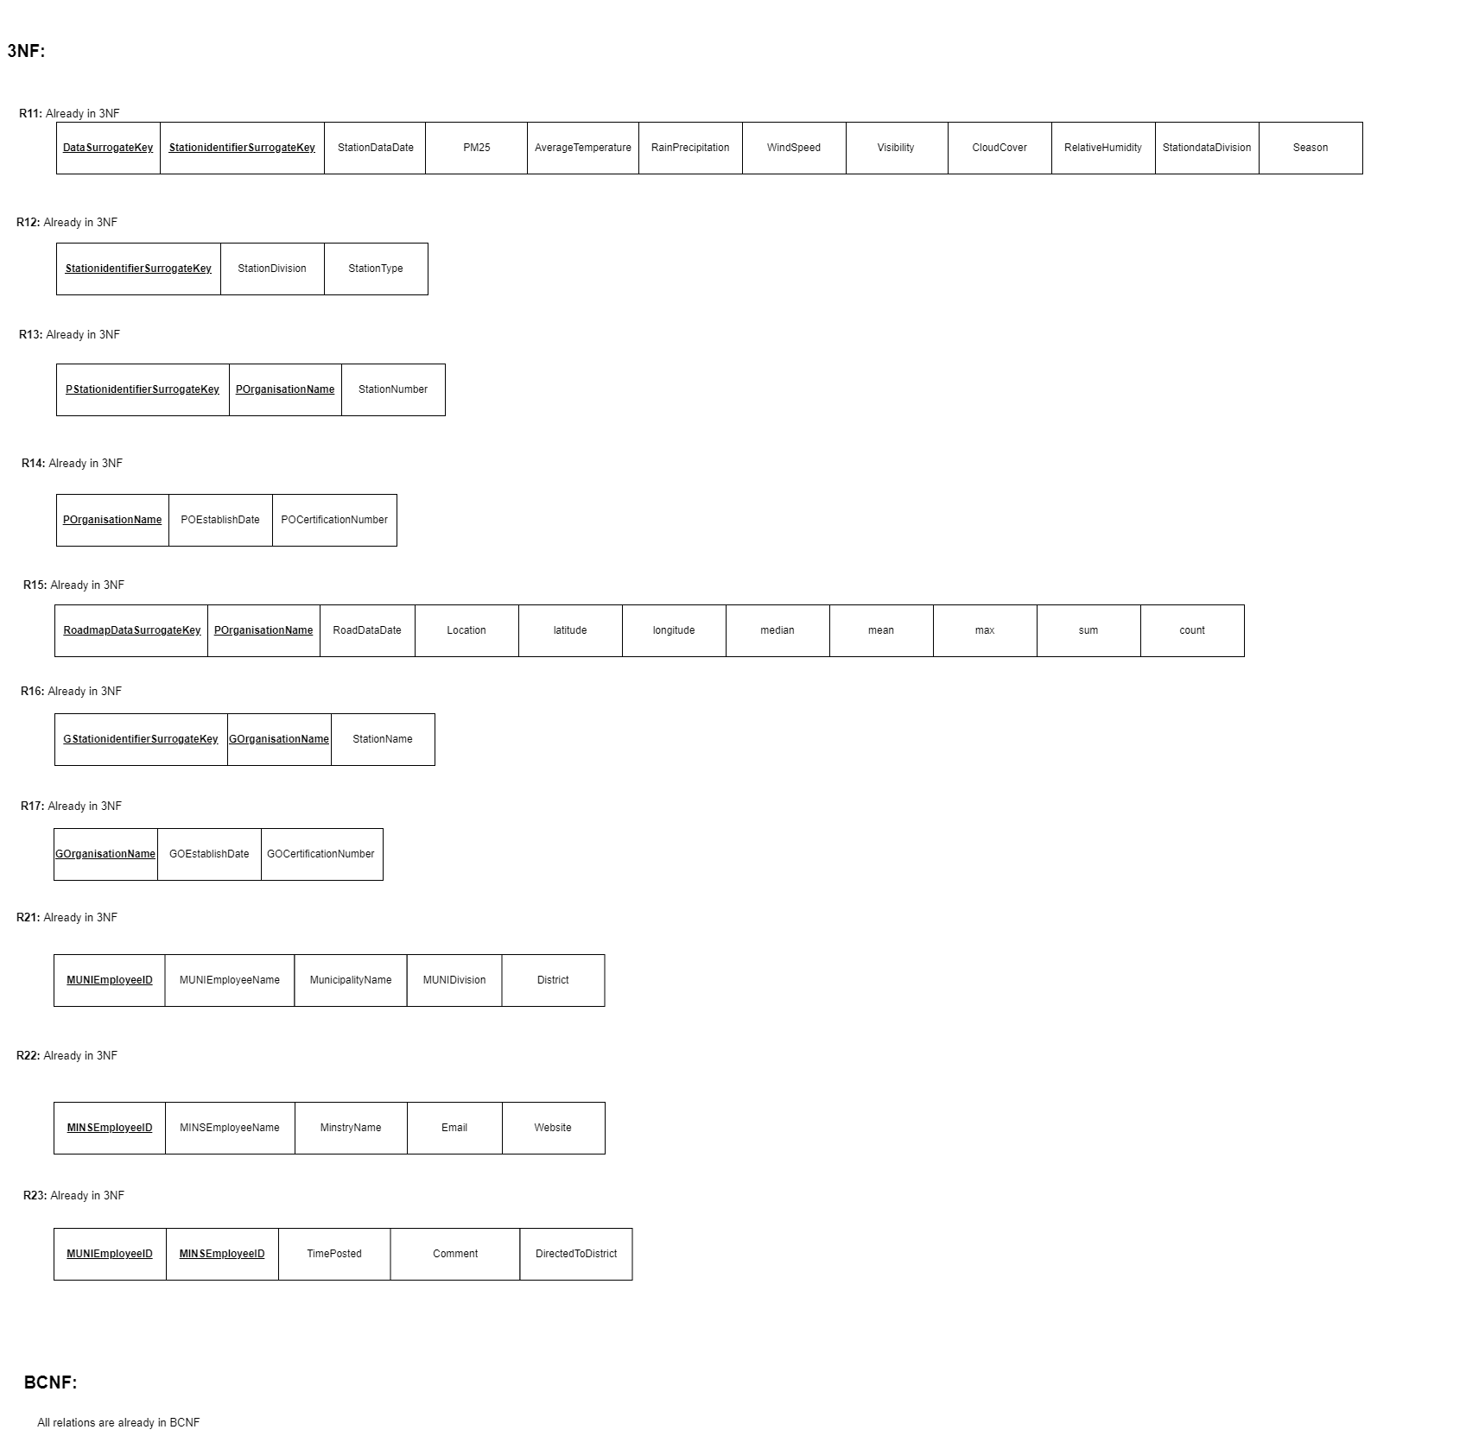

Slide 14
DATA DICTIONARY
-defining all the attributes in words
IMPLEMENTATION OF THE PROPOSED SYSTEM

Slide 15
THANK YOU! ☺

