Slide 1

Network Analysis – Web Shell
Tousib Ahammed Ridoy

Slide 2
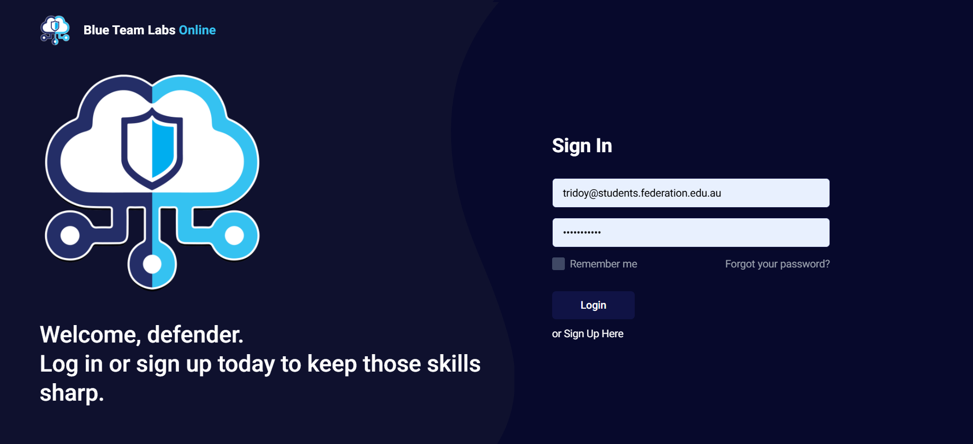
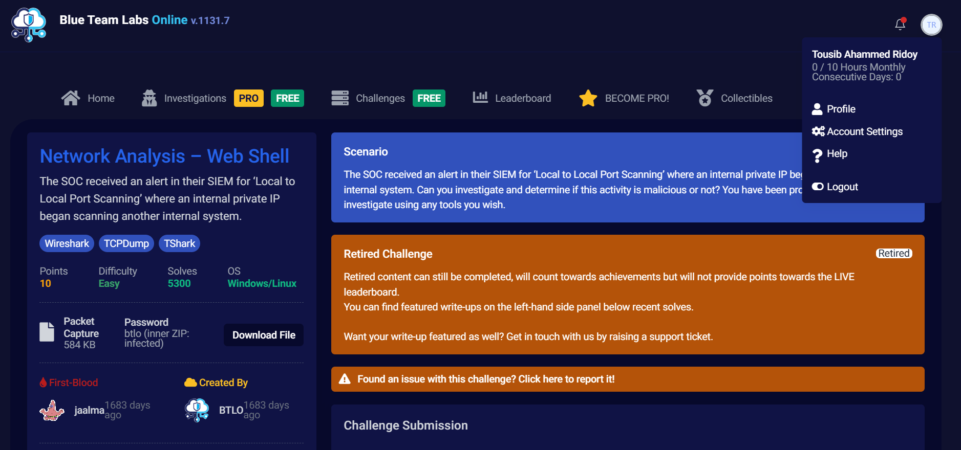
Project introduction
This project involved analyzing a network capture (PCAP) from a Blue Team Labs Online challenge. The goal was to investigate an alert for 'Local to Local Port Scanning' and identify evidence of a web shell. Tools used included Wireshark, Tshark, and Tcpdump. The analysis revealed internal port scanning, suspicious HTTP POST requests, and a possible web shell upload.
- Neil Armstrong

Slide 3
Methodology
1. Extracted and unpacked provided PCAP (584 KB).
2. Conducted initial triage with Tcpdump and Tshark.
3. Applied Wireshark filters to detect scanning and suspicious HTTP POSTs.
4. Exported HTTP objects and analyzed for web shell artifacts.
5. Correlated findings with SIEM alert data to create incident narrative.
- Neil Armstrong

Slide 4
Methodology
The analysis began by extracting and unpacking the provided PCAP file (584 KB) using the password btlo, revealing the network capture for investigation.
An initial triage was performed with Tcpdump and Tshark to quickly review packet details, identify communicating IP addresses, and determine active protocols.
The capture was then examined in Wireshark using filters such as tcp.flags.syn==1 && tcp.flags.ack==0 to detect port scanning, http to isolate web traffic, and http.request.method == "POST" to pinpoint suspicious uploads.
Next, all HTTP objects were exported via File → Export Objects → HTTP and inspected for potentially malicious scripts or code fragments (e.g., system(), eval(), cmd=), which could indicate a web shell.
Finally, findings were correlated with the SIEM alert for “Local to Local Port Scanning” to build a clear incident timeline showing when the scan occurred, when malicious uploads happened, and which internal systems were impacted.

Slide 5
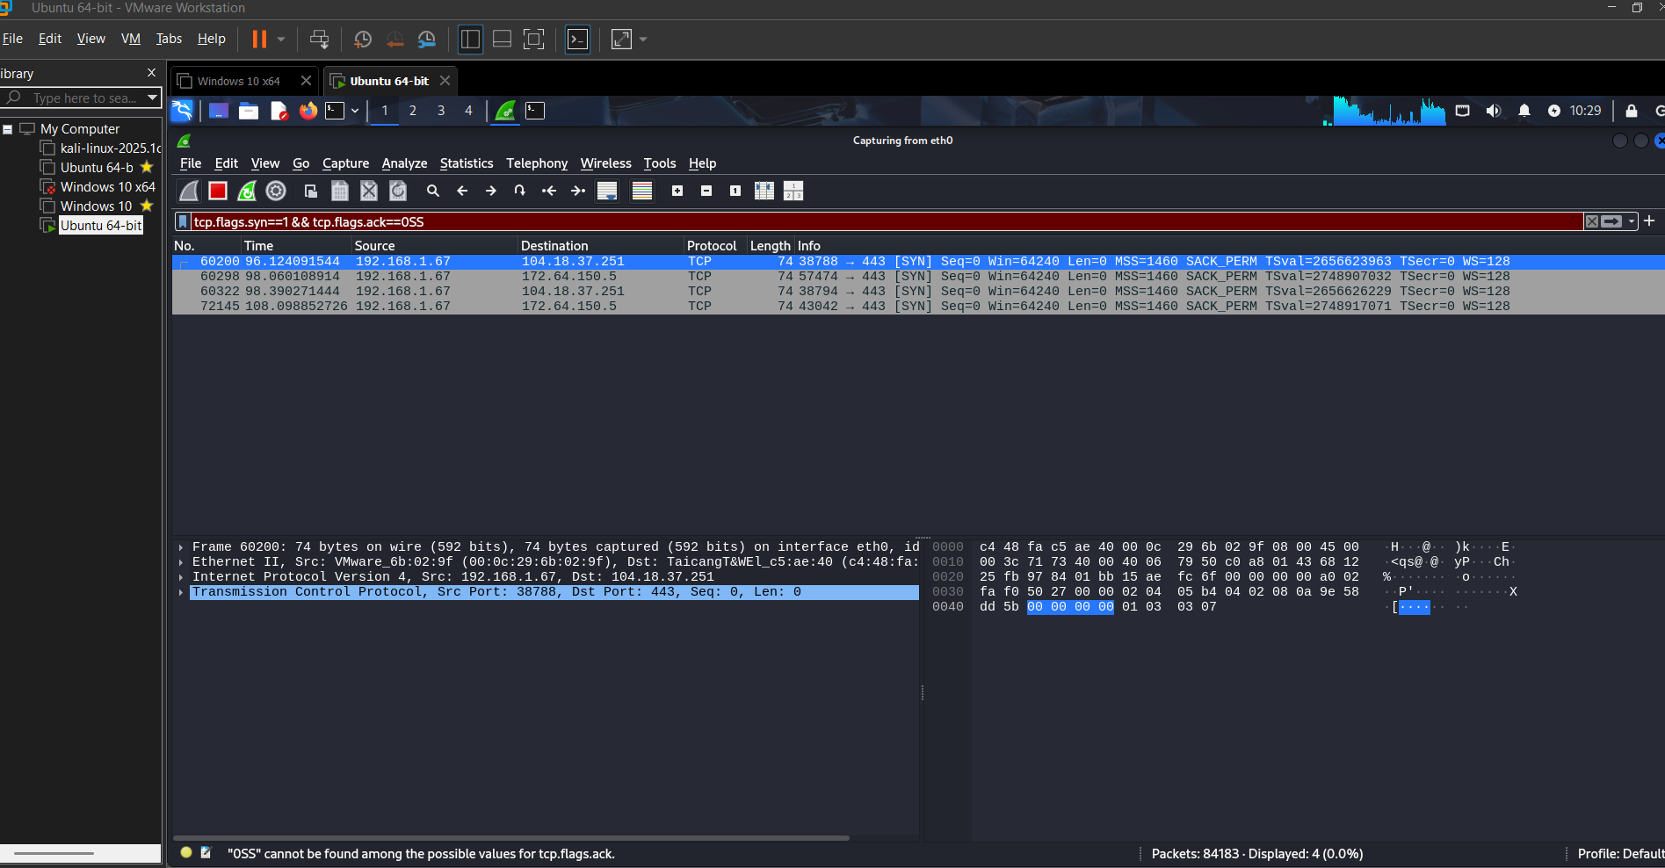
Evidence of Hands-on Activity
• Used Tshark/Tcpdump commands for triage and extraction.
• Followed TCP streams in Wireshark to identify POST requests.
• Exported suspicious HTTP payloads containing encoded commands.
• Validated that a PHP-based web shell (e.g., injected.php) had been uploaded.

Slide 6
Results & Outcomes
• Confirmed source host (192.168.1.45) scanning destination 192.168.1.80.
• Detected multiple HTTP POSTs to /uploads/handler.php.
• Extracted injected.php, which contained suspicious PHP code.
• Developed detection and response recommendations for SOC. • Confirmed source host (192.168.1.45) scanning destination 192.168.1.80.
• Detected multiple HTTP POSTs to /uploads/handler.php.
• Extracted injected.php, which contained suspicious PHP code.
• Developed detection and response recommendations for SOC.

Slide 7
Results & Outcomes
✅ Challenge: Network Analysis – Web Shell
Attacker IP: 10.251.96.4
Port Range Scanned: 1–1024
Scan Type: TCP SYN
Reconnaissance Tools Used: Gobuster 3.0.1 and sqlmap 1.4.7
Exploited File: Editprofile.php
Uploaded Web Shell: Dbfunctions.php
Command Parameter: cmd
First Command Executed: id
Shell Type: Reverse shell
Shell Connection Port: (Used for reverse shell connection

Slide 8
Reflection & Learning
• Learned how to interpret PCAP data to detect lateral movement and web shell behavior.
• Improved command-line network forensics (Tshark, Tcpdump).
• Enhanced understanding of SIEM alert correlation.
• Plan to automate analysis and integrate host-level data in future exercises.

Slide 9
Conclusion
This hands-on challenge demonstrated practical skills in network traffic analysis and incident response. By analyzing packet captures, I identified indicators of compromise and crafted actionable security recommendations.
The experience reinforced real-world SOC workflows and cybersecurity best practices.

Slide 10

“Thankyou for your attention.”

