Slide 1
SciGraph
Scalable scientific literature intelligence over OpenAlex metadata
A reproducible Spark pipeline with text, graph, temporal, retrieval, ML, ranking, and visualization outputs.
2,500
53,877
13
OpenAlex article records
Gold citation edges
Generated figures
Notes:
Sources: reports/results/schema_summary.json; reports/results/bronze_silver_gold_report.json; docs/VISUALIZATIONS.md. Metrics reflect the completed 2,500-record development run, not the in-progress 1,000,000-record production acquisition.

Slide 2
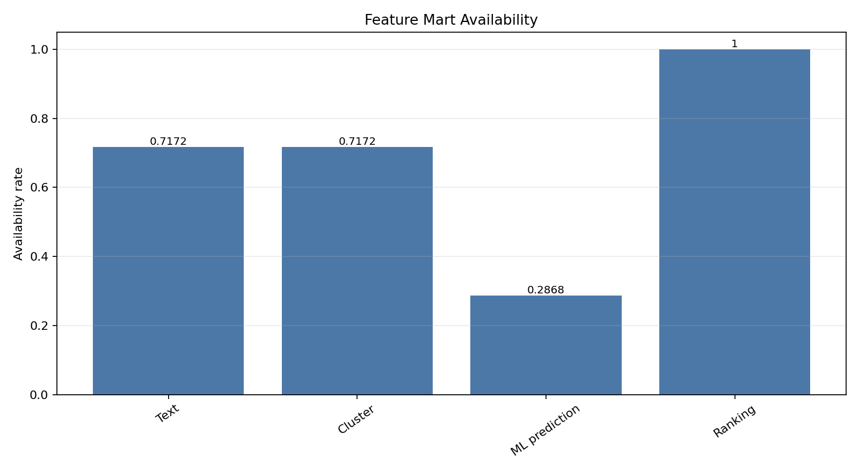
Project Objective
Build a transparent literature analytics system without relying on an LLM-only workflow
The project turns raw scholarly metadata into analysis-ready tables, reports, and visual evidence. The emphasis is on reproducibility, measured results, and clear limitations.
1. Acquire OpenAlex article records with abstracts
2. Normalize nested metadata with Spark
3. Analyze text, citation links, collaboration, and time
4. Compare sparse, dense, hybrid, and graph-aware retrieval
5. Publish a feature mart, figures, notebook, and final report
Notes:
Sources: docs/PROJECT_REPORT.md; reports/figures/feature_mart_availability.png. Metrics reflect the completed 2,500-record development run, not the in-progress 1,000,000-record production acquisition.

Slide 3
System Architecture
A layered pipeline keeps raw data, normalized tables, and analysis outputs separate
OpenAlex API
Bronze
Silver
Gold
Analysis
Outputs
Raw JSONL metadata
Raw nested Spark table
Publication-level normalization
Publications, authors, citations, topics
Text, graph, temporal, retrieval, ML
Reports, figures, tables, notebook
Storage pattern: Parquet tables for data, JSON for metrics, Markdown for interpretation, PNG for figures.
Notes:
Sources: docs/ARCHITECTURE.md; docs/PROJECT_REPORT.md. Metrics reflect the completed 2,500-record development run, not the in-progress 1,000,000-record production acquisition.

Slide 4
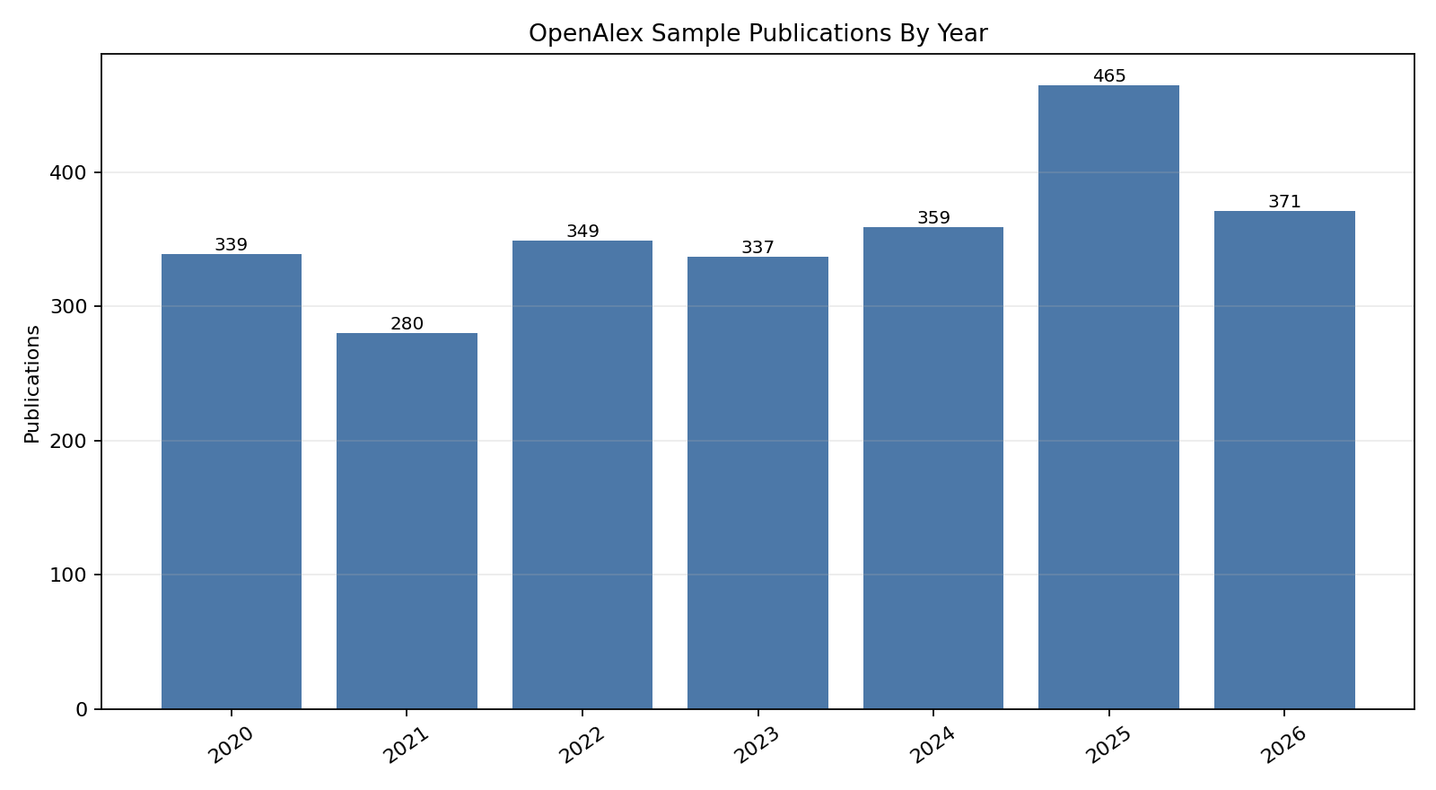
Dataset And Scale
The completed run uses a larger 2,500-record sample
Metric | Value
Records | 2500
Publication years | 2020-2026
Unique authors | 9274
Referenced works observed | 53900
Document type | article
The sample remains heterogeneous, which helps test the pipeline but weakens claims about field-specific clusters.
Notes:
Sources: reports/results/schema_summary.json; reports/figures/dataset_publications_by_year.png. Metrics reflect the completed 2,500-record development run, not the in-progress 1,000,000-record production acquisition.

Slide 5
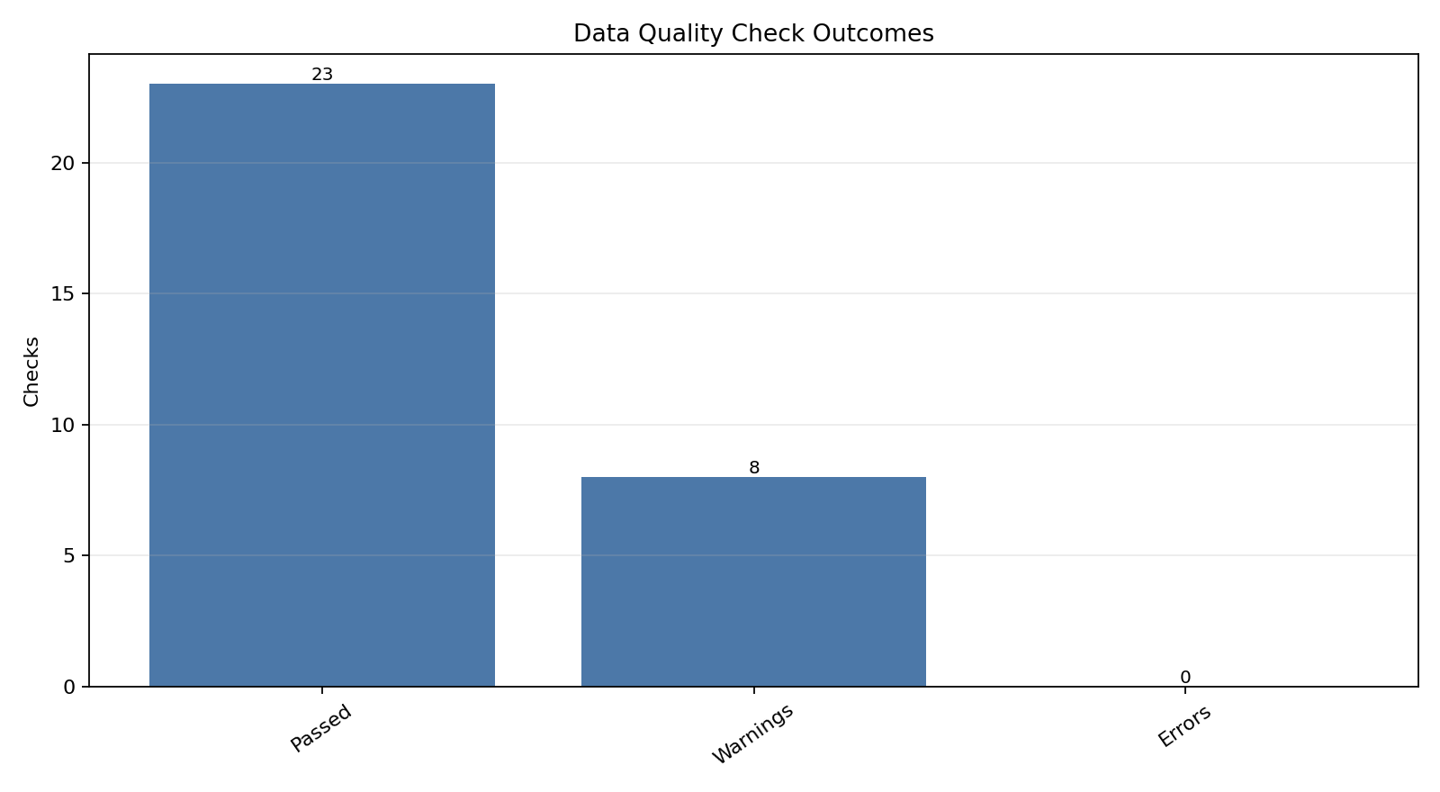
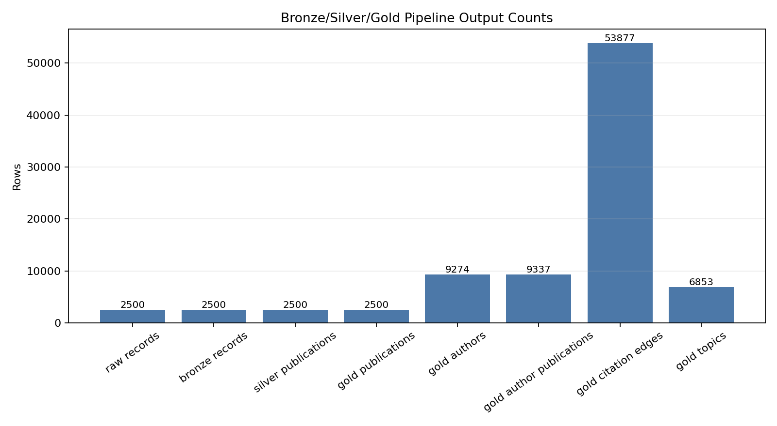
Data Quality And Spark Outputs
No blocking quality errors appeared in the completed run
2500
9274
53877
Gold publications
Gold authors
Citation edges
Notes:
Sources: reports/results/data_quality_report.json; reports/results/bronze_silver_gold_report.json; reports/figures/data_quality_checks.png; reports/figures/pipeline_stage_counts.png. Metrics reflect the completed 2,500-record development run, not the in-progress 1,000,000-record production acquisition.

Slide 6
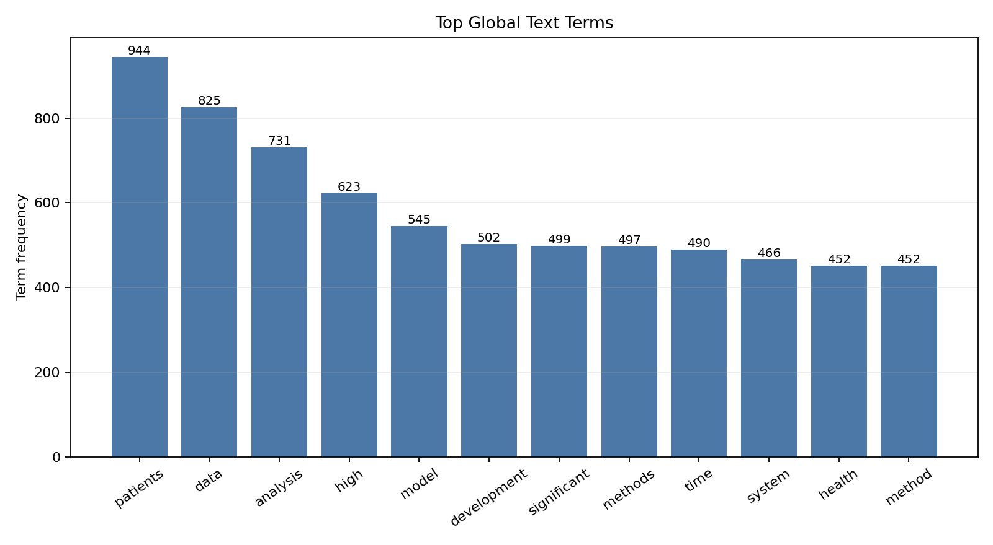
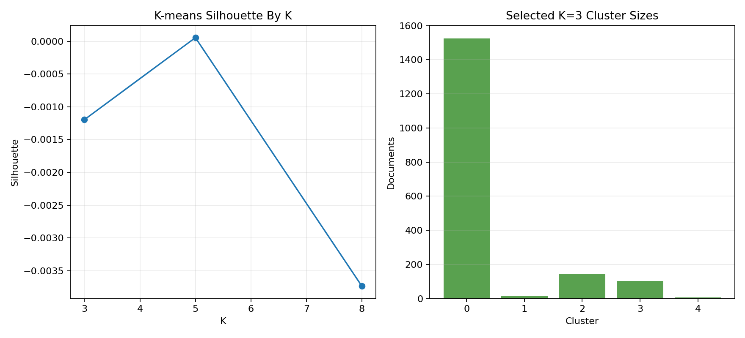
Text Analysis And Clustering
Text features scale, but clusters remain exploratory
1793
26728
5
English text documents
Retained vocabulary
Selected K
Notes:
Sources: reports/results/text_analysis_report.json; reports/results/clustering_report.json; reports/figures/text_top_terms.png; reports/figures/clustering_results.png. Metrics reflect the completed 2,500-record development run, not the in-progress 1,000,000-record production acquisition.

Slide 7
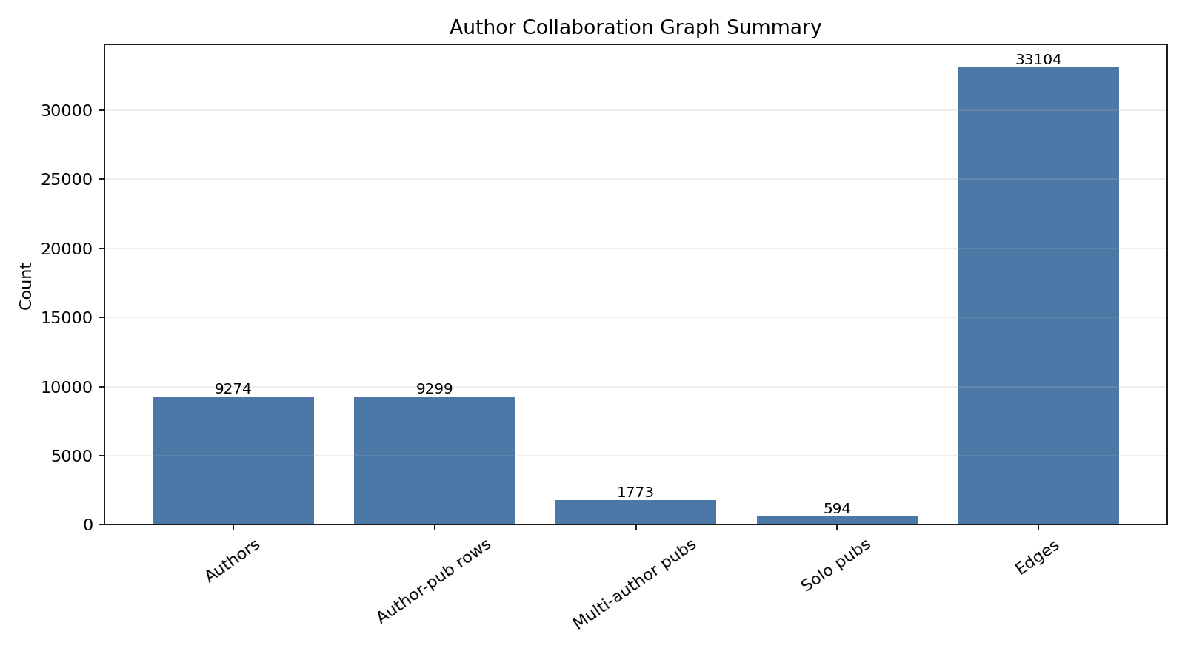
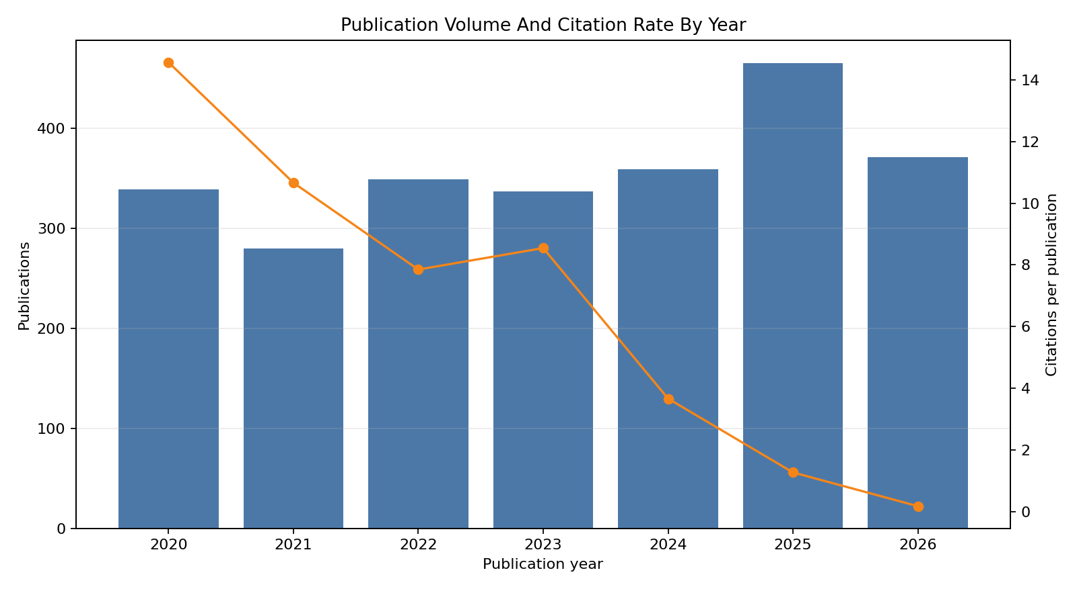
Graph And Temporal Signals
Collaboration is informative, while sampled citation links remain sparse
Citation graph: 53,877 full edges, but 0 in-sample citation edges. PageRank is therefore limited for ranking sampled papers.
Author graph: 9,274 authors and 33,104 coauthor edges across the current sample.
Temporal analysis: 7 year buckets and 5,566 topic-year rows.
Notes:
Sources: reports/results/citation_graph_report.json; reports/results/author_collaboration_report.json; reports/results/temporal_analysis_report.json. Metrics reflect the completed 2,500-record development run, not the in-progress 1,000,000-record production acquisition.

Slide 8
Retrieval And ML Results
Graph-aware reranking produced the strongest NDCG in the current comparison
System | P@10 | Recall@10 | MRR | NDCG@10
bm25 | 0.48 | 0.37 | 0.62 | 0.54
dense | 0.18 | 0.08 | 0.41 | 0.20
hybrid reranked | 0.44 | 0.32 | 0.72 | 0.57
hybrid reranked graph | 0.46 | 0.37 | 0.77 | 0.62
hybrid rrf | 0.36 | 0.24 | 0.73 | 0.43
0.6188
Best NDCG@10
0.36
Sparse P@10
0.9174
Citation model AUC
Notes:
Sources: reports/results/retrieval_report.json; reports/results/advanced_retrieval_results.json; reports/results/ml_citation_prediction_report.json. Metrics reflect the completed 2,500-record development run, not the in-progress 1,000,000-record production acquisition.

Slide 9
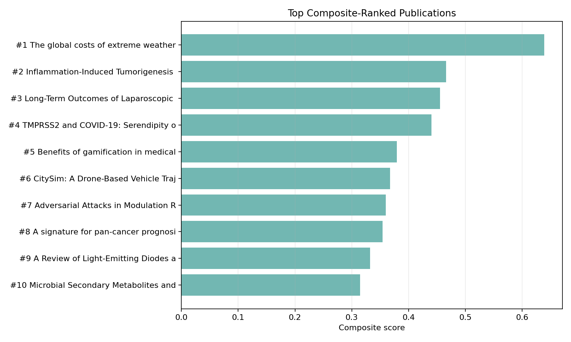
Feature Mart And Review Artifacts
The project now has a single inspection surface plus presentation-ready outputs
The feature mart preserves 2,500 publication rows and 34 columns. Text-derived features cover 71.7% of rows, while ranking features cover 100.0%.
Review paths: PROJECT_REPORT.md, VISUALIZATIONS.md, reports/tables CSV files, and notebooks/scigraph_visual_summary.ipynb.
Notes:
Sources: reports/results/feature_mart_report.json; docs/PROJECT_REPORT.md; docs/VISUALIZATIONS.md. Metrics reflect the completed 2,500-record development run, not the in-progress 1,000,000-record production acquisition.

Slide 10
Limitations And Next Steps
The strongest deliverable is the reproducible system and its measured evidence
Current limitation | Why it matters
Heterogeneous sample | Clusters do not represent validated research fields
No in-sample citation edges | PageRank has limited value for sampled-paper ranking
Proxy retrieval labels | Metrics need human judgments for stronger claims
Static streaming replay | Production streaming would need checkpointed inputs
Recommended extensions
1. Acquire a field-specific or citation-neighborhood sample
2. Add human relevance judgments for retrieval
3. Build a semantic index with FAISS or Chroma
4. Turn the notebook into an interactive dashboard
Notes:
Sources: docs/LIMITATIONS.md; docs/PROJECT_REPORT.md. Metrics reflect the completed 2,500-record development run, not the in-progress 1,000,000-record production acquisition.

