Slide 1
Autoware - Quick Start
This Quick Start guide is based on Autoware manual dated 2016-08-01.

Slide 2
1. Autoware
Autoware & ROS
Autoware is an open source software based on ROS. It is developed by Nagoya University and is intended for autonomous driving research and development. It is open sourced on GitHub.
bag file (rosbag)
In ROS, all the messages of topics are logged and time-stamped to a .bag file called “rosbag”. This can be used for replay of the messages with RViz (3D visualization tool for ROS). In robotics, it is often difficult to analyze the interactions with multiple sensors at once, and this tool enables efficient analysis and debugging of system. Also, the logged messages can be replayed repeatedly, allowing developers to debug their systems without actual sensors.

Slide 3
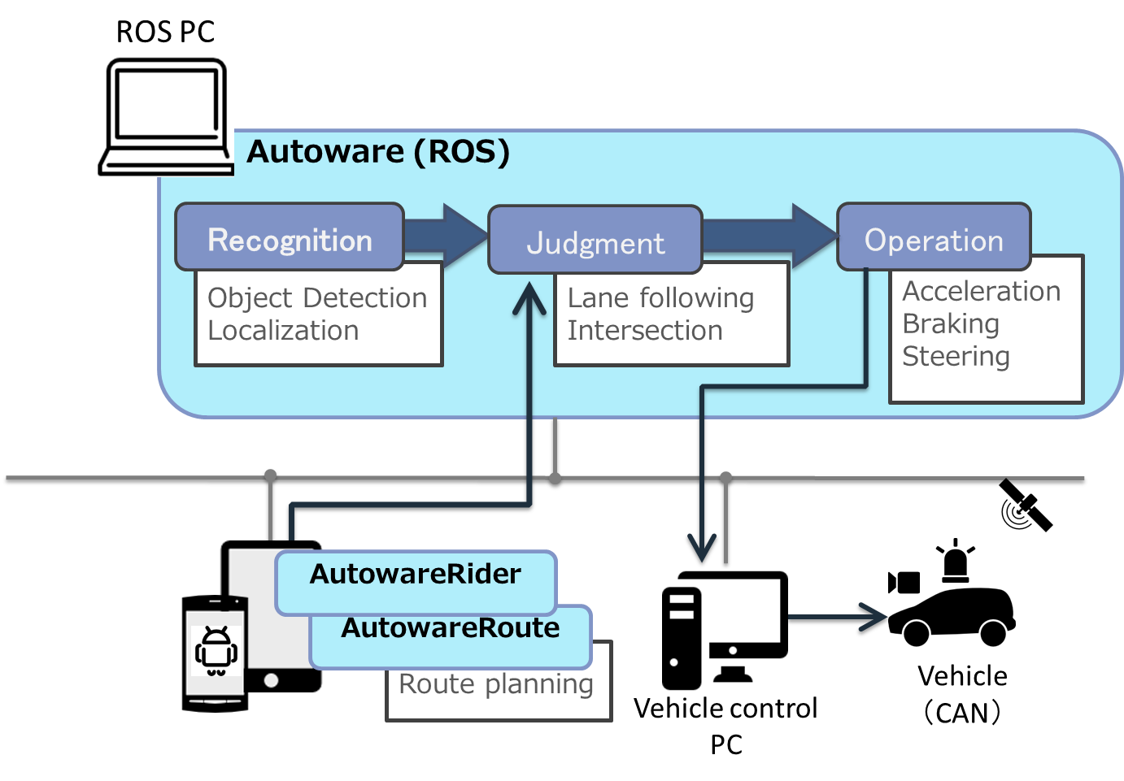
1. Autoware
Functions provided
Autoware provides the following functions.
Localization
Object detection
Driving control
3D map generation and sharing

Slide 4
2. User Interface
Available user Interfaces
RViz
Visualizes in 3D the various functions of Autoware such as localization, object-detection, path-planning, path-following, in an integrated manner.
Runtime Manager
A GUI application for controlling Autoware.
AutowareRider
A tablet application for setting and generating a route plan, turning autonomous driving mode on.
Other UIs
It is possible to visualize the 3D map being used on the in-vehicle displays and device such as Oculus.

Slide 5
The operations of main functionalities of Autoware– Quick start version
Setup of demo data
Launch Autoware
Prepare to play rosbag
Localization
Mission planning
Motion following

Slide 6
The operations of main functionalities of Autoware
Operation steps
replay of demo data
Replay the rosbag demo data downloaded from Nagoya University.
Out of scope of this Quick-start guide A.
Autoware on a real vehicle
Drive a real vehicle with Autoware autonomously.
rosbag replay
Replay the data corrected on the procedure on left.
1. Setup of demo data
1.
1.
2. Launch Autoware
2.
2.
3. Prepare to play rosbag
3.
3.
4. Localization
4.
4.
5. Mission planning
...
...
6. Motion Planning

Slide 7
1. Setup of demo data
1.1. make a directory
Make a directory “.autoware“ for demo data.
~$ mkdir .autoware
1.2. Downloading the demo data
Download the data from following sites and place in “~/.autoware”
A script for generating a demo launch file:
http://db3.ertl.jp/autoware/sample_data/my_launch.sh
Map/calibration/path data (Moriyama area):
http://db3.ertl.jp/autoware/sample_data/sample_moriyama_data.tar.gz
rosbag data:
http://db3.ertl.jp/autoware/sample_data/sample_moriyama_150324.tar.gz
Note that this ROSBAG data do not contain the video data. Therefore the object detection is not supported.
If [.autoware] directory is not shown, set your file browser to display hidden files.

Slide 8
1. Setup of demo data
1.3. Unpacking demo data
Unpack the demo data as follows.
~$ cd .autoware
~/.autoware$ tar xfz sample_moriyama_data.tar.gz
~/.autoware$ tar xfz sample_moriyama_150324.tar.gz
1.4. Run my_launch.sh
Run the following script to generate launch files.
~/.autoware$ sh my_launch.sh
The following set of launch files should have been generated.
my_launch/
my_map.launch # Load PointClouds and vector maps
my_sensing.launch # Load device drivers
my_localization.launch # Localozation
my_detection.launch # Object detection
my_mission_planning.launch # Path planning
my_motion_planning.launch # Path following

Slide 9
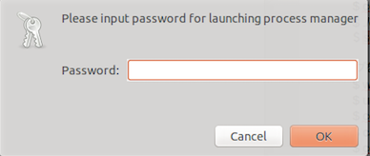
2. Launch Autoware
2.1. Launch Runtime Manager
Double clicking “Autoware/ros/run” or “./ run” on a ROS PC will launch the Runtime Manager.
Two separate terminals will appear once the run is executed. One is [roscore], and the other is [runtime_manager].
2.2. Entering the supervisor credential
Autoware requires the supervisor password to execute its functions.
A password dialogue will be displayed upon launching the Runtime Manager. Enter the supervisor password.
Runtime Manager window will open.

Slide 10
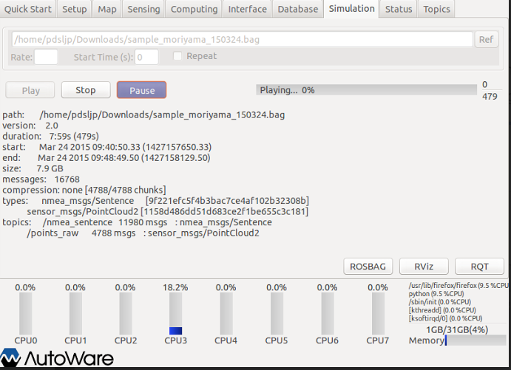
3. Prepare to play ROSBAG
3.1 Play rosbag for a few seconds and pause
Autoware requires the rosbag to be played for a few seconds to connect.
In [Simulation] tab, specify following .bag file and press [Play] button.
“~/.autoware/sample_moriyama_150324.bag”
Press [Pause] button.
3.2 Launching and setting up RViz
Autoware provides set-up files for RViz.
Pressing [RViz] button to launch RViz. （The same button is available in all tabs of Runtime Manager and any can be used）
Select [File]-[Open Config] in RViz
Upon [Choose a file to open] dialogue, select the following file, then press [Open].
“~/Autoware/ros/src/.config/rviz/default.rviz”

Slide 11
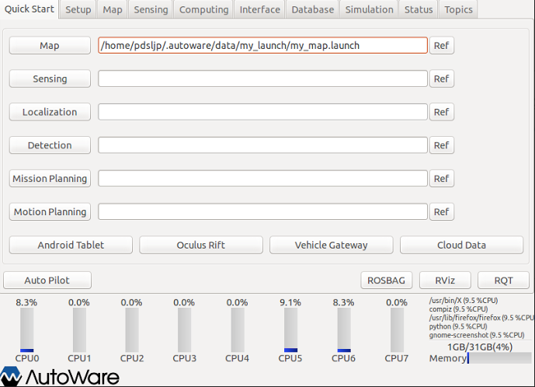
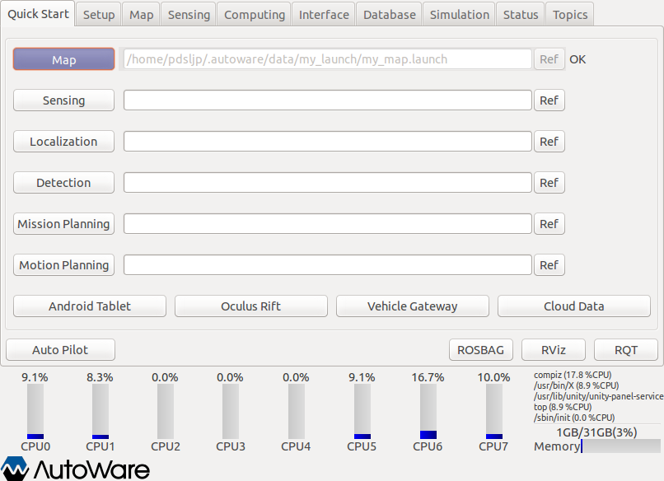
3. Prepare to play ROSBAG
3.3 Loading PointCloud and Vector maps
In [Quick Start] tab, specify the “my_map.launch” generated in 1. Setup of demo data in the text field next to [Map] button and press the [Map] button.
“~/.autoware/data/my_launch/my_map.launch”
Proceed to next step after this “OK” is displayed.

Slide 12
4. Localization
4.1 Start Localization
In [QuickStart] tab, specify following .launch file in the text field next to [Localization] button, then press the [Localization] button
“~/.autoware/my_launch/my_localization.launch”
In [Simulation] tab, press [Pause] button to release it to restart ROSBAG replay.

Slide 13
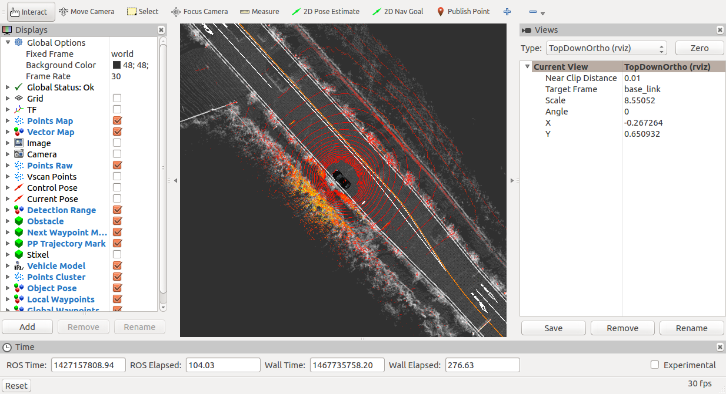
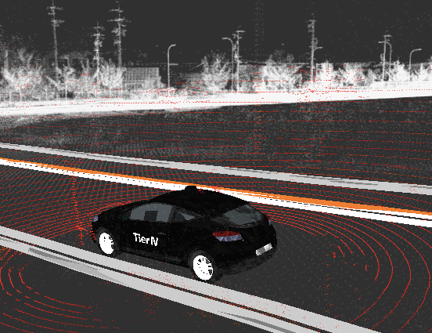
4. Localization
4.2 Display in RViz
In [Global Options]-[Fixed Frame] in the [Display] window, specify “world”. This will overlay the display of Velodyne data and 3D map data.
In [Current View]-[Target Frame] the [View] window, specify “base_link” and set [Type] to “TopDownOrtho” then press [Zero] button. (This will initiate the tracking the car position)
When the progress bar in the [Simulation] tab reaches 23% (110/479 sec), the display should stabilize.
In [Current View], setting “TopDownOrtho(rviz)” to “ThirdPersonFollower(rviz)” change the display to this.

Slide 14
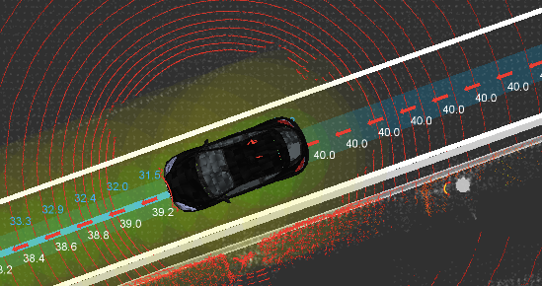
5. Mission Planning
5.1 Start Mission Planning
In [QuickStart] tab, specify the following .launch file in the text field next to [Mission Planning] button and press the [Mission Planning] button.
“~/.autoware/my_launch/my_mission_planning.launch”
Soon after the turning the first corner (progress bar 38%, at around 182/479 sec), the path and the speed will be displayed as shown below.

Slide 15
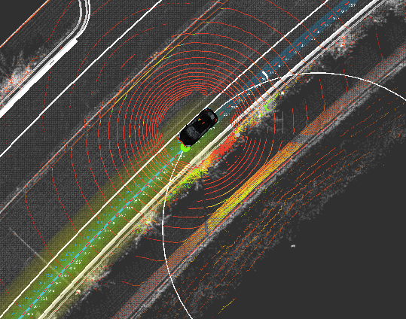
6. Motion Planning
6.1 Start Motion Planning
In [QuickStart] tab, specify the following .launch file in the text field next to [Motion Planning] button and press the [Motion Planning] button.
“~/.autoware/my_launch/my_motion_planning.launch”
Once the car reaches the path set in the path planning, it will display the small green ball and the radial circles calculated as pure pursuit.

