Slide 1
Lending Club Capstone
By: Thomas Ouyang

Slide 2
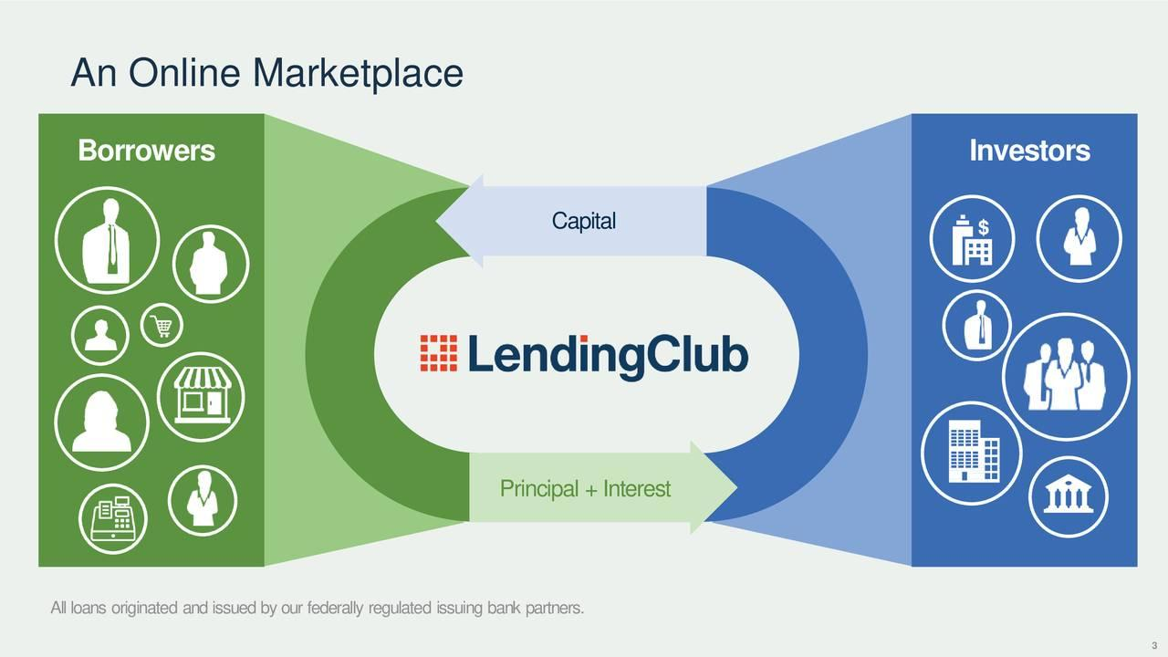
Introduction to Lending Club
Peer-to-peer (P2P) Company
HQ in San Francisco, California
Lenders can earn higher returns compared to savings
Borrowers can borrow money at lower rates

Slide 3
Objective: Predict the total payment percentage

Slide 4
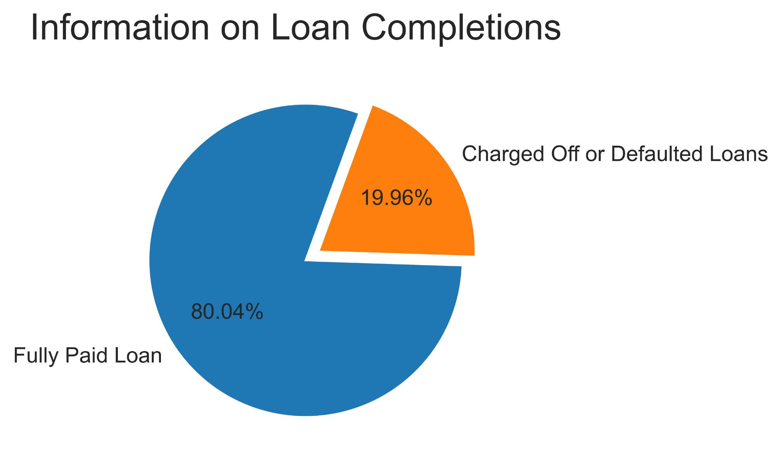
Loan Completions
Fully Paid: Completely paid off loan
Defaulted: Failure to make required interest or principal repayments on loan
Charged-Off: Lender has written the account off as a loan, and the account is closed to future charges.

Slide 5
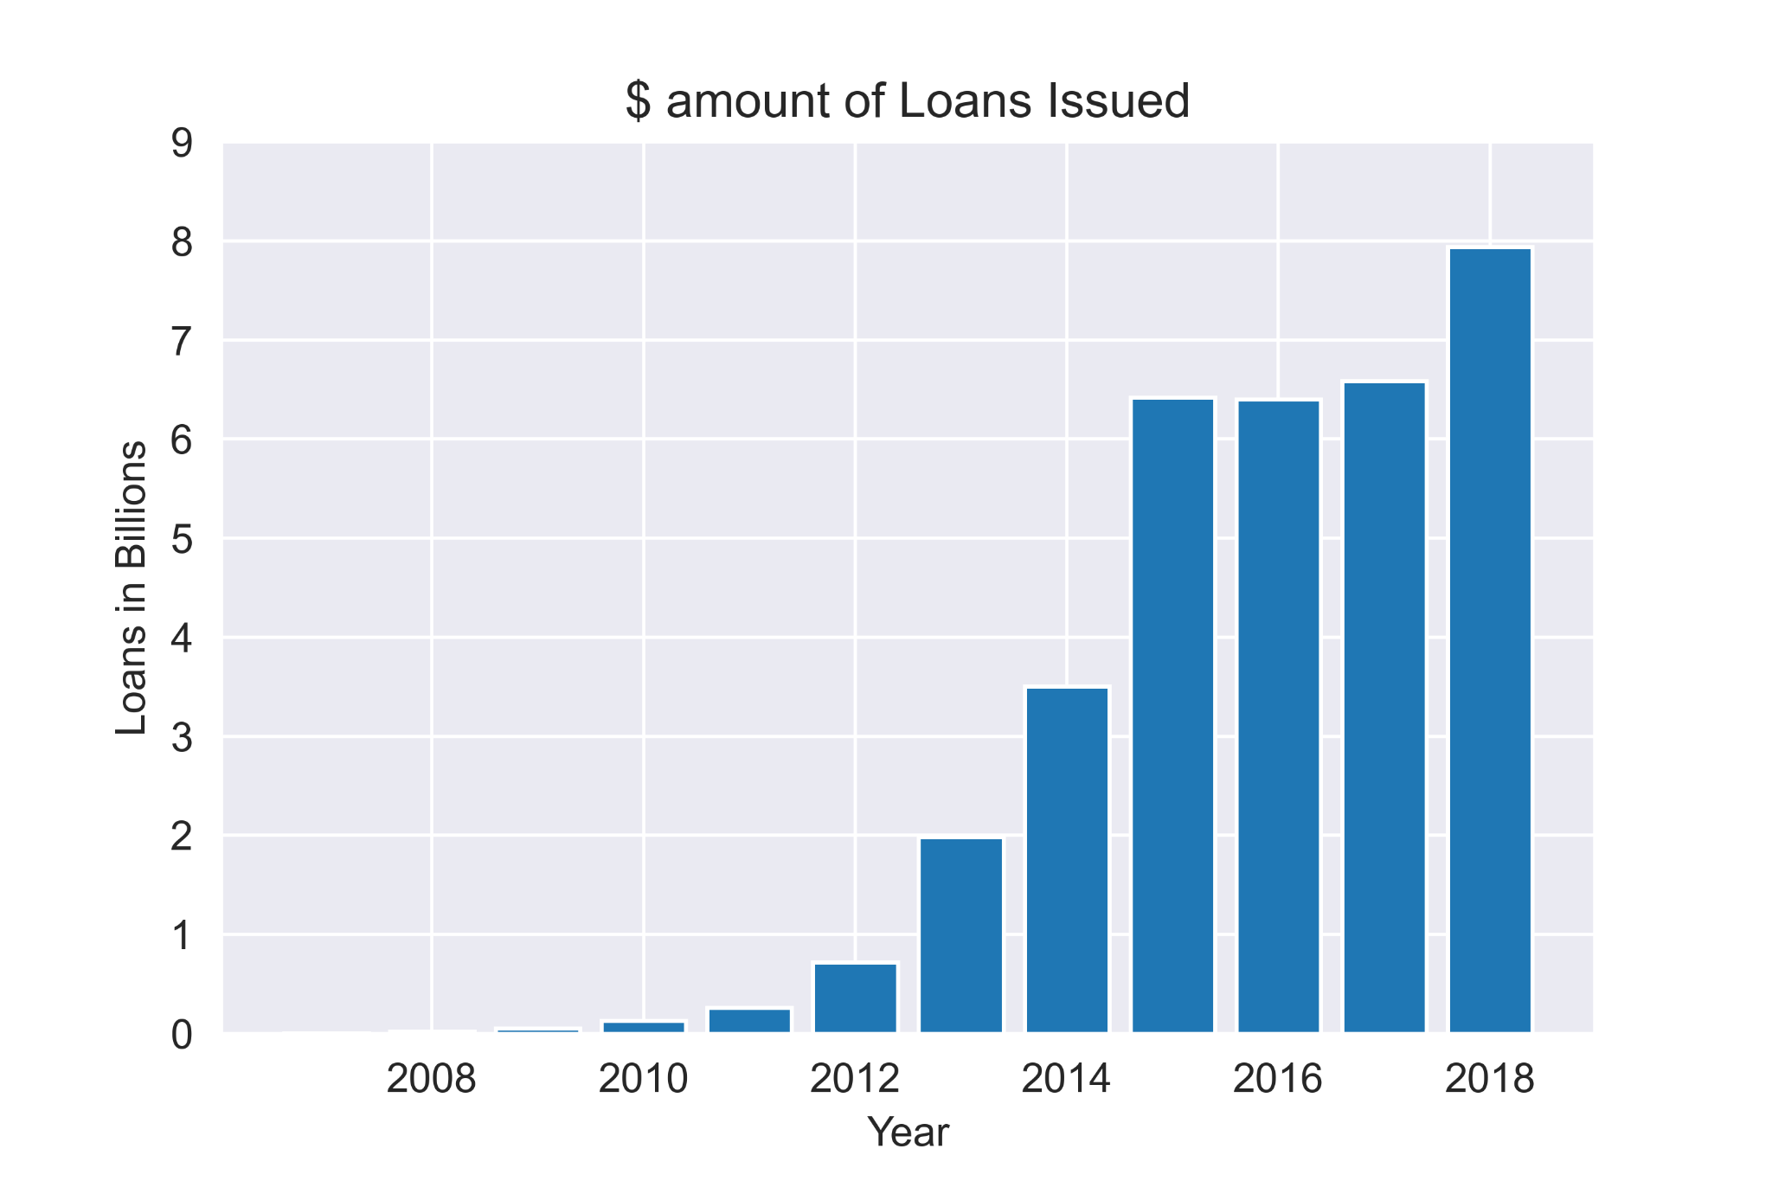
Data Exploration
Lending Club Growth

Slide 6
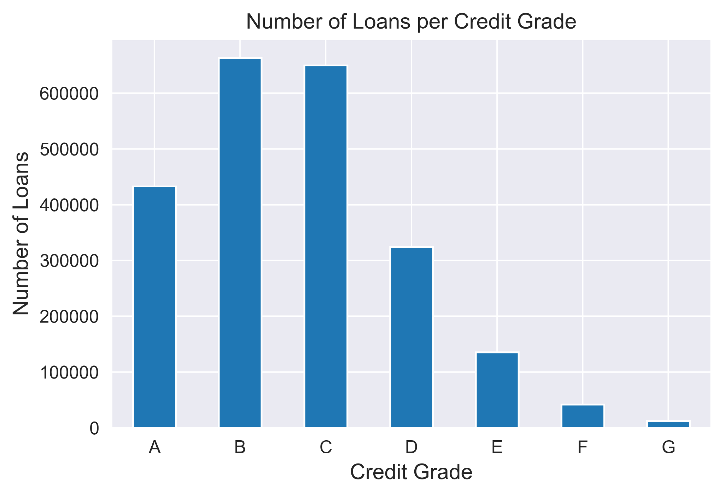
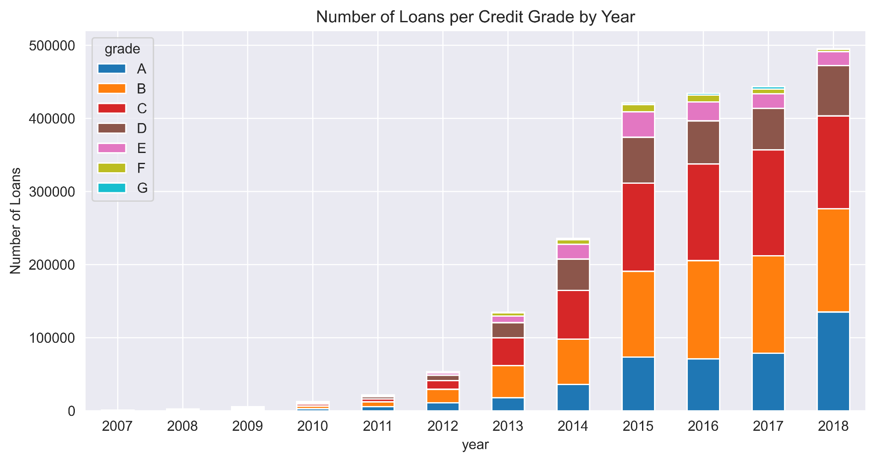
Credit Grade

Slide 7
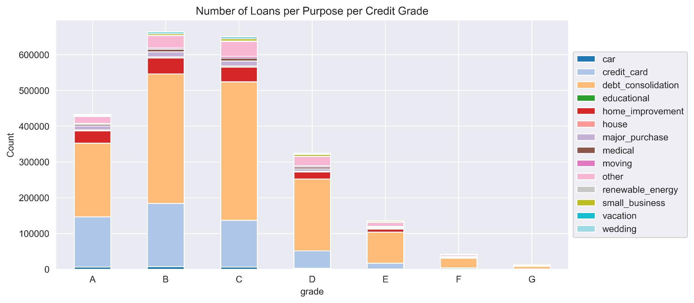
Purpose of Loan

Slide 8
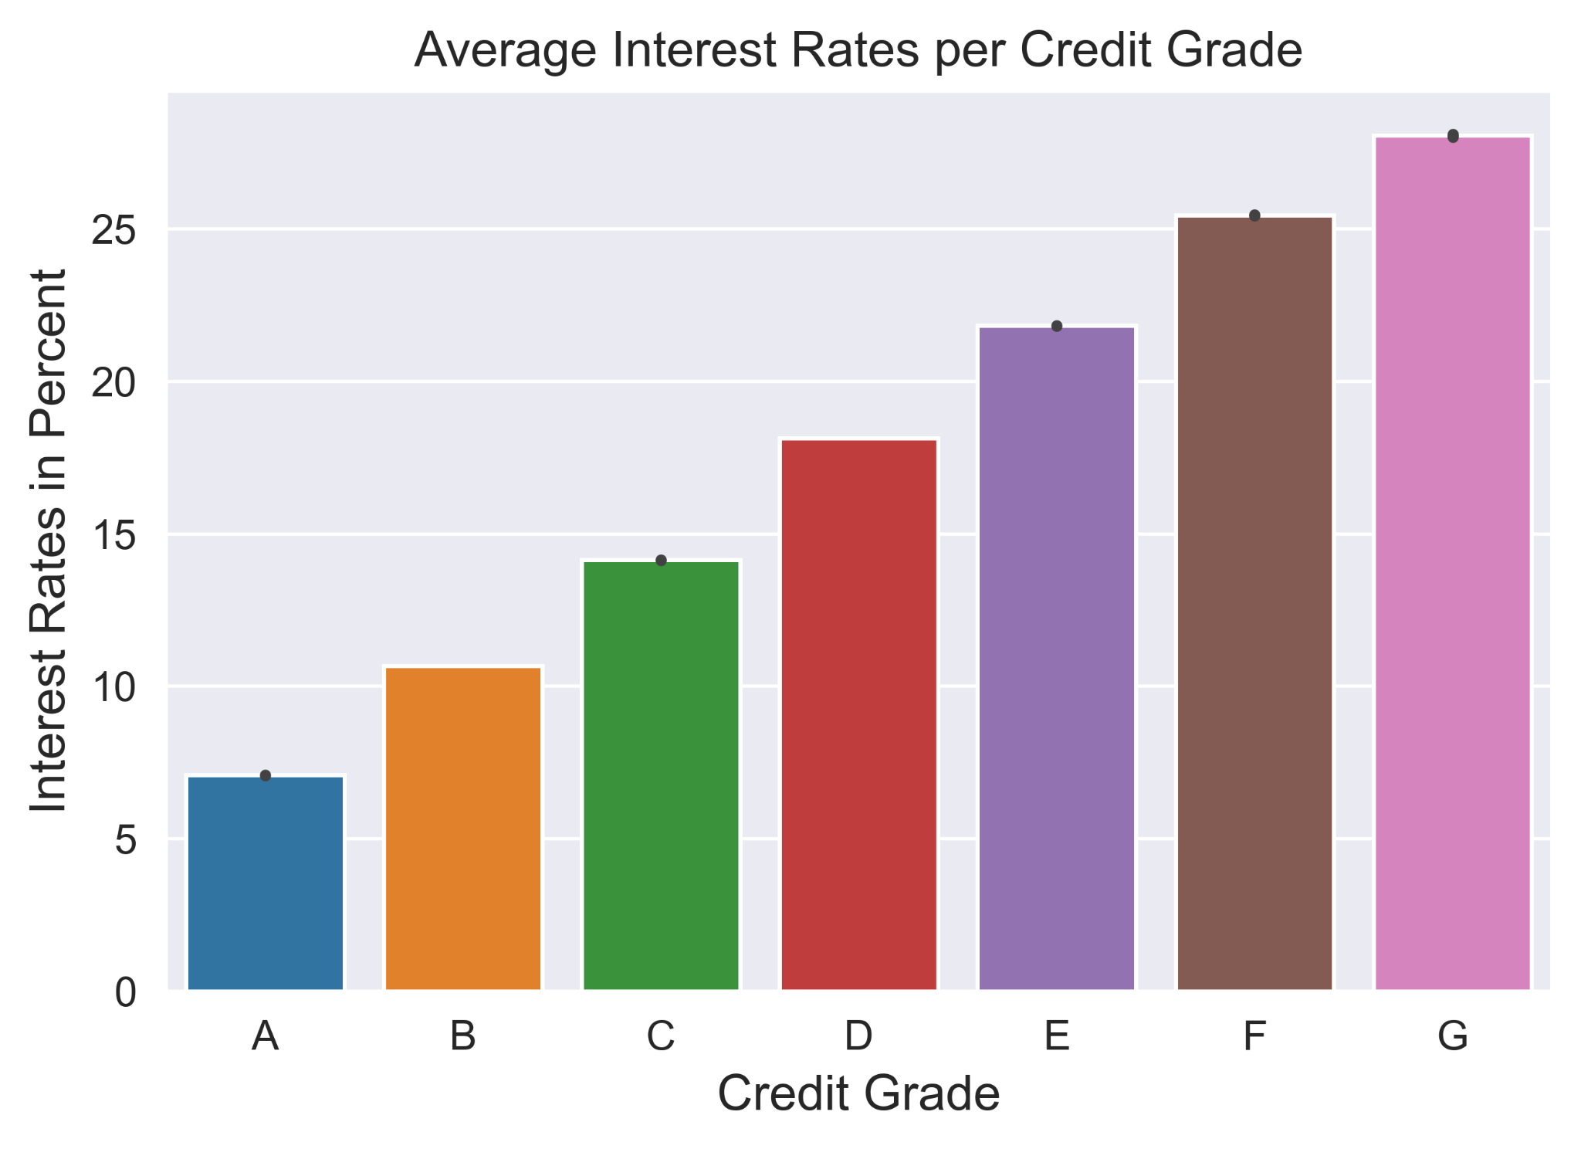
Interest Rate

Slide 9
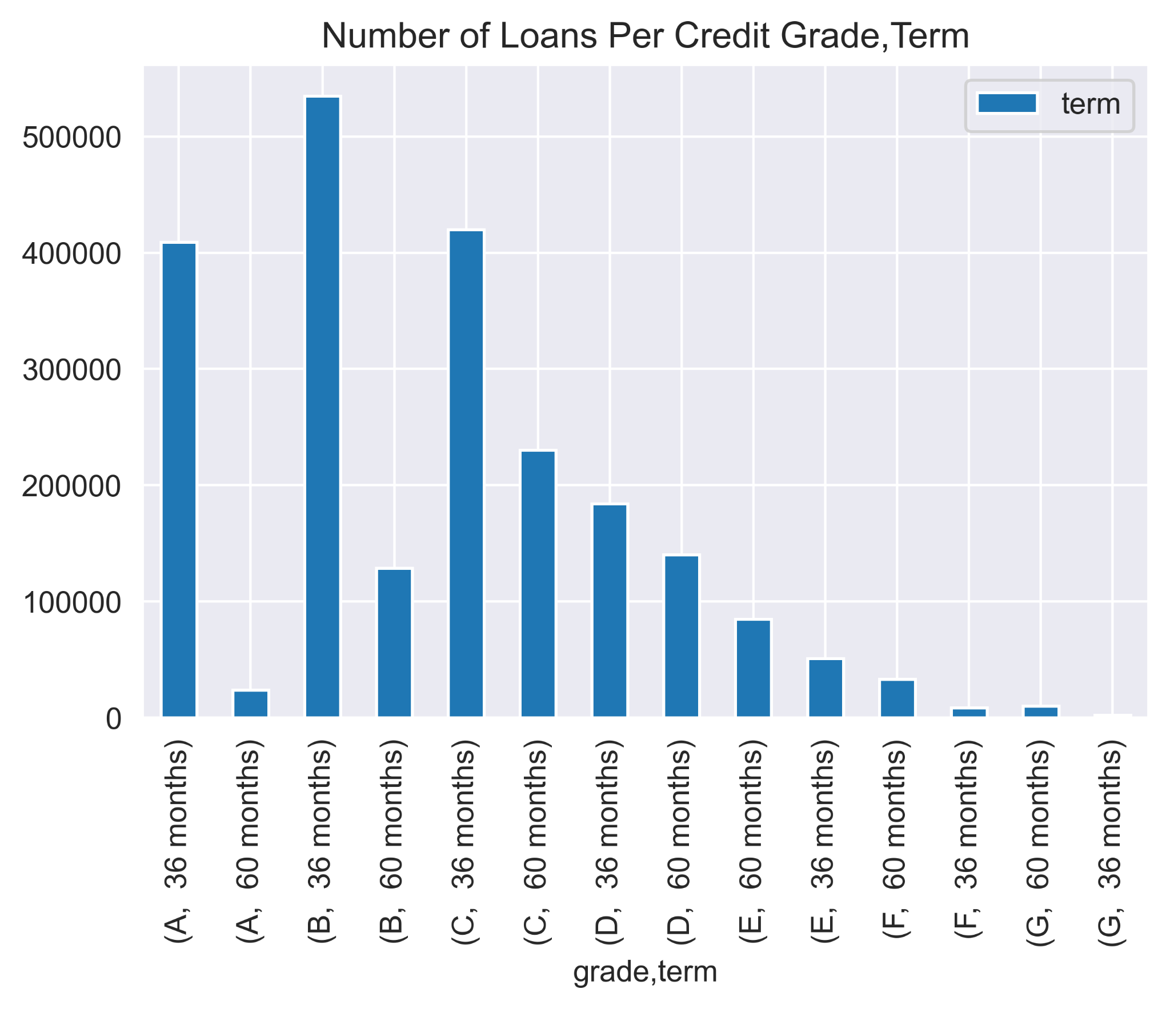
Loan Term Length

Slide 10
Feature Engineering
Selecting features available at loan origination
Missing values?
New Target Variable: Projected Total Payment Ratio

Slide 11
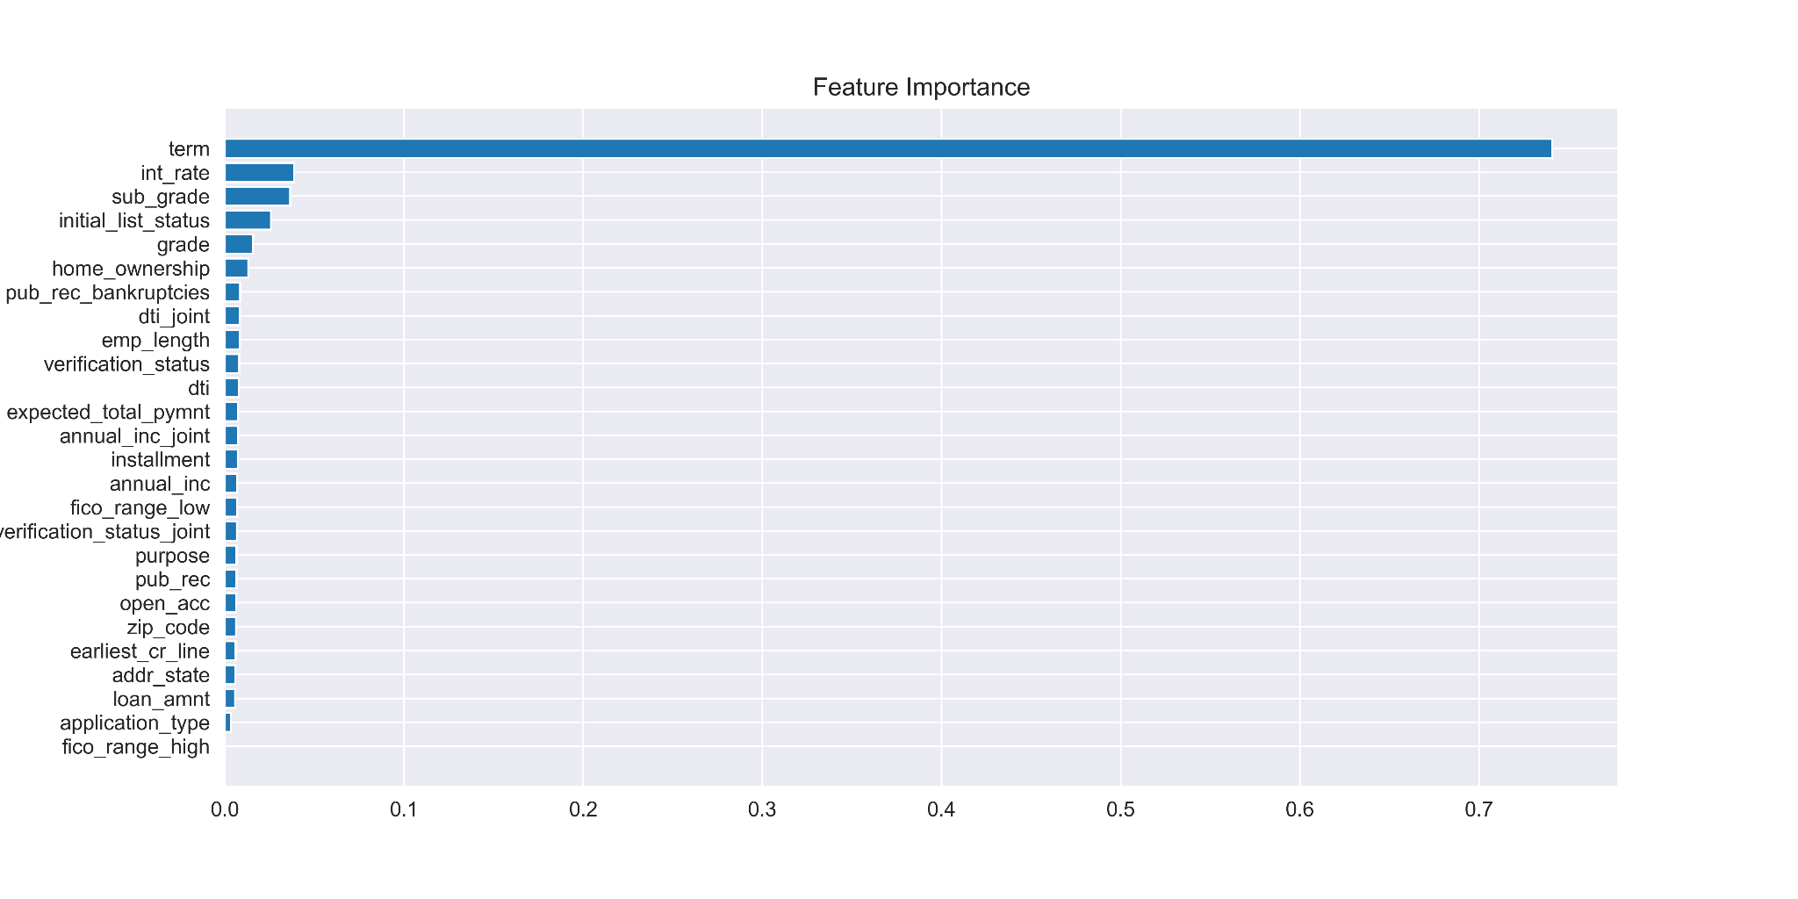
Model Results
Most ‘important’ features:
Term
Interest Rate
Sub Grade (Ex: B1)
Initial List Status (Whole or Fractional)
Grade
R2 = 0.2

Slide 12
Measuring Against Other Forms of Investment
Ex: Can you create a portfolio that outperforms the market index (S&P500)
Created Function that returned a list of borrowers that have a higher projected return compared to S&P500.
Note: Not risk-adjusted

Slide 13
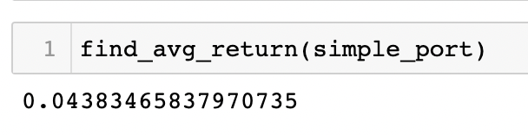
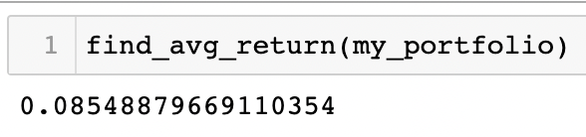
Portfolio Comparison
Ex: Outperform portfolio that randomly selects 25% of borrowers with credit grade of B1
Created Function that gives me the top 25% best performing B1 borrowers based on my model, and compared it to those randomly selected.

Slide 14
For the Future
Check Assumptions: For example, I pooled my data together, but time-series may be more accurate.
Features are determined by Lending Club. Reverse-engineering their metric may provide more robust model.

Slide 15
Thank You

