Slide 1

Estimate your chances to receive a PR in Canada
Problem area
Near 500 000 new PR every year

Slide 2
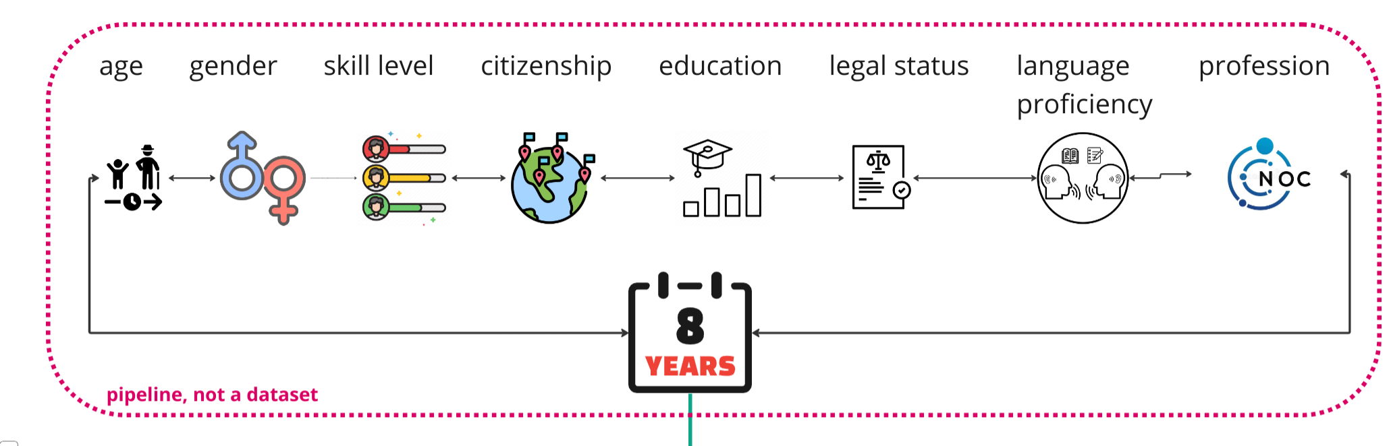
DATASET

Slide 3
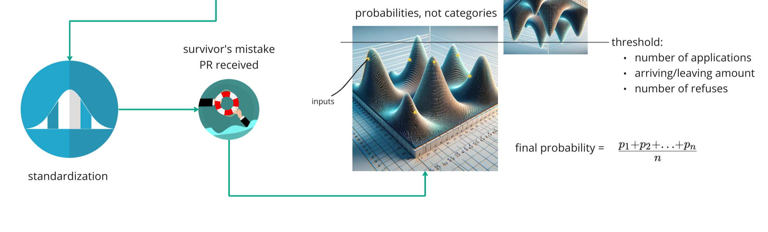
Model

Slide 4
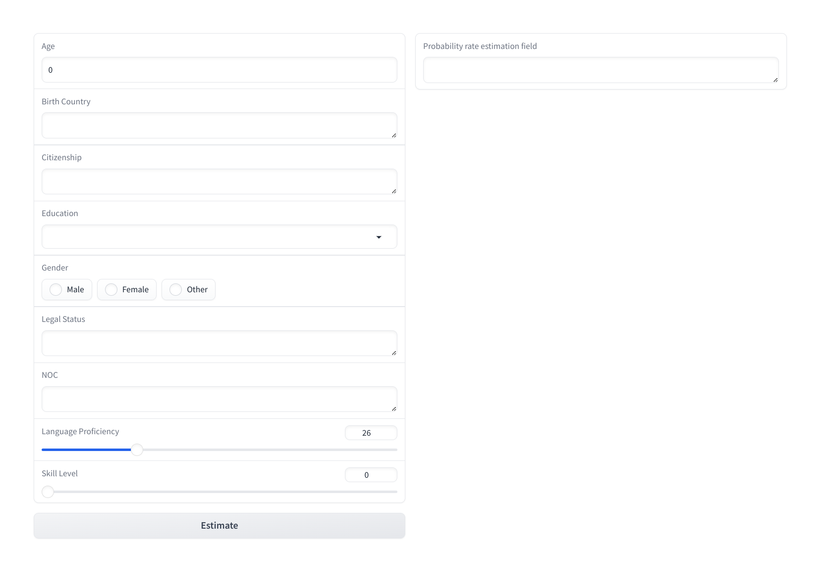

Basic UI
Entering your basic information will calculate your chances of obtaining permanent residency in Canada.

Slide 5
Thank you

