Slide 1
RINGS
Rolling IN Great Sword
CMB
TEXT
HSBC
RBWM
GBM
GLTC-APAC-SE-PC
HSBC Technology and Services

Slide 2
RINGS
Agenda
Project purpose
System scope
System feature
System demo
Core technology
Network diagram
Q & A
GLTC-APAC-SE-PC
HSBC Technology and Services

Slide 3
RINGS
Project purpose
LN will be replaced by Outlook,
many functions can not be
implemented. Any changes on LN application need dispensation
Retired
Can not make
interface to other
system
Poor database
structure lead to
slow response
Maintenance
Performance
LN System
Save conflict
records often exist. Data can not be
migrated to other system easily
Data
Capacity
System size
limitation in
domino server
GLTC-APAC-SE-PC
HSBC Technology and Services

Slide 4
RINGS
System scope
Web system
Workflow
RINGS
EUC
New
GLTC-APAC-SE-PC
HSBC Technology and Services

Slide 5
RINGS
System feature
User name / Password
AD Login
Single Sign-On
User friendly UI
Flexible customization
Login
Layout
RINGS
Interface
Dashboard
Group system
External system
Multiple system
Accurate statistics
GLTC-APAC-SE-PC
HSBC Technology and Services

Slide 6
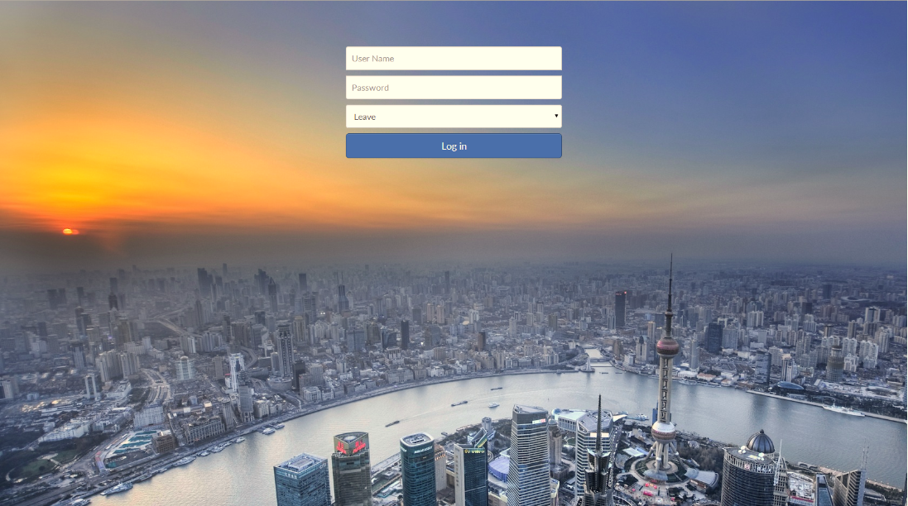
RINGS
System feature - 1
GLTC-APAC-SE-PC
HSBC Technology and Services

Slide 7
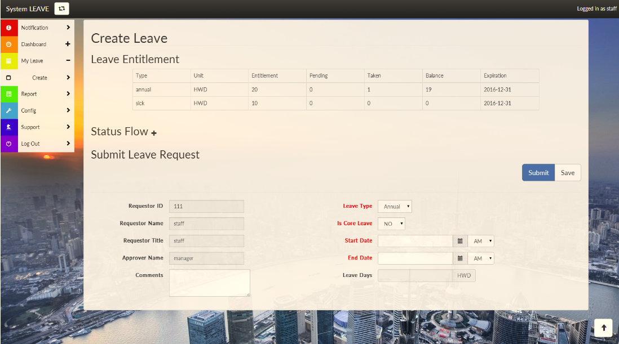
RINGS
System feature - 2
GLTC-APAC-SE-PC
HSBC Technology and Services

Slide 8
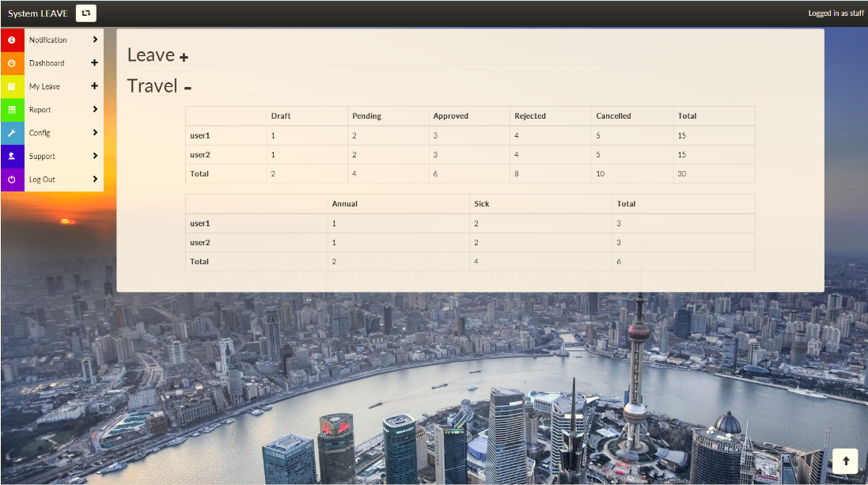
RINGS
System feature - 3
GLTC-APAC-SE-PC
HSBC Technology and Services

Slide 9
RINGS
System feature - 4
Client
AS400
Mainframe
CD GW
RINGS
Browser
MQ
SMTP
Mobile
MISC
GLTC-APAC-SE-PC
HSBC Technology and Services

Slide 10
RINGS
System demo
New
request
Pending
review
Approve
Complete
GLTC-APAC-SE-PC
HSBC Technology and Services

Slide 11
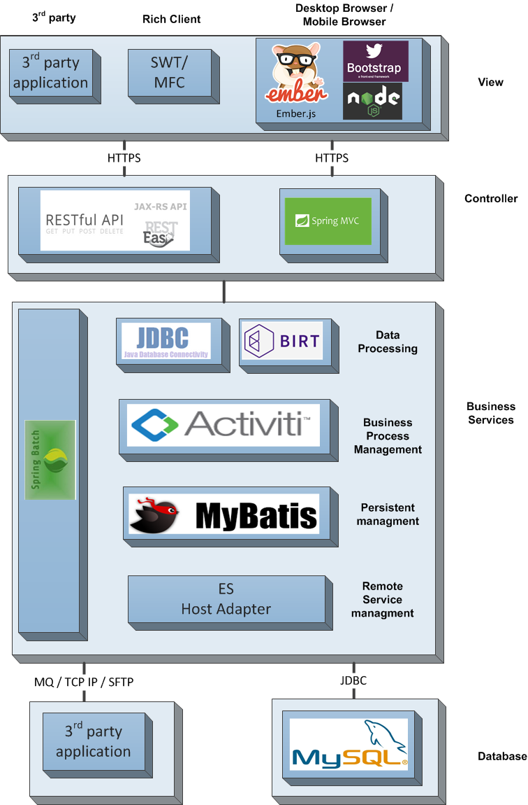
RINGS
Core technology
GLTC-APAC-SE-PC
HSBC Technology and Services

Slide 12
RINGS
Core technology
Industry-leading
architecture
Independent frontend & backend
Flexible
workflow
R2
Multi
app
GLTC-APAC-SE-PC
HSBC Technology and Services

Slide 13
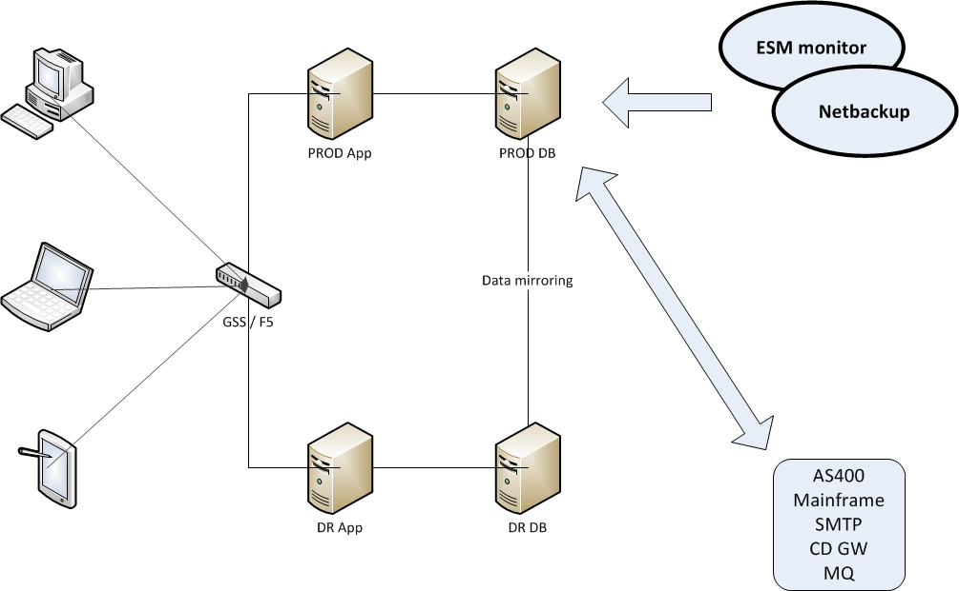
RINGS
Network diagram
GLTC-APAC-SE-PC
HSBC Technology and Services

Slide 14
RINGS
Q & A
Thank You
GLTC-APAC-SE-PC
HSBC Technology and Services

