Slide 1
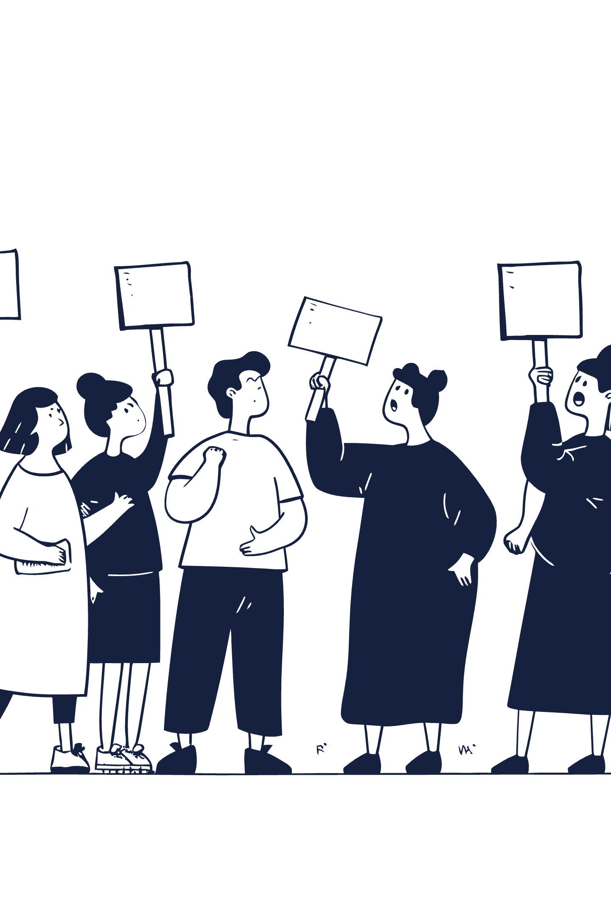
Profiling Customer Clusters
(Grocery Shop)
Understanding our customer base is crucial for tailored marketing. We've identified four distinct clusters, each with unique profiles and needs.

Slide 2
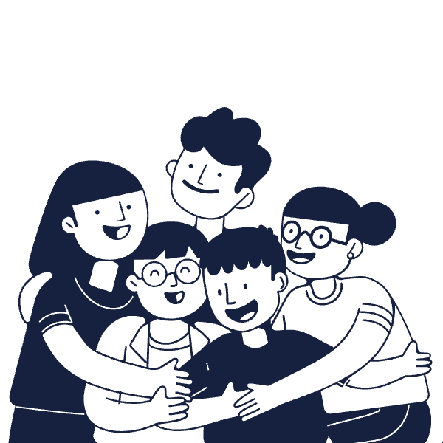
CLUSTER 0
The Family-Focused Shopper
Customer Profile
Parents, 2-4 household members.
Commonly include teenagers.
Relatively older demographic.
This cluster values convenience and family-sized solutions for their busy lives.

Slide 3
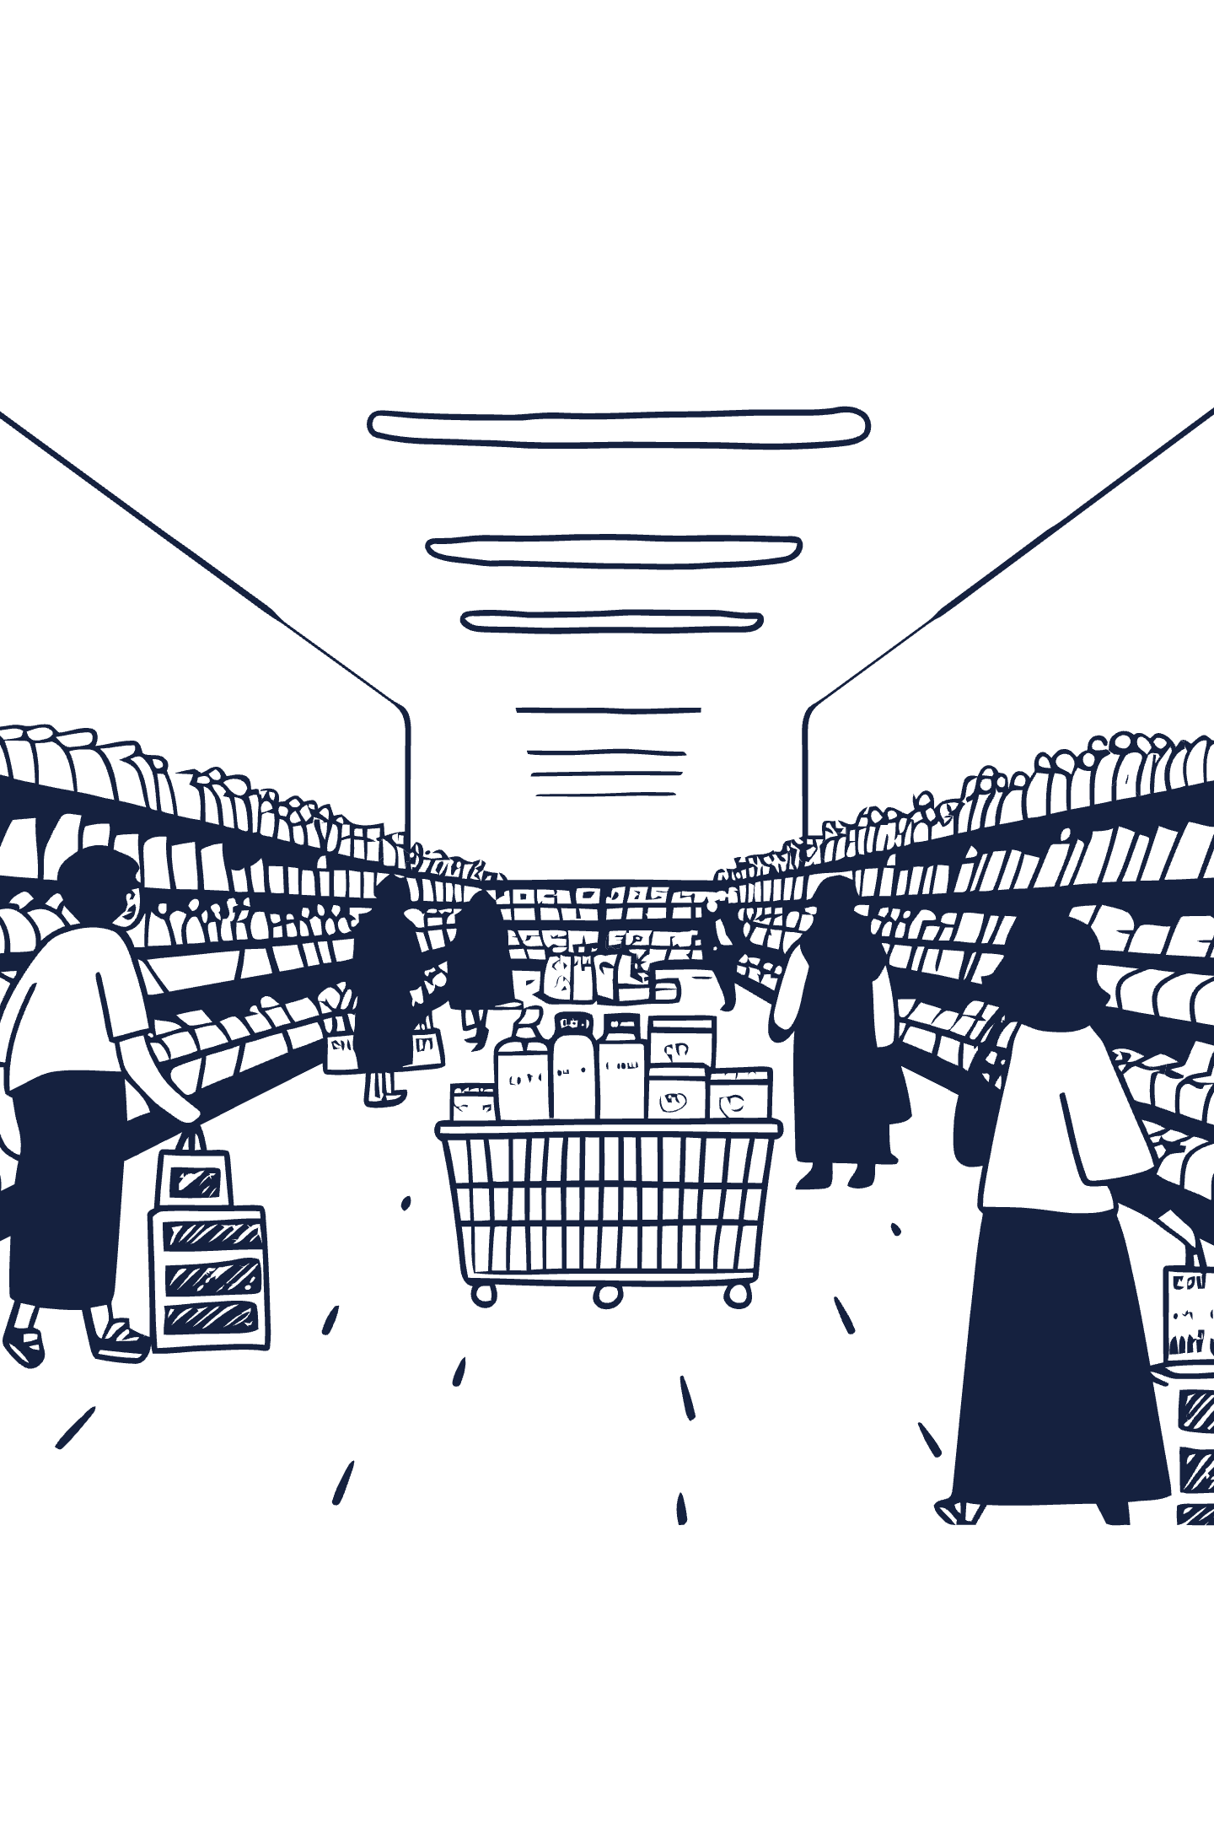
CLUSTER 0
Marketing for Convenience & Value
Promote Multi-Buy Offers
Offer Family Meal Kits
Ready-made meals or kits for 3-4 people to appeal to busy routines.
Focus on cereals, snacks, and cleaning products for household essentials.
Utilize Traditional Channels
Flyers and newspaper inserts complement digital promotions for this older group.

Slide 4
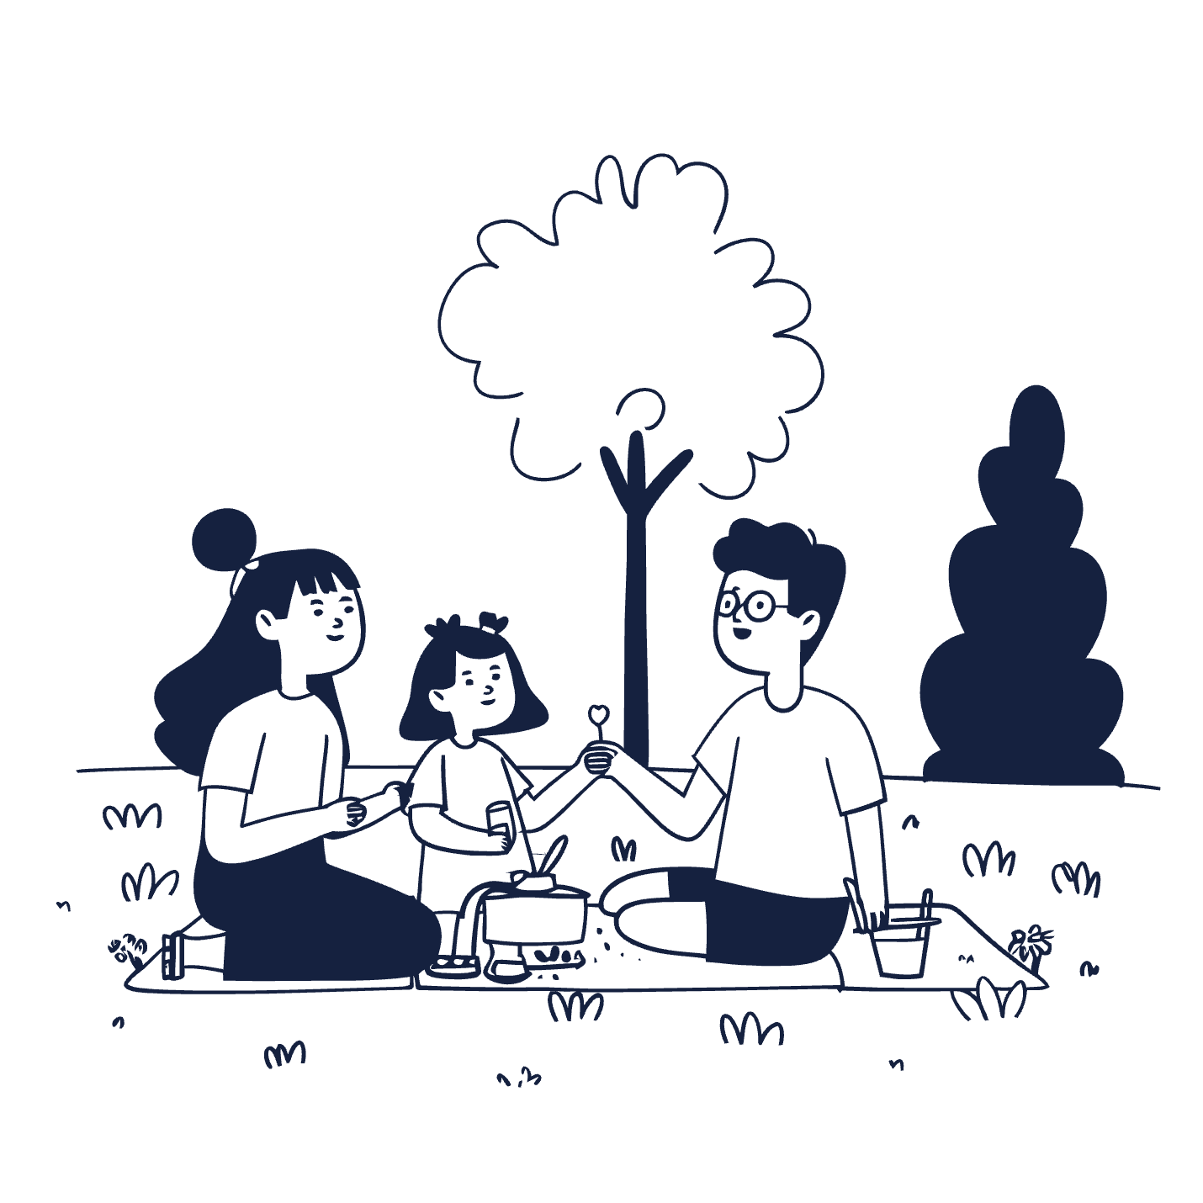
CLUSTER 1
Young Parents with Small Children
Customer Profile
Parents, max 3 household members.
One young child, not teenagers.
Relatively younger demographic.
This group prioritizes child-focused products, quality, and convenient shopping experiences.

Slide 5
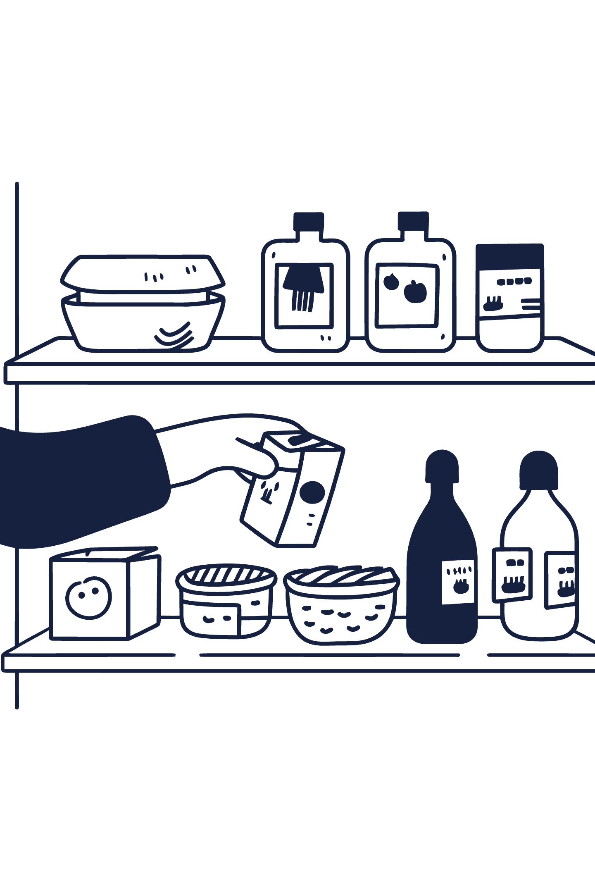
CLUSTER 1
Targeting Quality & Child-Focused Needs
Fresh & Organic Focus
Digital Engagement
Promote fresh produce, organic baby, and toddler items.
Targeted social media campaigns and app-based personalized coupons.
In-Store Experiences
Kid-friendly samples or family-friendly parking to enhance engagement.

Slide 6
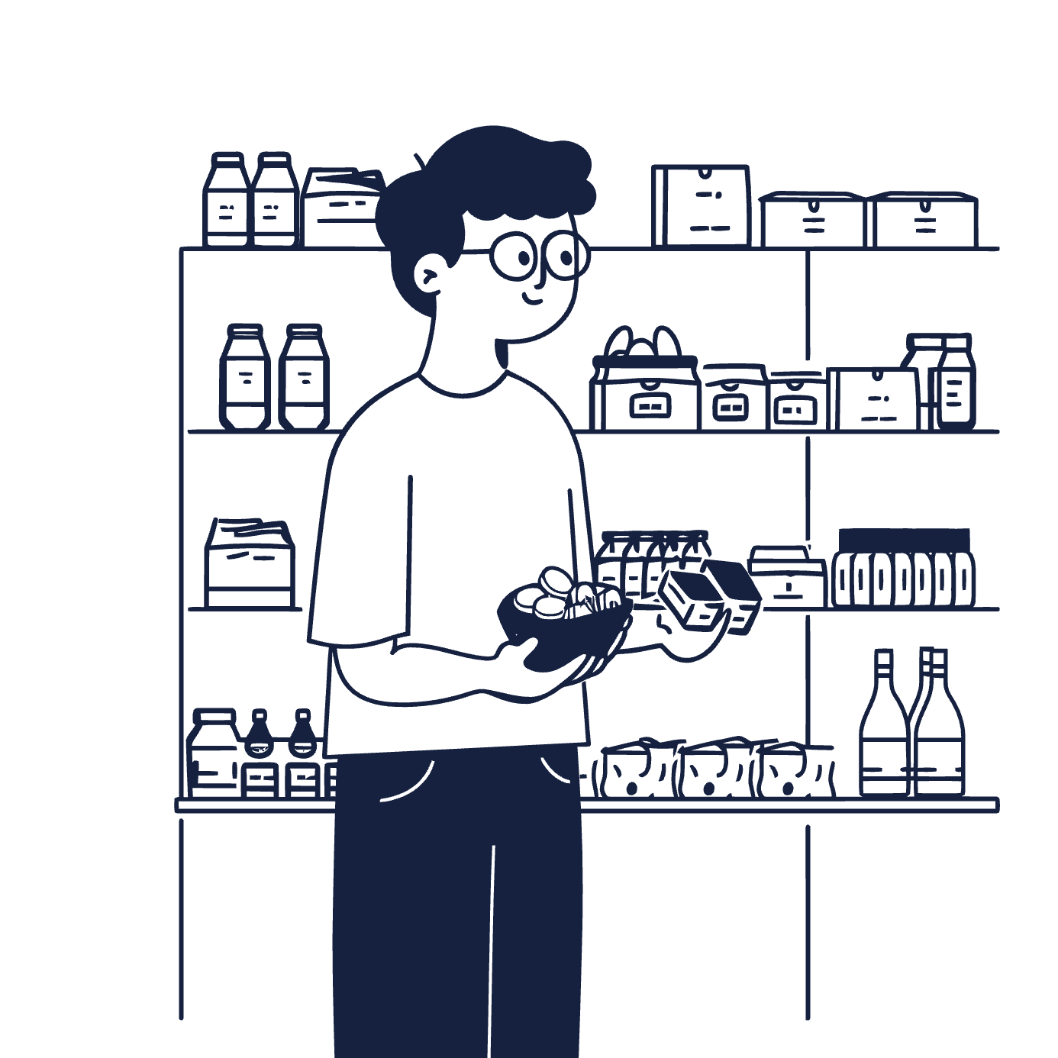
CLUSTER 2
High-Income, Non-Parent Households
Customer Profile
Not parents, 1-2 household members.
Couples slightly outnumber singles.
Wide age range, high-income segment.
This cluster seeks premium, specialty products and unique shopping experiences.

Slide 7


CLUSTER 2
Showcasing Premium & Exclusivity
1
2
3
Gourmet Offerings
Quality Over Discounts
Curated Bundles & Newsletters
Highlight high-quality meats, imported cheeses, fine wines, and international foods.
Emphasize exclusivity and unique shopping experiences, not just price.
Offer themed dinner kits and magazine-style email newsletters for an upscale brand image.

Slide 8
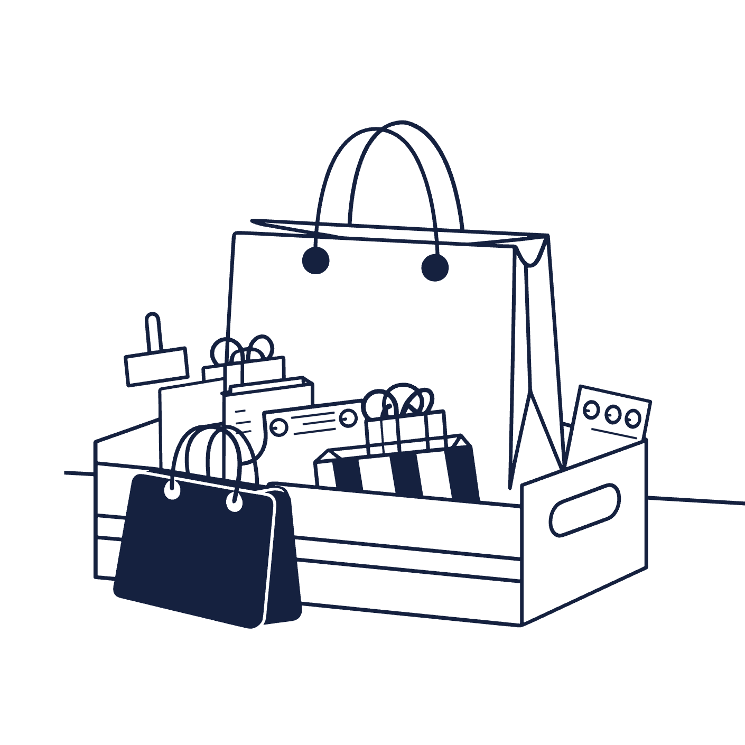
CLUSTER 3
Cost-Conscious Large Families
Customer Profile
Parents, 2-5 household members.
Teenagers are common.
Older demographic, lower-income segment.
This cluster focuses on maximizing savings and value for their larger households.

Slide 9
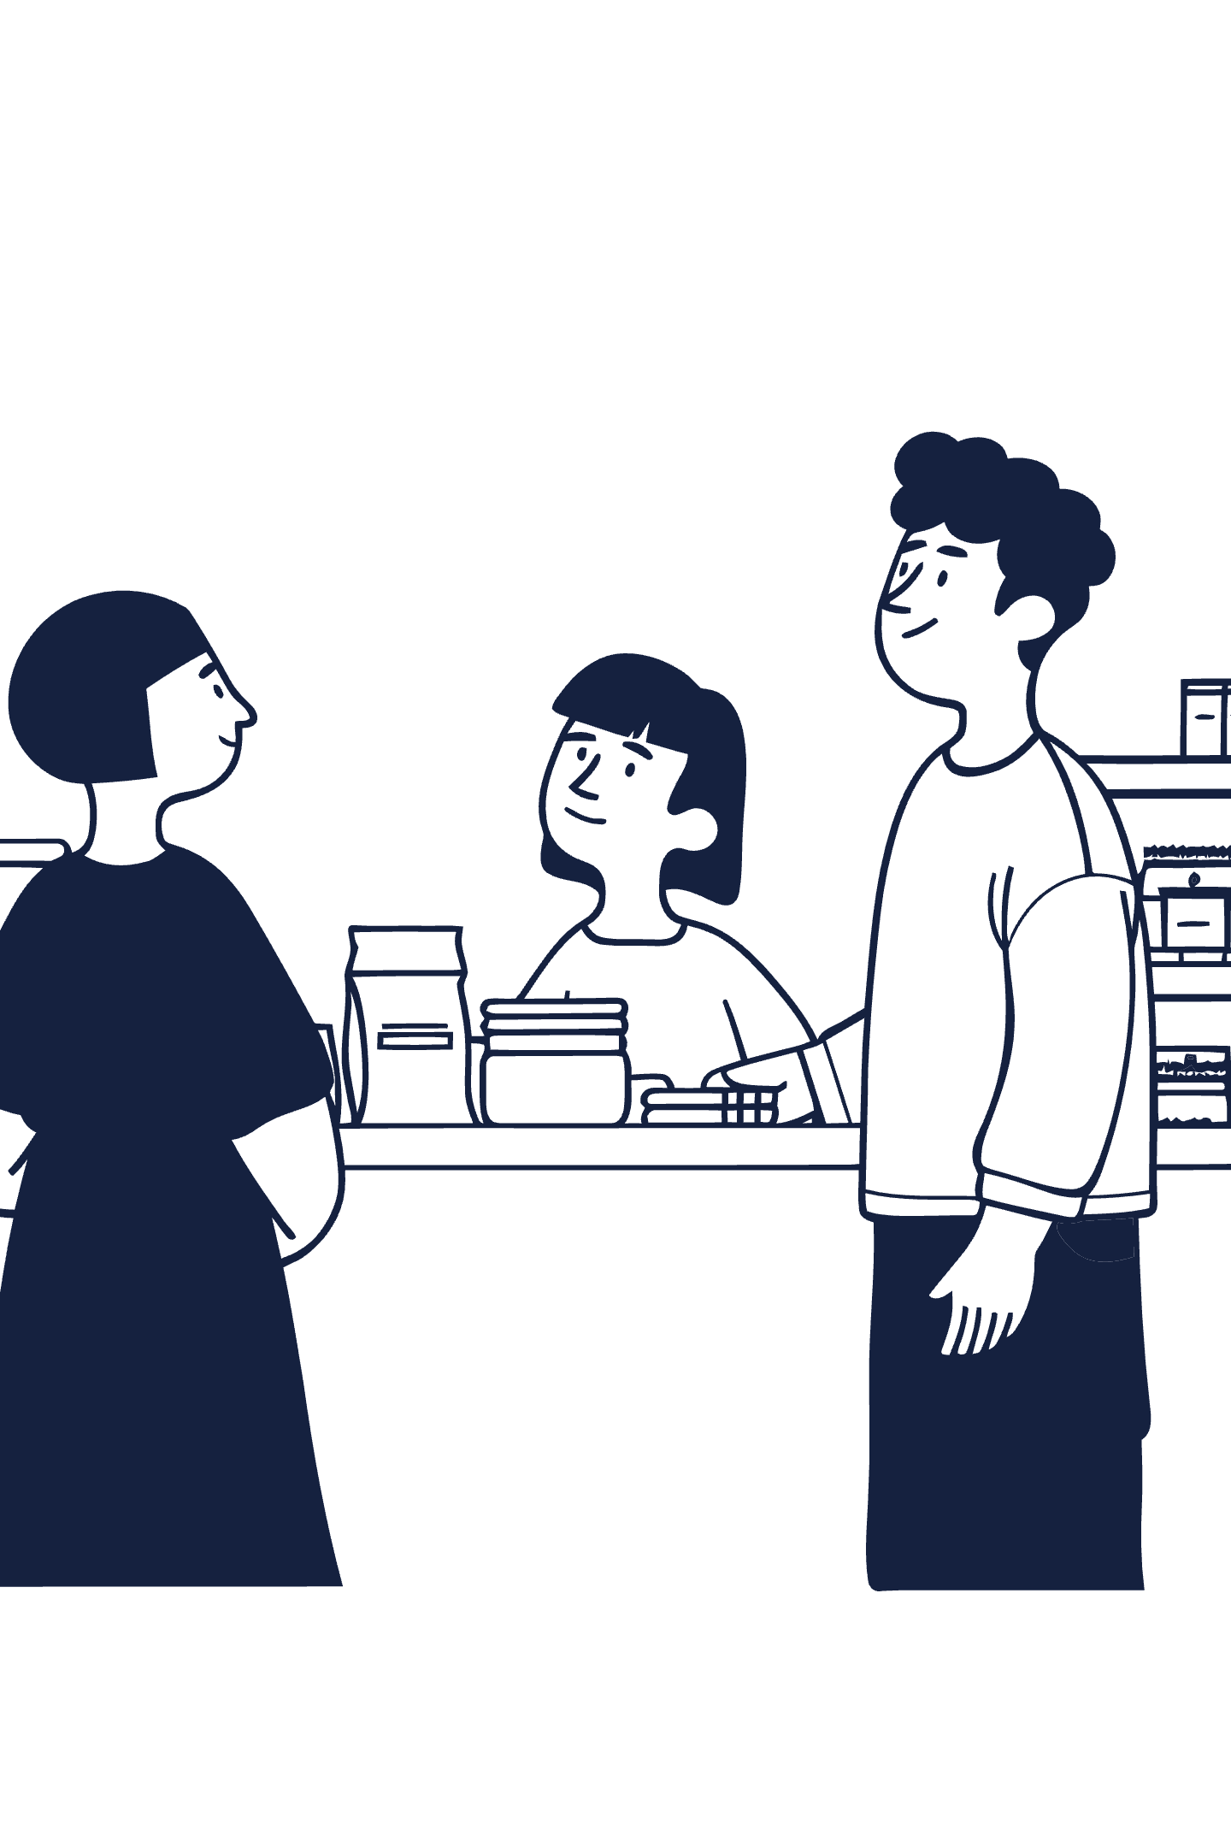

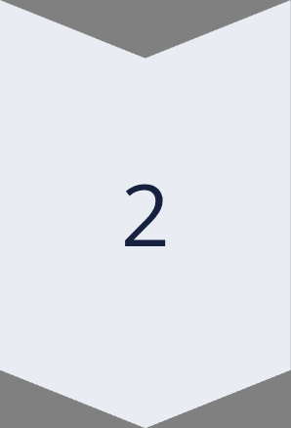
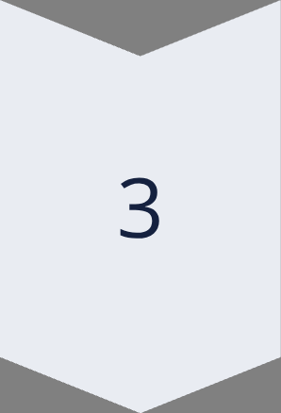
CLUSTER 3
Strategies for Savings & Volume
Promote Private-Label
Emphasize store-brand products for better value across categories.
Bulk Purchasing
Highlight bulk options and clearly communicate weekly sales via flyers.
Loyalty Program
Offer high-value points or immediate cash-off rewards to encourage repeat visits.

Slide 10








Tailored Marketing for Every Customer
By understanding each customer cluster, we can develop highly effective marketing strategies that resonate with their specific needs and preferences.
Cluster 0
Cluster 1
Family Convenience
Young Family Quality
Cluster 3
Cluster 2
Value & Bulk
Premium Lifestyle

