Slide 1

Customer Shopping Behavior Analysis
Understanding customer behavior is key to driving growth.

Slide 2

Project Overview
Objective
Goal
Identify spending patterns, key customer groups, and product interests from 3,900 purchases.
Shape marketing, retention, and product strategies.

Slide 3

Dataset Summary
3,900 transactions, 18 features:
Customer demographics
Purchase details
Shopping behavior
Missing data: 37 entries in Review Rating.

Slide 4
Exploratory Data Analysis (Python)
01
02
Data Loading & Exploration
Missing Data Handling
Imported dataset, checked structure and summary statistics.
Imputed missing 'Review Rating' entries using median by category.
03
04
Column Standardization
Feature Engineering
Renamed columns to snake_case for consistency.
Created 'age_group' and 'purchase_frequency_days'.
05
06
Data Consistency Check
Database Integration
Removed 'promo_code_used' due to duplication with 'discount_applied'.
Cleaned data loaded into PostgreSQL for structured queries.

Slide 5
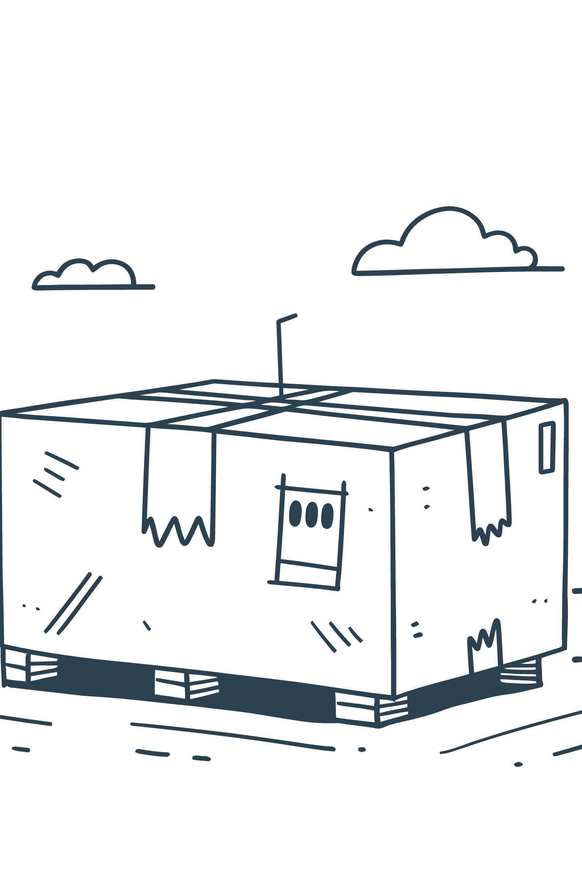
Data Analysis (SQL)
Simulated business transactions for actionable insights.
1
Revenue by Gender
Female: $75,191, Male: $157,890
2
High-Spending Discount Users
Identified 839 customers for upsell campaigns.
3
Top 5 Products by Rating
Gloves (3.86), Sandals (3.84), Boots (3.82), Hat (3.80), Skirt (3.78)
4
Shipping Type Comparison
Standard: $58.46, Express: $60.48

Slide 6

SQL Insights Continued
1
2
Subscribers vs. Non-Subscribers
Discount-Dependent Products
Subscribers: 1053 customers, $62,645 revenue.
Hat (50%), Sneakers (49.66%), Coat (49.07%), Sweater (48.17%), Pants (47.37%)
3
4
Customer Segmentation
Repeat Buyers & Subscriptions
Loyal (3116), Returning (701), New (83)
958 repeat buyers are subscribers.

Slide 7

Top Products & Revenue by Age
Top 3 Products per Category
Revenue by Age Group
Young Adult: $62,143
Accessories: Jewelry, Sunglasses, Belt
Middle-aged: $59,197
Adult: $55,978
Clothing: Blouse, Pants, Shirt
Senior: $55,763
Footwear: Sandals, Shoes, Sneakers
Outerwear: Jacket, Coat

Slide 8
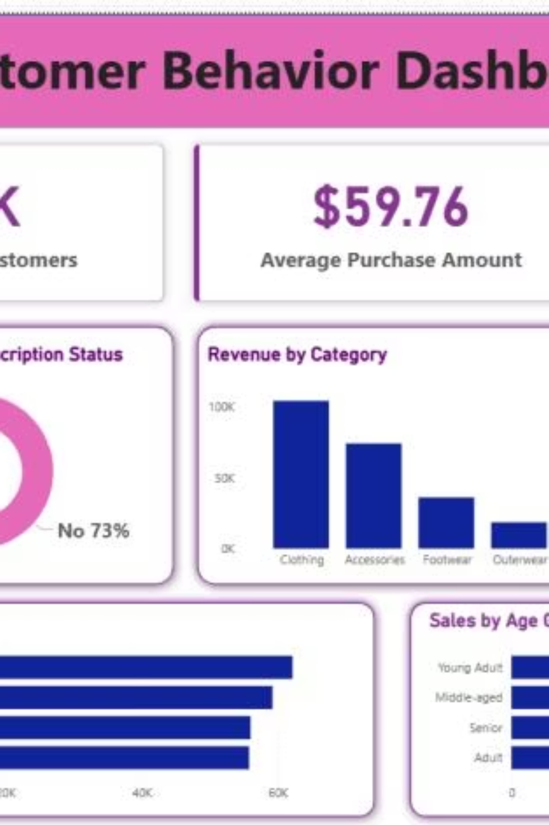
Dashboard in Power BI
Interactive dashboard for visual insights.
3.9K
$59.76
3.75
Customers
Avg. Purchase
Avg. Review

Slide 9
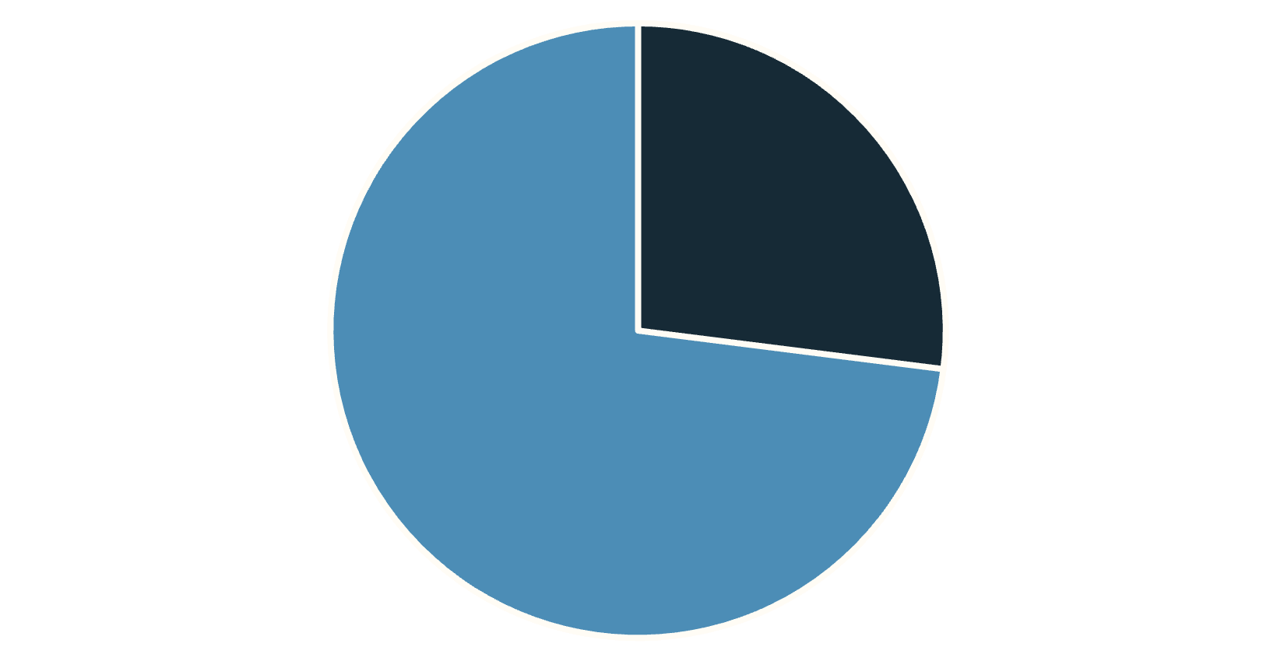
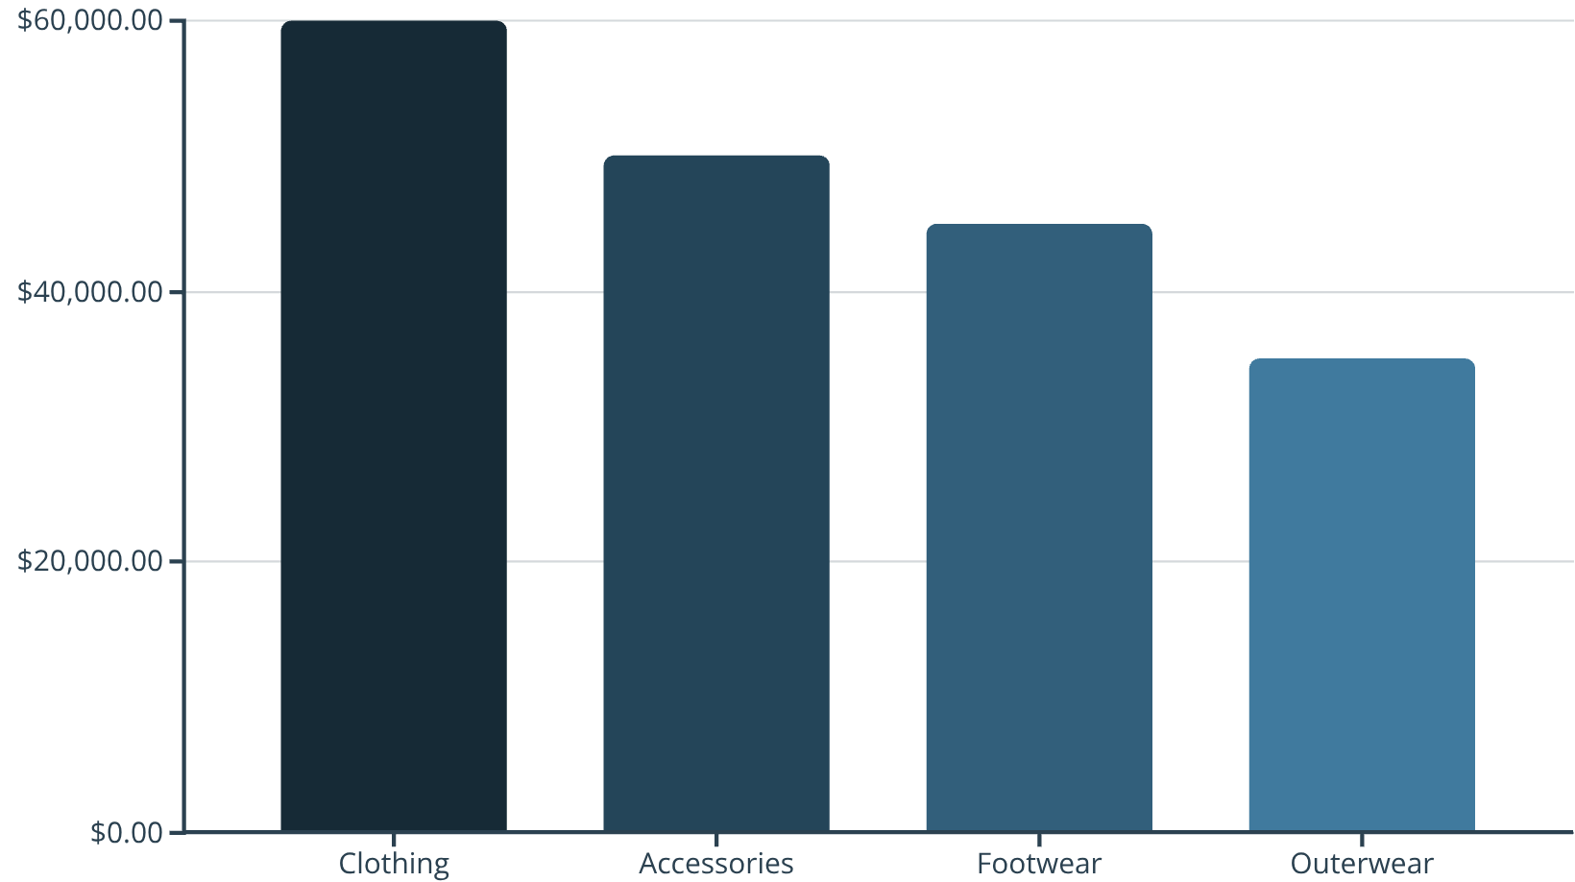
Dashboard Visuals
Yes
No
Subscription Status: 27% Yes, 73% No.
Revenue by Category: Clothing leads.

Slide 10

Business Recommendations
Boost Subscriptions
Promote benefits like free shipping, early access.
Customer Loyalty Programs
Introduce rewards for repeat buyers.
Review Discount Policy
Evaluate discount-reliant products for profitability.
Product Positioning
Feature top-rated products in marketing.
Targeted Marketing
Focus on high-revenue age groups and Express shipping users.

