Slide 1
WELLCOME
TO OUR PRESENTATION

Slide 2
ENROLLMENT SYSTEM
Presenter
Md. Towhidul Islam
Shrouve Jamil Biswhs
Subject: Software Engineering Practical
(CSE-322)
Session: 2015-2016
Department: CSE(6TH semester)
Roll:324,309

Slide 3
Introduction
Enrollment system is one of the most important and evident, not only in a university, but also in lower levels of education. An accurate and efficient enrollment records helps to ensure a good impression of the institution on possible enrollees encouraging them to matriculate in the institution. The purpose of an enrollment process is to provide a means for staffs and the faculty to write down data that are essential to enrollment. As the enrollees increase every year, the enrollment procedures become harder and harder to deal. The amount of information that needs to be jot down also increases. This only serves to slower process and confusion among the staffs and faculty.

Slide 4
OBJECTIVE
Enrollment System is system for maintaining the student on the daily basis in the college or Scholl. Each student will be given with a separate username and password based on the subject. Here he/she/admin can add ,delete ,view search ,update their informations and also student panel use to view student information and add, update student information.

Slide 5
Hardware and Software information
Hardware information:
A computer
RAM: 4GB
Software information:
XAMPP Control Panel
Windows OS
64 bit operating system
Sublime Text 3/Notepad/Net beans.

Slide 6
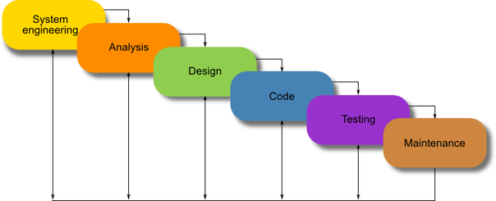
Enrollment System is a system for maintaining of the students on the daily basis in the college and school. This system follows the approach of waterfall model.
Waterfall Model
The waterfall model is a sequential approach, where each
fundamental activity of a process represented as a separate phase,
arranged in linear order.
In the waterfall model, you must plan and schedule all of the
activities before starting working on them (plan-driven process).

Slide 7
Why Use to Waterfall Model.
This model is used only when the requirements are very well known, clear and fixed.
Product definition is stable.
Technology is understood.
There are no ambiguous requirements
Ample resources with required expertise are available freely
The project is short.
In Waterfall model, very less customer interaction is involved during the development of the product. Once the product is ready then only it can be demonstrated to the end users.
Once the product is developed and if any failure occurs then the cost of fixing such issues are very high, because we need to update everything from document till the logic.
In today’s world, Waterfall model has been replaced by other models like iterative, agile etc.

Slide 8
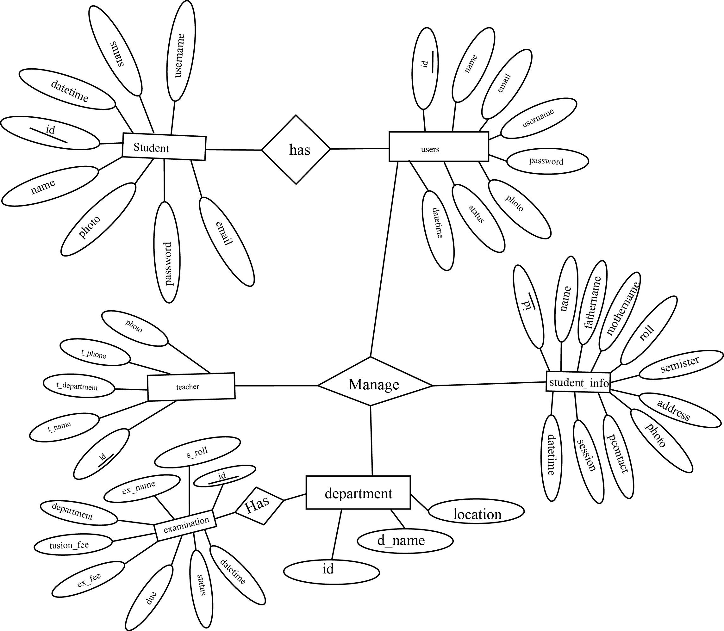
E-R Diagram

Slide 9
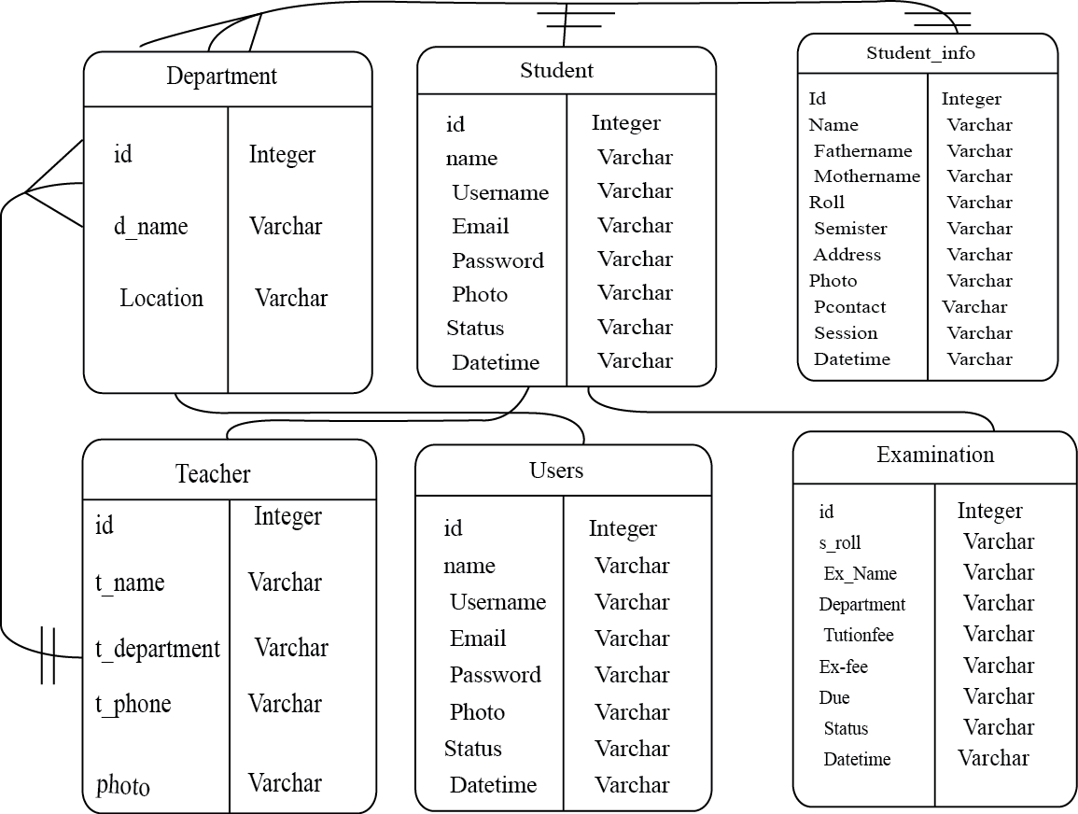
Database E-R Diagram

Slide 10
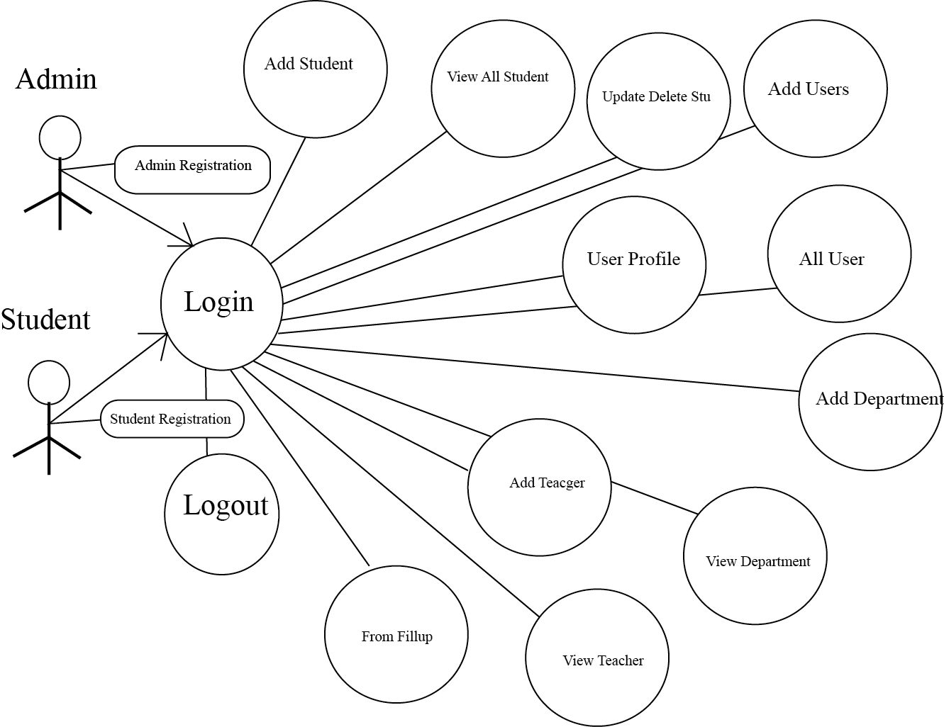
Data Flow Diagram

Slide 11
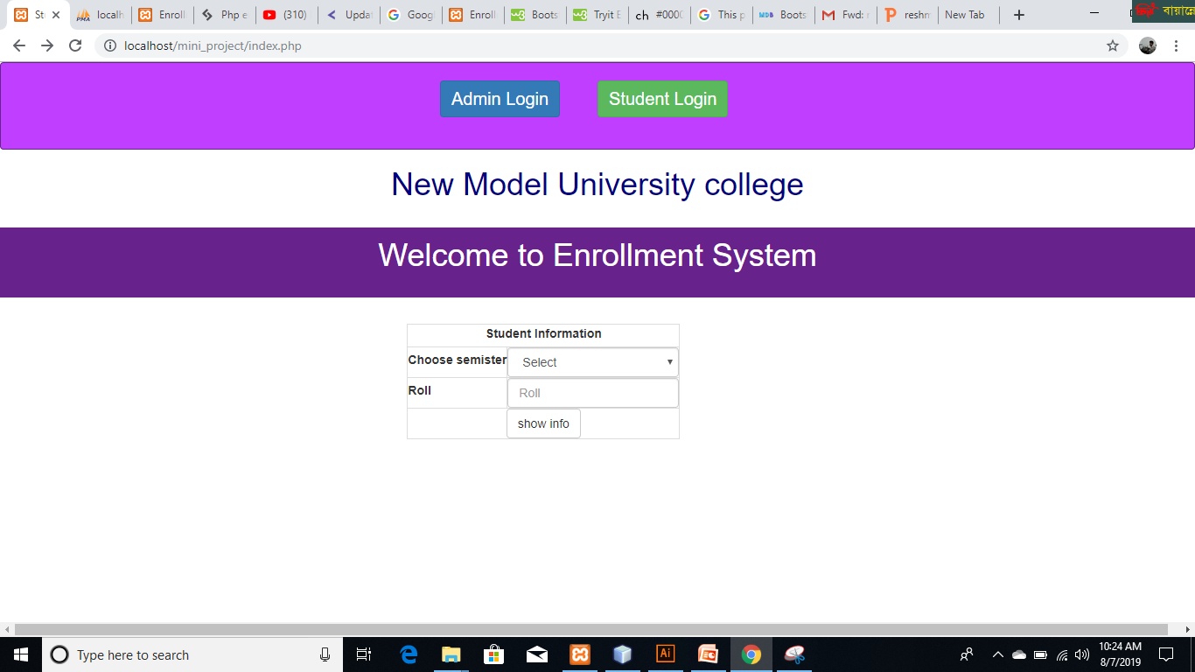
Index Page

Slide 12
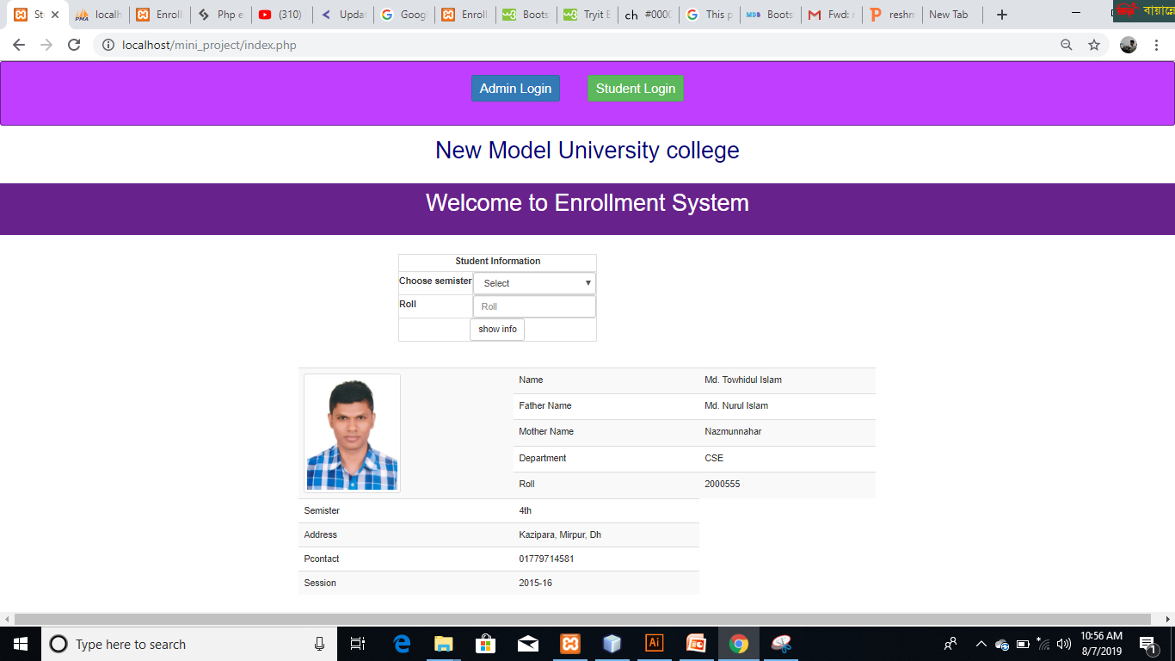
View Student Information

Slide 13
Index Page

Slide 14
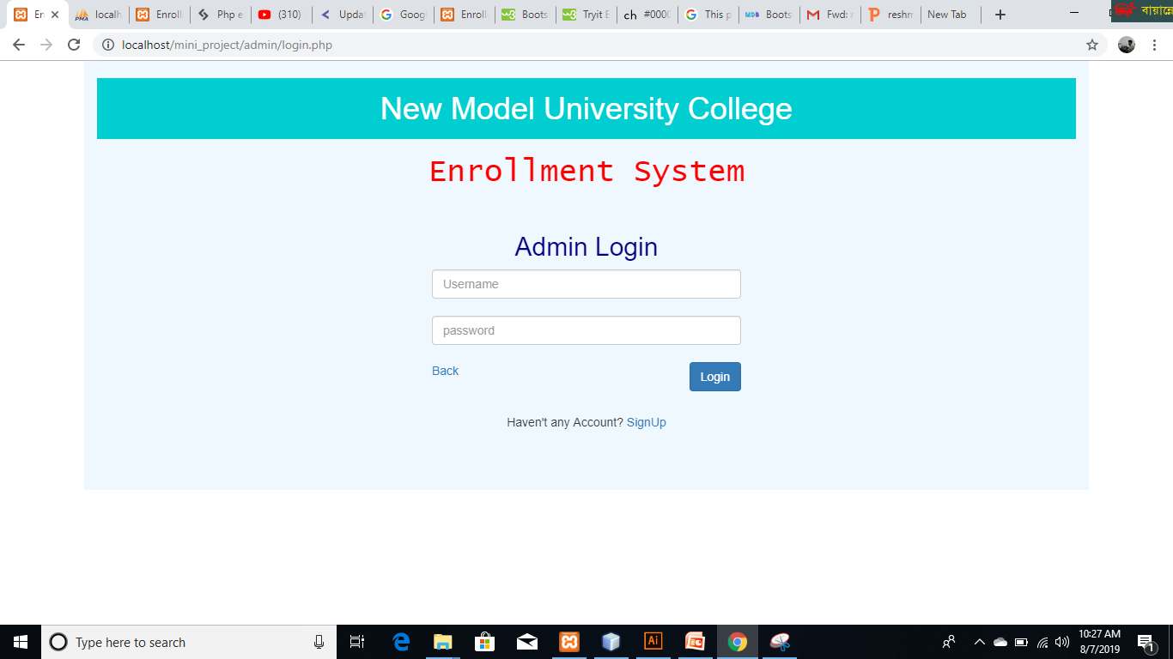
Admin Login Page
Click Login

Slide 15
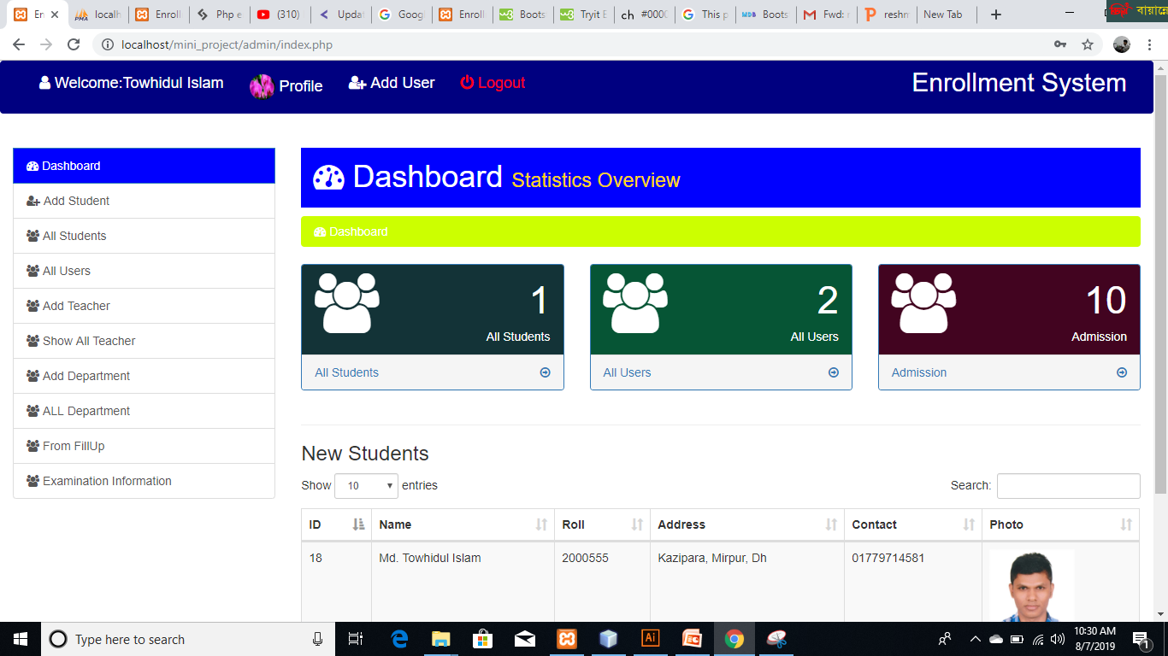
ADMIN PANEL

Slide 16
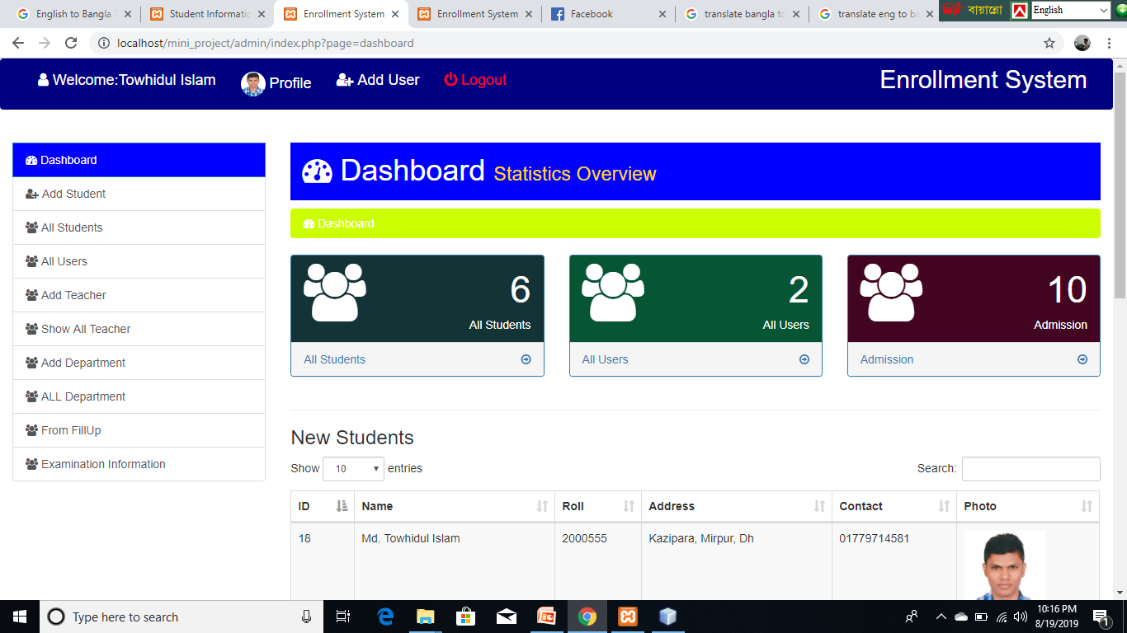
ADD STUDENT
Click Add Stu
Click add stu

Slide 17
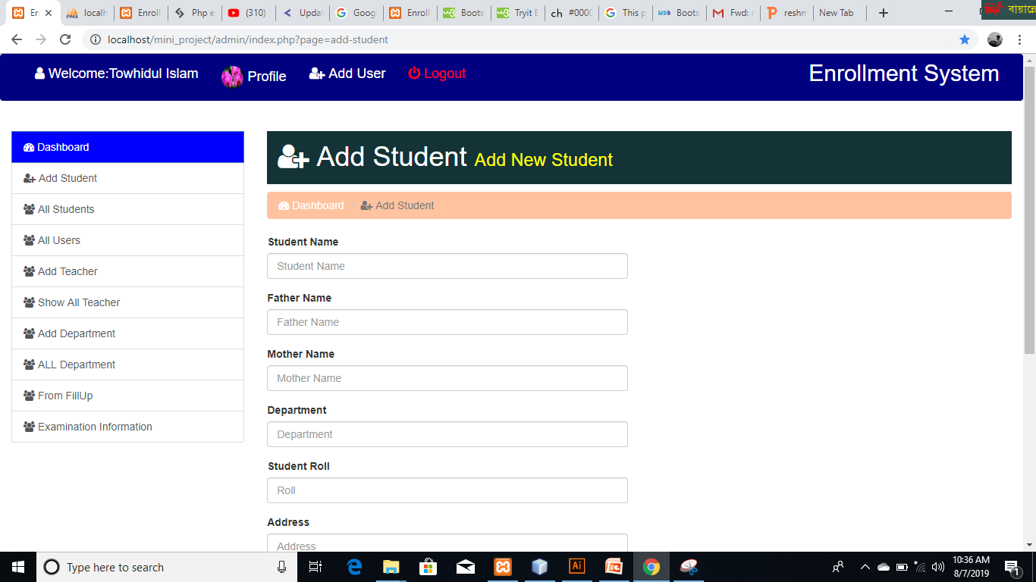
ADD STUDENT

Slide 18
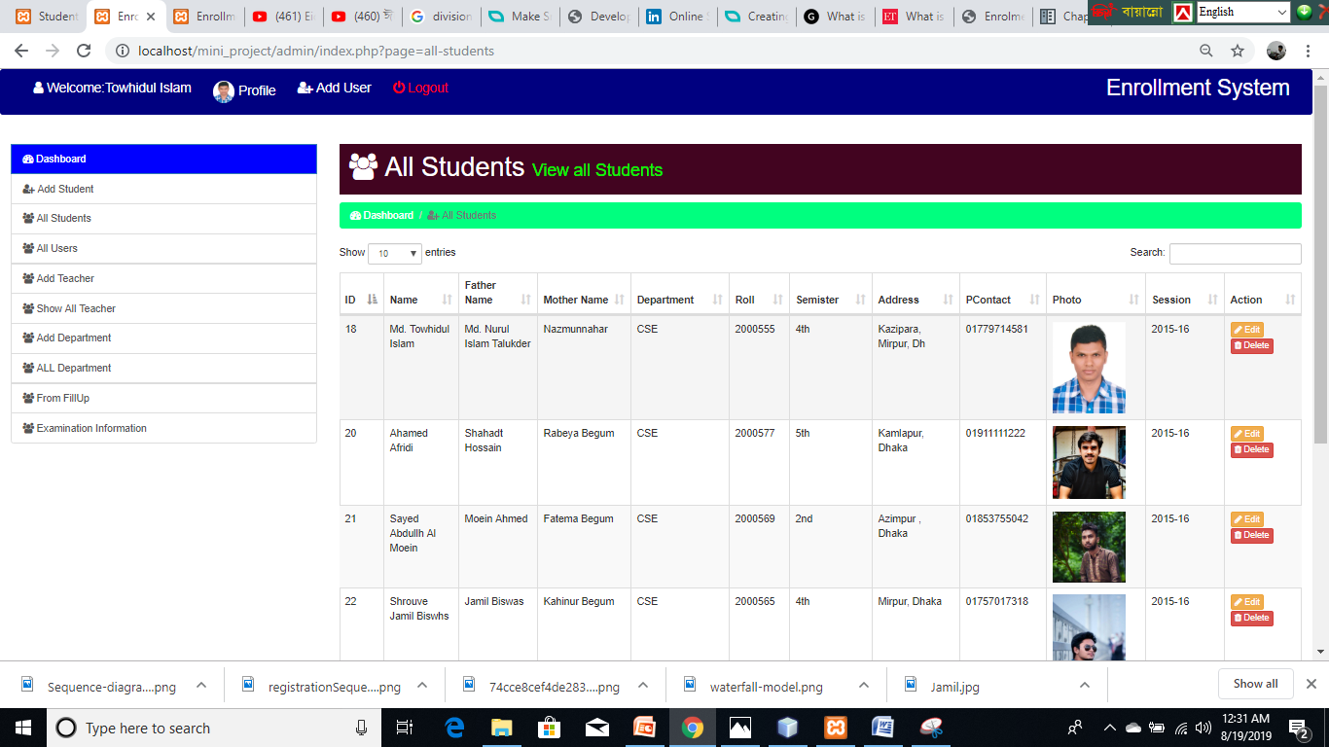
VIEW ALL STUDENT
All Student

Slide 19
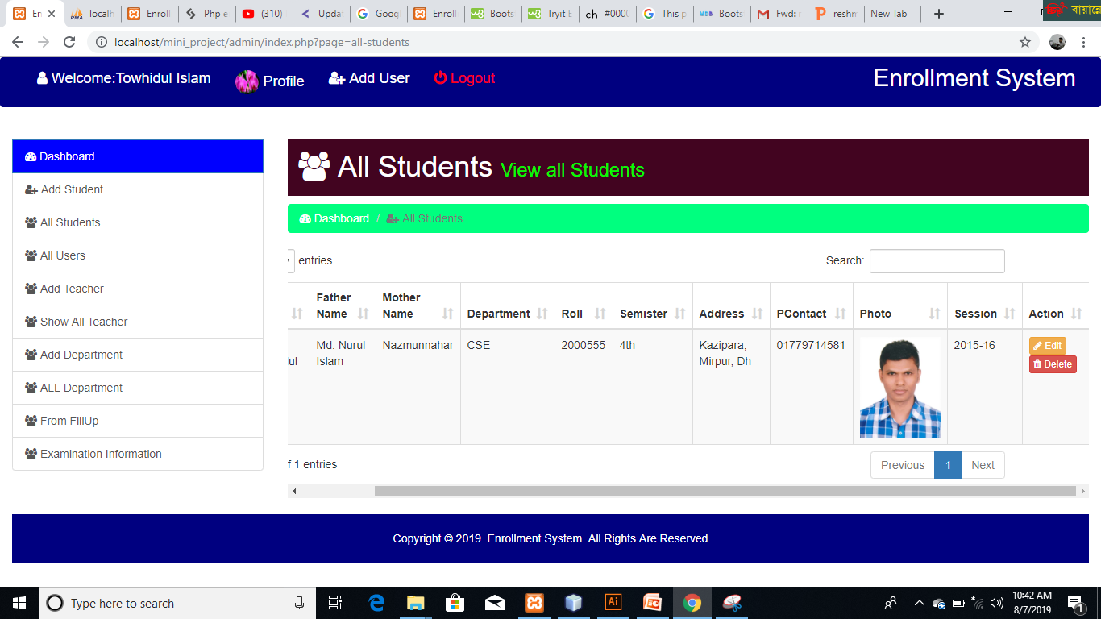
Update and Delete Student
Edit

Slide 20
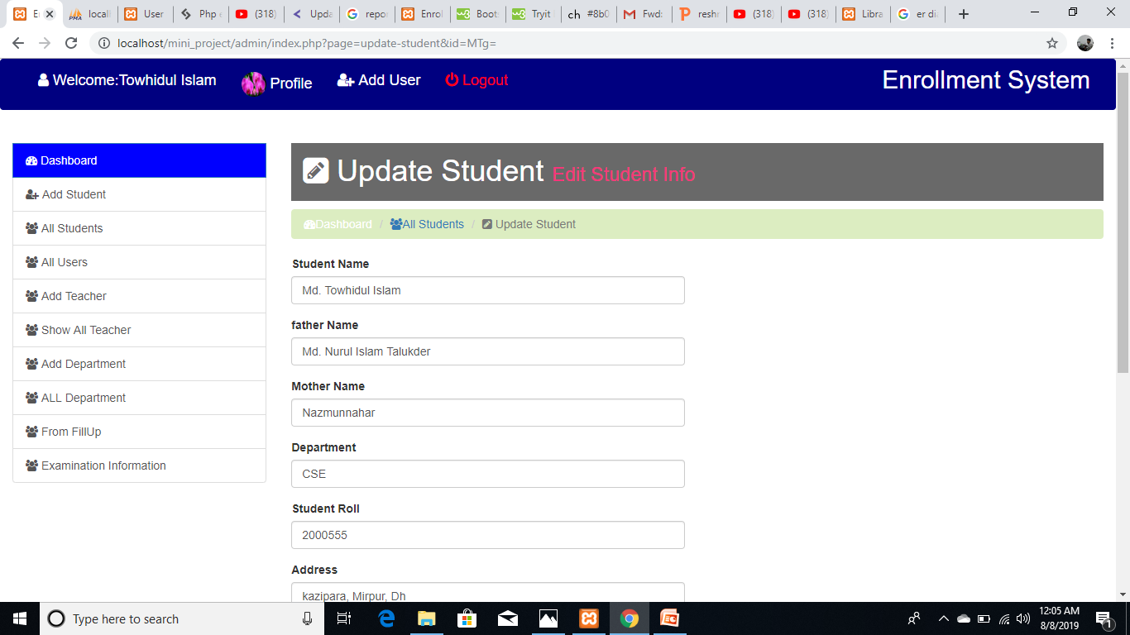
Upadate Student Info

Slide 21
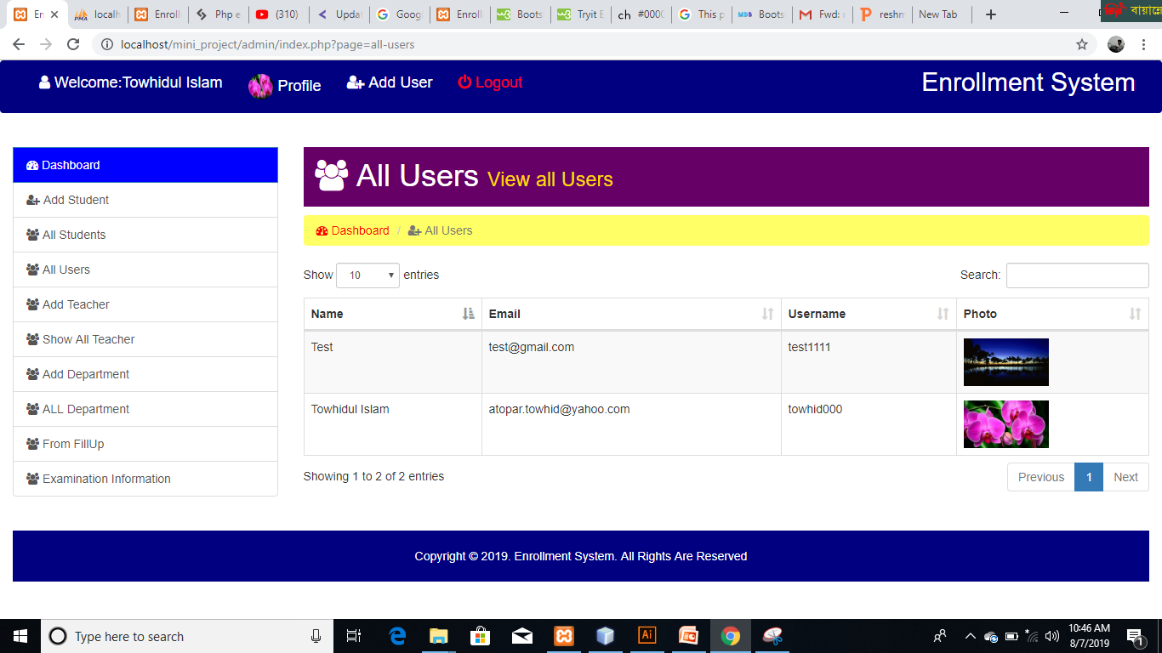
ALL USERS
Click Profile

Slide 22
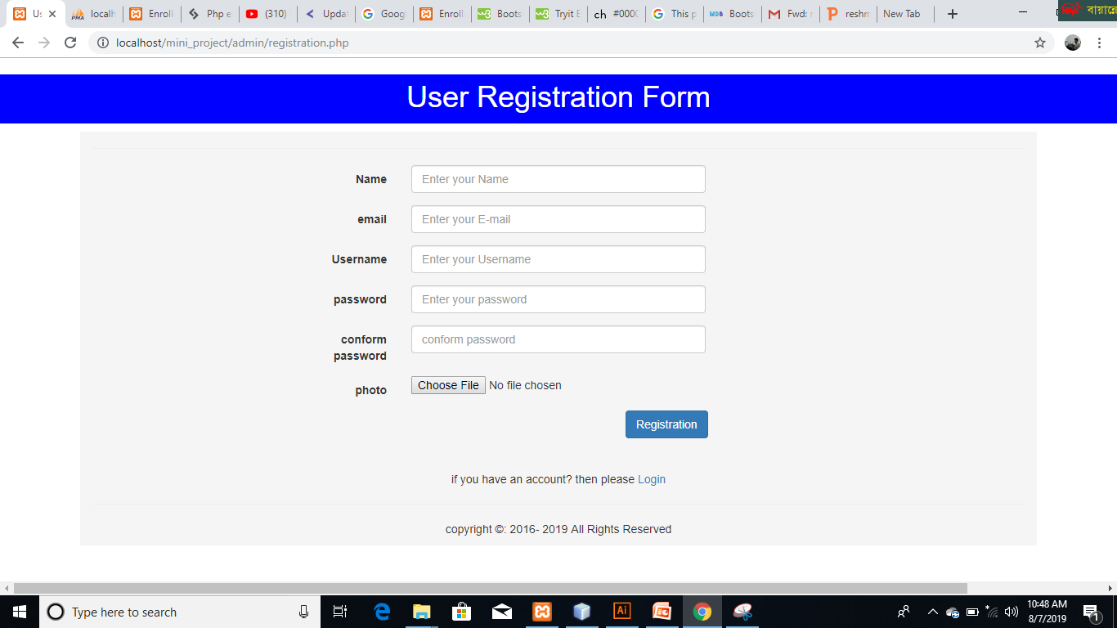
Add Users

Slide 23
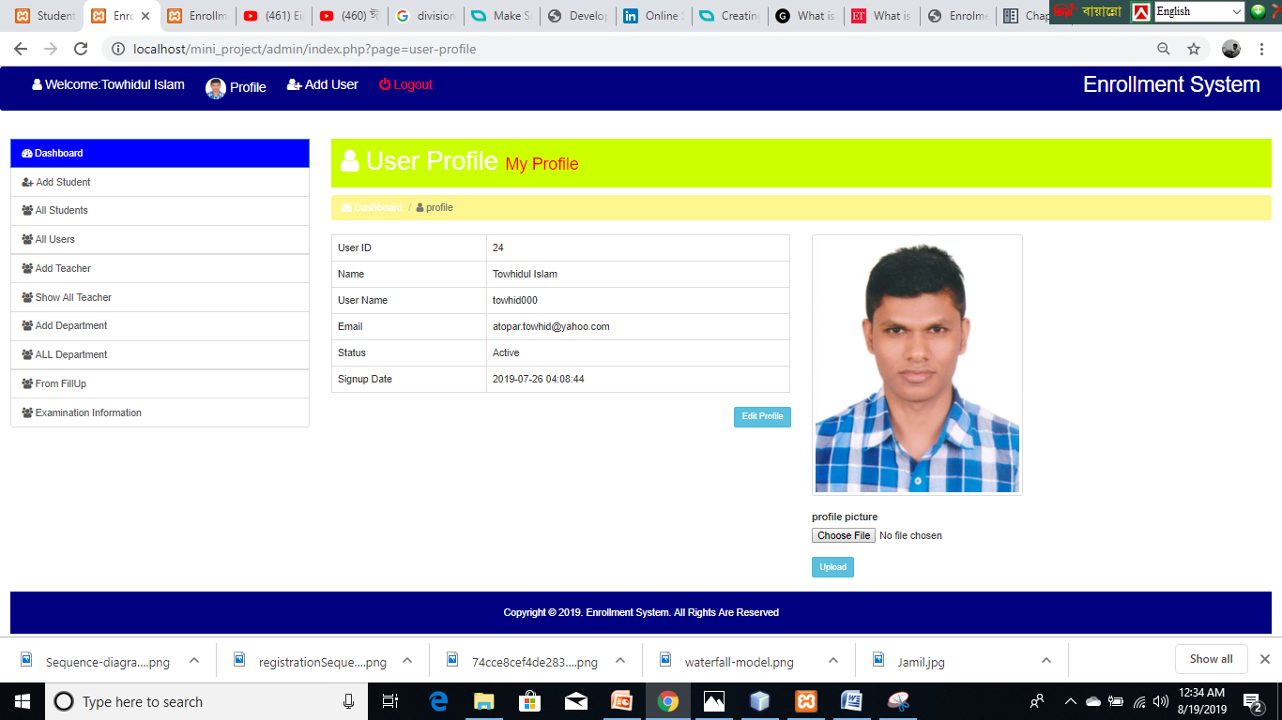
View Profile And Update

Slide 24
Future Plan
In future, we develope our software ‍so that we can get used to our college work.

Slide 25
Limitation/Problem
Student can not log in if admin did not logged in.
When we update student information then the photo need to upload again.
Header location Cannot Properly Work.

Slide 26
Colclusion
Implementing the Enrollment System, the registration procedure has been simplified. Previously student had to go door to door in order to get the documents acknowledged from the concerned officials whereas the currently developed system offers an efficient way to perform these operations. The students can access the registration portal online either from a computer or a smart phone, and fill the necessary information and submit it for further approval. This web application provides us with ease of access, user friendliness and transparency. On the other hand, from organizations viewpoint, it helps in maintaining transparency, data consistency, data accessibility and easy maintenance.

