Slide 1

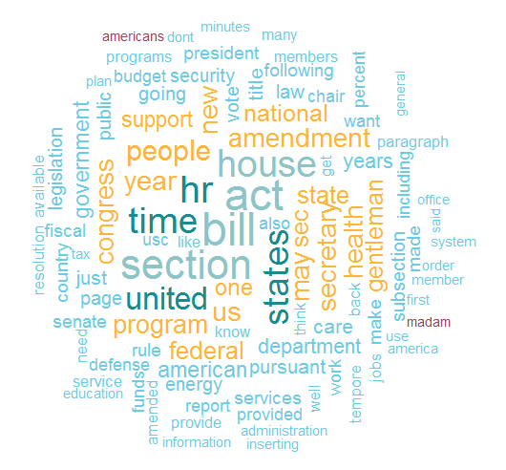
crec_scrape: Scraping U.S. Congressional Records

Slide 2
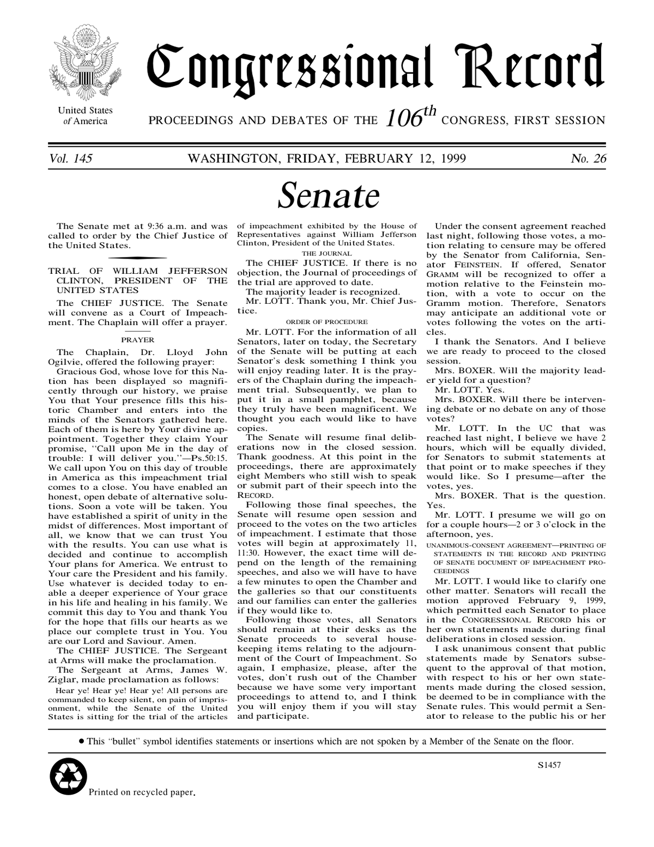



Idea
National legislature of the United States
Daily Digest
Senate
Senate:
100 members
House of Represenatives:
435 members
House
Extensions of Remarks
Congressional Records are publicly available at https://www.govinfo.gov/
Problem: Text is lengthy, administrative language, bulky denomination of laws, etc.
→ Difficult to access texts of debates via R
Idea: Contribute to the accessibility of congressional debates and to the open science community by scraping, and tidying (and visualizing) daily records
Notes:
To give you an impression, how a CSR report may look like, I have an example from H&M
Who of you would conclude that H&M is a sustainable company?
Maybe you might be a bit sceptical toward the report because it contains only positive content and if you are not you might get sceptical when I am showing you this report by a third party
In general CSR reports face credibility issues and therefore
Global Reporting Initiative offers to provide a truly transparent CSR report balancing positive and negative incidents
The problem with this solution is that company fear to lose stakeholders support disclosing their negative incidents

Slide 3
Contribution and Benefits for the Community
Previous work:
There exist no R code that retrieves CREC text data
Benefits for the community:
Accessing CREC data
Assessing the use of keywords over time to follow a certain debate
Insights in the way politicians act
APIs | https://projects.propublica.org/api-docs/congress-api/ | Vote data, member data, bill data, nomination data, committee data, statement data, lobbying data
R packages | https://cran.r-project.org/web/packages/ProPublicaR/index.html | Wrapper functions for ProPublica‘s API
 | https://www.rdocumentation.org/packages/RTextTools/Versions/1.4.2/topics/USCongress | Bill data
Python projects | https://towardsdatascience.com/political-python-1e8eb46c1bc1 | CREC data
 | https://github.com/unitedstates/congress | Bill data, amendments data, roll call votes data, core data
 | https://github.com/propublica/Capitol-Words | CREC data, congress people data

Slide 4




What have we achieved and how?
User
master-sourcing-the-rest.R
https://www.govinfo.gov/content/pkg/CREC-YYYY-MM-DD.zip
Step 1: Load required packages
SCRAPING PROCESS
Step 2: Enter start_date and end_date
Step 3: Source 1_scraper.R
TIDYING PROCESS
Step 4: Source 2_clean_html_files.R and get dataframe called „my_data“
VISUALIZATION PROCESS
Step 5: Source 3_data_visualization.R
1_scraper.R
output
2_clean_html_files.R
my_data
Notes:
To give you an impression, how a CSR report may look like, I have an example from H&M
Who of you would conclude that H&M is a sustainable company?
Maybe you might be a bit sceptical toward the report because it contains only positive content and if you are not you might get sceptical when I am showing you this report by a third party
In general CSR reports face credibility issues and therefore
Global Reporting Initiative offers to provide a truly transparent CSR report balancing positive and negative incidents
The problem with this solution is that company fear to lose stakeholders support disclosing their negative incidents

Slide 5
Data Output “my_data”
Variable | Type | Description | Example
vol | Num | A new volume is started every year | 158
no | Num | A new issue is printed every day | 112
date | Date | Date in format YYYY-MM-DD | 2012-07-25
unit | Factor | Four sections: House, Senate, Daily Digest, and Extensions of Remark | Senate
pages | Factor | Sequentially numbered throughout the session of Congress. The pageprefix specify units by H, S, D and E | S5321-S5418
start_page | Int | Where the unit starts its text | 5321
end_page | Int | Where the unit ends its text | 5418
text | Chr | Contains the processed text | vol 158 washington wednesday july 25 2012 112 prayer chaplain dr barry …
Notes:
To give you an impression, how a CSR report may look like, I have an example from H&M
Who of you would conclude that H&M is a sustainable company?
Maybe you might be a bit sceptical toward the report because it contains only positive content and if you are not you might get sceptical when I am showing you this report by a third party
In general CSR reports face credibility issues and therefore
Global Reporting Initiative offers to provide a truly transparent CSR report balancing positive and negative incidents
The problem with this solution is that company fear to lose stakeholders support disclosing their negative incidents

Slide 6
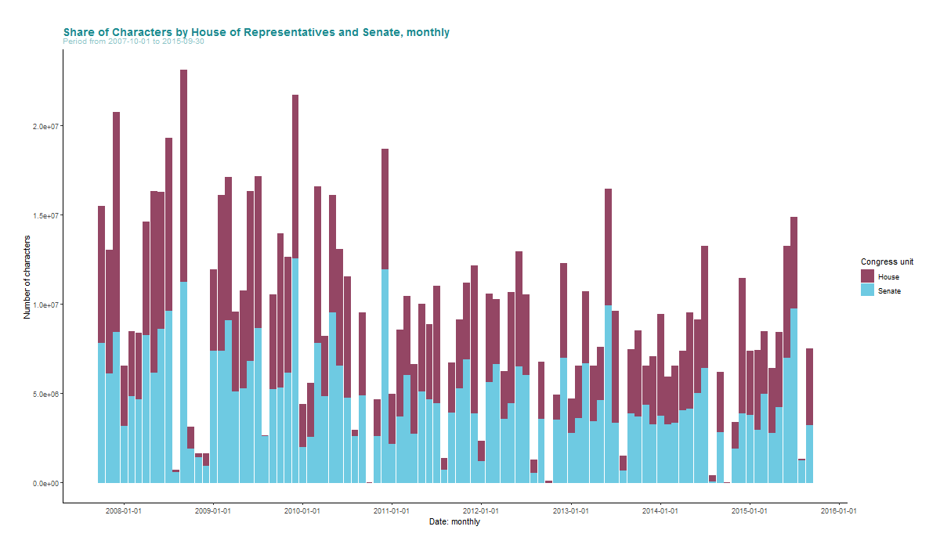
Data Visualization
Notes:
To give you an impression, how a CSR report may look like, I have an example from H&M
Who of you would conclude that H&M is a sustainable company?
Maybe you might be a bit sceptical toward the report because it contains only positive content and if you are not you might get sceptical when I am showing you this report by a third party
In general CSR reports face credibility issues and therefore
Global Reporting Initiative offers to provide a truly transparent CSR report balancing positive and negative incidents
The problem with this solution is that company fear to lose stakeholders support disclosing their negative incidents

Slide 7
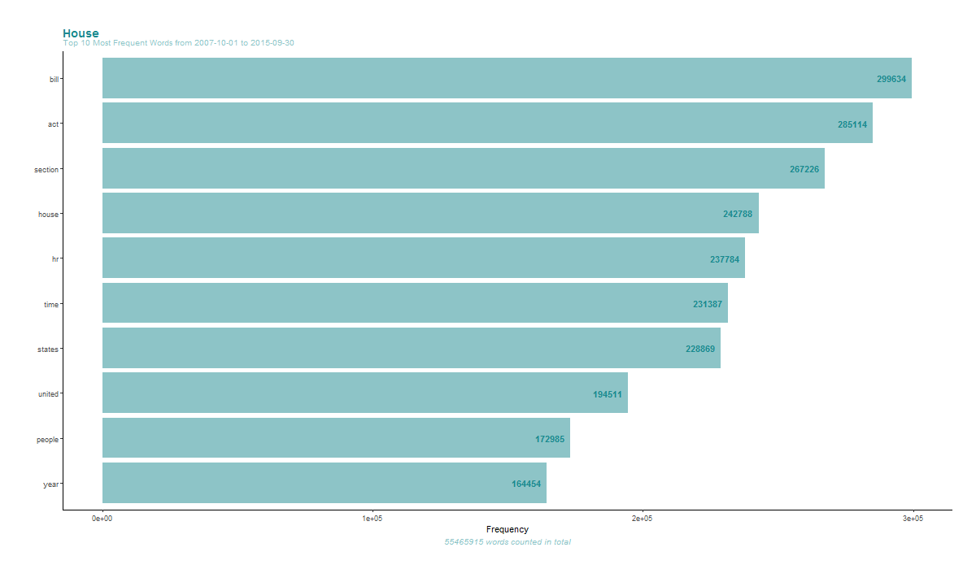
Data Visualization
Notes:
To give you an impression, how a CSR report may look like, I have an example from H&M
Who of you would conclude that H&M is a sustainable company?
Maybe you might be a bit sceptical toward the report because it contains only positive content and if you are not you might get sceptical when I am showing you this report by a third party
In general CSR reports face credibility issues and therefore
Global Reporting Initiative offers to provide a truly transparent CSR report balancing positive and negative incidents
The problem with this solution is that company fear to lose stakeholders support disclosing their negative incidents

Slide 8
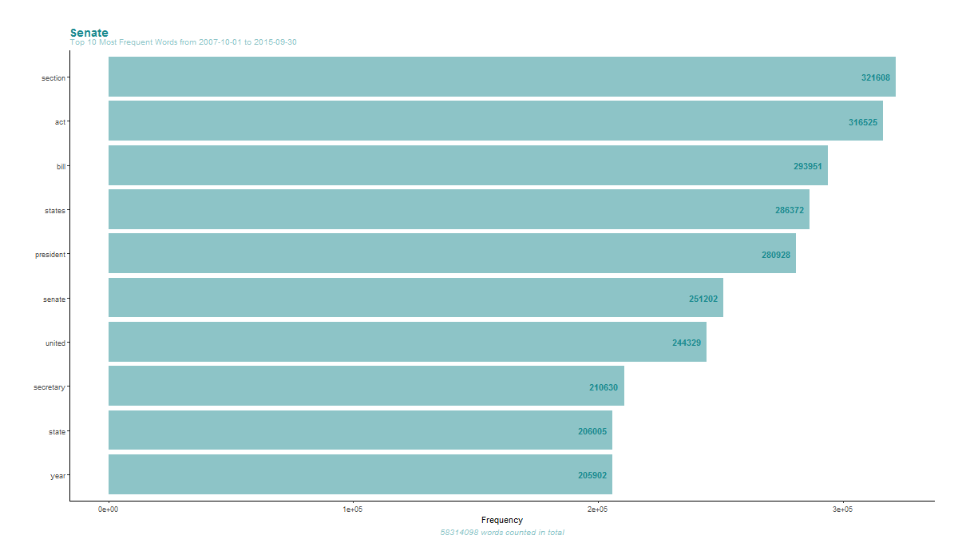
Data Visualization
Notes:
To give you an impression, how a CSR report may look like, I have an example from H&M
Who of you would conclude that H&M is a sustainable company?
Maybe you might be a bit sceptical toward the report because it contains only positive content and if you are not you might get sceptical when I am showing you this report by a third party
In general CSR reports face credibility issues and therefore
Global Reporting Initiative offers to provide a truly transparent CSR report balancing positive and negative incidents
The problem with this solution is that company fear to lose stakeholders support disclosing their negative incidents

Slide 9
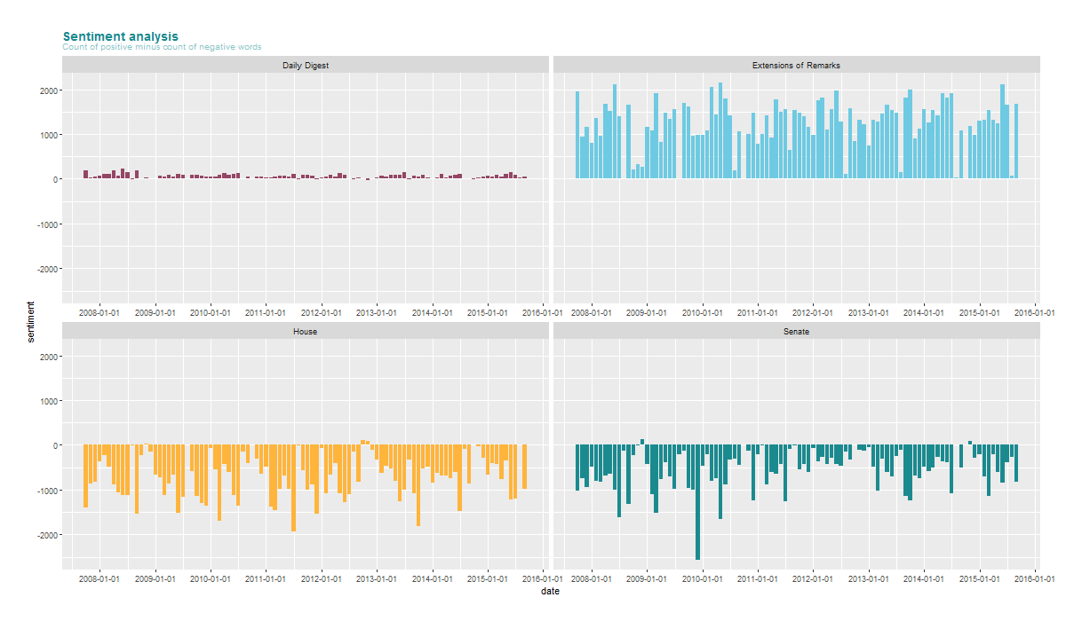
Data Visualization
Notes:
To give you an impression, how a CSR report may look like, I have an example from H&M
Who of you would conclude that H&M is a sustainable company?
Maybe you might be a bit sceptical toward the report because it contains only positive content and if you are not you might get sceptical when I am showing you this report by a third party
In general CSR reports face credibility issues and therefore
Global Reporting Initiative offers to provide a truly transparent CSR report balancing positive and negative incidents
The problem with this solution is that company fear to lose stakeholders support disclosing their negative incidents

Slide 10
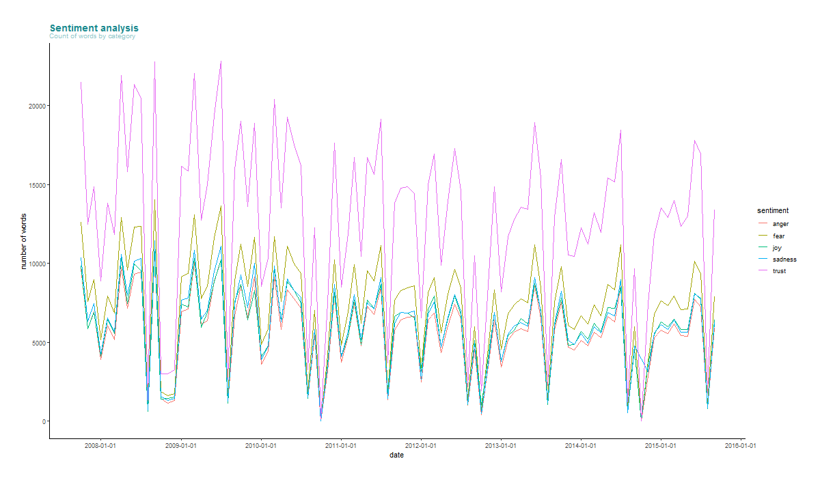
Data Visualization
Notes:
To give you an impression, how a CSR report may look like, I have an example from H&M
Who of you would conclude that H&M is a sustainable company?
Maybe you might be a bit sceptical toward the report because it contains only positive content and if you are not you might get sceptical when I am showing you this report by a third party
In general CSR reports face credibility issues and therefore
Global Reporting Initiative offers to provide a truly transparent CSR report balancing positive and negative incidents
The problem with this solution is that company fear to lose stakeholders support disclosing their negative incidents

Slide 11
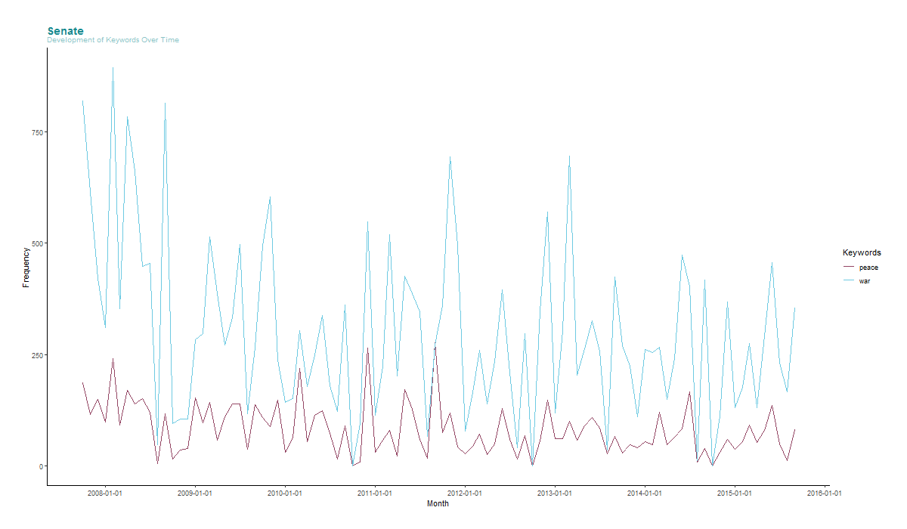
Data Visualization
Notes:
To give you an impression, how a CSR report may look like, I have an example from H&M
Who of you would conclude that H&M is a sustainable company?
Maybe you might be a bit sceptical toward the report because it contains only positive content and if you are not you might get sceptical when I am showing you this report by a third party
In general CSR reports face credibility issues and therefore
Global Reporting Initiative offers to provide a truly transparent CSR report balancing positive and negative incidents
The problem with this solution is that company fear to lose stakeholders support disclosing their negative incidents

Slide 12
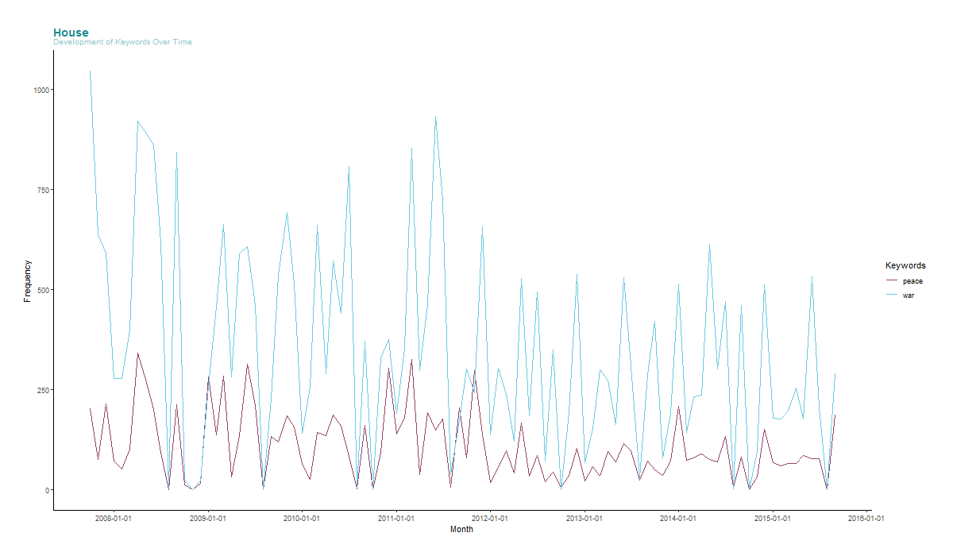
Data Visualization
Notes:
To give you an impression, how a CSR report may look like, I have an example from H&M
Who of you would conclude that H&M is a sustainable company?
Maybe you might be a bit sceptical toward the report because it contains only positive content and if you are not you might get sceptical when I am showing you this report by a third party
In general CSR reports face credibility issues and therefore
Global Reporting Initiative offers to provide a truly transparent CSR report balancing positive and negative incidents
The problem with this solution is that company fear to lose stakeholders support disclosing their negative incidents

Slide 13
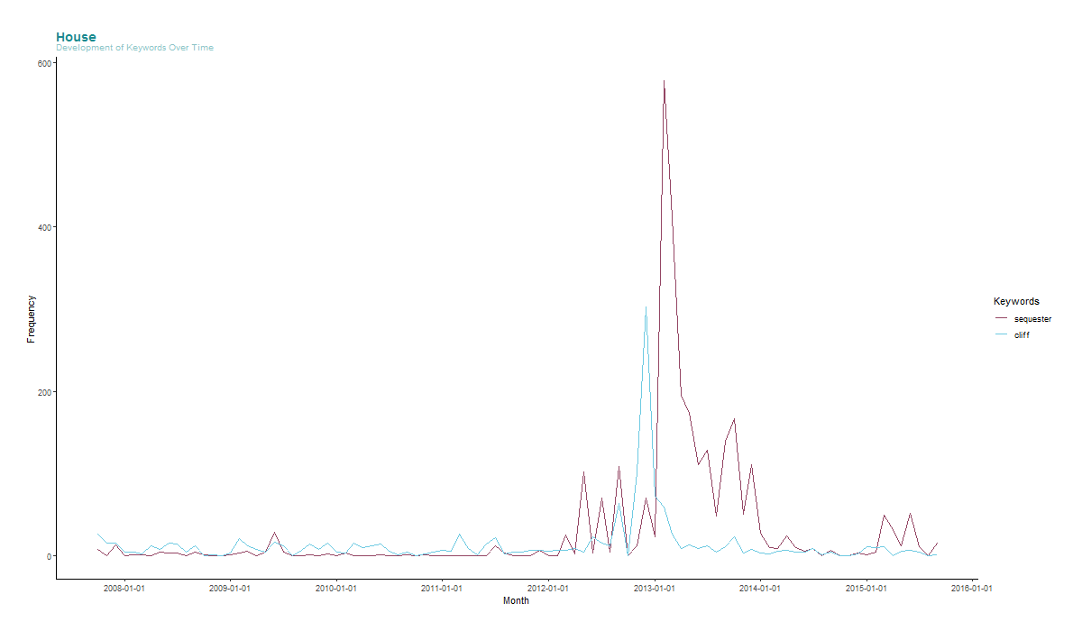
Data Visualization
Notes:
To give you an impression, how a CSR report may look like, I have an example from H&M
Who of you would conclude that H&M is a sustainable company?
Maybe you might be a bit sceptical toward the report because it contains only positive content and if you are not you might get sceptical when I am showing you this report by a third party
In general CSR reports face credibility issues and therefore
Global Reporting Initiative offers to provide a truly transparent CSR report balancing positive and negative incidents
The problem with this solution is that company fear to lose stakeholders support disclosing their negative incidents

Slide 14
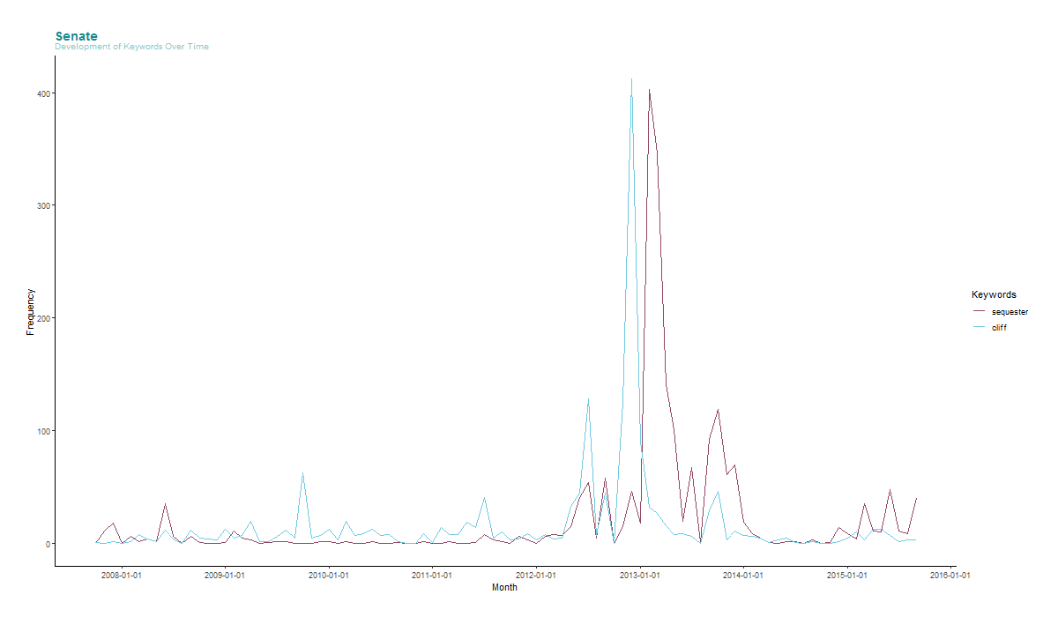
Data Visualization
Notes:
To give you an impression, how a CSR report may look like, I have an example from H&M
Who of you would conclude that H&M is a sustainable company?
Maybe you might be a bit sceptical toward the report because it contains only positive content and if you are not you might get sceptical when I am showing you this report by a third party
In general CSR reports face credibility issues and therefore
Global Reporting Initiative offers to provide a truly transparent CSR report balancing positive and negative incidents
The problem with this solution is that company fear to lose stakeholders support disclosing their negative incidents

Slide 15


Challenges during Scraping Process
https://www.govinfo.gov/content/pkg/CREC-YYYY-MM-DD.zip
How to store large zip files after download
What to do with days where no text data is available
Function to stop at errors
1_scraper.R
output
Use of a temporary store by using the function tempfile() and unzip data selecting only html from there (low use of server resources)
Warnings introduced, warnings will be saved separately
Intro of tryCatch to keep function running with warnings
Notes:
To give you an impression, how a CSR report may look like, I have an example from H&M
Who of you would conclude that H&M is a sustainable company?
Maybe you might be a bit sceptical toward the report because it contains only positive content and if you are not you might get sceptical when I am showing you this report by a third party
In general CSR reports face credibility issues and therefore
Global Reporting Initiative offers to provide a truly transparent CSR report balancing positive and negative incidents
The problem with this solution is that company fear to lose stakeholders support disclosing their negative incidents

Slide 16
Challenges during Tidying Process
Each CREC is divided into several html-files
Extract volume, number, date, unit, page from html-text
Tidy text, e.g., drop repetitive elements, strip special characters, etc.
output
2_clean_html_files.R
Read each html-file, split them into frame and amalgamate them along date and unit
Write and apply several functions
Tidy text by removing punctuation and special signs, introducing lower case, removing multiple white spaces, removing stop words, removing single characters
my_data
Notes:
To give you an impression, how a CSR report may look like, I have an example from H&M
Who of you would conclude that H&M is a sustainable company?
Maybe you might be a bit sceptical toward the report because it contains only positive content and if you are not you might get sceptical when I am showing you this report by a third party
In general CSR reports face credibility issues and therefore
Global Reporting Initiative offers to provide a truly transparent CSR report balancing positive and negative incidents
The problem with this solution is that company fear to lose stakeholders support disclosing their negative incidents

Slide 17
How will we make the project FAIR?
FINDABLE
discoverable with metadata, identifiable and locatable by means of a standard identification mechanism
Metadata for each scraped text: Volume, number, date, unit, pages
ACCESSIBLE
always available and obtainable; even if the data is restricted, the metadata is open
Public GitHub respository
INTEROPERABLE
Use common formats and standards and controlled vocabulary
both syntactically parseable and semantically understandable, allowing data exchange and reuse between researchers, institutions, organizations or countries
REUSABLE
Well-documented in README and a clear contribution policy
Notes:
To give you an impression, how a CSR report may look like, I have an example from H&M
Who of you would conclude that H&M is a sustainable company?
Maybe you might be a bit sceptical toward the report because it contains only positive content and if you are not you might get sceptical when I am showing you this report by a third party
In general CSR reports face credibility issues and therefore
Global Reporting Initiative offers to provide a truly transparent CSR report balancing positive and negative incidents
The problem with this solution is that company fear to lose stakeholders support disclosing their negative incidents

Slide 18
Questions?

Slide 19
Backup Slides

Slide 20
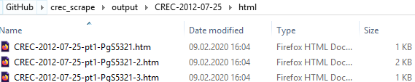
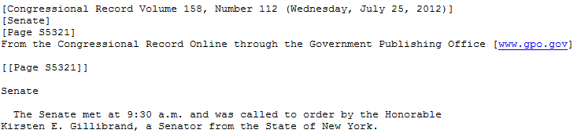
Challenges during Tidying Process
Each CREC is divided into several html-files
output
Each html-file follow a certain structure
2_clean_html_files.R
my_data
Build a frame based on the structure
V1 | V2 | V3 | V4 | V5 | V6
 | [Congressional Record Volume 158, Number 112 (Wednesday, July 25, 2012)] | [Senate] | [Page S5321] | From the Congressional Record Online through the Government Publishing Office [www.gpo.gov] | \n[[Page S5321]]\n\nSenate\n\n The Senate met at 9:30 a.m. and was called to order by the Honorable \nKirsten E. Gillibrand, a Senator from the State of New York.\n ______\n \n\n\n
Apply certain extracting and cleaning functions to get my_data
Notes:
To give you an impression, how a CSR report may look like, I have an example from H&M
Who of you would conclude that H&M is a sustainable company?
Maybe you might be a bit sceptical toward the report because it contains only positive content and if you are not you might get sceptical when I am showing you this report by a third party
In general CSR reports face credibility issues and therefore
Global Reporting Initiative offers to provide a truly transparent CSR report balancing positive and negative incidents
The problem with this solution is that company fear to lose stakeholders support disclosing their negative incidents

Slide 21
Demonstration of a Use Case
Notes:
To give you an impression, how a CSR report may look like, I have an example from H&M
Who of you would conclude that H&M is a sustainable company?
Maybe you might be a bit sceptical toward the report because it contains only positive content and if you are not you might get sceptical when I am showing you this report by a third party
In general CSR reports face credibility issues and therefore
Global Reporting Initiative offers to provide a truly transparent CSR report balancing positive and negative incidents
The problem with this solution is that company fear to lose stakeholders support disclosing their negative incidents

Slide 22
Unsettles Issues
At YYYY-01-03 a new volume starts but it can be that there are two volumes of this day → cannot capture them in our URL
Outlook:
Web application
Notes:
To give you an impression, how a CSR report may look like, I have an example from H&M
Who of you would conclude that H&M is a sustainable company?
Maybe you might be a bit sceptical toward the report because it contains only positive content and if you are not you might get sceptical when I am showing you this report by a third party
In general CSR reports face credibility issues and therefore
Global Reporting Initiative offers to provide a truly transparent CSR report balancing positive and negative incidents
The problem with this solution is that company fear to lose stakeholders support disclosing their negative incidents

