Slide 1
Data preprocessing
Python for AI
‹#›

Slide 2
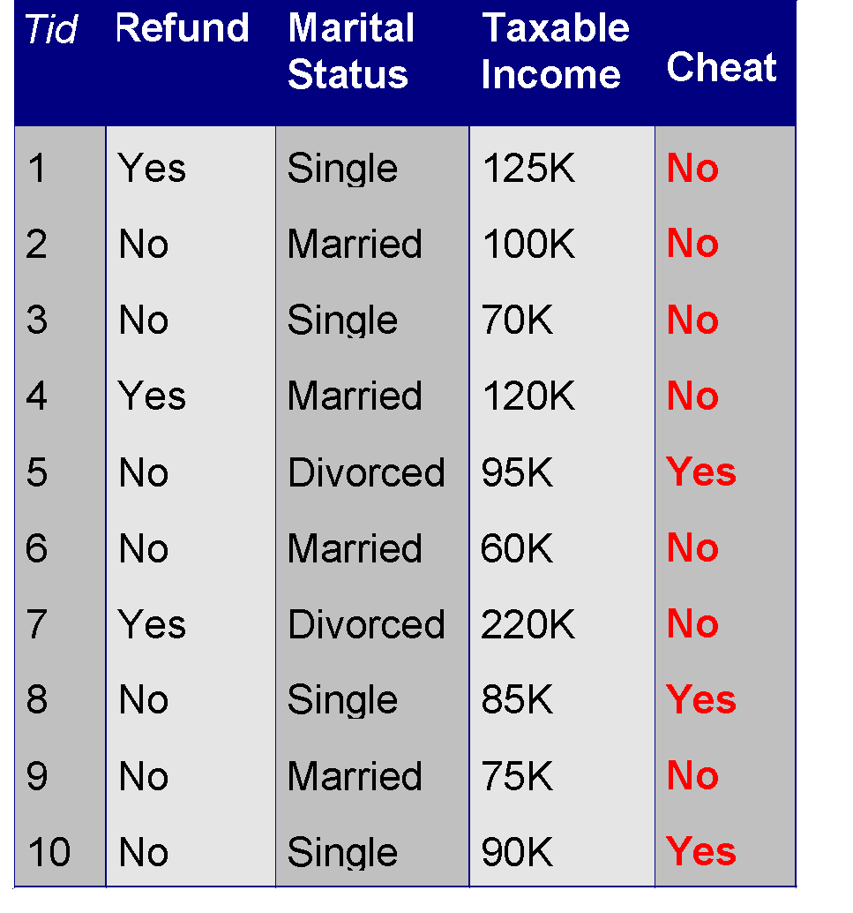
What is Data?
Collection of data objects and their attributes
An attribute is a property or characteristic of an object
Examples: eye color of a person, temperature, etc.
Attribute is also known as variable, field, characteristic, or feature
A collection of attributes describe an object
Object is also known as record, point, case, sample, entity, or instance
Attributes
Objects
‹#›
Notes:
‹#›

Slide 3
Attribute Values
Attribute values are numbers or symbols assigned to an attribute
Distinction between attributes and attribute values
Same attribute can be mapped to different attribute values
Example: height can be measured in feet or meters
Different attributes can be mapped to the same set of values
Example: Attribute values for ID and age are integers
But properties of attribute values can be different
ID has no limit but age has a maximum and minimum value
‹#›

Slide 4
Why Data Preprocessing?
Data in the real world is dirty
incomplete: lacking attribute values, lacking certain attributes of interest, or containing only aggregate data
noisy: containing errors or outliers
inconsistent: containing discrepancies in codes or names
No quality data, no quality mining results!

Slide 5
How to Handle Missing Data?
Ignore the tuple: usually done when class label is missing (assuming the task is classification—not effective in certain cases)
Fill in the missing value manually: tedious + infeasible?
Use a global constant to fill in the missing value: e.g., “unknown”, a new class?!
Use the attribute mean to fill in the missing value
Use the attribute mean for all samples of the same class to fill in the missing value: smarter
Use the most probable value to fill in the missing value: inference-based such as regression, Bayesian formula, decision tree

Slide 6
How to Handle Noisy Data?
Binning method:
first sort data and partition into (equi-depth) bins
then one can smooth by bin means, smooth by bin median, smooth by bin boundaries, etc.
used also for discretization (discussed later)
Clustering
detect and remove outliers
Semi-automated method: combined computer and human inspection
detect suspicious values and check manually
Regression
smooth by fitting the data into regression functions

Slide 7
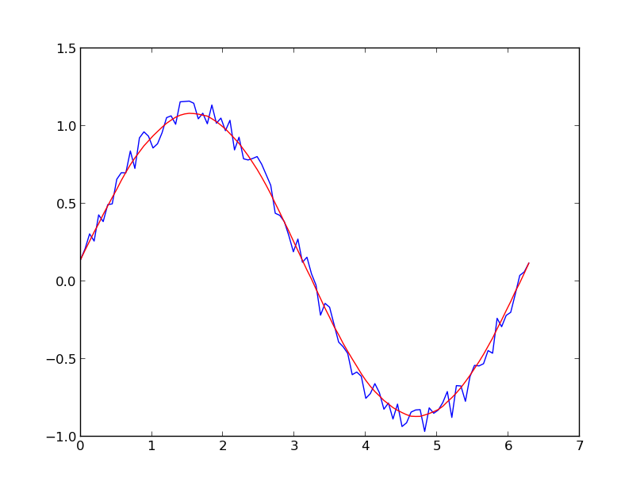
Data smoothing
Data smoothing is executed by making use of a specialized algorithm for removing noise from the given data set.
‹#›

Slide 8
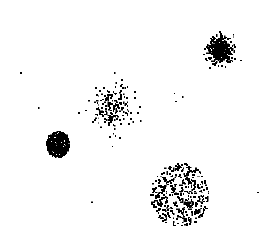
Outliers
Outliers are data objects with characteristics that are considerably different than most of the other data objects in the data set
‹#›

Slide 9
Binning Methods for Data Smoothing
* Sorted data for price (in dollars): 4, 8, 9, 15, 21, 21, 24, 25, 26, 28, 29, 34
* Partition into (equi-depth) bins:
- Bin 1: 4, 8, 9, 15
- Bin 2: 21, 21, 24, 25
- Bin 3: 26, 28, 29, 34
* Smoothing by bin means:
- Bin 1: 9, 9, 9, 9
- Bin 2: 23, 23, 23, 23
- Bin 3: 29, 29, 29, 29
* Smoothing by bin boundaries:
- Bin 1: 4, 4, 4, 15
- Bin 2: 21, 21, 25, 25
- Bin 3: 26, 26, 26, 34

Slide 10
Duplicate Data
Data set may include data objects that are duplicates, or almost duplicates of one another
Major issue when merging data from heterogeous sources
Examples:
Same person with multiple email addresses
Data cleaning
Process of dealing with duplicate data issues
‹#›

Slide 11
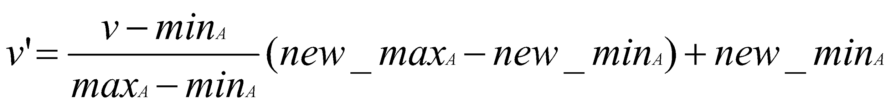

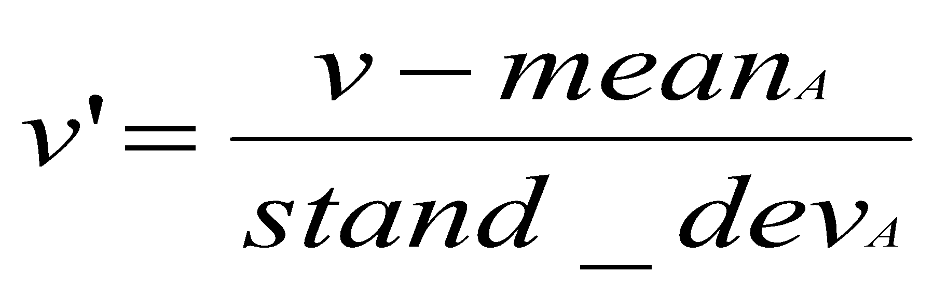
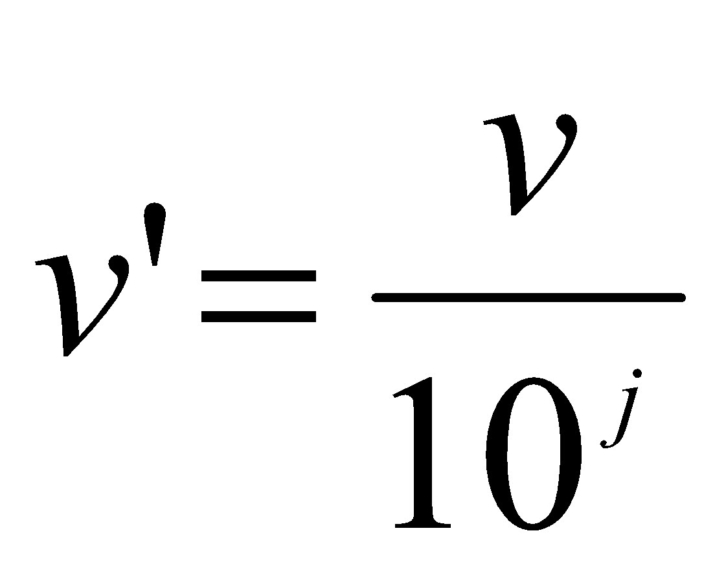
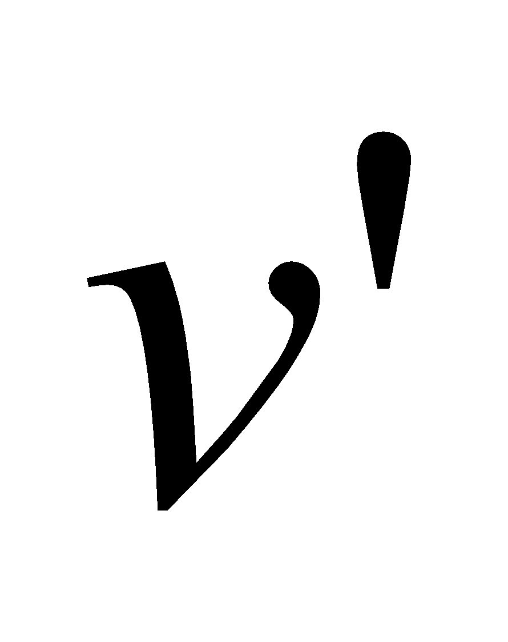
Data Transformation: Normalization
Particularly useful for classification (NNs, distance measurements,
nn classification, etc)
min-max normalization
z-score normalization
normalization by decimal scaling
Where j is the smallest integer such that Max(| |)<1

Slide 12
Discretization/Quantization
Three types of attributes:
Nominal — values from an unordered set
Ordinal — values from an ordered set
Continuous — real numbers
Discretization/Quantization:
divide the range of a continuous attribute into intervals
Some classification algorithms only accept categorical attributes.
Reduce data size by discretization
Prepare for further analysis
x1
x2
x3
x4
x5
y1
y2
y3
y4
y5
y6

Slide 13
Sampling
Sampling is the main technique employed for data selection.
It is often used for both the preliminary investigation of the data and the final data analysis.
Statisticians sample because obtaining the entire set of data of interest is too expensive or time consuming.
Sampling is used in data mining because processing the entire set of data of interest is too expensive or time consuming.
‹#›
Notes:
‹#›

Slide 14
Example and code
Download code in the classroom
On class: follow a step by step tutorial
‹#›

