Slide 1
Classification problem
Python for AI

Slide 2
Classification: Definition
Given a collection of records (training set )
Each record contains a set of attributes, one of the attributes is the class.
Find a model for class attribute as a function of the values of other attributes.
Goal: previously unseen records should be assigned a class as accurately as possible.
A test set is used to determine the accuracy of the model. Usually, the given data set is divided into training and test sets, with training set used to build the model and test set used to validate it.

Slide 3
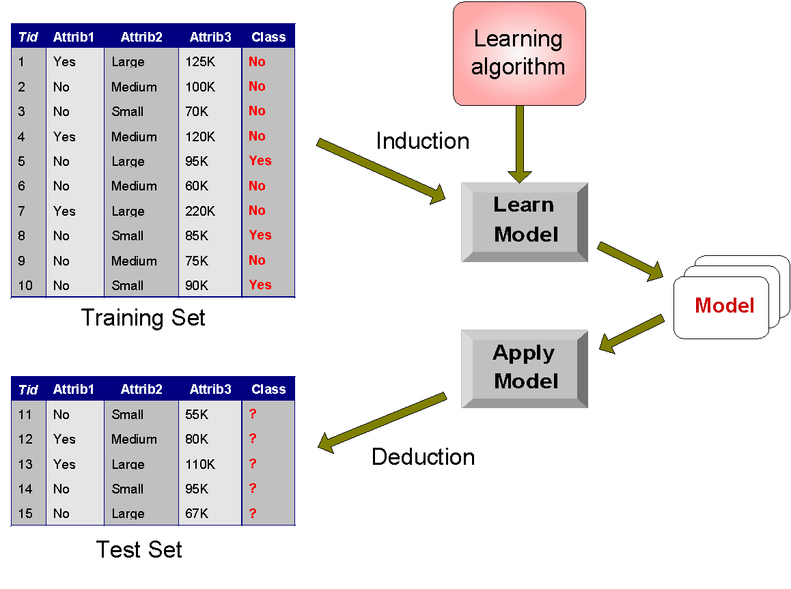
Illustrating Classification Task

Slide 4



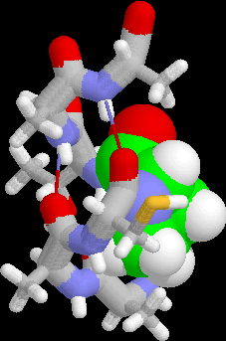
Examples of Classification Task
Predicting tumor cells as benign or malignant
Classifying credit card transactions as legitimate or fraudulent
Classifying secondary structures of protein as alpha-helix, beta-sheet, or random coil
Categorizing news stories as finance, weather, entertainment, sports, etc

Slide 5
Classification Techniques
Decision Tree based Methods
Rule-based Methods
Memory based reasoning
Neural Networks
Naïve Bayes and Bayesian Belief Networks
Support Vector Machines

Slide 6
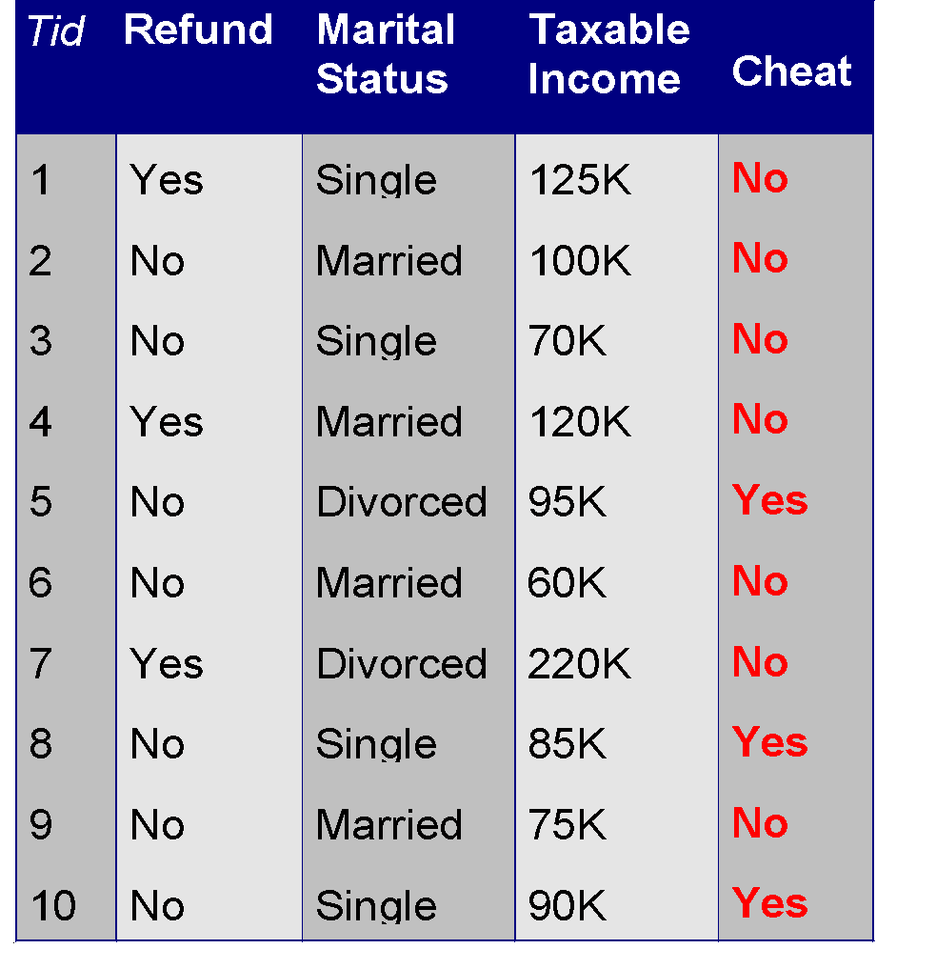
Example of a Decision Tree
categorical
categorical
continuous
class
Splitting Attributes
Refund
Yes
No
NO
MarSt
Single, Divorced
Married
TaxInc
NO
< 80K
> 80K
NO
YES
Training Data
Model: Decision Tree

Slide 7
Another Example of Decision Tree
categorical
categorical
continuous
class
MarSt
Single, Divorced
Married
NO
Refund
Yes
No
NO
TaxInc
< 80K
> 80K
NO
YES
There could be more than one tree that fits the same data!

Slide 8
Practical Issues of Classification
Underfitting and Overfitting
Missing Values
Costs of Classification

Slide 9
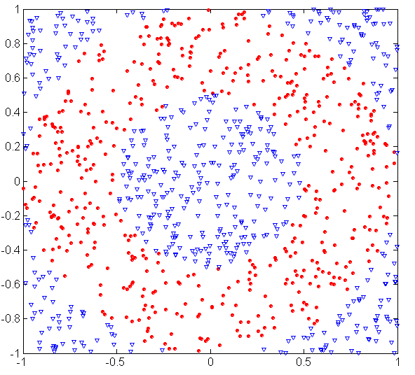
Underfitting and Overfitting (Example)
500 circular and 500 triangular data points.
Circular points:
0.5 ≤ sqrt(x₁²+x₂²) ≤ 1
Triangular points:
sqrt(x₁²+x₂²) > 0.5 or
sqrt(x₁²+x₂²) < 1

Slide 10
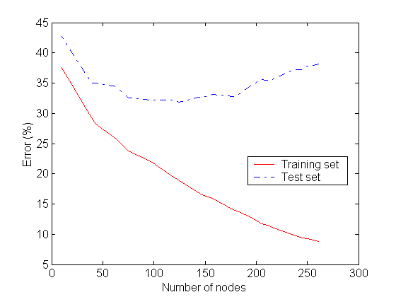
Underfitting and Overfitting
Overfitting
Underfitting: when model is too simple, both training and test errors are large

Slide 11
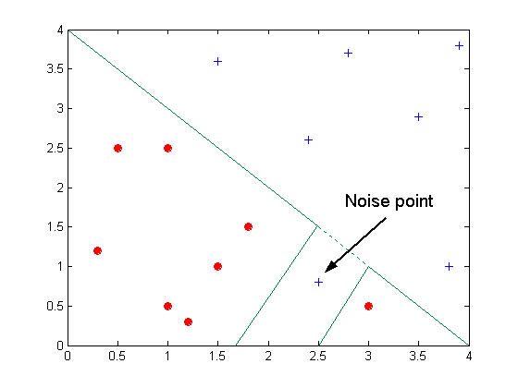
Overfitting due to Noise
Decision boundary is distorted by noise point

Slide 12
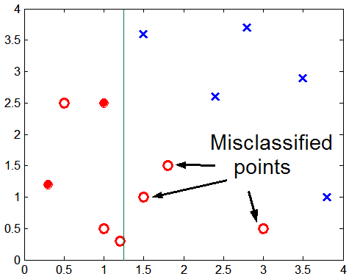
Overfitting due to Insufficient Examples
Lack of data points in the lower half of the diagram makes it difficult to predict correctly the class labels of that region
- Insufficient number of training records in the region causes the decision tree to predict the test examples using other training records that are irrelevant to the classification task

Slide 13
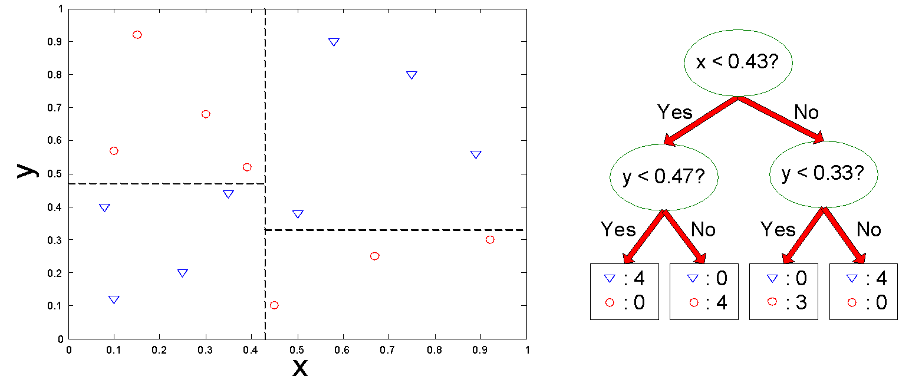
Decision Boundary
Border line between two neighboring regions of different classes is known as decision boundary
Decision boundary is parallel to axes because test condition involves a single attribute at-a-time

Slide 14
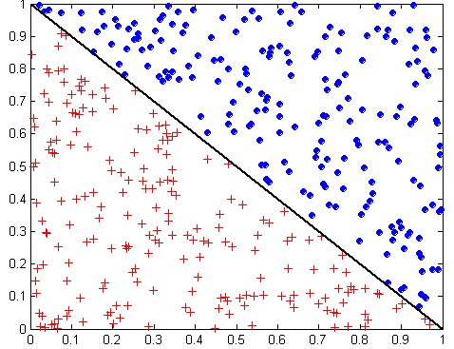
Oblique Decision Trees
x + y < 1
Class = +
Class =
Test condition may involve multiple attributes
More expressive representation
Finding optimal test condition is computationally expensive

Slide 15
Metrics for Performance Evaluation
Focus on the predictive capability of a model
Rather than how fast it takes to classify or build models, scalability, etc.
Confusion Matrix:
 | PREDICTED CLASS
ACTUAL CLASS |  | Class=Yes | Class=No
 | Class=Yes | a | b
 | Class=No | c | d
a: TP (true positive)
b: FN (false negative)
c: FP (false positive)
d: TN (true negative)

Slide 16
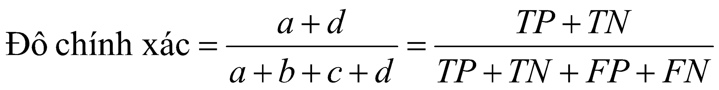
Metrics for Performance Evaluation…
Most widely-used metric:
 | PREDICTED CLASS
ACTUAL CLASS |  | Class=Yes | Class=No
 | Class=Yes | a (TP) | b (FN)
 | Class=No | c (FP) | d (TN)

Slide 17
Limitation of Accuracy
Consider a 2-class problem
Number of Class 0 examples = 9990
Number of Class 1 examples = 10
If model predicts everything to be class 0, accuracy is 9990/10000 = 99.9 %
Accuracy is misleading because model does not detect any class 1 example

Slide 18
Cost Matrix
 | PREDICTED CLASS
ACTUAL CLASS | C(i|j) | Class=Yes | Class=No
 | Class=Yes | C(Yes|Yes) | C(No|Yes)
 | Class=No | C(Yes|No) | C(No|No)
C(i|j): Cost of misclassifying class j example as class i

Slide 19
Computing Cost of Classification
Cost Matrix | PREDICTED CLASS
ACTUAL CLASS | C(i|j) | + | -
 | + | -1 | 100
 | - | 1 | 0
Model M₁ | PREDICTED CLASS
ACTUAL CLASS |  | + | -
 | + | 150 | 40
 | - | 60 | 250
Model M₂ | PREDICTED CLASS
ACTUAL CLASS |  | + | -
 | + | 250 | 45
 | - | 5 | 200
Accuracy = 80%
Cost = 3910
Accuracy = 90%
Cost = 4255

Slide 20
Cost vs Accuracy
Count | PREDICTED CLASS
ACTUAL CLASS |  | Class=Yes | Class=No
 | Class=Yes | a | b
 | Class=No | c | d
Accuracy is proportional to cost if 1. C(Yes|No)=C(No|Yes) = q 2. C(Yes|Yes)=C(No|No) = p
N = a + b + c + d
Accuracy = (a + d)/N
Cost = p (a + d) + q (b + c)
= p (a + d) + q (N – a – d)
= q N – (q – p)(a + d)
= N [q – (q-p) × Accuracy]
Cost | PREDICTED CLASS
ACTUAL CLASS |  | Class=Yes | Class=No
 | Class=Yes | p | q
 | Class=No | q | p

Slide 21
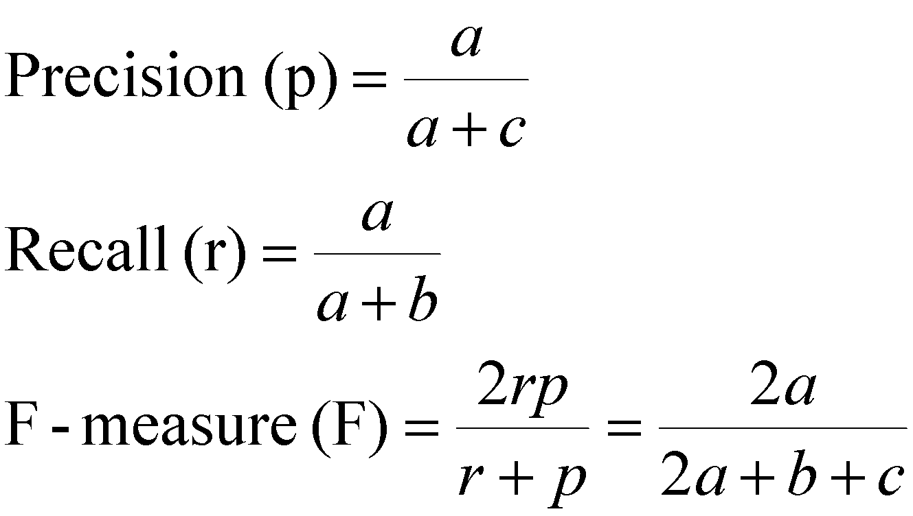
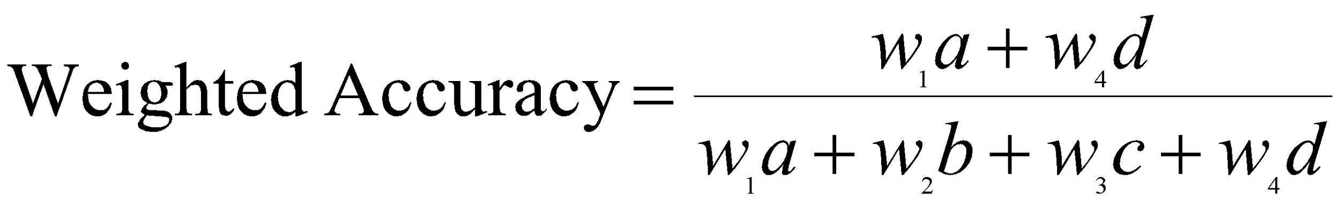
Cost-Sensitive Measures
Precision is biased towards C(Yes|Yes) & C(Yes|No)
Recall is biased towards C(Yes|Yes) & C(No|Yes)
F-measure is biased towards all except C(No|No)

Slide 22
Example and code
Download code in the classroom
On class: follow a step by step tutorial
‹#›

