Slide 1
Regression problem
Python for AI

Slide 2
Types of learning problems
1. Supervised
a. Classification
b. Regression
2. Unsupervised
a. Clustering
b. Association
3. Reinforcement

Slide 3
Correlation vs. Regression
A scatter plot can be used to show the relationship between two variables
Correlation analysis is used to measure the strength of the association (linear relationship) between two variables
Correlation is only concerned with strength of the relationship
No causal effect is implied with correlation
Scatter plots
Correlation

Slide 4
12.1 Regression Models
Linear relationships
Curvilinear relationships
Y
Y
X
X
Y
Y
X
X

Slide 5
Types of Relationships
Strong relationships
Weak relationships
Y
Y
X
X
Y
Y
X
X

Slide 6
Types of Relationships
No relationship
Y
X
Y
X

Slide 7
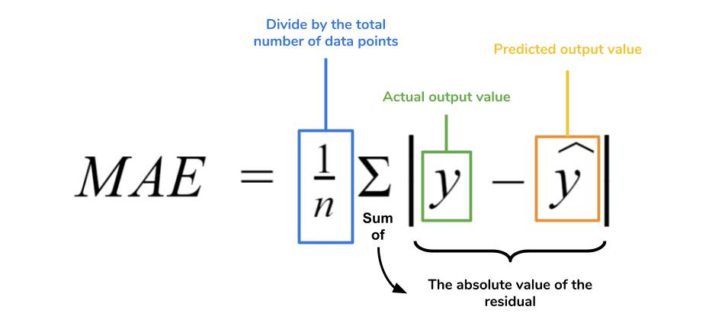
Metrics

Slide 8
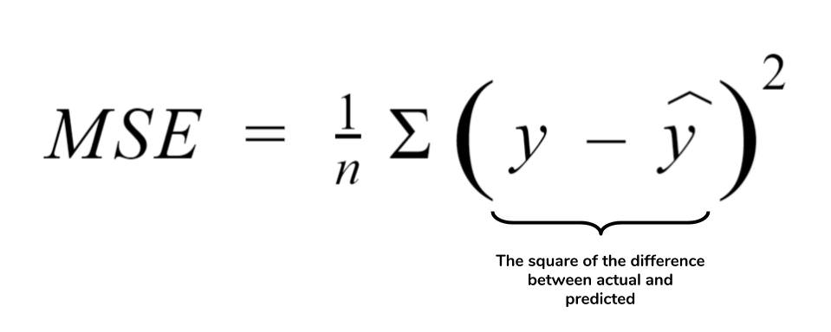
Metrics

Slide 9

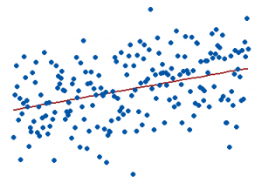
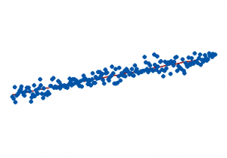
Metrics
0% represents a model that does not explain any of the variation in the response variable around its mean. The mean of the dependent variable predicts the dependent variable as well as the regression model.
100% represents a model that explains all the variation in the response variable around its mean.

Slide 10

Cross-validation
Notes:
PC: https://en.wikipedia.org/wiki/Cross-validation_(statistics)

Slide 11
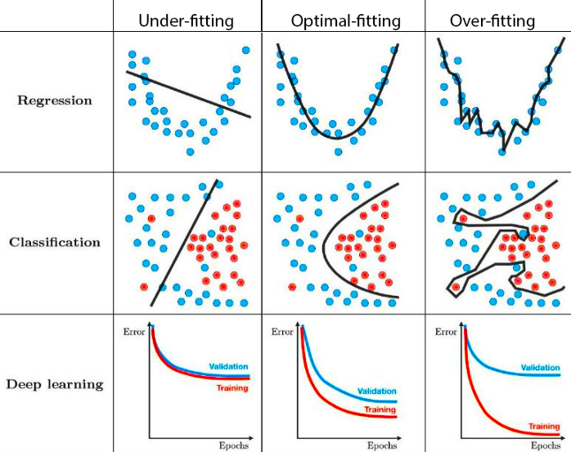
Challenges: Underfitting & Overfitting
Notes:
PC: https://towardsdatascience.com/techniques-for-handling-underfitting-and-overfitting-in-machine-learning-348daa2380b9

Slide 12
Example and code
Download code in the classroom
On class: follow a step by step tutorial

